Slide 1
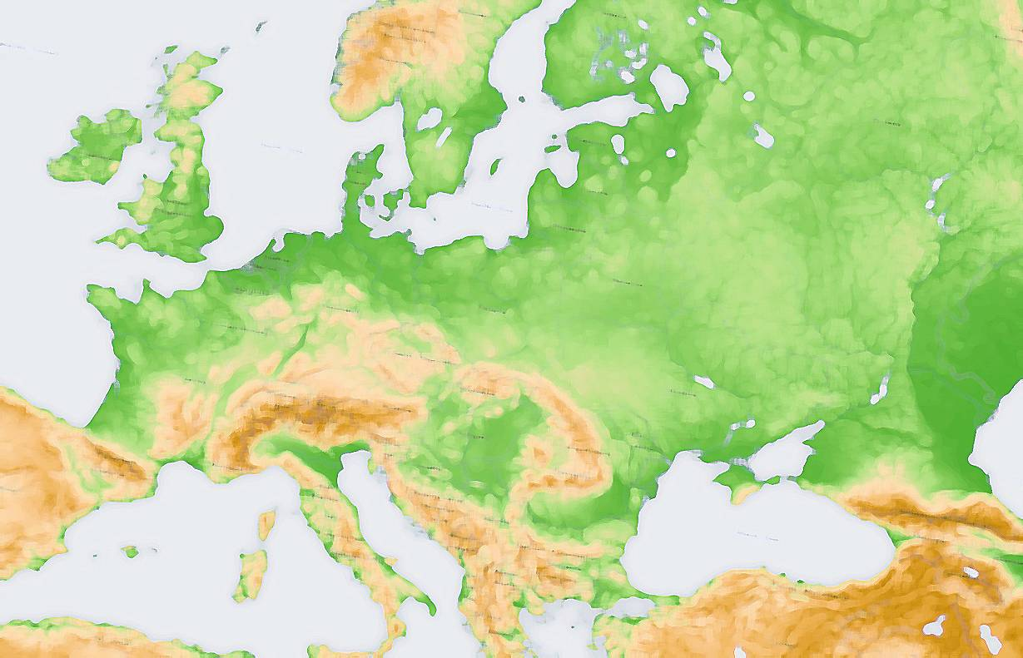


Maynooth Centre for European and Eurasian Studies Seminar Series and events 2018-19
Thursday 13th February 2019 (1400-1530, John Hume Boardroom, 3rd Floor Hume Building)
Dr. Patrick Holden (Plymouth University)
‘Don’t Pay the Ferryman: European geo-economics and geo-politics in the Age of Brexit and Trump’’
Monday 25th^{h} February 2019 (1830-2000, John Hume 2)
‘Brexit: Deal or No Deal?’
Event staged in cooperation with Politics and Sociology Society
A panel discussion featuring John McGrane (British-Irish Chamber of Commerce) and John O’Brennan (Jean Monnet Professor of European Integration, Maynooth University), Clodagh Quain (IIEA Dublin)
Friday 8th March 2019 (Mussi Seminar Room, Iontas Building)
‘From the Long War to the Long Peace: Northern Ireland a generation after the Good Friday Agreement’
A symposium in association with Capital and Class journal
Tuesday 12th March 2019 (4pm, Mussi Seminar Room, Iontas Building)
'Cultivating citizenship: Political ecologies of empire on Russia's southern frontier, 1865-1914‘
Spreaker: Dr. Jennifer Keating (UCD)
Monday 18th March to Thursday 21^{d} March 2019
Maynooth University Annual European Studies Fieldtrip to Brussels

Slide 2
Maynooth Centre for European and Eurasian Studies Seminar Series and events 2018-19
Tuesday 26th March (4pm, Mussi Seminar Room, Iontas Building)
Roundtable discussion on the 2019 European Parliament Elections
Speakers:
Francis Jacobs (former head, European Parliament Office, Dublin)
Mary Whelan (former Irish Ambassador to Austria)
Katherine Meenan (former Irish Ambassador to Germany)
Daniel Keohane (European Movement Ireland)
John O’Brennan (Maynooth University)
Wednesday 8th May (6pm, Mussi Seminar Room, Iontas Building)
Prof. Joshua Sanborn (Lafayette College)
‘Bad Romance, Spies, Scientists and the Politics of Adventure in the Cold War’
Saturday 22nd June to Saturday 29th June 2019 (Mussi Seminar Room, Iontas Building
Jean Monnet Summer School in EU External Relations
Notes:
2

