Slide 1
CPD Group Activity: Team Teaching Scenarios

Slide 2
Guidance note for facilitators
Facilitators of a Team Teaching workshop can set up this activity using the scenarios provided below.
There are 8 scenarios to choose from: each involves a conflict or misunderstanding. Create groups of 4 or 5. Each scenario has two ‘role cards’ (one for each of the two teachers). The teachers in role will act out a conversation based on the scenario described on their card. The other (2 or 3) group members observe the dynamics as they unfold. The teachers in role use the cards to get into their ‘character’ and should not disclose the contents of the card before the conversation begins!
Directions:
Teachers role-play the conversation as outlined on their respective role cards​ (5 mins) while the other teachers in each group observe the conversation. Then (out of role) groups discuss how the scenario played out (15 mins).
Key questions to ask:
What was the source of the conflict: Was it resolved?
What could have been done to avoid it?
What insights were gained?
Team Teaching Scenarios (role-play activity)

Slide 3
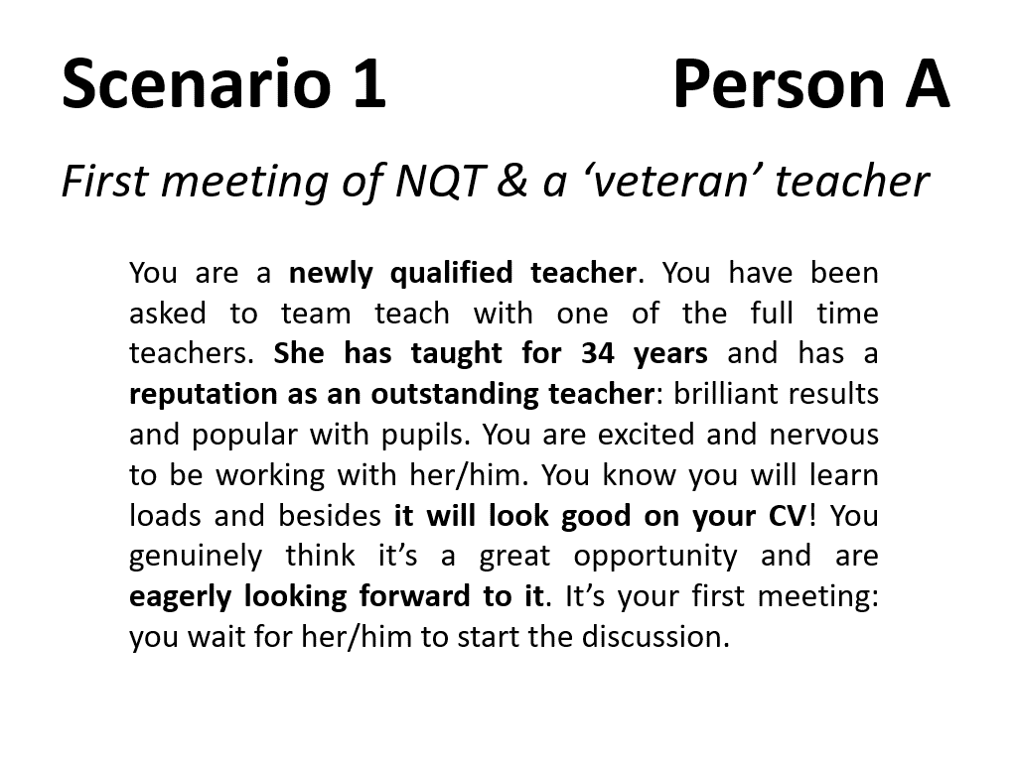

Slide 4
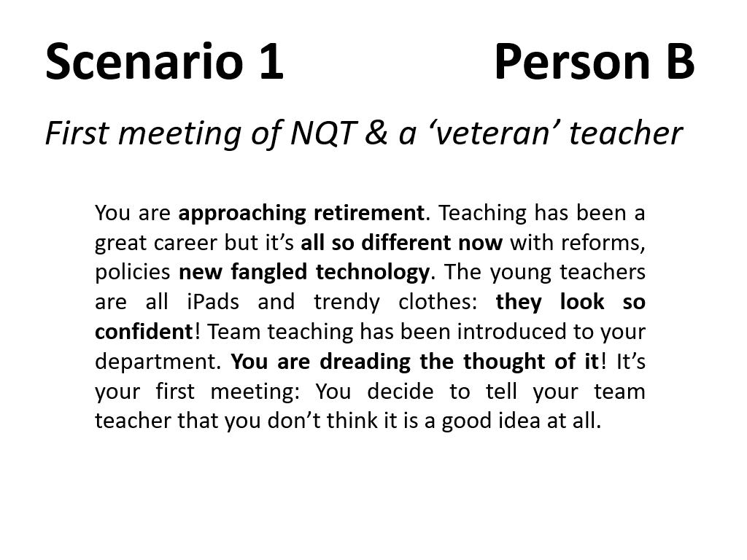

Slide 5
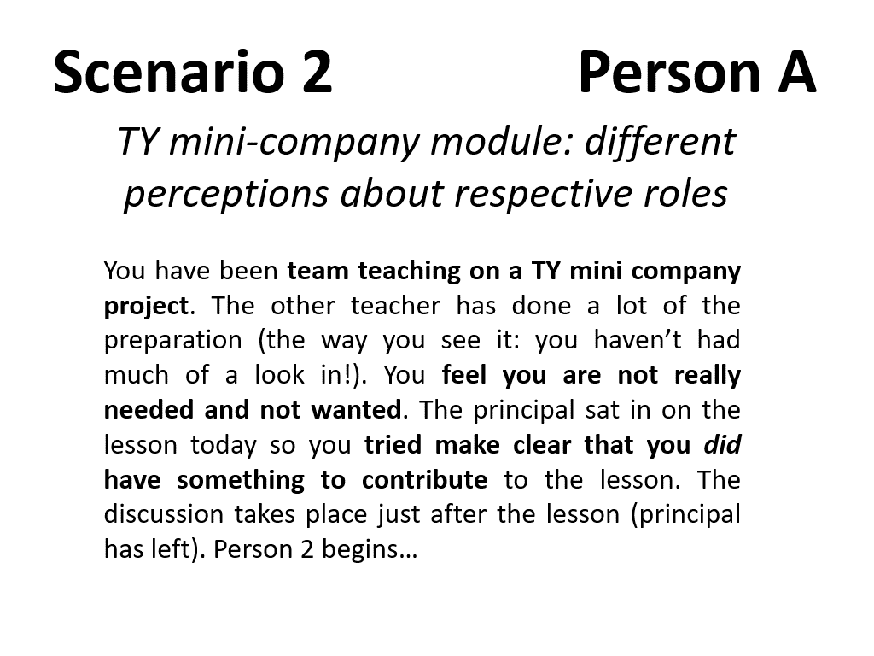

Slide 6
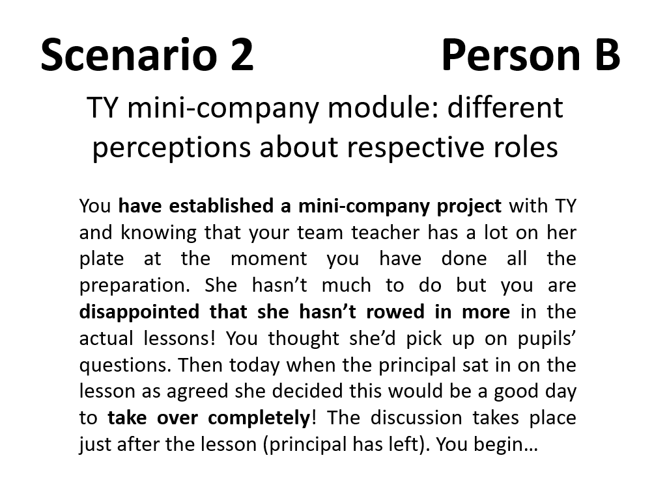

Slide 7
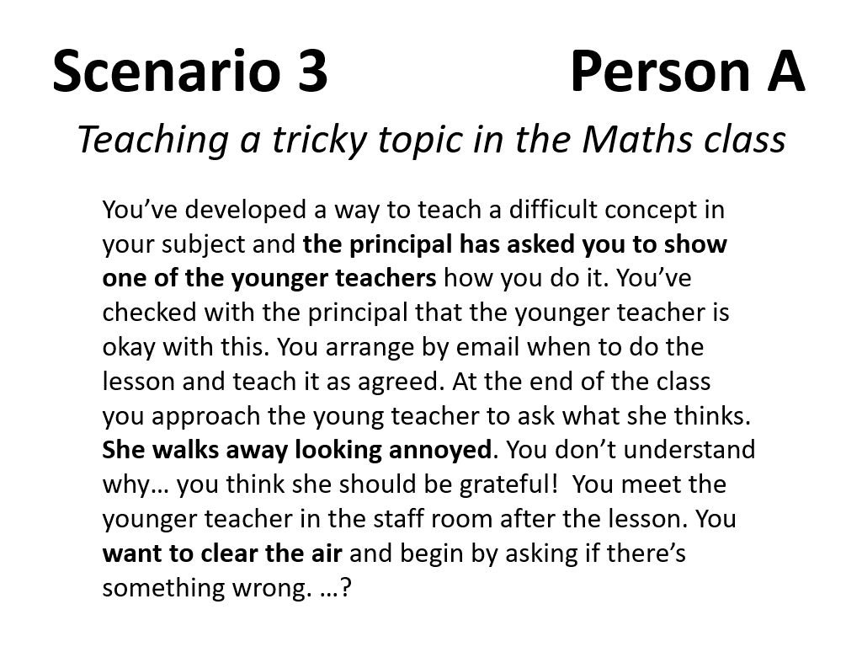

Slide 8
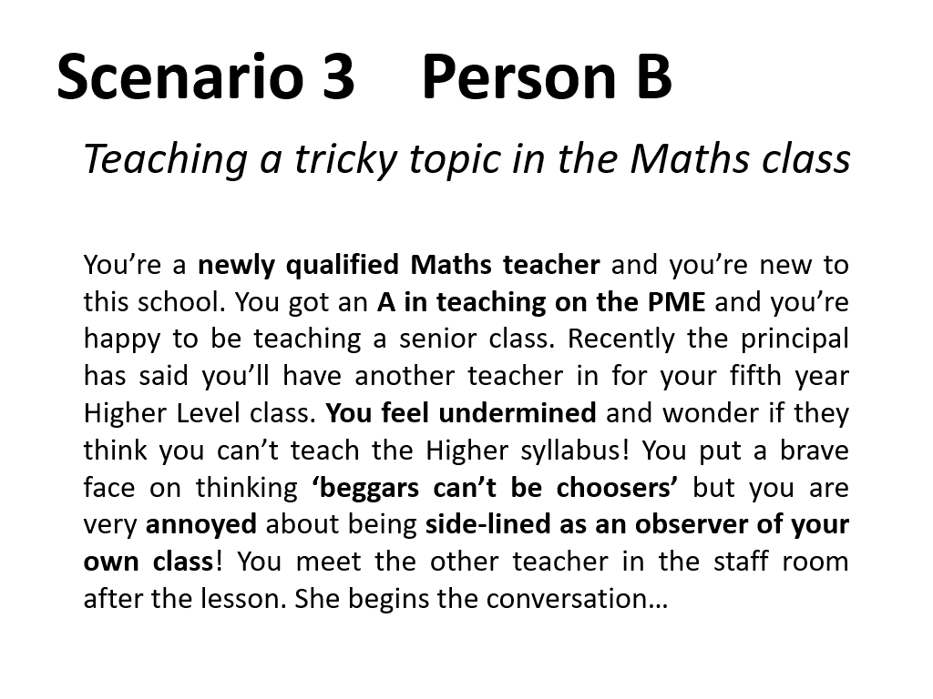

Slide 9
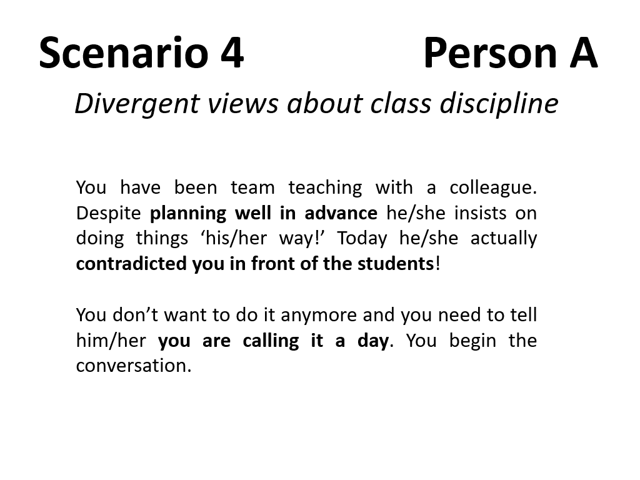

Slide 10
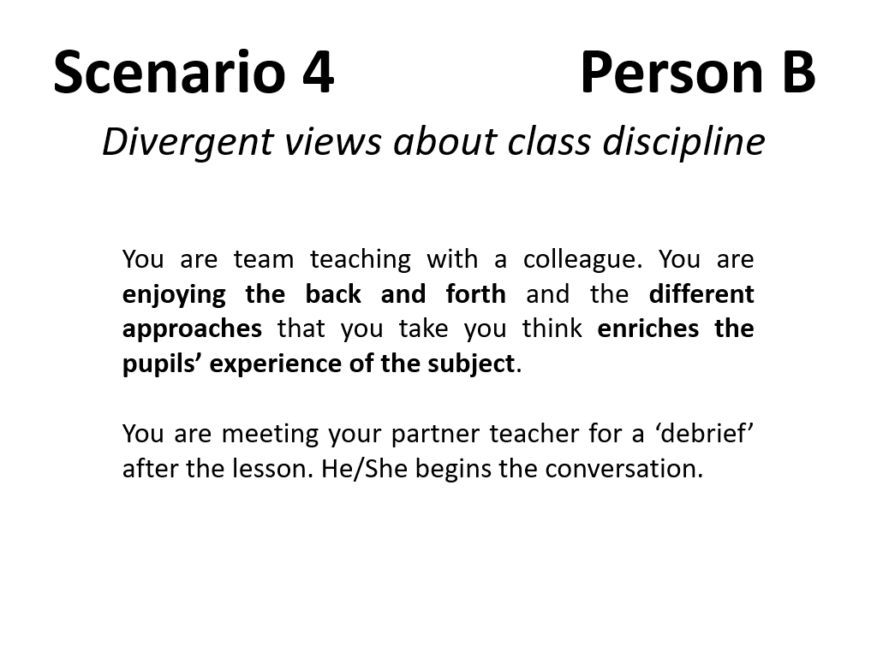

Slide 11
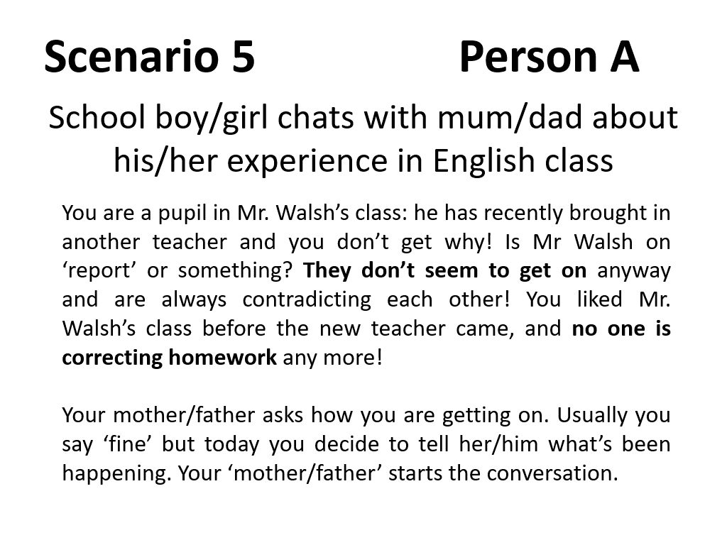

Slide 12
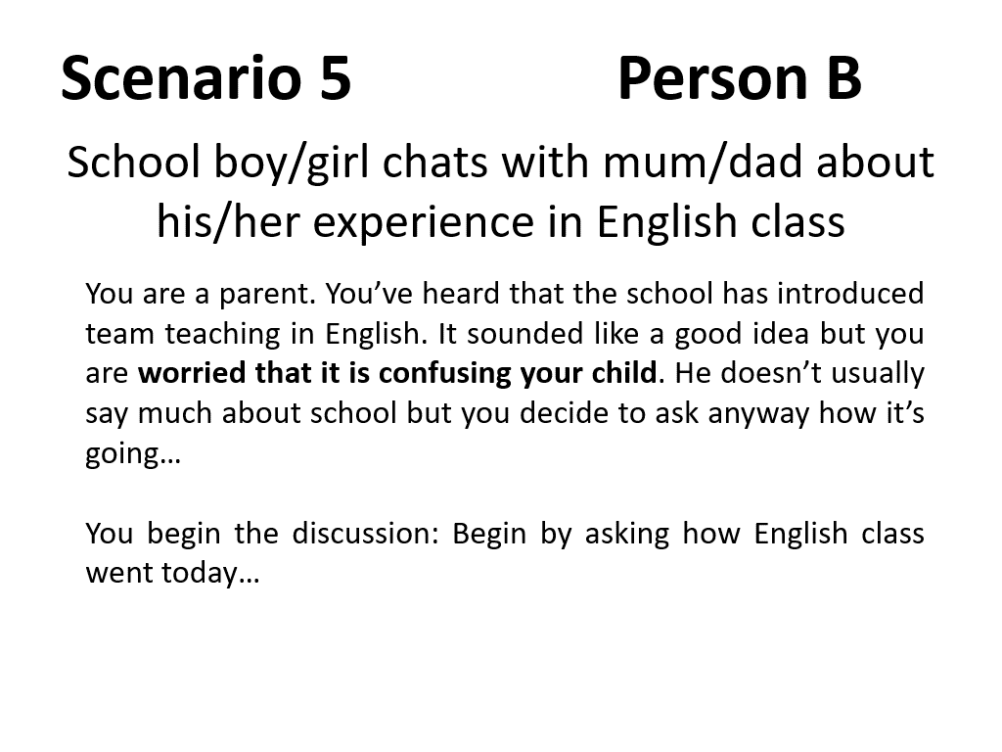

Slide 13
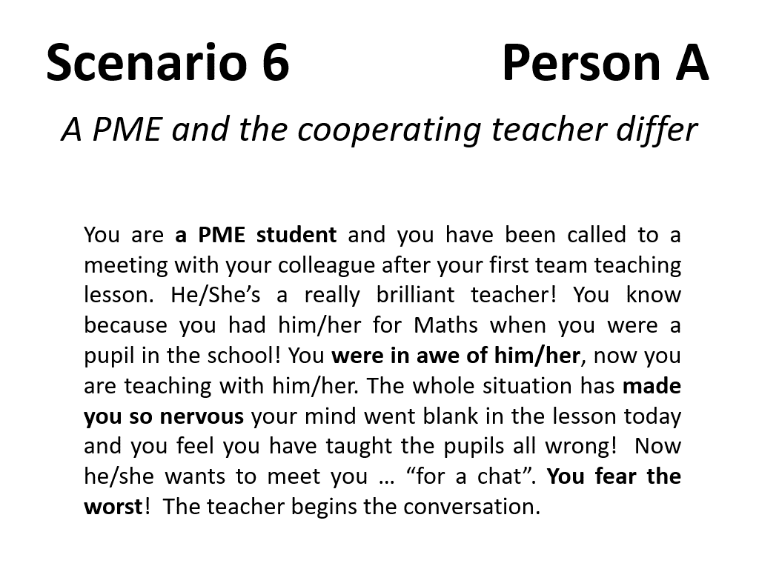

Slide 14
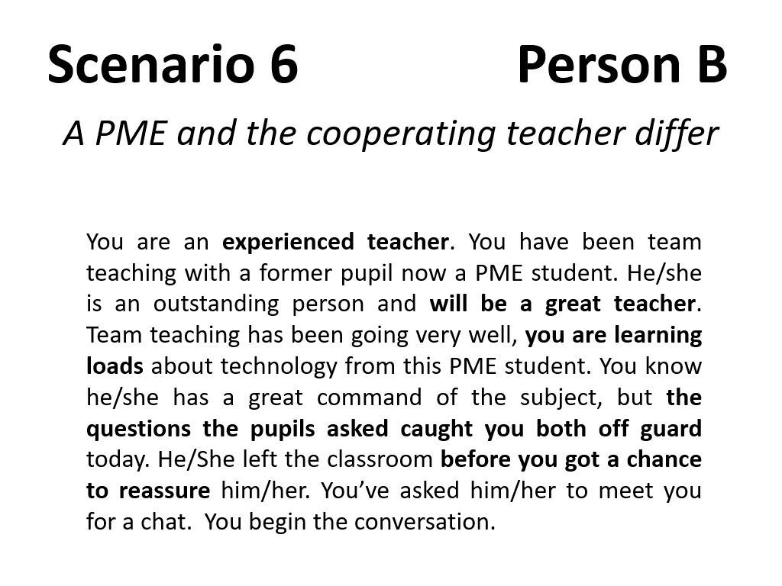

Slide 15
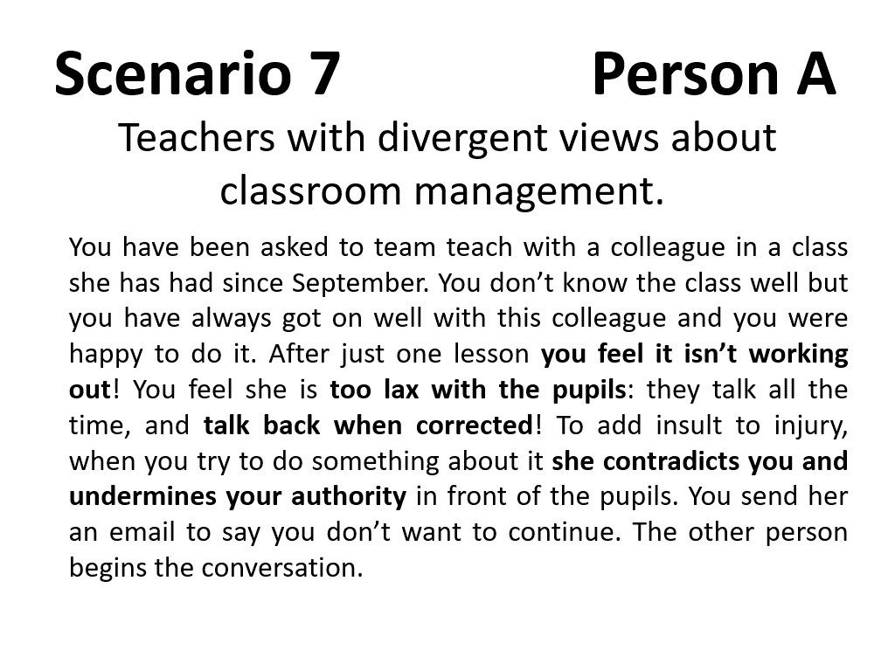

Slide 16
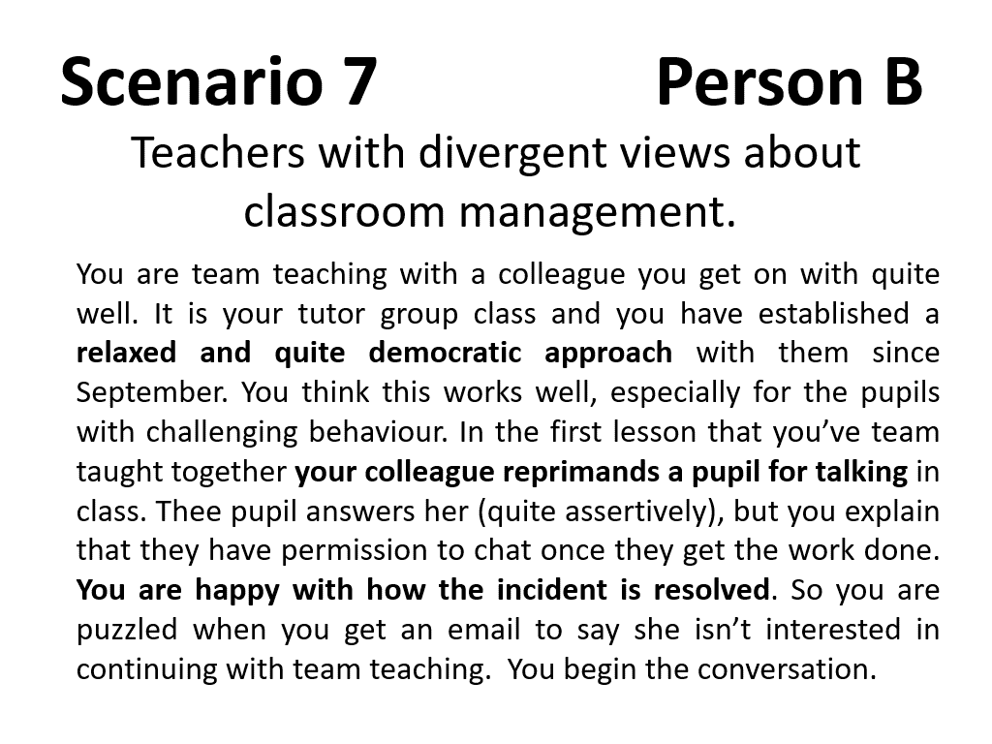

Slide 17
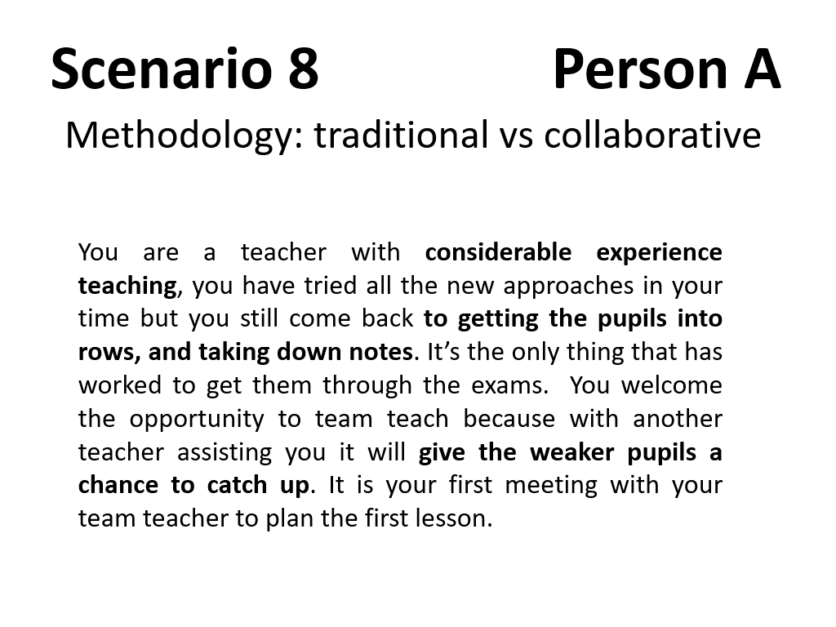

Slide 18
