Slide 1
Subject & Module Choice in Second year for Science
Programme Advisory Team

Slide 2
Overview of Session
Subject & Module Choice in Year 2
Electives
Opportunities to enhance your degree
Marks & Standards
Where to find more information
Programme Advisory Office, Office of the Dean of Teaching & Learning

Slide 3
Science Subject Choice in Year 2 & beyond
Science students choose three subjects to progress into Year 2 ( three subjects x 20 credits each)
In year 3 you progress with two of your subjects and then after year three
In your final year can then progress with a double major or single major

Slide 4
Coursefinder
Choose the For Current Student option from the drop down menu

Slide 5
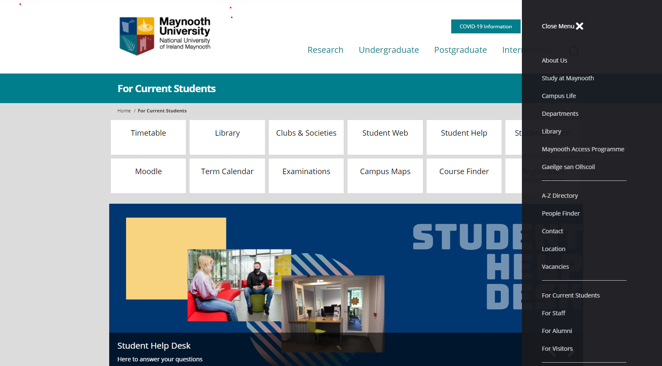
CourseFinder

Slide 6
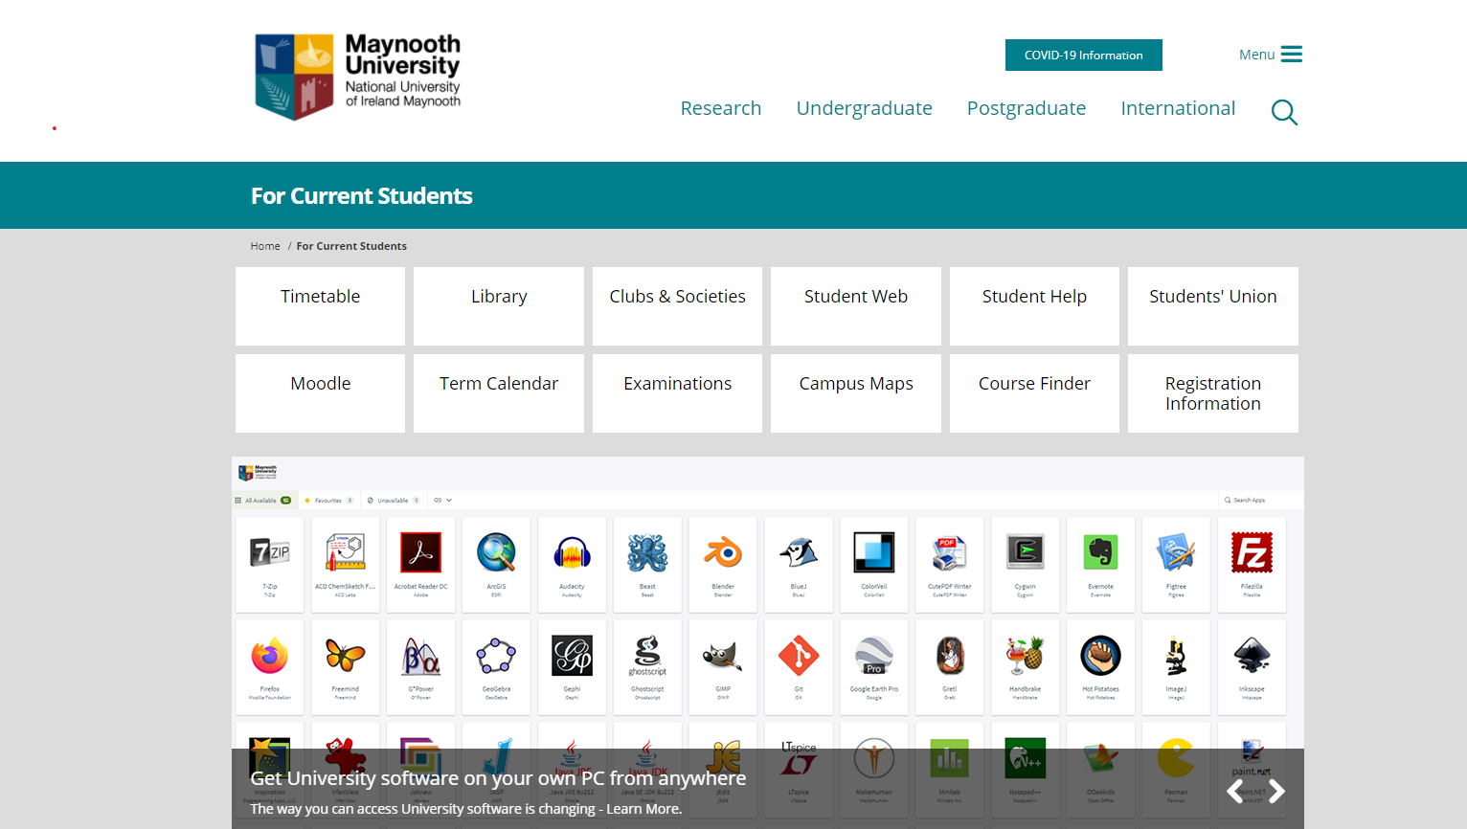
For Current Students

Slide 7
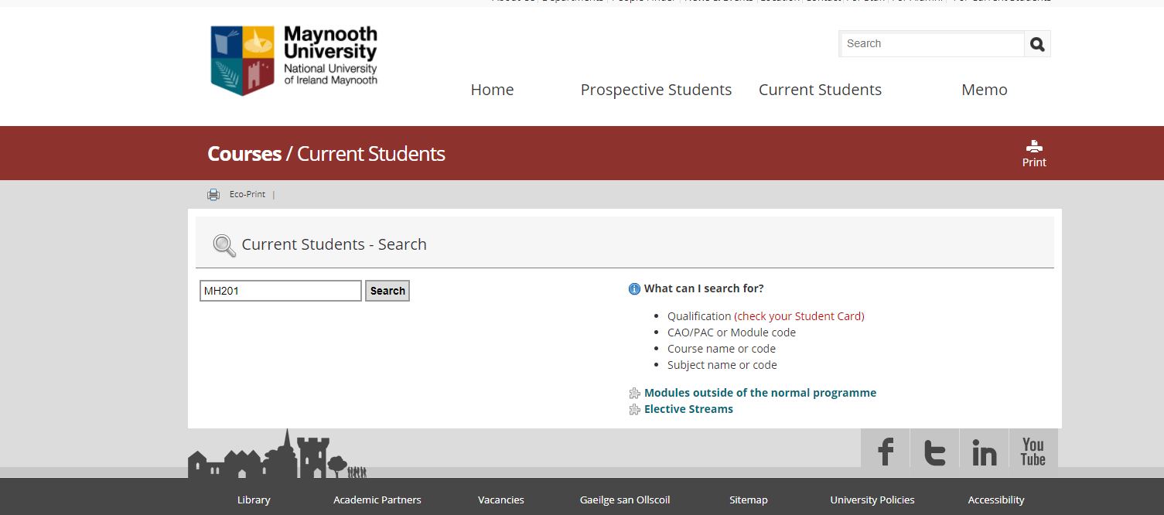
CourseFinder
For information on your pathways, subjects and modules in every year of study
Search by course code or module code

Slide 8
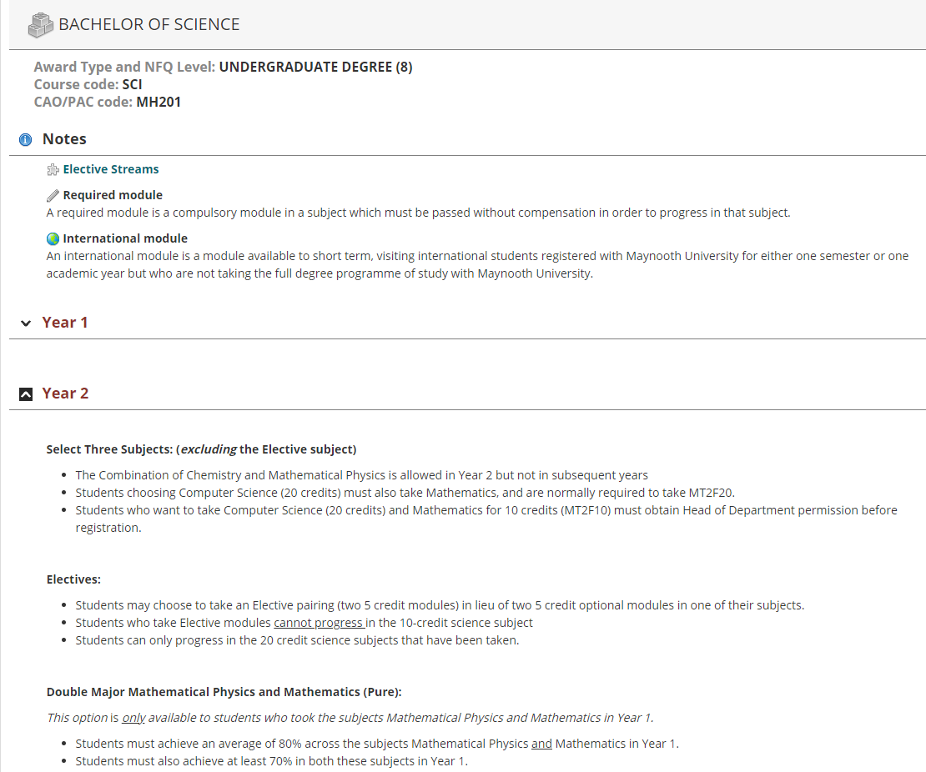
BSc in CourseFinder

Slide 9
Specific subject combinations
Students must complete Engineering Science, Computer Science and Mathematics in order to be eligible to transfer into Year 2 of Electronic Engineering. The transfer is also subject to achieving a minimum grade at the first sitting as determined by Head of Department, you should contact the Engineering Department Admin Office to discuss this.
Students choosing Computer Science (20 credits) must also take Mathematics, and are normally required to take MT2F20
Students who want to take Computer Science (20 credits) and Mathematics for 10 credits (MT2F10) must obtain Head of Department (CS) permission before registration
Students who take 2nd Science Statistics Double Major or 2nd Science Statistics Minor must take 2nd Science Mathematics (MT2F20)
Statistics cannot be combined with Experimental Physics in Year 3 and 4
Chemistry and Mathematical Physics are allowed in Year 2 but not in subsequent years

Slide 10
What is an Elective?
Electives allow you to expand your university education by providing the opportunity to study an area outside your chosen degree programme.
An Elective is worth 10 credits : 2 x five credit modules - one five credit module in each semester .

Slide 11
How an Elective works for - Science
Subject 1 20 credits | Subject 2 20 credits | Subject 3 10 credits | Elective 10 credits
Science students cannot progress the subject studied at 10 credits (subject
3 in the example above) into your third and final year.
In CourseFinder this subject is referred to as Non-Progression Subject.
Programme Advisory Office, Office of the Dean of Teaching & Learning

Slide 12
Why take an Elective?
Develop new skills that will compliment your chosen programme (e.g. language, entrepreneurship, or science communication)
Broaden your perspective: study across disciplines, learn
how to think differently & appreciate different viewpoints
Introduction to the diverse fields of research as well as the excellent lecturing staff throughout the University
To start a new language or keep up a current one
Intrigued by the topic
Programme Advisory Office, Office of the Dean of Teaching & Learning

Slide 13
Ts & Cs apply
Registration for all modules are subject to usual timetable viability and requirements in your main subjects
Electives are not available on every programme
Programme Advisory Office, Office of the Dean of Teaching & Learning

Slide 14
Electives on offer this year
Many students have the opportunity to take an Elective in Year 2
Some of theElectives this year include:
Accounting in Society
Beginners Chinese
Critical Skills (NEW!)
Continuing French/Spanish/German/Gaeilge/Chinese
Film and Screen Studies
Gender and Sexuality in Society and Culture
Good and Evil
Engaging with civil society: justice, welfare and environment
Skills for Success

Slide 15
Exception to the Rule… Skills for Success
Professional Development and Employability Skills module
5 credits in either semester one or semester two
Practice and develop a range of employability skills: teamwork, communication, leadership, creative problem solving, self awareness and more
Continuous Assessment: Simulated Recruitment Process with job application, interview and E-portfolio
Programme Advisory Office, Office of the Dean of Teaching and Learning

Slide 16
Transfer from Science MH201 to….
Into 2nd year of another programme

Slide 17
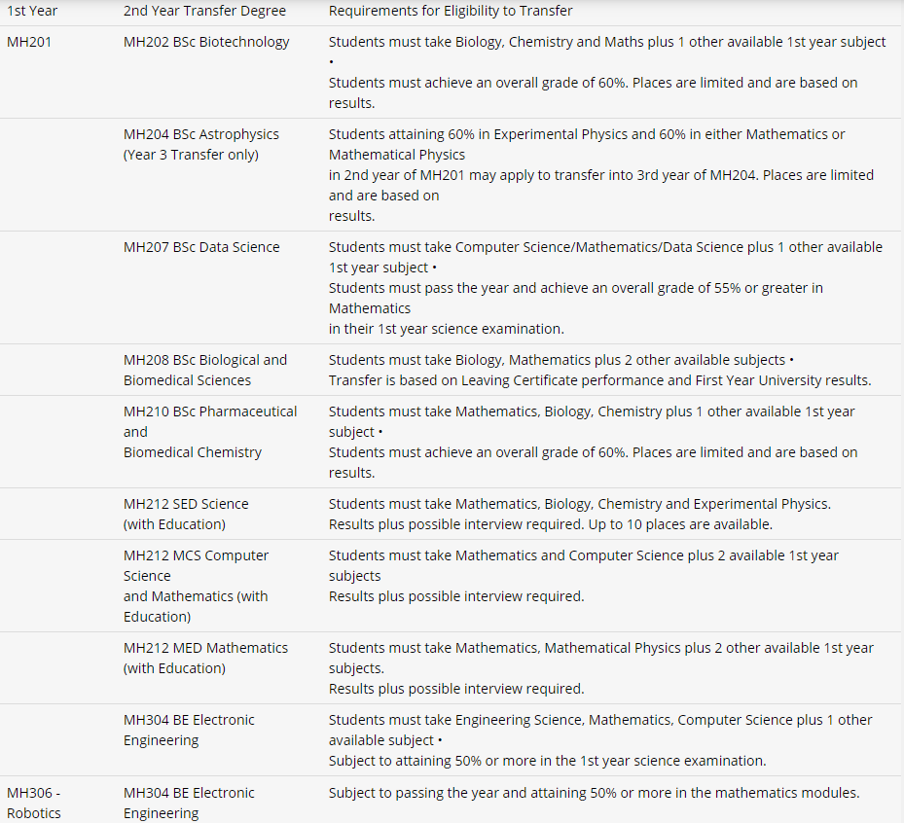
Second year transfer options
Programme Advisory Office, Office of the Dean of Teaching & Learning

Slide 18
Transferring to 2nd Year of another programme
Other possible transfer options for MH201 students see: https://www.maynoothuniversity.ie/study-maynooth/undergraduate- studies/courses/bachelor-science
Internal Transfer Request form
Deadline is July 14th 2022
€10 fee
Transfers are subject to the availability of places, the student's performance in first year and possibly an interview.
https://www.maynoothuniversity.ie/study-maynooth/undergraduate-studies/how- apply/transfer-applicants
Programme Advisory, Office of the Dean of Teaching & Learning

Slide 19
Marks & Standards
All years after first year contribute to your final degree result.
Three year degree
Year 2 | 30%
Year 3 | 70%
Four year degree
Year 2 | 10%
Year 3 | 20%
Year 4 | 70%
Programme Advisory Office, Office of the Dean of Teaching & Learning

Slide 20
Any questions about 2nd year
Subject & Elective Module Choice?

Slide 21
Programme Advisory Office Contact Details
HOW TO CONTACT US:
Email: programme.choices@mu.ie
Webpage and query form:
www.maynoothuniversity.ie/programme-advisory-office

