Slide 1
Ollscoil Mhá Nuad Maynooth University
Scoil Ghnó
School of Business
MH101 ARTS to MH401/MH402/MH403/MH404/MH407/MH409/MH502
Prof. Joseph Coughlan

Slide 2
Format of this Presentation
Advice per pathway
- MH401 BA Finance
- MH402 BSc Quantitative Finance
- MH403 BA Accounting & Finance
- MH404 BBS – all streams
- MH407 BBS Business & Accounting
- MH409 BBA Business & Languages
- MH502 BCL Law with Accounting/Business
General Advice and next steps
Ollscoil Mhá Nuad Maynooth University
Scoil Ghnó School of Business

Slide 3
Most Important
You must pass year 1 of MH101 in order to progress to year 2
Pass outcomes include
- Progress
- Restricted Progression
- Progression Allowed
Note that these last two may allow you to progress to year 2 but not always in all subjects in MH101 and not for all transfer options
Ollscoil Mhá Nuad Maynooth University
Scoil Ghnó School of Business

Slide 4
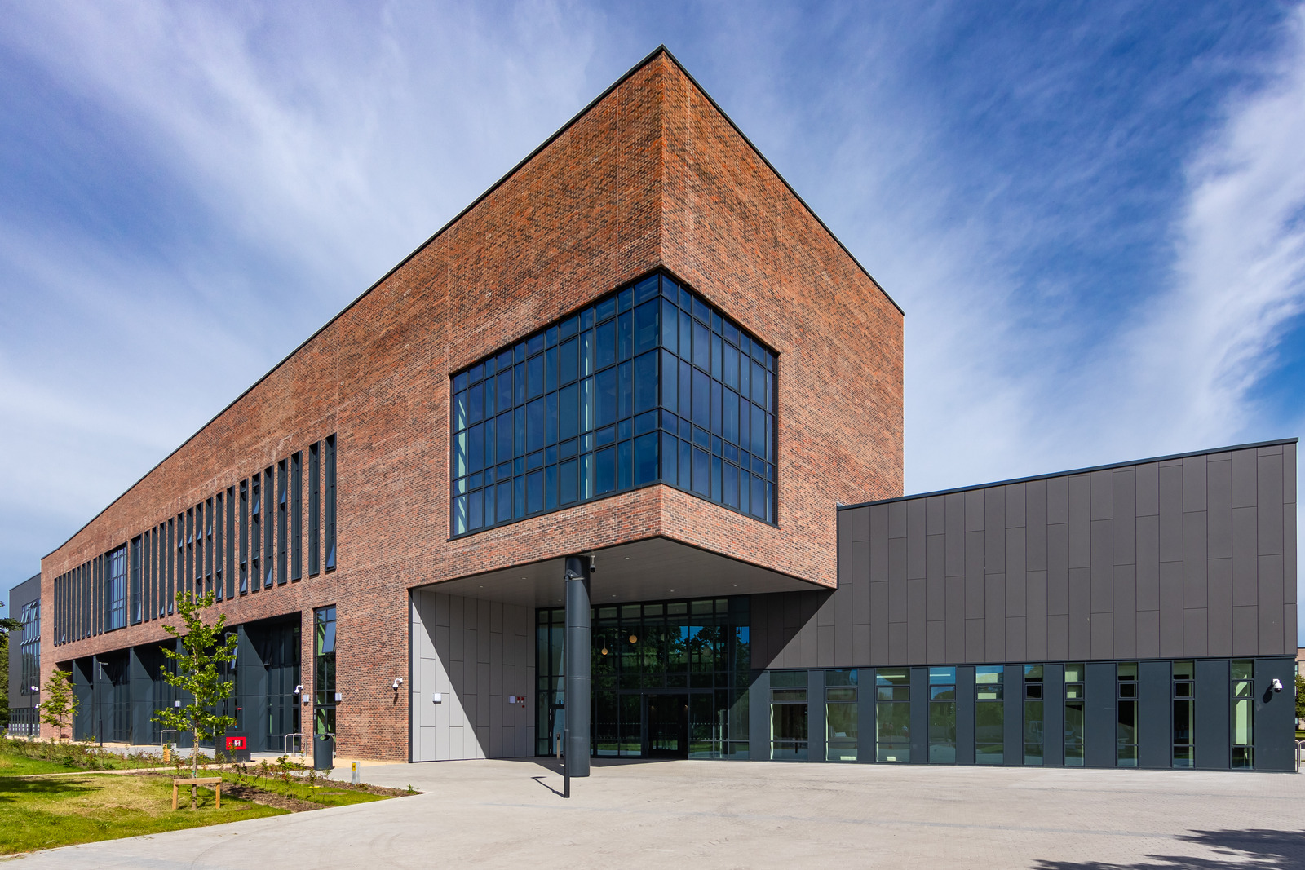
MH101 ARTS
to
MH401 BA Finance
Ollscoil Mhá Nuad Maynooth University
Scoil Ghnó School of Business

Slide 5
Requirements to Transfer
Average Mark of 50 or higher in either the subject Economics OR the subject Finance (15 ECTS)
AND
Pass one of the two Accounting subjects (15 or 30 ECTS)
Ollscoil Mhá Nuad Maynooth University
Scoil Ghnó School of Business

Slide 6
MH101 ARTS
to
MH402 BSc Quantitative Finance
Ollscoil Mhá Nuad Maynooth University
Scoil Ghnó School of Business

Slide 7
Requirements to Transfer
Average Mark of 60 or higher in either the subject Economics OR the subject Finance (15 ECTS)
AND
Average Mark of 60 or higher in the subject Mathematical Studies (15 ECTS)
AND
Average Mark of 60 or higher in the subject Computer Science (15 ECTS)
Ollscoil Mhá Nuad Maynooth University
Scoil Ghnó School of Business

Slide 8
MH101 ARTS
to
MH403 BA Accounting & Finance
Ollscoil Mhá Nuad Maynooth University
Scoil Ghnó School of Business

Slide 9
Requirements to Transfer
Average Mark of 60 or higher in the 30 credit Accounting subject (30 ECTS)
AND
Pass the subject Economics OR the subject Finance (15 ECTS)
Ollscoil Mhá Nuad Maynooth University
Scoil Ghnó School of Business

Slide 10
Note
Your Accounting modules must include ALL three of
- AC151 Introduction to Accounting
- AC152 Financial Accounting 1
- AC160 Fundamentals of Finance & Accounting
The 15 ECTS Accounting subject is not sufficient
Ollscoil Mhá Nuad Maynooth University
Scoil Ghnó School of Business

Slide 11
MH101 ARTS
to
MH404 BBS Business
Ollscoil Mhá Nuad Maynooth University
Scoil Ghnó School of Business

Slide 12
Requirements to Transfer
Pass the subject Double Business in Year 1
OR
Pass the subject Single Business in Year 1 AND Pass the subject Accounting AND Pass either the subject Economics OR the subject Finance
Ollscoil Mhá Nuad Maynooth University
Scoil Ghnó School of Business

Slide 13
Double Business
Semester 1
Semester 2
AC155 Accounting for Business Students
AND One of
MN151 Bus. Models & Marketing
MN152 Con. Research & Marketing
MN159 Glob. Bus. & Marketing
EC101M Microeconomics
AND
MN155 OB & Management
Ollscoil Mhá Nuad Maynooth University
Scoil Ghnó School of Business

Slide 14
Progression Routes
MH101 Business (International)
Transfer to BBS International Business
MH101 Business (Management)
Transfer to BBS Business & Management
MH101 Business (Marketing)
- Transfer to BBS Marketing
Ollscoil Mhá Nuad Maynooth University
Scoil Ghnó School of Business

Slide 15
MH101 ARTS
to
MH404 BBS Business and Global Cultures
Ollscoil Mhá Nuad Maynooth University
Scoil Ghnó School of Business

Slide 16
Requirements to Transfer
Pass any Business (15 or 30 ECTS) subject in Year 1
AND
Pass the Anthropology subject (15 or 30 ECTS) in Year 1
Ollscoil Mhá Nuad Maynooth University
Scoil Ghnó School of Business

Slide 17
Progression Routes
MH101 Business (International)
Transfer to BBA International Business and Global Cultures
MH101 Business (Management)
Transfer to BBA Business Management and Global Cultures
MH101 Business (Marketing)
- Transfer to BBA Marketing and Global Cultures
Ollscoil Mhá Nuad Maynooth University
Scoil Ghnó School of Business

Slide 18
MH101 ARTS
to
MH407 BBS Business & Accounting
Ollscoil Mhá Nuad Maynooth University
Scoil Ghnó School of Business

Slide 19
Requirements to Transfer
Average Mark of 60 or higher in the subject Accounting (30 ECTS)
AND
Pass any of one of the three Business subjects (15 ECTS)
Ollscoil Mhá Nuad Maynooth University
Scoil Ghnó School of Business

Slide 20
Note
Your Accounting modules must include ALL three of
- AC151 Introduction to Accounting
- AC152 Financial Accounting 1
- AC160 Fundamentals of Finance & Accounting
The 15 ECTS Accounting subject is not sufficient
Ollscoil Mhá Nuad Maynooth University
Scoil Ghnó School of Business

Slide 21
MH101 ARTS
to
MH409 BBA Business and Languages
Ollscoil Mhá Nuad Maynooth University
Scoil Ghnó School of Business

Slide 22
Requirements to Transfer
Pass any of the three Business (15 or 30 ECTS) subjects in Year 1
OR
Average Mark of 60 or higher in the subject Accounting (30 ECTS)
AND
Pass any Language subject (15 or 30 ECTS) in Year 1 from French, Spanish, German or Chinese
Ollscoil Mhá Nuad Maynooth University
Scoil Ghnó School of Business

Slide 23
Note
Your Accounting modules must include ALL three of
- AC151 Introduction to Accounting
- AC152 Financial Accounting 1
- AC160 Fundamentals of Finance & Accounting
The 15 ECTS Accounting subject is not sufficient
Ollscoil Mhá Nuad Maynooth University
Scoil Ghnó School of Business

Slide 24
MH101 ARTS
to
MH502 LWA BCL Law with Accounting
Ollscoil Mhá Nuad Maynooth University
Scoil Ghnó School of Business

Slide 25
Requirements to Transfer
Average Mark of 60 or higher in the subject Accounting (30 ECTS)
AND
Pass in Law (30 ECTS)
Ollscoil Mhá Nuad Maynooth University
Scoil Ghnó School of Business

Slide 26
Note
Your Accounting modules must include ALL three of
- AC151 Introduction to Accounting
- AC152 Financial Accounting 1
- AC160 Fundamentals of Finance & Accounting
The 15 ECTS Accounting subject is not sufficient
Ollscoil Mhá Nuad Maynooth University
Scoil Ghnó School of Business

Slide 27
MH101 ARTS
to
MH502 LWB BCL Law with Business
Ollscoil Mhá Nuad Maynooth University
Scoil Ghnó School of Business

Slide 28
Requirements to Transfer
Pass in any of the Double Business subjects (30 ECTS)
AND
Pass in Law (30 ECTS)
Ollscoil Mhá Nuad Maynooth University
Scoil Ghnó School of Business

Slide 29
Other Options in Law
BCL Law & Arts (Major in Law & Minor in Business or Finance)
- Business (any stream) OR Finance – Pass
- Law (15 ECTS) – Pass
BCL Law & Arts (Double Major in Law & Accounting/Business/Finance)
- Business (any stream)/Accounting/Finance – Pass
- Law (30 ECTS) - Pass
Ollscoil Mhá Nuad Maynooth University
Scoil Ghnó School of Business

Slide 30
NEXT STEPS
Ollscoil Mhá Nuad Maynooth University
Scoil Ghnó School of Business

Slide 31
What do I need to do now?
If you meet the requirements for transfer, the option will appear at registration in year 2 in August/September 2025
The School of Business will (typically) write to you to inform you that you have the option to take up a place in July 2025
There is no form to fill out if you are a MH101 student for any of these routes
Ollscoil Mhá Nuad Maynooth University
Scoil Ghnó School of Business

Slide 32
Do I have to transfer?
There is no requirement to transfer
You can continue in Arts with two subjects
- Accounting
Available as a Double Major only
- Business (all three streams)
Available as Double Major, Major or Minor
- Finance
Available as Double Major or Minor
Ollscoil Mhá Nuad Maynooth University
Scoil Ghnó School of Business

Slide 33
What if I did not get the grade I need in a module or subject?
You can repeat module(s) to get a Pass or more in the August repeats
There is no quota on places so you will still be able to transfer
Ollscoil Mhá Nuad Maynooth University
Scoil Ghnó School of Business

Slide 34
Benefits of Transfer
Specialist degree
Can still access university electives in year 2
Opportunity for a one-year paid work placement in year 3 (MH401, MH403, MH404, MH407, MH502)
Integrated paid work placement in MH402
Placement also available on MH101 but currently BOTH subjects must be in the School of Business
Opportunity to go abroad in year 3 to a partner university
Ollscoil Mhá Nuad Maynooth University
Scoil Ghnó School of Business

Slide 35
We look forward to seeing you in the School of Business!
GET IN TOUCH!
@MU_Business
business@mu.ie
www.maynoothuniversity.ie/business
Ollscoil Mhá Nuad Maynooth University
Scoil Ghnó School of Business

