Slide 1
Making College Both Affordable & Accessible: Lessons from the U.S.
SARA GOLDRICK-RAB
University of Wisconsin-Madison
Notes:
THANK YOU FOR HAVING ME

Slide 2
Overview
Benefits of higher education are clear
Though some debate over public vs. private returns
Widespread interest in college-going
Price is a barrier
To access, full participation, & completion
Especially for “disadvantaged” but others as well
U.S. balances access & affordability by targeting financial aid to the needy
But it largely does not succeed

Slide 3
How Do We Know?
15 years of intensive research on college affordability – policies, politics, practices, effects
Mixed-methods: randomized experiments, large scale surveys, in-depth interviews, ethnography
Multi-disciplinary collaboration

Slide 4
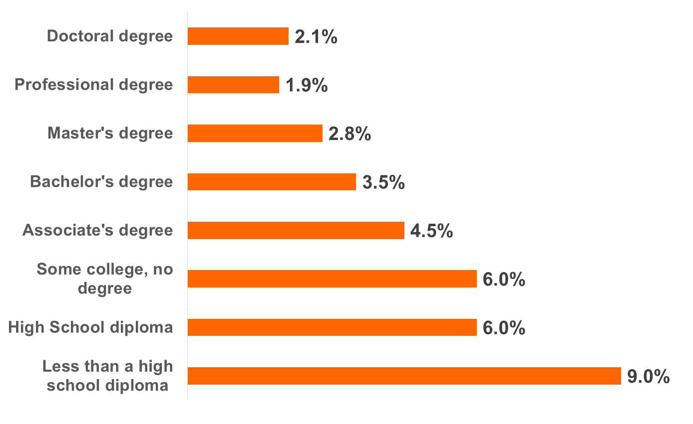
Degree Completion Matters
Unemployment Rate in 2014, U.S.
Source: Bureau of Labor Statistics
Notes:
The thing is --Degree completion matters –
Some college without a degree is no better than HS
That associates degree really pays off

Slide 5
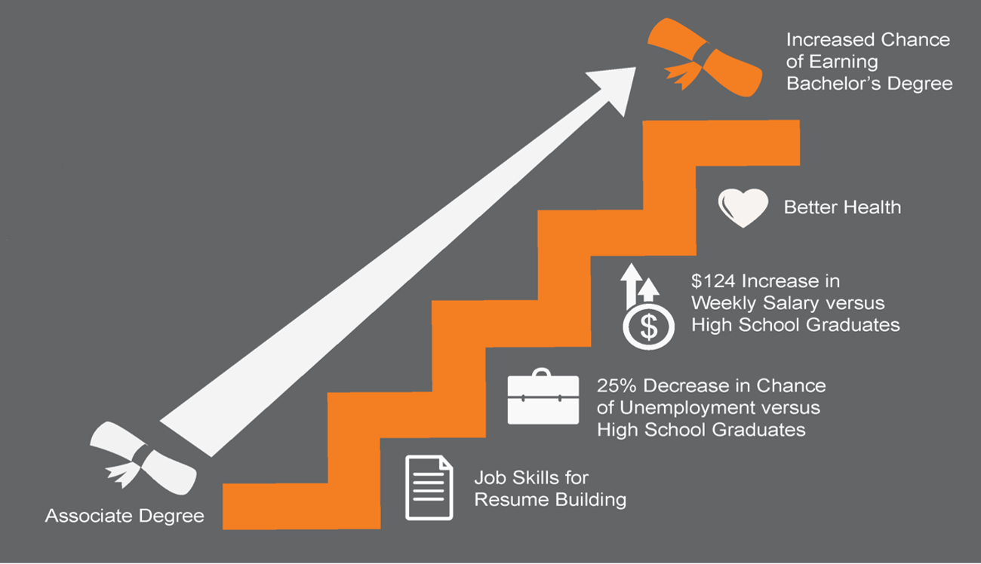
Associate Degrees Pay Off

Slide 6
Today’s U.S. Students
51% are low-income
40% are 25 years of age or older
39% work
37% attend college part-time
26% are parents
15% are single parents
The typical undergraduate rarely lives in a dorm…
In fact, dorms house just 12% of students

Slide 7
Cost of Attendance
Federal definition: Tuition, fees, room & board, book & supplies, transportation, and other expenses
In order to successfully enroll full-time, students need to cover these costs
Extensive work will compromise full-time enrollment
Many students are unaware of what living will really cost

Slide 8
Pricing Model
Net Price and Cost of Attendance
Tuition
Required Fees
Books
Room & Board*
+ Other Costs
Cost of Attendance
Cost of Attendance
- Grant Aid
Net Price
* based on living arrangements

Slide 10
Net Price of Community College,
By Family Income (Dependents): 2012-13
Family Income | Community College
 | Net Price/Year | % of Income
Low ($21,000) | $8,300 | 40%
Moderate ($52,000) | $11,300 | 22%
Middle ($81,000) | $13,300 | 16%
High ($142,000) | $14,000 | 10%

Slide 11
U.S. Financial Aid
$164B annual investment

Slide 12
Success?
Does aid induce people to choose college?
Does aid increase full participation in college life?
Does aid improve completion rates?
Does aid level inequality?
Can aid be sustained?

Slide 13
Fraction of Birth Cohort Completing BA, by Family Income
Bailey & Dynarski 2011
Notes:
Minh- text is tiny, can you fix?

Slide 14
Bachelor’s Degree Attainment
High School Sophomores’ Math Test Scores
Notes:
Minh- text is tiny, can you fix?
Even among high-achieving students there is a 33 % pt gap in BA completion!
Low and Middle-income students are those really left behind– no matter how smart they are.

Slide 15
Percentage Change in Inflation-Adjusted Mean Family Income by Quintile: 1983-1993, 1993-2003, and 2003-2013
Notes:
Minh- text is tiny, can you fix?

Slide 16
Pell Recipients: 2008-2012
At community colleges:
Percent receiving state aid fell from 40 to 25%
Net price in constant dollars as % of income rose from just over 30% to just over 40%
At public 4-years:
Percent receiving state aid fell from ~55 to ~45%
Net price in constant dollars as % of income rose from just over 30% to just over 40%

Slide 17
What Do Pell Recipients Do?
Notes:
Minh- text is tiny, can you fix?

Slide 18
1st Year Borrowing Among Pell Recipients
Notes:
Minh- text is tiny, can you fix? Also lines are too thin

Slide 19
Coping
Federal loan limits= $5,500
When net price exceeds loan limits, what do students do?
Work
Take fewer classes
Use off-books strategies
Go without basic needs– including food and housing

Slide 20
Student Voice
“Without a home and without meals, I felt like an impostor amongst my brilliant peers. I was shamefully worrying about food, and shamefully staring at the clock to make it out of class in time to get in line for the local shelter, when I should have been giving my undivided attention to the lecturer.”
-Brooke Evans, senior, UW-Madison

Slide 21
Lessons #1 & 2
1) Making college affordable and accessible requires addressing opportunity costs
2) Students who are focused on paying for college face difficulties concentrating on learning.
Notes:
Can you make text bigger and/or center?

Slide 22
The Real Debt Problem
Low-income people must take on debt in order to attend college
90% of Pell Recipients who graduate have debt
Debt and no degree
1 in 3 Pell Recipients in public higher education leave with no degree and debt averaging $9,000

Slide 23
Lesson #3
3. Trust is a major concern. Stating that “aid is available” for the poor but asking them to confront risk of debt they cannot repay is eroding faith in education & government.
Notes:
Can you make text bigger and/or center?

Slide 24
Reducing the Price Works
Experimental Impact of Offering the Wisconsin Scholars Grant to Students Beginning at Public Universities
Goldrick-Rab, et al. 2016
Notes:
Text is too small

Slide 25
Tying Aid to Credits or Grades?
Several studies tested efficacy of tying aid to academic performance in college
None of these directly compares with strings to without strings
One study, examining very low income community college students finds some positive impacts on college credits
But several other studies finds that students choose easier majors and/or take fewer classes, attaining LESS when their funding is tied to performance

Slide 26
Lesson #4
4. Punitive efforts to motivate students can lead to adverse or unexpected consequences
Notes:
Can you make text bigger and/or center?

Slide 27
Sustainability
Declines in the purchasing power of Pell, 1973-2013
Notes:
Please add
This is blurry and I will redo this in Excel, but
I need to ask for Jed’s help to do the double axis.

Slide 28
Lesson #5
5. Consistency is key. In the U.S. the price shifts every year. This is partly because of shifting government decisions and partly due to changes in higher education. Inconsistency breeds scarcity.
Notes:
Can you make text bigger and/or center?

Slide 29
Recommendation
Build a simple, comprehensive system that expresses the nation’s values for education.
If education is important to flourishing, then it must be provided for all and in a manner that is accessible to all.
Prioritize access and affordability over choice—guarantee that quality exists in the choices you can afford to resource, rather than spreading resources across too many choices.

Slide 30
Choices
% of Federal Aid Dollars Flowing to Private Institutions vs. Public
~$70B facilitating “choice”
Notes:
I think this is in the F2C0 paper
I don’t know how you want to show $$ for the Loans since they’re both combined.
$38.6 B Public (Combined for Subsidized and Unsubsidized Loans)
$38.7 B Private (Combined for Subsidized and Unsubsidized Loans)

Slide 31
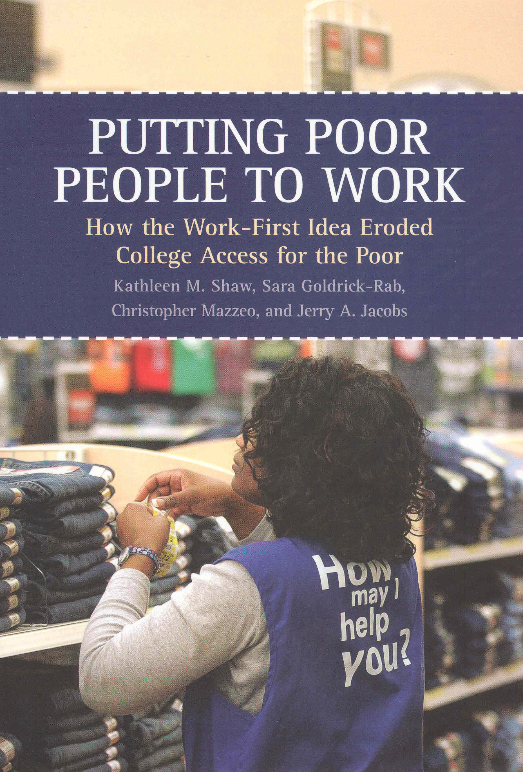
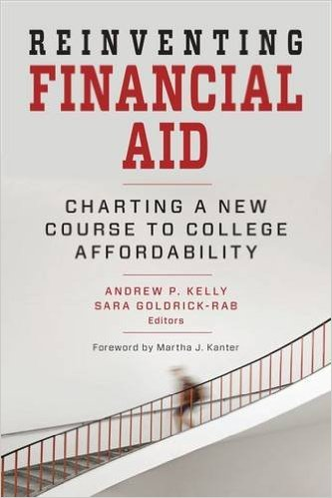
Coming Soon:
Paying the Price:
College Costs, Inequality, and the Betrayal of the American Dream
www.wihopelab.com
www.saragoldrickrab.com
Twitter: @saragoldrickrab

