Slide 1

Pre-Arrival Information for International Students
Maynooth University
September 2025
Helen Kirrane
International Student Experience Officer

Slide 2
Welcome!
Welcome to Maynooth University
We're excited to have you join our international community!
This presentation will help you prepare for your arrival.

Slide 3
Before You Travel
It is important to prepare these items:
Ensure you have a valid passport – that is not expiring soon
Student visa for Ireland (if required)
Health Insurance for your time in Ireland

Slide 4
Before you travel
Connect with other new incoming international students on our Goin’ app. Satya, our International Student Ambassador, is on the app and available to answer questions
Use the app to find a group to take a taxi from the airport, find accommodation, etc.
If you are arranging a courier to send your items to you in Maynooth, be sure that the courier is aware of and engages with Irish Customs – you do not want to be presented with a customs bill when your items arrive!

Slide 5
Visa & Immigration
Apply Early: Student visas can take weeks to process
Check if you need a student visa for Ireland via this link
All Non-EU/EEA citizens must register with Irish Immigration (Immigration Service Delivery) after they have arrived at the university and completed university registration. Further details will be provided during orientation.
Immigration registration is not required for EU citizens

Slide 6
Accommodation
On-campus accommodation
First year undergraduate degree students are guaranteed on-campus accommodation. You will receive a booking email in July.
Postgraduate students are offered our new Buckley House accommodation in Maynooth Town. You will be sent an expression of interest form for a 50 week lease. 38 week leases are for North Campus accommodation and have very limited accommodation
Accommodation costs between €5,500 to €12, 500 depending on the type of accommodation and lease duration

Slide 7
Accommodation
Off-campus accommodation
MU uses Studentpad which is open from 17 June to 28 August
Queries: maynoothstudentpad@mu.ie
Other popular sites (not affiliated to the university):
www.daft.ie
www.rent.ie
www.property.ie
www.myhome.ie
www.hostingpower.ie

Slide 8
Accommodation
Top tips for finding private off-campus accommodation:
Widen your search area to outside of Maynooth Town
Short-term guest accommodation is available on Maynooth campus if required – www.maynoothcampus.com
Join housing groups on social media but beware of scams!

Slide 9
Accommodation
How to avoid accommodation scams:
This website, from ICOS (the Irish Council for International Students) offers useful information that will help you to recognise when someone is trying to commit fraud or “scam” you:
www.internationalstudents.ie/info-and-advice/know-your-rights/scams-and-frauds

Slide 10
Accommodation
Off-campus accommodation
Know the difference - leasing versus licencing
Am I a tenant? - Threshold
If you are renting a house or apartment from a person who does not live there – you are a tenant, you will have a lease and have good rights.
If you are living in a house with a landlord who lives in that same house fulltime – that is a licence situation. Common in Ireland but fewer rights than tenants.

Slide 11

Money and Budgeting
It is a good idea to be prepared for the cost of living in Ireland.
The following website gives live updates on the costs of food, services, etc – www.numbeo.com – select Ireland.
Accommodation is expensive and also items like food.
Top tip: It is cheaper to cook for yourself, rather than dine out.

Slide 12
Money and Budgeting
Costs estimator for your time in Maynooth
Off campus accommodation – between 600 to 1,100 per month
On campus accommodation – between 529 and 1,000 per month (depending on the student block chosen)
Utilities (electricity, heating, broadband, etc) – 350-400 per month per household
Food (groceries) – 300 – 425 per month
Social life (discretionary) – 200 per month
Leap card – for reduced public transport fees
More information see Money and Budgeting section of the Arrivals website:
Money and Budgeting | Maynooth University

Slide 13
Student Registration
Two step process:
Step 1 – before you get here – expect an email from our Student Records office by the end of the second week of August. If you don’t receive an email by Monday 18 August email student.records@mu.ie
Step 2 – when you get here as part of your orientation programme – complete registration, get your student ID card

Slide 14
When to Get Here
Students are expected to arrive in time to participate in the Welcome Week Orientation programme, which runs from Monday 15 September to Friday 19 September.
Classes begin on Monday 22 September.
Exceptions:
School of Business
Students taking the MSc in Business Analytics and MSc Finance are required to attend an Autumn School which takes place from 8- 12 September - in person on campus.
MSc in Business Analytics, first class takes place in CB8 (Callan Building)
MSc Finance, first class takes place in TSI 241 (second floor)
Department of Computer Science
HDip and MSc Data Science students are required to attend a 3-week programming introduction course, which will run from 1 to 19 September – in person on campus.
PhD students – your induction runs in October

Slide 15
Arriving in Ireland
Dublin Airport is the nearest airport.
Preparing for border control:
You must show your passport to the Immigration Officer on arrival.
All students should carry a physical copy of their Maynooth University offer letter for inspection by the Immigration Officer.

Slide 16
Connecting your phone on arrival in Ireland
If you wish to use your mobile (cell) phone from home, make sure it is unlocked from your home provider before you get here.
Sim Cards available on arrival at Dublin Airport – details in our Pre-Arrival Guide. Free wifi at Dublin Airport.
Sim cards: Main mobile operators Vodafone, Three, Tesco Mobile can be purchased in their outlets in Maynooth Town.
Pre-order sim cards – www.48.ie – 12.99 per month unlimited data.

Slide 17
Dublin Airport
Welcome Service
Welcome Service staffed by MU students
Designed to be a welcoming face, and provide information on where to go to get your bus, taxi, SIM card, etc.
Operational:
6.00 am to 6.00 pm on
Friday 12 September
Saturday 13 September
Sunday 14 September
Available in the Arrivals Hall Terminal Arrivals and Arrivals Hall Terminal 2 – look out for the Maynooth University flag and our students in MU hoodies/t-shirts.
Dublin Airport is relatively small, only a few minutes walk between terminals, don’t be too daunted!

Slide 18
Getting to Maynooth
Transport to Maynooth: Bus or taxi connection to Maynooth from the airport. Taxi is the best option to get you right to your door. The bus service will drop you in Maynooth town, near the Glenroyal Hotel which is in the town centre. It’s a walk of about 20 minutes to the North Campus.
Late at night/lots of luggage – get a taxi directly from the Airport
Detailed information in our Pre-Arrival Guide and on our Arrivals website
          Download the TFI Live app
          (Transport for Ireland app –
          public transport maps, schedules, journey planner, etc.).

Slide 19
Finding your way around
Eircode
Pronounced air-code. Every house, building, apartment in Ireland has a unique identifier code. If you have the code for your house/apartment, you can give it to your taxi driver or put it into Google maps to find your way to your accommodation.
www.Eircode.ie
Be sure to download Google Maps to your phone so you can find your way around with Eircode

Slide 20
Welcome Week Orientation
Monday 15 to Friday 19 September 2025
Events throughout the week including:
Campus tours
Academic registration
Meet fellow students
Info sessions on staying well and safe, clubs and societies, student life.
Fun stuff!

Slide 21
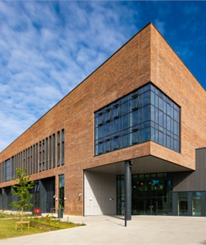
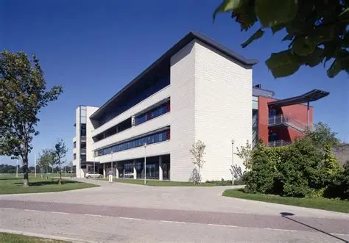
Where do I go for Orientation?
International Office information desk in the TSI foyer -staffed from 9 am to 5 pm each day of welcome week.
TSI Building, North Campus (pictured)
Eircode W23 X04D
International office talks for new international students will take place in the John Hume Building, North Campus
Eircode W23 F2H6

Slide 22
Opening an Irish bank account
There are three main banks in Ireland – Bank of Ireland, AIB and PTSB.
Now possible to apply to open an Irish bank account 45 days in advance of your arrival with Bank of Ireland
AIB Online Quick Apply is available once you arrive in Ireland
PTSB is apply in person at the bank.
More details available on the Money and Budgeting Section of our Arrivals Information website – also check this section for details on saving money!!

Slide 23
Student
Help
Desk
There are two dedicated student help desks on our North Campus and online
They will help you to resolve any queries you might have, provide general information and guidance, or to help you understand support services or the layout of the university.
Desk 1: Ground Floor, TSI Building
Desk 2: Ground Floor, Arts Block
Monday to Friday 9.15am to 4.45pm
studenthelp@mu.ie

Slide 24
Support Services
There are several support services for international students on campus including:
Student Services Centre
Student Health Centre (with doctor, nurses and mental health Nurse)
Counselling Service
Academic Writing Support
Mathematics Support
See our Student Support section on our Arrivals website for more details

Slide 25
Stay Connected
Join official MU social media
Check your email regularly
Attend events and get involved!
Download Goin’ App
to connect with new incoming students
Download the Maynooth University App
for maps, campus information, etc.

Slide 26
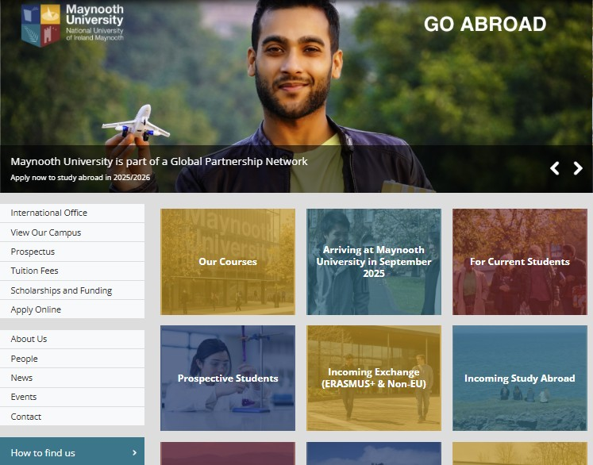

Arrivals Website
Dedicated website for pre-arrival and arrival information – find it on the main International Office website – www.maynoothuniversity.ie/international

Slide 27
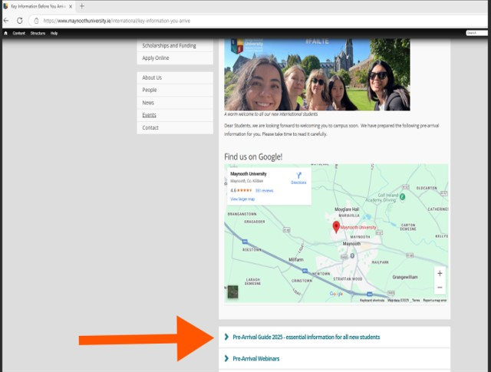
Pre-Arrival Guide - Essential reading
Be sure to read our Pre-Arrival Guide available
under the Key Information Before you Arrive section
of our Arrivals Website
Key Information Before You Arrive | Maynooth University

Slide 28
Safe Travelling!
We look forward to welcoming you to our campus!
Here’s a word from Satya our International Student Ambassador
Followed by Q&As

