Slide 1
Wandering but not lost: Finding one’s own voice in academics
Mahesh Subramony
Professor of Management, Northern Illinois University
msubramony@niu.edu

Slide 2
Topics
Research Program
Research Approach – Bridging:
  Levels of Analysis
  Disciplines
  Theory and Practice
Tips for Emerging Scholars

Slide 3
My Research Program
Environment and Events
Organizations
Workers
Customers

Slide 4
Career Timeline
1994–1998
PhD Student
Curious about a phenomenon
1998–2003
Practitioner
Finding a significant gap
2003–2009
I-O Professor
Starting a research program
2009–2018
Developing my own voice
2018-Present
Professor
Redefining impact

Slide 5
Research Snapshot

Slide 6

My Research Approach: Building Bridges
Levels of Analyses
Disciplinary Clusters & Networks
Theory & Practice

Slide 7
Bridging Levels of Analyses
Firms
Firm-level investments in HR/HC & Org. Performance
Work Groups
Unit-level tenure, diversity, customer-orientation, turnover & Unit Performance
Individuals
Employee work-life balance, friendships, safety threats & Well-being

Slide 8
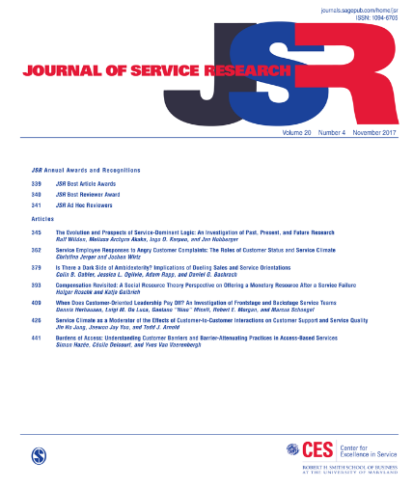

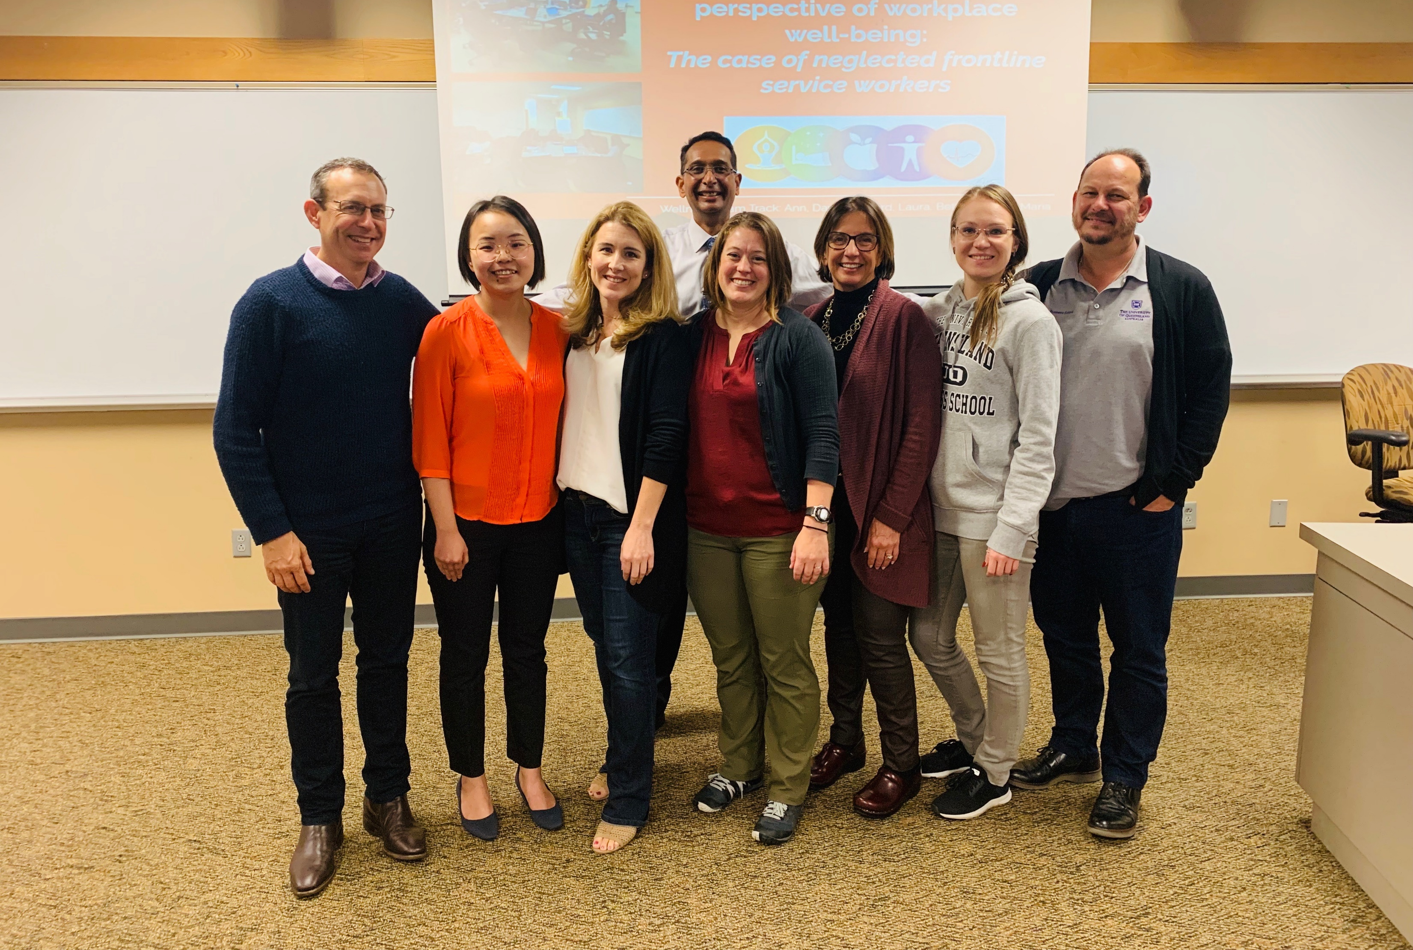
Bridging Disciplinary Gaps

Slide 9
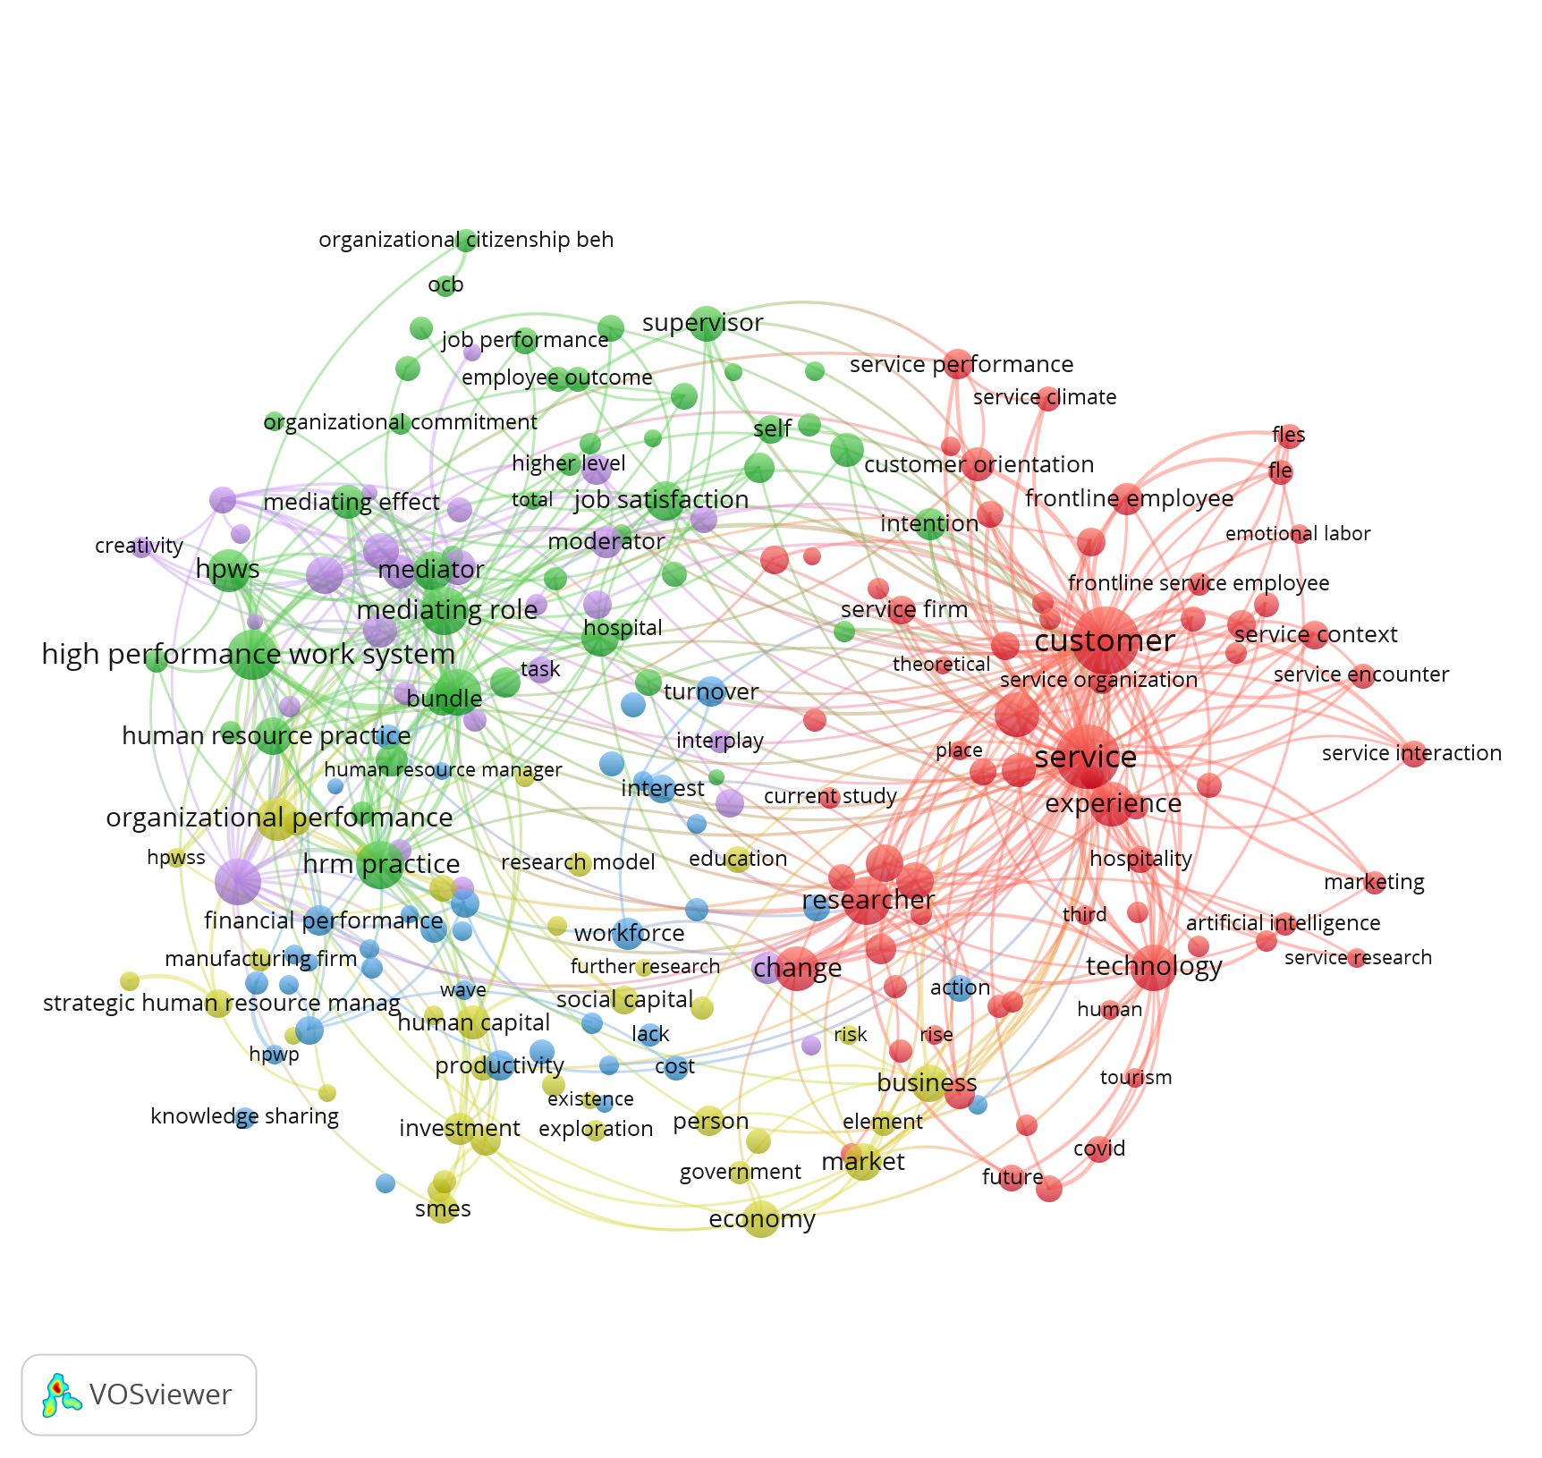
Disciplinary Clusters

Slide 10
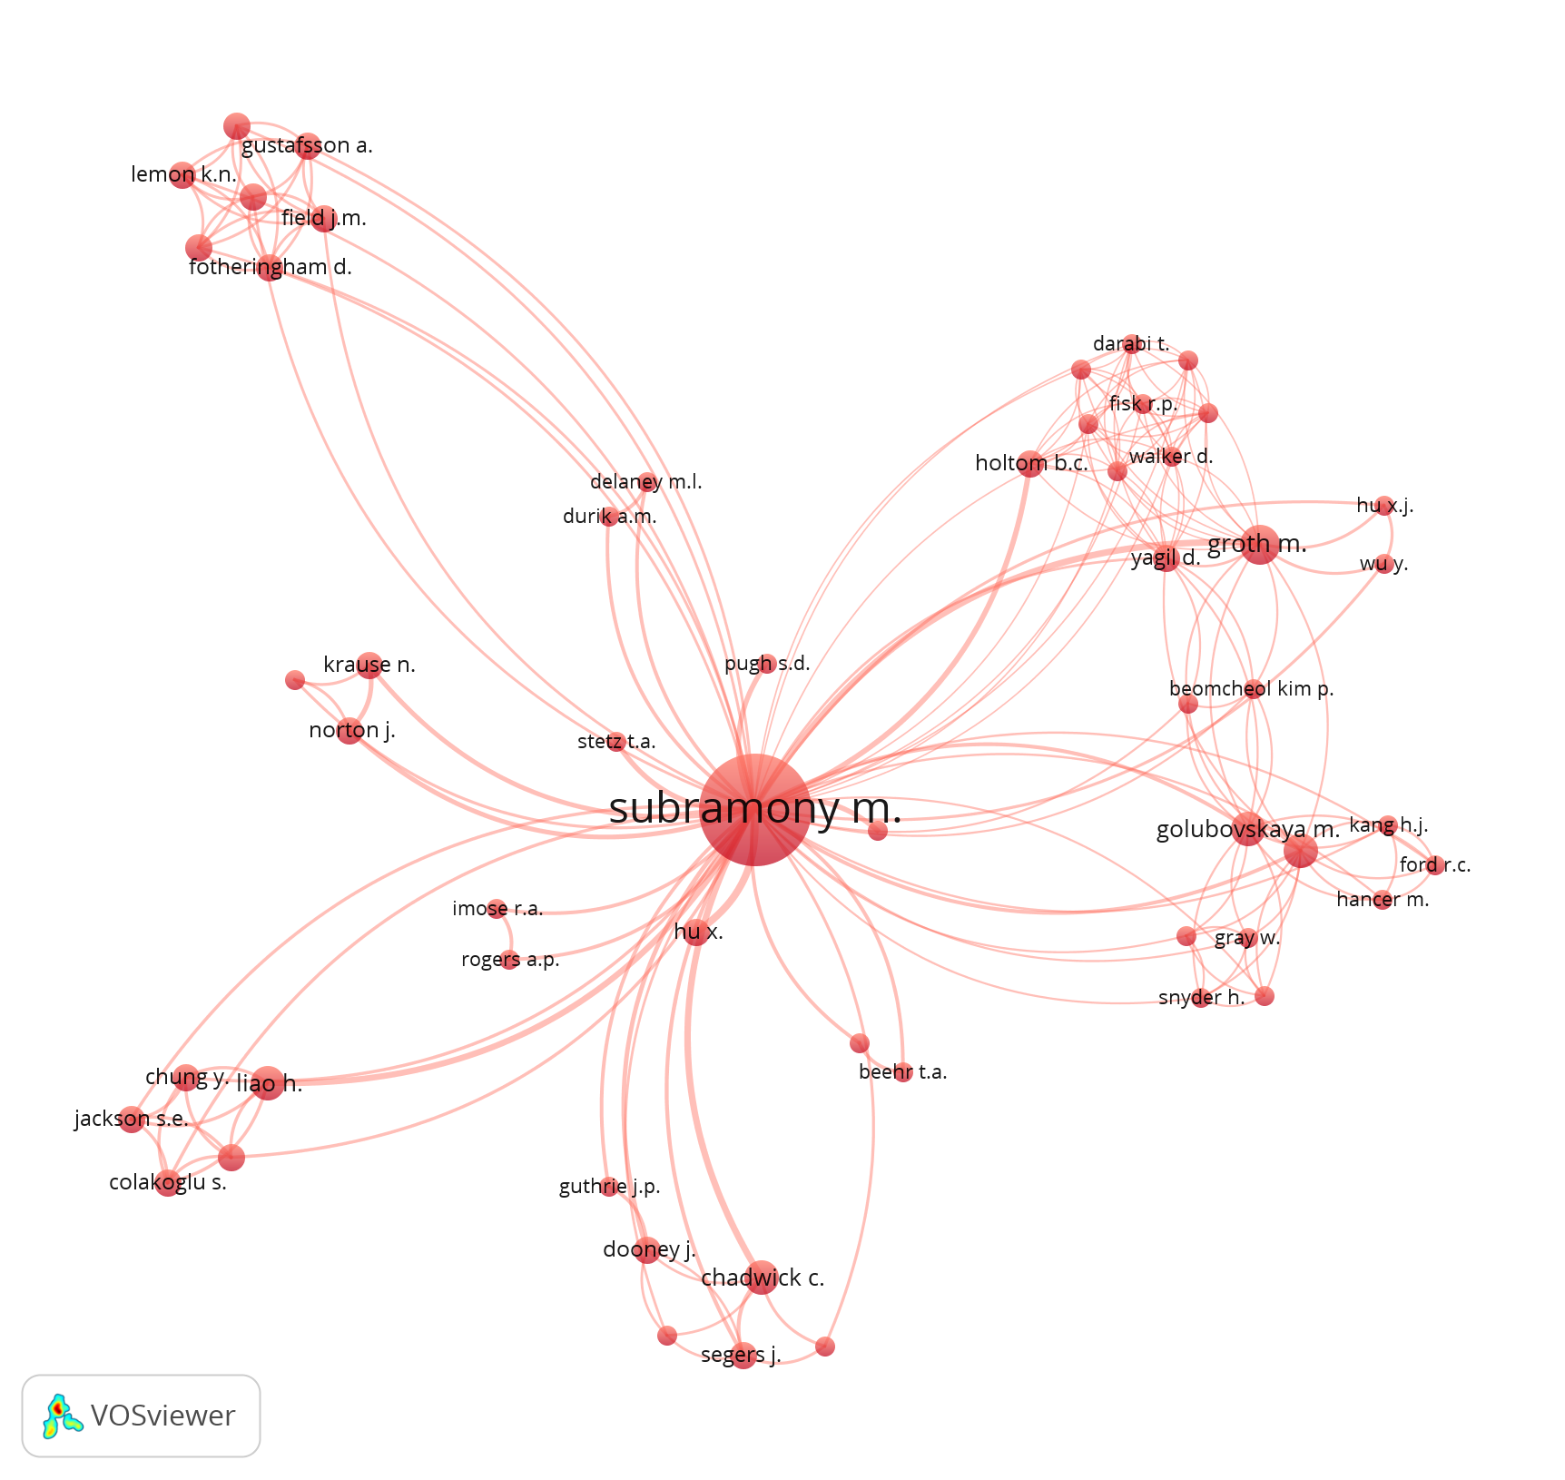
Heterogeneity of Network

Slide 11
Theory and Practice
Respected scholarly publication influencing many academics in the field
Respected scholarly publication influencing many academics in the field and others (disciplines, teachers, practitioners, SDGs)
Rigorous scholarly publication influencing a narrow area of study
Relevant publication influencing others (e.g., books, cases, practitioner journals)
Scholarly Impact
Limited ------------------------ High
Limited ------------------------ High
External Impact

Slide 12
High Scholarly and External Impact
Scholarship that understands and helps solve real-world problems
Scholarship that can help change and develop others
Scholarship that transcends academic disciplinary silos

Slide 13
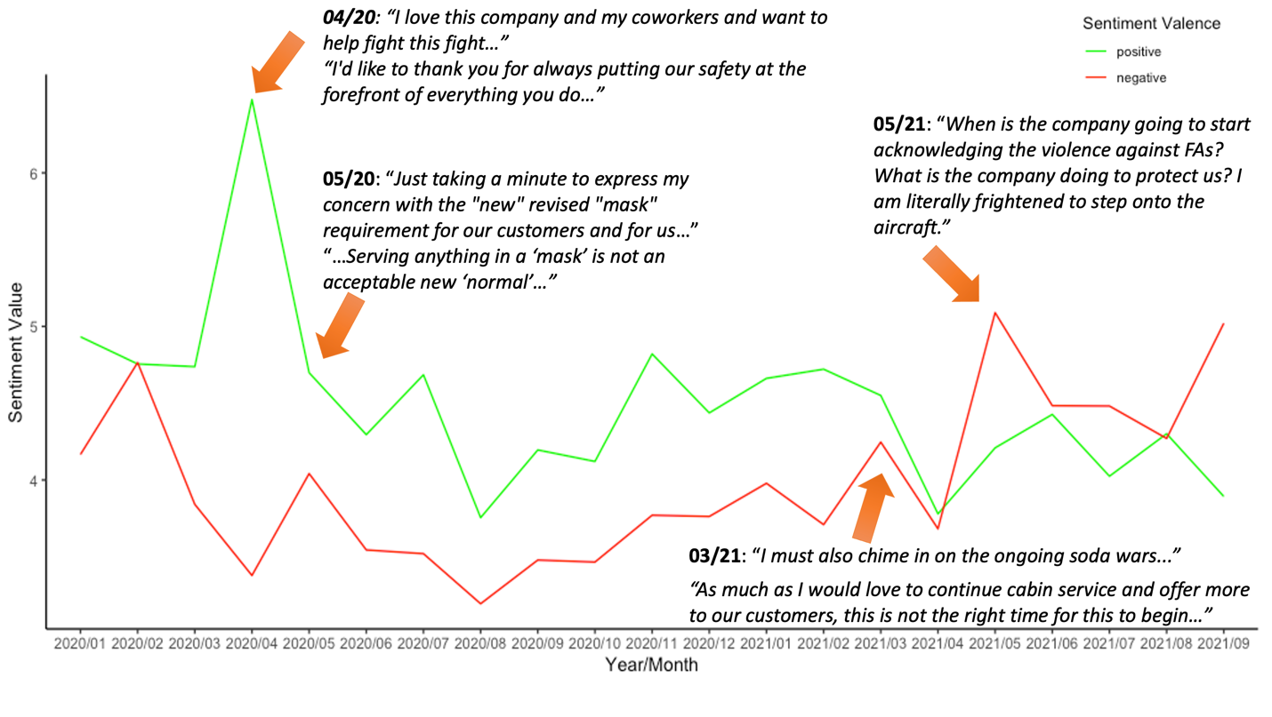
Project Motivation
5981 reports of unruly passengers in the year 2021 (Federal Aviation Administration, 2021).

Slide 14
Research Questions
What are the factors driving passenger non-compliance and incivility in SWA flights?
How do flight attendants experience and respond to non-compliance and incivility?
What can be done to better manage passenger non-compliance and incivility?

Slide 15
Methodology
Interviews
16 flight attendants
5 supervisors
Noncompliance Data
2019-2022
Internal Database
2020-2022
12898 entries
3 pilots
9254 entries

Slide 16
Project Overview
Data Collection & Analysis on Incivility
Training Design and Module 1 & 2 Roll-out
Data Collection & Analysis on Incivility Management Strategies
2020-2021
January - October 2023
March - November 2023
Module 3 Roll-Out
January 2024

Slide 17
Personal & Practical Considerations For Success in Research
Curiosity regarding phenomenon
Motivation to pursue & persist on projects
Ability to design & implement projects
Access to resources (people, knowledge, money, space, time)
External incentive structures

Slide 18
Tips for Emerging Scholars
Find the right balance between:
Internal motivation & external incentives
Novelty & extension/replication
Leverage the power of others:
Fellow travelers (inside/outside discipline)
People who live (in) the phenomenon
Learn something new:
Literature, concepts, perspectives
Methodology
Develop your own voice
Read widely and deeply
Find moments of flow
Think like an entrepreneur
Identify need, develop or leverage capabilities
Design prototype → Test prototype → Develop product etc.

