Slide 1


MSC
Individual Fellowships
Dr. Jennifer Brennan
National Contact Point
National Delegate
Marie Skłodowska-Curie Actions

Slide 2

Marie Curie Actions, an Irish Success Story
€600 million
Ireland’s “Take” from FP7 to-date
€104 million
Portion of this secured via Marie Curie
(2nd Largest FP7 Income-Stream)
€25 million
Funding to support research training for postgraduate students
300
Irish Marie Curie Contracts Signed
5
Among the top 5 performing MS in 2013 Calls
Data based on Contracts signed as of March 2014

Slide 3

Irish Marie Skłodowska-Curie Office
Sponsored by the Irish Research Council
Promote the Actions to Irish researchers and research organisations
Support researchers in preparing funding applications
Contribute to policy initiatives relevant to the Actions
Two staff members:
Dr. Suzanne Miller-Delaney (SFI Centres)
Dr. Jennifer Brennan

Slide 4
Marie Skłodowska Curie Actions in Horizon 2020:
Marie
S-Curie Actions
Training
Mobility
Career
€6.2 billion budget
In the Excellence Science Pillar
Funds ALL RESEARCH AREAS
(no thematic calls or priorities)
Implemented via Annual
Calls for Proposals

Slide 5
ITN
Innovative Training Networks
RISE
Research & Innovation Staff Exchange
COFUND
Co-financing fellowship or doctoral programmes with transnational mobility
IF
Individual Fellowships
NIGHT
European Researchers’ Night
Funding for PIs/Research Orgs

Slide 6
Want to know more about the other MSCA?
View my webinar at http://www.iua.ie/webinar-on-marie-sklodowska-curie-actions/

Slide 7

Individual Fellowships
A personal fellowship to support a period of mobility
For Experienced Researchers
  Post-PhD or equivalent
  No upper age or experience limit
Fully-funded fellowships
  Salary, research costs etc.
Academic or non-academic host

Slide 8



IF – European and Global
European Fellowships
1 – 2 years
Global Fellowships
2 – 3 years (incl. 12 months back in Europe)

Slide 9
Mobility is key
In the main, cannot apply for a fellowship in a country where you have lived for >12 months in the 3 years before the Call deadline
Currently studying in Ireland?
European Fellowship: must apply with host outside Ireland (i.e. move country)
Global Fellowship: rule applies to country outside Europe, so can apply to come back to Irish host (or anywhere else in Europe). If you’re not European, must have lived in Europe for 5 years before applying for GF.
Recently moved to Ireland?
Could apply for EF with current host, and GF if you’ve been in Europe for > 5 years before applying

Slide 10
European Fellowship – three options
Standard European Fellowship (EF)
Mobility rule as described on previous slide
Proposals ranked in disciplinary panels (more info. later)
Reintegration Panel (RI)
For those who wish to (or recently have) relocated to their European host country from outside Europe
Must be nationals or previous long-term residents (> 5 years) of a European country
Relaxed Mobility Rule: no more than 3 years in the 5 years before the call deadline in the country of the host organisation
Career Restart Panel (CAR)
For people who have taken a career break (any reason) for at least 12 months before call deadline
Relaxed Mobility Rule: see above

Slide 11
More than just a research project; a career development fellowship
Training through research (individual project)
Additional scientific skills (new techniques, instruments etc.)
Transferable skills (e.g. communication, IPR, entrepreneurship etc.)
Interdisciplinary/inter-sectoral transfer of knowledge (secondments)
  Can spend up to 6 months (in total) working in another organisation (ideally in another sector) in Europe.
  Opportunity to link with industry, NGO, public sector, national archive etc.
Research and financial management of the fellowship
Organising and taking part in events (including public engagement)
Training in gender and ethics issues
Must be managed by a Career Development Plan

Slide 12
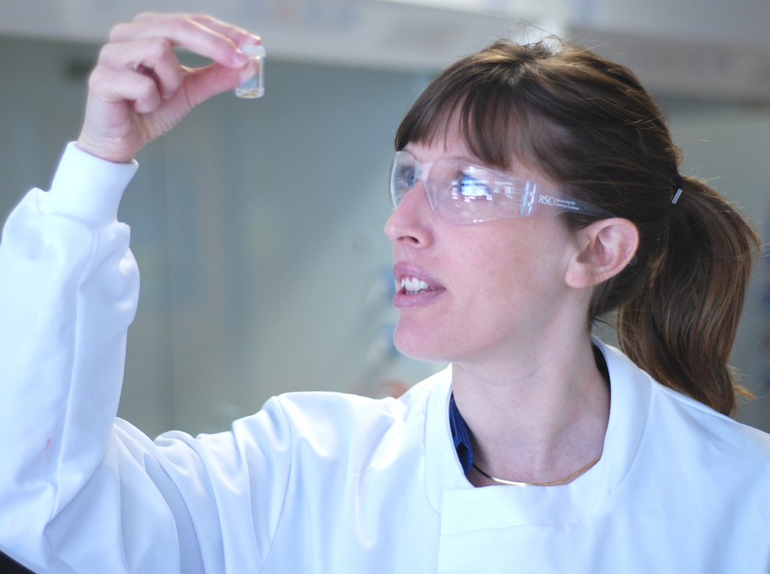
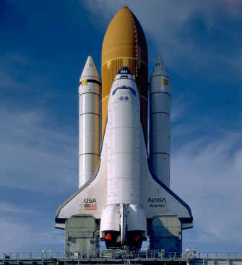
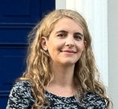
Examples from FP7
Dr. Elena Martines, UCD
Early-career researcher who studied/worked in Scotland, France, Sweden, Spain and Italy
Moved to UCD in 2009, then successfully applied for a Marie Curie Fellowship in 2010
Prof. Gary Stutte, LIT
NASA Researcher since 1992 who began a collaboration with LIT in 2002
Moved to LIT on Marie Curie Fellowship awarded in 2010
Dr. Aoife Gowen, UCD and Kobe University, Japan
Awarded a Marie Curie Fellowship in 2008 to spend two years in Japan
Returned to UCD to complete the reintegration year of the Fellowship
Successfully applied for an ERC Starting Grant worth €2.5 million

Slide 13
Reasons for Research Orgs to get involved
Build links with research groups worldwide (“swap” your researchers)
Attract up-and-coming researchers
Fund a Sabbatical Abroad (up-skill for ERC)
Attract leading researchers

Slide 14
Funding Model

Slide 15
Categories of eligible costs Marie Skłodowska-Curie action | Costs of researcher PER MONTH |  |  | Institutional costs PER MONTH
 | Living allowance (a) | Mobility allowance (b) | Family allowance (c) | Research, training and networking costs (a) | Management and indirect costs (b)
IF (100%) | 4 650 | 600 | 500 | 800 | 650
Fellow’s Salary = Living Allowance + Mobility Allowance (+ Family Allowance)
Rates in table are inclusive of employers’ costs (e.g. employer’s PRSI, pension contribution)
A country coefficient applies to the Living Allowance (e.g. 113.5 for Ireland, 68.3 for Romania)
Estimated Gross Salary (prior to employee’s tax, social security and pension deductions)
  €55,000 p.a. (no family allowance)
  €60,000 p.a. (with family allowance)

Slide 16
How to apply

Slide 17
Prospective Fellow
Find a host organisation and a supervisor
  2 of each for Global F’ship
Look for ads on EURAXESS
Ask your supervisor for recommendations
Write the application together
Submit application together
Prospective Supervisor
Find an applicant
Search EURAXESS CV Database
Ask research collaborators for recommendations
Write the application together
Submit application together

Slide 18
Administrative Forms
Completed online
Visit Call page on Participant Portal
ECAS Account Login
Need PIC (Participant Identification Code) to submit
Call deadlines are Brussels time!
Proposal “Part B”
Download template from inside online system
Complete and save as PDF
Upload to online system
Multiple submissions possible – submit early and often!

Slide 19
1
Excellence
2
Impact
3
Implementation
4
Researcher’s CV (5 pages max)
5
Capacities of the host(s) - Tables
6
Ethics issues
7
Letters of Commitment (GF only)
10 pages
max

Slide 20
Evaluation

Slide 21
Evaluation Panels
Proposals are read by at least 3 disciplinary experts
Distribution of awards across Panels is proportional to # of proposals received
From Call deadline to Grant Agreement Signature – 8 months max.
Global Fellowships/Standard European Fellowships – single disciplinary ranking
Chemistry (CHE)
Physics (PHY)
Mathematics (MAT)
Life Sciences (LIF)
Economic Sciences (ECO)
ICT and Engineering (ENG)
Social Sciences & Humanities (SOC)
Earth & Environmental Sciences (ENV)
Reintegration (RI) European Fellowship – multidisciplinary ranking
Career Restart (CAR) European Fellowship – multidisciplinary ranking

Slide 22
FP7 Fellowships in Ireland – By Panel
Social Sciences and Humanities Researchers were the most successful in FP7 Individual Fellowships

Slide 23
Evaluation Criteria
Criterion | Weighting | Priority (ex-aequo)
Excellence | 50% | 1
Impact | 30% | 2
Implementation | 20% | 3
Overall threshold of 70%
No individual thresholds

Slide 24
Excellence (50%) Priority 1 | Impact (30%) Priority 2 | Implementation (20%) Priority 3
Quality, innovative aspects and credibility of the research (including inter/multidisciplinary aspects) | Enhancing research- and innovation-related human resources, skills, and working conditions to realise the potential of individuals and to provide new career perspectives | Overall coherence and effectiveness of the work plan, including appropriateness of the allocation of tasks and resources
Clarity and quality of transfer of knowledge/training for the development of researcher in light of the research objectives |  | Appropriateness of the management structures and procedures, including quality management and risk management
Quality of the supervision and the hosting arrangements | Effectiveness of the proposed measures for communication and results dissemination | Appropriateness of the institutional environment (infrastructure)
Capacity of the researcher to reach or re-enforce a position of professional maturity in research |  | Competences, experience and complementarity of the participating organisations and institutional commitment
Proposal template matches this table

Slide 25

The “Charter and Code” and
Human Resources Strategy for Researchers (HRS4R)
Embedded in Evaluation Criteria for all MSCA
Charter: researchers’ career management
Code: open and transparent recruitment and appraisal
If institution has endorsed the C&C, include in proposal
HRS4R: mainstreaming C&C in institutions
Awarded the right to use “HR Logo”
UCD, UL, NUIG, WIT, RCSI and UCC are awardees
(to-date).
If applicable, should be included in proposal
http://ec.europa.eu/euraxess/index.cfm/rights/index
List of institutions: http://ec.europa.eu/euraxess/index.cfm/rights/strategy4ResearcherOrgs

Slide 26
Indicative Call Timetable
Activity | Date
Publication of Call | 12-Mar-2014
Deadline | 11-Sep-2014
Evaluation of Proposals | Oct/Nov 2014
Evaluation Outcome | Feb 2015
Signing of Grant Agreements* | May 2015
* Earliest start date – can postpone for up to 12 months

Slide 27
IF Call 2015
CALL | Opening Date | Closing Date | Call Budget
H2020-MSCA-IF-2015 | 12-Mar-2015 | 10-Sep-2015 | €215 million*
* €27 million for Global Fellowships
Results 2014 | IE Submitted | IE Funded | IE Success Rate | EU Success Rate
Global Fellowship | 25 | 4 | 16% | 11.3%
European Fellowship Standard | 129 | 16 | 12.4% | 18.6%
European Fellowship Career Restart | 2 | 1 | 50% | 18.2%
European Fellowship Reintegration | 14 | 3 | 21.4% | 18.9%

Slide 28
How the MSC Office can help
Information
Email Distribution List (mariecurie@iua.ie)
Support
Training Webinars for specific Calls (recordings on website and YouTube)
Marie Skłodowska-Curie Office Ireland on Linkedin
Dedicated website www.iua.ie/mariecurie
Partner search via MSCA NCP network
Advice on whether your concept ‘fits’ the Call
YouTube channel MarieCurieActionIre
Twitter @mariescurie_ire
Proposal writing workshops for IF

Slide 29
IF Proposal Writing Workshops
What?
A half-day, hands-on, interactive proposal writing workshop
Applicants should leave with the “nuts and bolts” of a good proposal
Who can attend?
Applicants and/or Supervisors (attending together works well)
Where?
Maynooth University and in IUA Offices Dublin 2
When?
@Maynooth between 15th – 17th June (tbc)
@IUA Offices in June and August (dates tbc)

Slide 30


Thank you!
mariecurie@iua.ie
www.iua.ie/mariecurie
Marie Skłodowska-Curie
Office Ireland
MarieCurieActionsIre
@Mariescurie_ire

Slide 31
Writing a good proposal:
Advice from evaluators and the PeopleNetwork+ of MSCA NCPs

Slide 32
General Comments
Use a self-explanatory title and a memorable acronym
Use the proposal template:
  It matches the evaluation criteria and helps you to put the right information in the right place for the evaluators to find it.
  Some evaluators use a “checklist” approach to marking – if the information is not in the correct section, they will give you “zero” for that sub-criterion.
“A picture is worth a thousand words”
  Use Diagrams, Charts, Tables or Figures where possible - easy to evaluate
Be aware of the overall weighting of each criterion
  You need to score well in all sections in order to be funded – don’t spend all your time writing the Excellence section!

Slide 33
Abstract (Admin forms)
Provided to evaluators to help them choose the proposals they will evaluate
Be concise
Reflect the whole proposal including proposed impact
Identify precise & concrete objectives for the whole proposal, not just the research
Provide enough technical/research information to help an evaluator with knowledge of the field to select it

Slide 34
Layout of Proposal
Not evaluated but it makes life easier for the evaluators
Template
Use the Correct Template
Provide a Table of Contents with page numbers
Format
Use charts, diagrams, tables, text boxes, figures.
Use appropriate font size, line spacing, page margins
Language
Avoid jargon
Use the Full Page Limits
Use the Template sub-headings (provides good structure)
Put the proposal acronym in the Header
Put Page Numbers (format Page X of Y) in the Footer
Ensure any colour diagrams etc. are understandable when printed in black and white
Use highlighting where appropriate (bold, underline, italics) but don’t overdo it!
Explain any abbreviations
Simple clear text
Avoid long sentences
Get rid of repetitions (refer to other parts of proposal if necessary)
Don’t copy text from other documents or websites
Be consistent with language (UK/US English)

Slide 35
1.1 Quality of research programme
Educate the Evaluator
  The majority of evaluators will not be expert in the specific subject area of the proposal so….
  Write in a style that is accessible to the non-expert using figures/tables/charts/diagrams to illustrate where appropriate
Research objectives/questions/hypothesis
  A “must have”
  Make them clear, focused and up front – a bulleted list works well
  Describe the state-of-the art and relate the objectives to it
  Make sure the ‘state of the art’ is up to date
  Include a list of bibliographic references (in footnotes)

Slide 36
1.1 Quality of research programme - 2
Provide a clear, focused description of the research methodology, i.e., how you will work toward the research objectives
Make a clear statement of the originality and innovative aspects of the proposal – highlight any multi/disciplinary aspects
Gendered innovations are NB and must be mentioned
How will the research contribute to the field?
Clearly explain how the research will:
  open up the best career possibilities for the researcher
  new collaboration opportunities for the host(s)

Slide 37
1.2 Quality of Training/Transfer of Knowledge
Spell out the training objectives and link them to your overall short and long term career goals
Clearly describe what you are trying to achieve (what – why- when)
Include a training schedule with well-defined timeframe (use the mandatory Gantt chart)
Must include the preparation and use of a Personal Career Development Plan
If a secondment of other opportunities for exposure to other sectors (industry, charity, national archive etc.) is included, be specific about why and when these will happen

Slide 38
1.2 Quality of Training/Transfer of Knowledge 2
Need to demonstrate potential acquisition of three kinds of skills:
  Research Skills core to your research project
  Additional Research Skills (to diversify your competencies)
  Transferable & Complementary Skills (also consider skills useful in non-academic careers)
Acquired through training courses and “on the job”
The VITAE Researcher Development Framework ©
is a useful resource

Slide 40
1.2 Quality of Training/Transfer of Knowledge
Explain how the host (ToK) will gain new knowledge from the researcher
Particularly important for
  Global Fellowships (ToK between host outside Europe and host in Europe)
  Reintegration European Fellowships (ToK into Europe from outside)

Slide 41
1.2 Quality of Training/Transfer of Knowledge 2
Precisely what knowledge will be transferred
  Provide a bulleted list or a table of objectives – easy for the evaluators to follow
How will you transfer it?
  What specific measures will you use to embed this knowledge into the host organisation and the wider Europe
  Examples: mentoring students, delivering workshops, attending conferences, building collaborations with other European research organisations.
  Be creative!

Slide 42
1.3 Quality of the supervision/hosting
Clearly demonstrate, with hard evidence, the quality of the research supervisor(s)/institution(s) with regard to the training of researchers
  Include numbers of postdocs mentored, number of Marie Curie Actions they participated in
If the researcher will be co-supervised/mentored by other members of the team, spell out their role and experience
Spell-out the supervision arrangements e.g., frequency of meetings, help with Career Development Plan etc.
Demonstrate that the supervisors are experts in the research area (cite their publications)
If your host has a researcher career development programme, then spell out precisely how you will incorporate relevant aspects of it into your personal training plan
Describe how the researcher will be integrated into the wider host organisation (hosting arrangements)

Slide 43
1.4 Capacity of the researcher / 4. CV
Need excellent track record appropriate to career stage, discipline and sector (academic/non-academic)
  E.g. publications/conference participation, granted patents, monographs, book chapter, examples of leadership in industrial innovation
  Include bibliographic information e.g. impact factor, number of citations, journal ranking in the field
  If you are not the first or lead author, briefly explain your contribution
Include all relevant experience (e.g. teaching, consultancy, supervision, event organisation)
Need to provide a clear statement that the Researcher is a good match to the proposed research but need to demonstrate that they will learn something new
5 pages available – use them all. A clear layout is key.

Slide 44
1.4 Capacity of the researcher/ 4. CV
Include a description of major research achievements – a short paragraph is sufficient. Link to information in CV – don’t duplicate
Provide good evidence of the candidate’s ability to think/act independently and show leadership
  If you really have no examples from your research career, you can include some from your personal life (e.g. student body president, captain of football team, secretary of gardening club……….)
Describe the potential for reaching a position of professional maturity
For 2015 Call, no opportunity to include letters of reference so you need to “sell yourself”

Slide 45
2.1: Research HR and new career perspectives
In all sections, be specific: provide details of how the impact will be achieved.
Explain the impact of the research and training on the fellow’s career, e.g.
  Research skills, transferable skills gained
  Exposure to non-academic sector (secondments or other), if applicable
  How it will help them to achieve/work towards their career goals
  Outline what they plan to do after the fellowship
Explain how the researcher’s activity will impact on European society and/or the economy
  Importance to the field of research
  Link to Horizon 2020 objectives, research roadmaps, European standardisation
  Promoting collaboration between the academic and non-academic sectors and between Europe and outside (for Global Fellowship/Reintegration Panel)
  Entrepreneurship, innovation (social and economic), creativity

Slide 46
2.1: Research HR and new career perspectives - 2
Look to EU policies on research which refer to training/careers for researchers
  E.g. Innovation Union, Agenda for New Skills and Jobs, Youth on the Move
  Final Report of the Expert Group on the Research Profession
  Most docs are available on the EURAXESS Policy Library http://ec.europa.eu/euraxess/index.cfm/services/researchPolicies
Don’t simply cut and paste from EU docs or “pay lip service” by naming them in the document
  Read what they say about research careers and say why this fellowship fits in with their stated objectives/policies
This will gain you “bonus points”

Slide 47
2.2: Communication and Dissemination
1. Communication strategy & outreach/public engagement plan
New Guidelines document* describes difference between communications and outreach/public engagement
Outreach is meant to engage a large audience and to bring knowledge and expertise on a particular topic to the general public.
Communication is two-way from sender to receiver e.g. an article in a newspaper or on TV or radio
Plan a range of activities targeted at multiple audiences – what is the impact?
2. Dissemination strategy
Target audience: Other researchers, potential users and the wider research and innovation community
What is the potential impact of disseminating to them?
* http://ec.europa.eu/research/mariecurieactions/documents/documentation/publications/outreach_activities_en.pdf

Slide 48
2.2: Communication and Dissemination - 2
Intellectual Property Rights & Exploitation
  How are the research results useful to business?
    Outline plans to exploit any IP/commercial potential arising from the programme
    What is the potential impact of exploiting commercial potential/IP?
  How are the research results useful to the wider society?
    If applicable, how will you ensure that relevant societal actors (community, voluntary sector etc. etc.) will benefit from your project?
    What’s the potential impact of societal exploitation of the results?
General tip: include quantifiable targets for measuring the effectiveness of communication, dissemination, IP and exploitation

Slide 49
3.1: Workplan
Must have a clear work plan
Use the standard EU format of Work Packages, deliverables and milestones – be clear and concise
Must complete the required Gantt Chart to illustrate timelines
  It is within the 10 pages limit
  You can modify the template chart to meet your own needs
Don’t just have research Work Packages, include, e.g.:
  Management
  Dissemination, Exploitation and Communication/Public Engagement
  Training/Transfer of Knowledge (including any secondments)

Slide 50
3.2: Management Structure & Procedures
Must have a clear management plan, to explain who will do what and when, including:
  Progress monitoring (research, training, transfer of knowledge, dissemination, outreach, career planning etc.)
  Financial management
  IPR management (if applicable)
  Risk management (research and the overall fellowship) – add a table of risks and associated contingency plans
Fellow must be involved in managing the fellowship but with the help of the supervisor

Slide 51
3.3: Infrastructure and Institutional Environment
Prove that the host(s) have the necessary research and training infrastructure to successfully implement the fellowship
Describe the main tasks of the host(s) and any secondment organisations
Infrastructures: technical and other such as office space, access to library and IT facilities, researcher development programmes etc.
Outline the relocation assistance for the researcher (EURAXESS can help) e.g. new researcher orientation etc.
Describe which institutional departments will help with managing the programme (Finance, HR etc.) and what their experience is
The Capacities Table in section 5 will also be used to evaluate this criterion – don’t duplicate the information.

Slide 52
3.4: Competences, Experience and Complementarity
Explain how the fellowship will benefit the researcher and the host organisation(s) and how committed the host organisation is to the fellow and the fellowship
For Global Fellowship, clearly explain the complementarities between the two organisations (in and outside Europe) and how these will be exploited (use a diagram or table)
Need a Letter of Commitment (in section 8) from the host outside Europe – no letter required for European host or secondment organisations

Slide 53
3.4: Competences, Experience and Complementarity
Have the organisation(s) endorsed the Charter & Code – if yes, say so!
  List at http://ec.europa.eu/euraxess/index.cfm/rights/charterAndCode
Is the organisation(s) working towards earning the “HR Excellence in Research” logo? If yes, say so!
  List at http://ec.europa.eu/euraxess/index.cfm/rights/strategy4ResearcherOrgs
But….don’t assume that evaluator knows what this means. Explain it to them – it underlines the institution’s commitment to excellent working conditions for researchers

Slide 54
5: Capacities Table
Information Requested | Suggested Content
General Description
Role and commitment of key persons (supervisor) | % time commitment. Role of other persons apart from supervisor.
Key Research Facilities, Infrastructure and Equipment | Relevant to the research to be carried out in the IF
Independent Research Premises? | Yes / No answer. If no, explain where the research premises are located. Example: spin-out company who has R&D space in an academic institution.
Previous involvement in research and training programmes | e.g. FP7 or FP6 Marie Curie, Erasmus, Structured Doctoral Programmes……
Current involvement in research and training programmes | As above
Relevant publications and/or research/innovation products | Relevant to the research to be carried out in the IF

Slide 55
6: Ethics Issues
All proposals will be checked for ethics issues
Ethics Table is in the Administrative Forms
If you indicate Ethics Issues in the Table:
  Clearly describe how Ethical Issues will be managed
  How does the proposal meet national legal and ethical requirements of the host country?
  Who will oversee the project’s ethical aspects? E.g. institutional ethics committee, Data Protection Officer
  Provide sample consent forms etc.
  There is no page limit, so provide as much relevant information as possible

