Slide 1


Ollscoil Mhá Nuad
Maynooth University
Overview of Particle Physics in Medicine
Dr Jeff Crosbie - March 2023

Slide 2

What is one of the main areas of Medical Physics?
Radiation Therapy for Cancer
  Megavoltage Linear Accelerators
    X-ray photons and electrons
  High energy particles
    proton and ion-beam therapy
  High dose radioactive isotope sources
    Brachytherapy
Ollscoil Mhá Nuad
Maynooth University

Slide 3
Radiation Therapy for Cancer Megavoltage Linear Accelerators

Slide 4
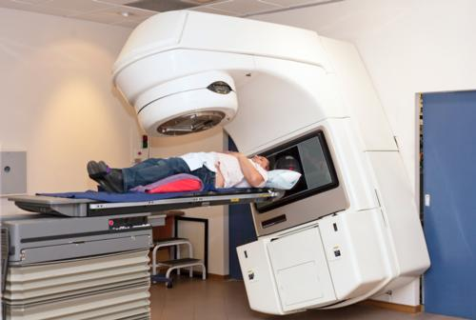
Linacs can be used to treat patients with megavoltage X-ray photons and electrons

Slide 5
Background: Radiotherapy treatment
High (lethal) dose of radiation to the tumour (target)
Low (tolerable) dose of radiation to healthy tissues
RT is used for localised cancers (not systemic)
Any part of the body (near surface or deep inside)
Small (few mm) to large (40 cm) cancers in size.
The linear accelerator is the ‘workhorse’ of radiotherapy departments in the developed world.

Slide 6
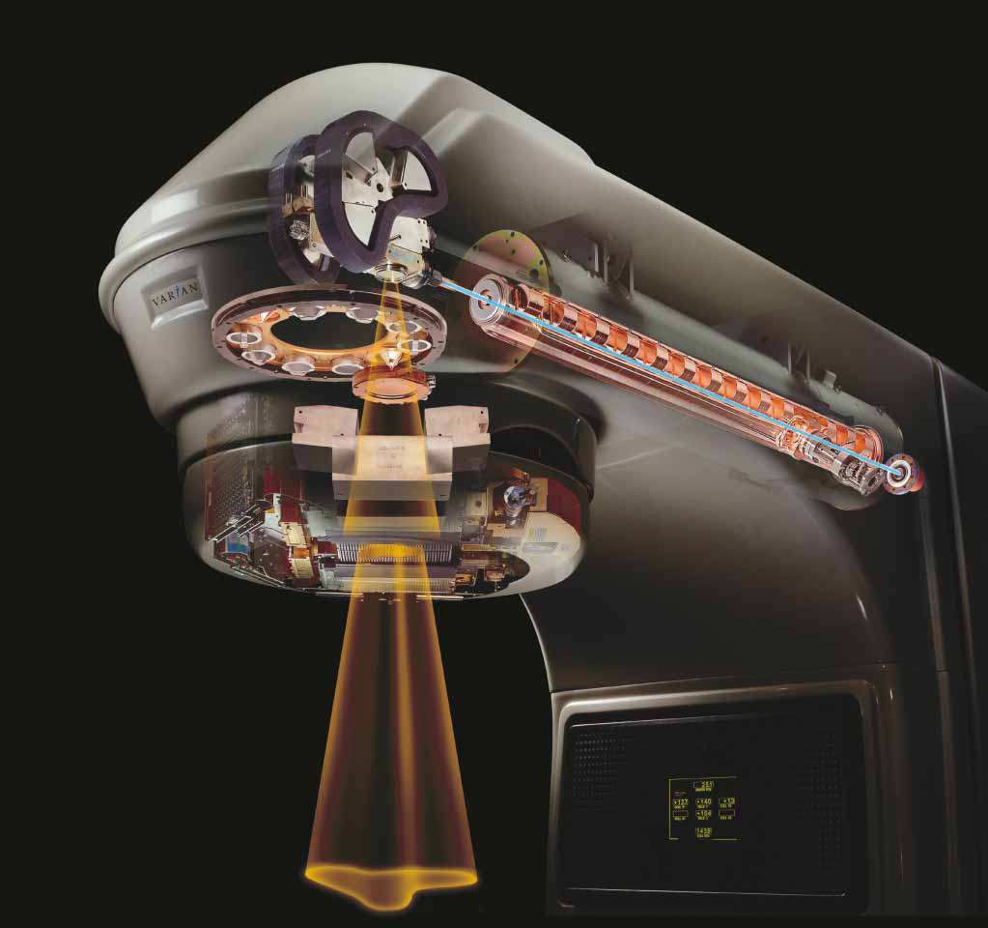
Modern Linear Accelerators
Image source: varian.com

Slide 7
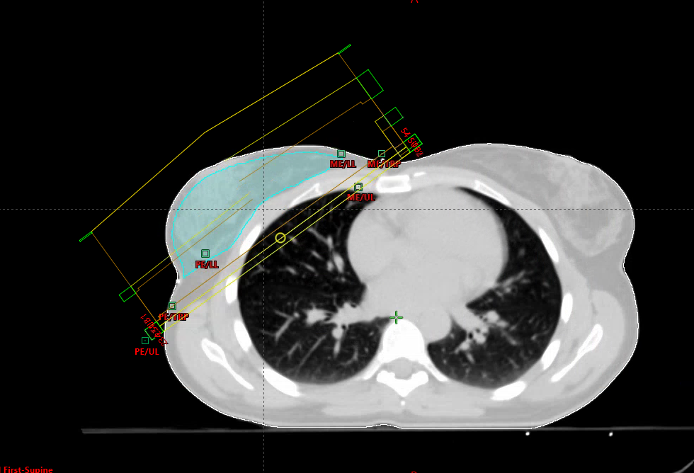
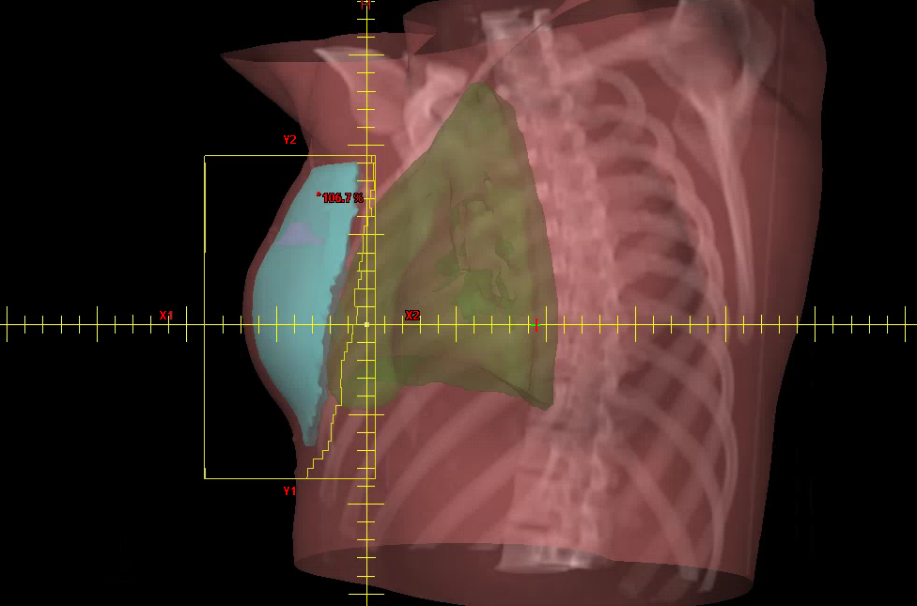
Breast cancer
Two opposed tangential MV photon beams
Beam’s eye view for medial tangent

Slide 8
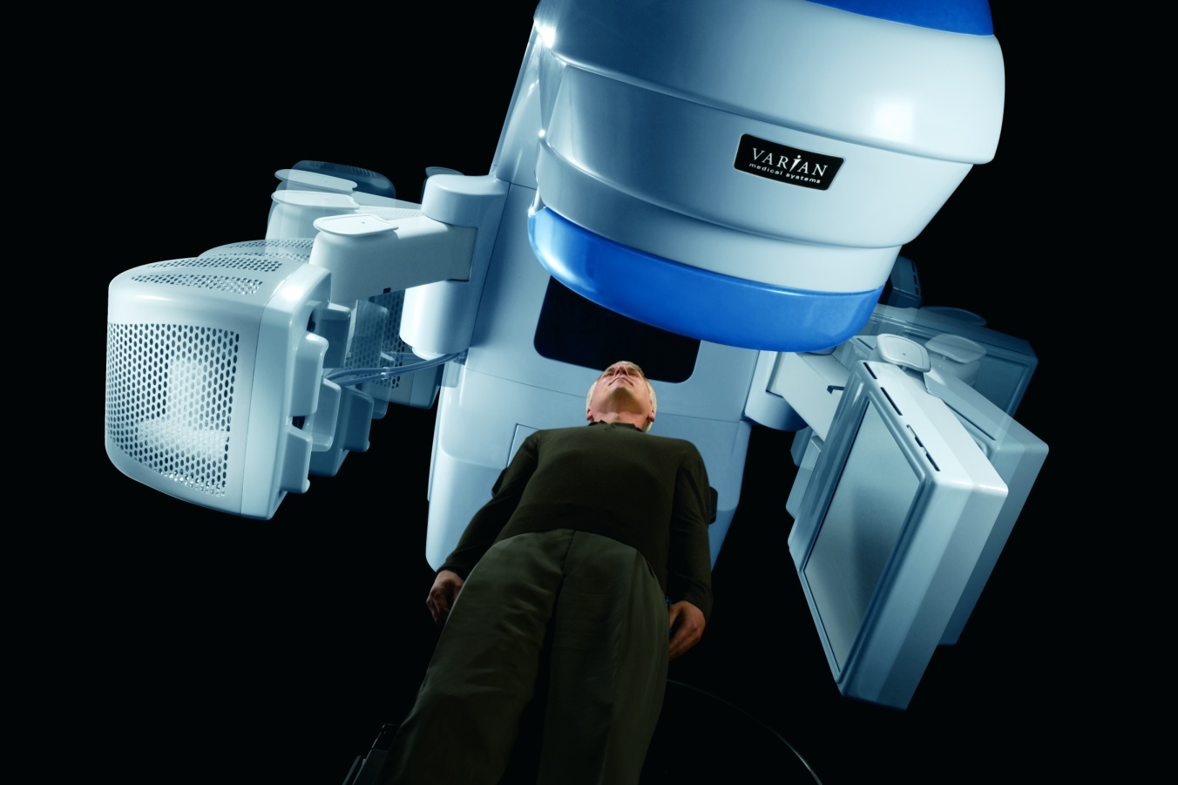
Use imaging to check the patient is in the right position
A kV imaging x-ray tube and detector panel can be mounted on the linac gantry
kV imaging system also rotates around isocentre

Slide 9
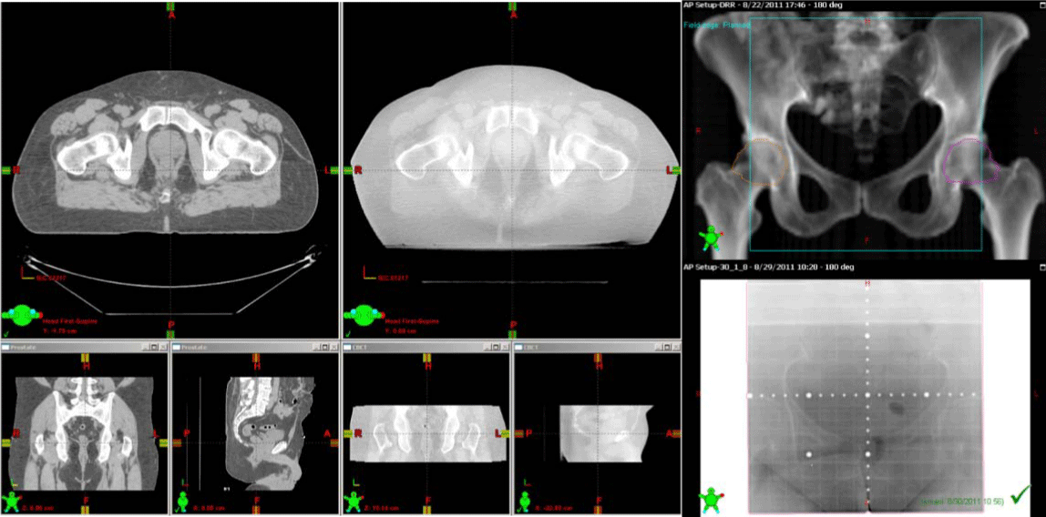
Use imaging and software to check the patient is in the right position

Slide 10
Radiation Therapy for Cancer Proton Beam Therapy

Slide 11
Proton Beam Radiotherapy
Protons are positively charged particles; approximately 1900 times more massive than negatively charged electrons. The mass of a proton is on the order of 10⁻²⁷ kg.
Proton beams have been used to treat cancers in human patients for over 50 years. However, proton therapy facilities are very expensive.
There are approx. 30 proton therapy facilities in Europe, but none in Ireland.
Protons are accelerated to high energies (like X-rays in Linacs) in order to penetrate the body. The typical energies of modern proton facilities is approx. 250 MeV.
Protons are accelerated in cyclotrons and travel about 50% of the speed of light in the process. Magnetic fields are used to maintain the protons’ orbit.
A cyclotron weighs about 200 Tons.

Slide 12
Proton Beam Radiotherapy
Protons belong to a family of particles known as hadrons (made up of quarks and gluons)
The percentage depth dose in water curve for protons is very different to that of X-rays.
Many of the things we need to know about protons can be understood from their depth dose curve.
Pay particular attention to the so-called Bragg-Peak in both the unmodulated/native case and the modulated or spread out case.
Critically, there is almost no radiation deposited beyond the Bragg peak. Now contrast this with X-rays, where attenuation continues.
Note also how X-rays have a higher entrance dose than proton beams.

Slide 13
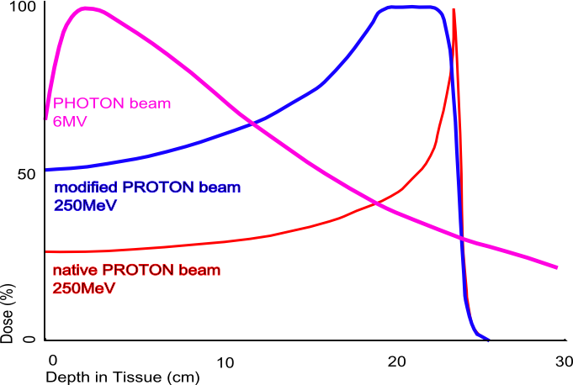
Proton Beam Radiotherapy
Spread out Bragg peak (SOBP)
Image source: Wikimedia commons

Slide 14
Proton Beam Radiotherapy
Proton beam therapy can be an effective treatment for certain difficult to treat brain tumours in adults and children (e.g. base of skull tumours).
Traditionally, protons have been used to treat small tumours e.g. brain tumours, tumours in the eye, and certain prostate cancers
Tumours of the spinal cord/Central Nervous System also respond well because one limits the damage to healthy tissue.
In more recent times (thanks to pencil beam scanning), larger tumours including left breast and head and neck cancers being treated successfully with protons.
Proton beams’ great potential is not so much in improved tumour control, but rather reduced normal tissue complications.

Slide 15
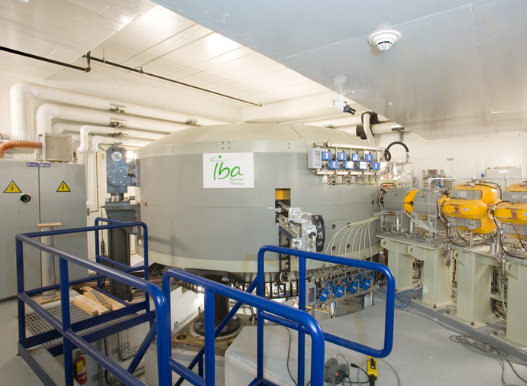
Proton Beam Radiotherapy
The Cyclotron where the megavoltage protons are produced from gaseous hydrogen.
Image source: IBA

Slide 16
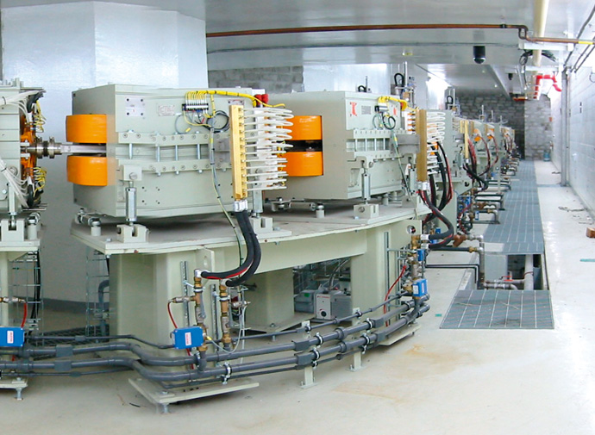
Proton Beam Radiotherapy
Proton beam transport from cyclotron to treatment rooms via focussing and steering magnets
Image source: IBA

Slide 17
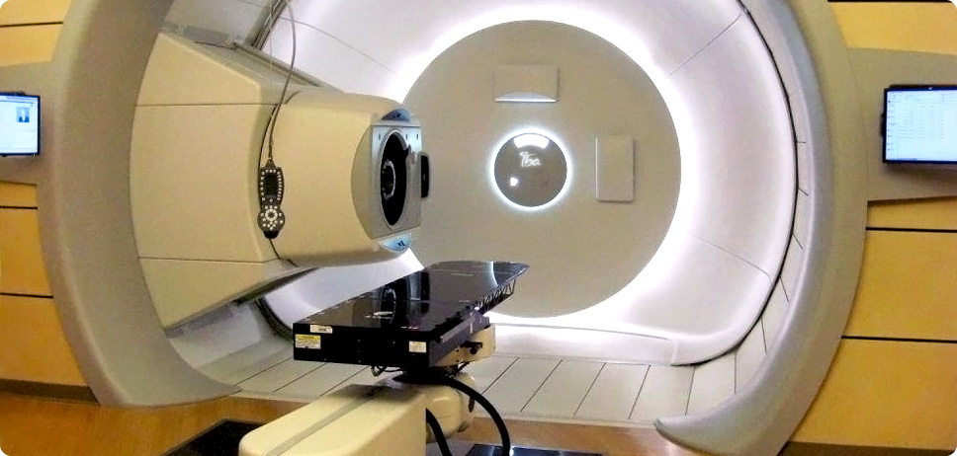
Proton Beam Radiotherapy
Rotating gantry inside proton treatment room. The rather compact-looking gantry belies the enormity of the full rotating gantry behind the treatment room.
Image source: IBA

Slide 18
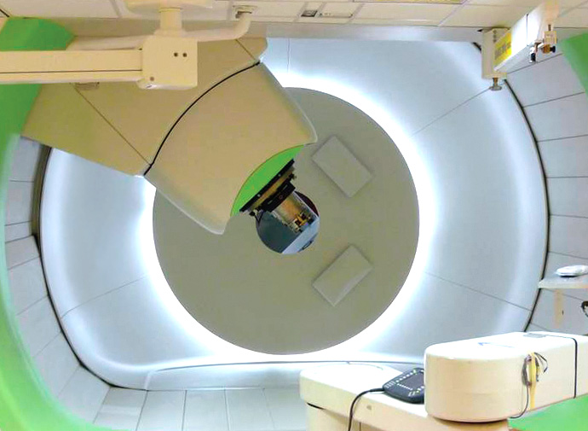
Robotic couch with 6 degrees of freedom
Treatment nozzle at the end of a gantry. Note the robotic couch as well on bottom right. Image source: IBA

Slide 19
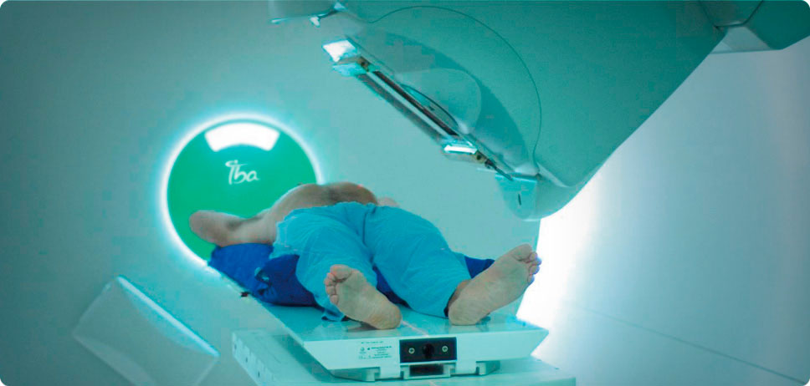
Image source: IBA

Slide 20
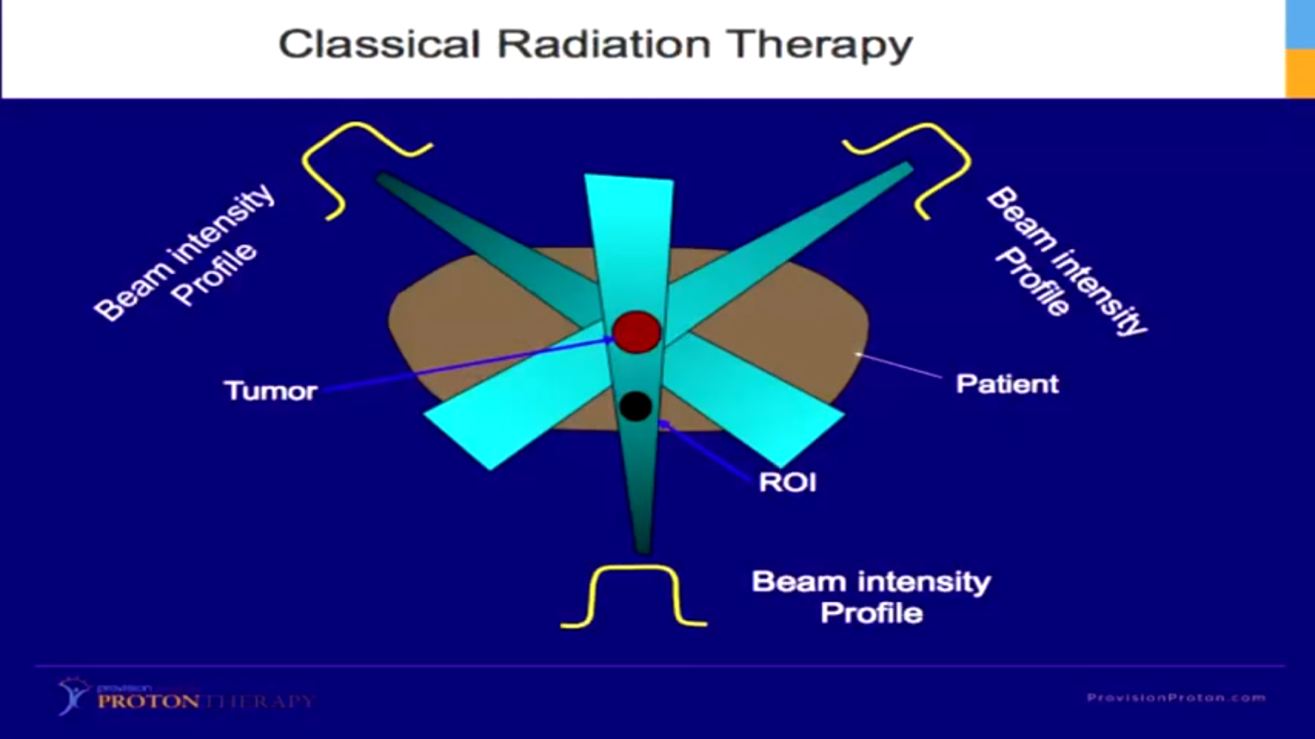
Classical RT using megavoltage X-rays. Dose is deposited upstream and downstream of the tumour. This pattern of dose deposition is unavoidable with X-rays.
Image source: Dr Niek Schreuder – Provision Health Care, USA

Slide 21
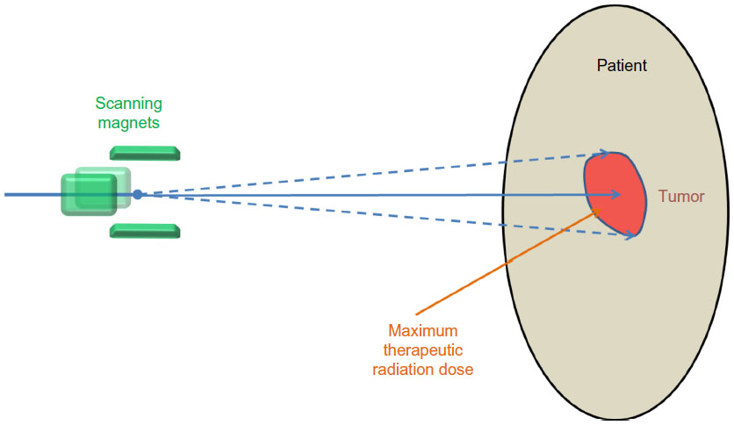
Active (or Pencil beam) scanning of proton beam via scanning magnets. Dose is deposited in a manner analogous to a 3D printer
Image source: Dove Medical Press

Slide 22
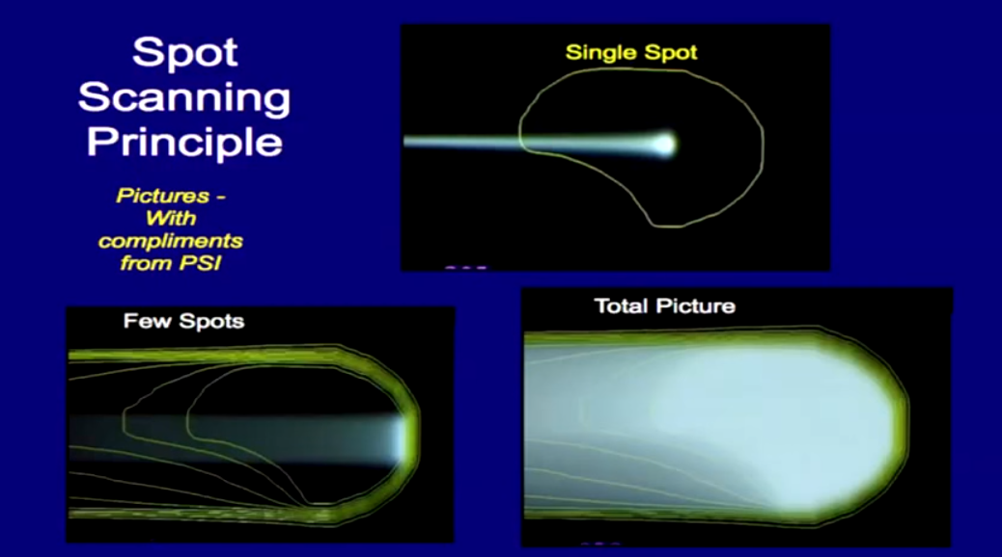

Slide 23
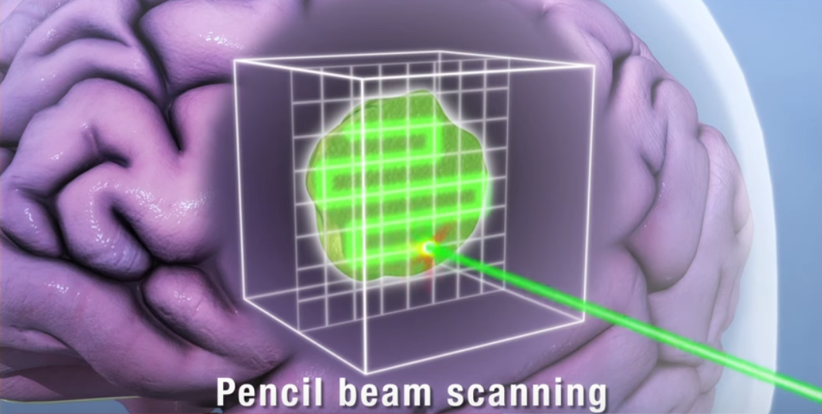
Image source: Mayo Clinic, Rochester, USA

Slide 24
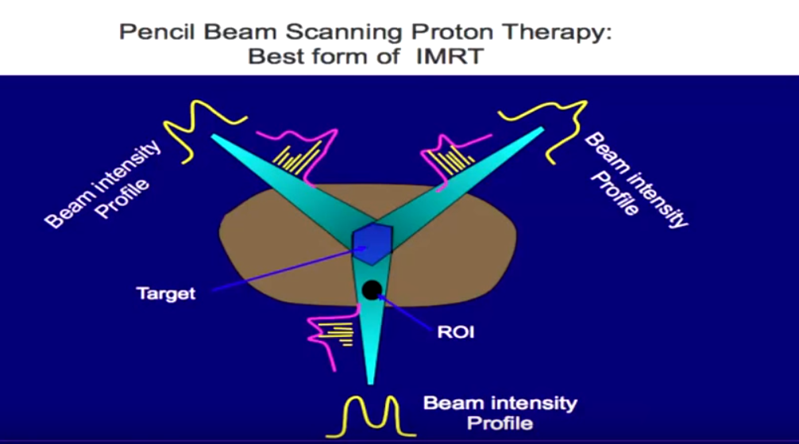
In pencil beam (active scanning) proton therapy dose deposition, the proton beam is actively scattered by magnets and the dose distribution can be sculpted around healthy tissue upstream of the tumour. Very Good!!
Image source: Dr Niek Schreuder – Provision Health Care, USA

Slide 25
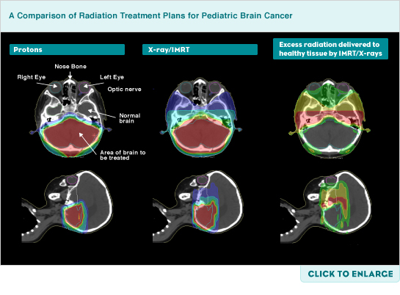
Proton Beam Radiotherapy
Proton beam therapy can be an effective treatment option for certain paediatric brain cancers.
Image source: www.praxis-margareten.at

Slide 26
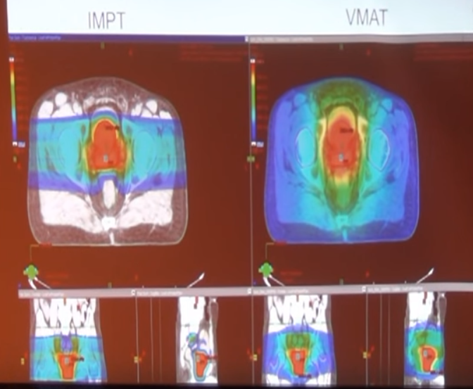
Proton Beam Radiotherapy
Note the low-dose ‘bath’ of radiation to large volumes of healthy tissue with the VMAT, X-ray technique. Image source: Dr Carl Rossi M.D.

