Slide 1
IDA Global Survey on DPO Participation in Development Programmes & Policies
Preliminary findings
May 2019, GLAD meeting, Ottawa

Slide 2
Background
Participation is a human right, which is often denied to persons with disabilities
Participation of persons with disabilities is at the heart of the CRPD, through Article 4.3: ‘Nothing about us without us’ becomes a legal obligation, and highlights the role of DPOs as organisations to represent persons with disabilities in decision-making for all issues concerning persons with disabilities
Since 2015, new commitments to include persons with disabilities from governments, the UN and funding agencies (2030 Agenda, Global Disability Summit commitment, UNSWAP/ UNDIS)
However, meaningful engagement of persons with disabilities through their representative organisations in policies and programmes is yet to be seen
There are significant risks for the advancement of the rights of persons with disabilities if global commitments made on inclusion of persons with disabilities are not backed by a human rights-based approach

Slide 3
An accountability tool
In this context, it is important that the disability rights movement plays an active role in engaging with governments and other decision-makers to guide legal, policy and services reforms, providing a cross-disability, CRPD-compliant perspective in development and humanitarian action
It is also important to understand the challenges that the disability rights movement faces and to ensure that investments are made continuously strengthens its capacity to engage and ascertain its views in decision-making processes.
The IDA Global Survey was therefore conceived a new instrument to monitor the reality of DPO engagement, consultation, involvement and participation in programmes and policies as part of a broader accountability exercise
This first version is meant to provide a baseline against which progress will be measured every two years
It will also support IDA and the disability rights movement more broadly to constantly re-question its role and efforts to represent the diversity of persons with disabilities at all levels, as a source of learning to identify where and how to focus advocacy and capacity development efforts

Slide 4
Scope and methodology
The questionnaire covered a wide range of a dimensions of participation, for example the types of stakeholders with whom DPO engage, the issues on which they are invited to participate, groups that are consulted, mechanisms and stages of the policy/ programme cycle at which they can take part, barriers and facilitators to participation, evolution and satisfaction of DPOs with their participation, etc.
The IDA Global Survey aimed to capture information about participation of persons with disabilities in programmes and policies through the opinion of their representative organisations (one response per DPO). The questionnaire was developed and tested with a group of respondents who also commented on its accessibility.
The final Global Survey questionnaire was developed in English plain language disseminated online in Arabic, Chinese, English, French, Russian, Spanish and International Sign. It was launched on the 3rd of December 2018.
573 DPOs responded to the questionnaire, covering 165 countries.

Slide 5
Limitations
The initial report provides only preliminary findings; further analyses will enable to conduct more in-depth analyses, ensuring disaggregation by region or level of DPO work (from local to global)
The IDA Global Survey brings an interesting dataset for potential analyses. However we need to caution against extrapolating from this single study across representative organisations of persons with disabilities globally, as it is impossible to state that the respondents to this study form a representative sample of the wider range of organisations of persons with disabilities worldwide.

Slide 6
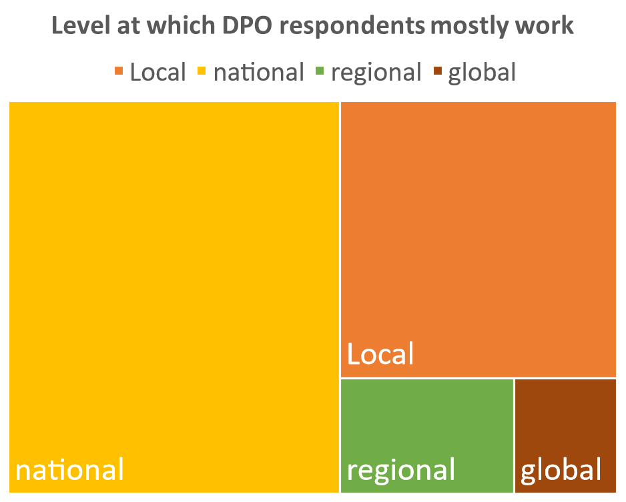
DPO respondents (573)

Slide 7
DPO respondents (573)
Respondent DPOs represented a wide range of constituencies among persons with disabilities

Slide 8
Nature of DPO participation with governments, UN and funding agencies
Overall, respondents indicated higher levels of involvement with government than with UN agencies or programmes and funding agencies
Among UN agencies, respondents are more involved with UNDP, UNICEF, WHO and OHCHR, and identify UNICEF and UNDP as the most inclusive of persons with disabilities.
Among funding agencies, respondents report higher rates of involvement with INGOs focused on disability and government funding agencies

Slide 9
Participation across disability constituencies
Preliminary analysis of the information provided in open-ended questions suggests that some groups are less represented than others in consultations with government, UN and funding agencies.
Persons with visual impairments, physical impairments and hearing impairments are considered to have more access than persons with intellectual disabilities, persons with deafblindness or indigenous persons with disabilities.
“Many groups are not included and are very marginalised, especially women with disabilities, blind people, deafblind, persons with intellectual or psychosocial needs, the elderly with disabilities, independent watchdog groups and individual activists … it is important to include their voices and for the government, international organisations, donors, and mainstream civil society to hear their voices and give them due credibility”
(IDA Global Survey respondent)

Slide 10
Perceived evolution of DPO involvement and influence with decision-makers
As compared to one year ago, respondents perceive that their involvement and influence is improving, which suggests that the global momentum on inclusion of persons with disabilities is somewhat impacting levels of participation of representative organisations

Slide 11
Satisfaction of DPOs with their engagement with decision-makers
However, DPOs are more displeased (45.6%) than pleased (31.0%) with their engagement with the government.
They are overall more pleased (44.7%) than displeased (18.7%) with their engagement with funding agencies

Slide 12
Next steps
Further analyses to produce a consolidated report to serve as baseline.
This will include for example: further association and text analysis of responses to open-ended questions, analysis of barriers and facilitators, disaggregation by disability constituency, region, level (local-global), etc.
Building on the huge learning related to the technical feasibility of a wide-scale, multilingual and accessible online survey reaching out to a wide audience in the disability rights movement for the next iteration of the Survey (consultation tool)

Slide 13
Acknowledgements
The analysis of the data collected through the first IDA Global Survey was done in partnership with the Assistive Living and Learning (ALL) Institute, Maynooth University, Ireland
IDA also wishes to extend their gratitude to the Ministry of Foreign Affairs, Finland and the Department for International Development of the United Kingdom for their financial support to this work.

