Slide 1
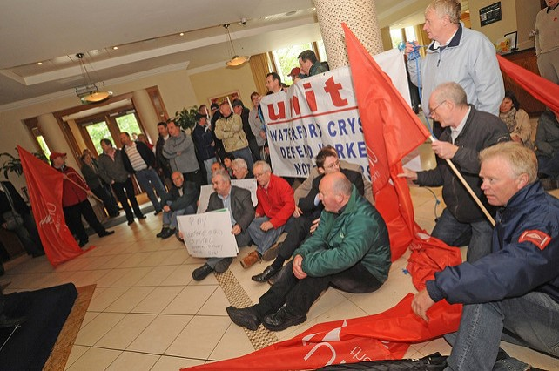
Oral histories of unionisation, community, radicalisation and critique: the case of the trade union movement in Waterford Crystal 1947 - 2009

Slide 2
Oral histories of unionisation, community, radicalisation and critique: the case of the trade union movement in Waterford Crystal 1947 - 2009
This research will use the development of trade unionism in Waterford Crystal as a portal to
examine the worker’s experience of trade unions and trade union activism over the life span of Waterford Crystal.
Unions are social movements and are seen as organisations that represent the collective interests of workers and negotiate with employers and governments to defend and improve the terms and conditions of their members.

Slide 3
Oral histories of unionisation, community, radicalisation and critique: the case of the trade union movement in Waterford Crystal 1947 - 2009
Academic work around the area in question is thin on the ground. Basil Chubb (1973), Emmet O’Connor (1989) and David Convery (2013) all explain that in the Irish context much of history writing leaves out the point of view of the ordinary people.
The aim of the research is to give voice to the ‘ordinary’ and to do this the study will draw on the work of Allesandro Portelli, Studs Terkel, Danilo Dolci amongst others.
Writers, researchers and academics such as these have used oral histories to great effect in placing the ordinary voice on the historic record.

Slide 4
Oral histories of unionisation, community, radicalisation and critique: the case of the trade union movement in Waterford Crystal 1947 - 2009
The proposed project entails examining oral histories of six decades of Trade Unionism at Waterford Crystal, drawing from several cohorts and generations of workers with different experiences of labour and unionisation.
Within this, many narratives emerge, and particular attention will be paid to the experiences of women activists, workers and non-activist union members.
The key theme of this research is how trade unionism was more than just a bargaining organisation: the Union became a centre of community and identity, it created bonds of solidarity within the factory, but also beyond that in solidarity with other workers

Slide 5
Oral histories of unionisation, community, radicalisation and critique: the case of the trade union movement in Waterford Crystal 1947 - 2009
Shared values create a community identity and communities are shaped historically by the daily routines which bring people together and weld working and non-working aspects of daily life into some kind of social and political unity, but as community becomes more complex values change.
In the Gramscian sense the activist cohort within social movements is the driving force of the collective purpose at the heart of the movement.
Following Boltanski’s ‘pragmatic sociology of critique’ the project will examine how the workers and activists conceive the ‘critical moment’ and how did they perceive themselves and their relationship to the wider society.
To what extent did changes in values cause tensions in the glass community in line with the development of the cohorts of activists over the decades
The research will explore the ways and the scope of the workers influence in the development of their community.

Slide 6
Oral histories of unionisation, community, radicalisation and critique: the case of the trade union movement in Waterford Crystal 1947 - 2009
The qualitative methodology will entail the use of 30+ semi-structured interviews allowing the participants discuss the key issues involved.
A judgment sample will be used to decide on the participants. Because of the limited size of the cohort it will be possible to use a high percentage of the activists, in particular, all of the older activists available.
The study will use 3 focus groups to engage with specific issues of gender, equality issues and the non activist view of activism.
The focus groups will be (i) a group of women activists, (ii) a group of non-activist shop-floor workers and (iii) a mixed cross sectional group including craft and general, male and female workers.

Slide 7
Oral histories of unionisation, community, radicalisation and critique: the case of the trade union movement in Waterford Crystal 1947 - 2009
The term `insider research' is used to describe projects where the researcher has a direct involvement or connection with the research setting (Robson 2002).
Such research contrasts with traditional notions of scientifically sound research in which the researcher is an `objective outsider' studying subjects external to his/herself (Denzin and Lincoln 2000).
There are pros and cons attached to the ‘insider’ concept as M. J. Greene (2014) points out.
Greene cites a number of sources including Aguiler (1981), Bell (2005) and Chavez (2008) in outlining the Pros and Cons.

Slide 8
Oral histories of unionisation, community, radicalisation and critique: the case of the trade union movement in Waterford Crystal 1947 - 2009
Knowledge:
Insiders speak the language and understand the geography. They can negotiate the nuances and understand the unspoken signs.
They are part of the culture.
Interaction:
They are familiar and are accepted. Portelli (1991) speaks of being accepted in a community because he did not pass judgement on the ‘narrators’ poverty. Insiders know how to approach individuals in their community.
Access:
Chavez (2008) considers being the ‘insider’ gives ease of access and expediency of access thereby speeding up the process and giving more intimate access to the population.
Too Subjective:
Being too close to the subject may cause a loss of objectivity.
Biased :
Greene cites Van Heugten (2004)… ‘The selection of a topic that clearly reflects a personal interest and the selection of colleagues as subjects raise the spectre of insider ‘bias’…’
Pros
Cons

Slide 9
Oral histories of unionisation, community, radicalisation and critique: the case of the trade union movement in Waterford Crystal 1947 - 2009
Bibliography
Aguiler, J. L. (1981). Insider research: An ethnography of a debate. In D. A. Messerschmidt (Ed.), Anthropologists at home in North America (pp. 15-26). New York, NY:
Cambridge University Press.
Bell, J. (2005). Doing your research project (4th ed.). Maidenhead, England: Open University Press.
Boltanski,Luc. On Critique: A Sociology of Emancipation (translated by Gregory Elliot), Polity Press, Cambridge, 2011,.
Chavez, C. (2008). Conceptualizing from the inside: Advantages, complications, and demands on insider positionality. The Qualitative Report, 13(3), 474-494. Retrieved from http://www.nova.edu/ssss/QR/QR13-3/chavez.pdf
Chubb, Basil. (1974). Review; Irish Historical Studies, Vol. 19, No. 74 (Sep., 1974), pp. 226-227
Convery David. Editor. (2013) Locked Out; A century of Irish Working class Life. Dublin: Irish Academic Press.
Denzin, N. K. & Lincoln, Y. S. 2000. ‘Introduction: The discipline and practice of qualitative research’, in N.K. Denzin & Y.S. Lincoln (eds.), Handbook of qualitative
research, 1-29. Second Edition. California: Sage Publications, Thousand Oaks.
Dolci, Danilo (1966). Poverty in Sicily. Harmondsworth: Penguin Books.
Greene, M. J. (2014). On the inside looking in: Methodological insights and challenges in conducting qualitative insider research. The Qualitative Report,), 1-13. Retrieved from http://www.nova.edu/ssss/QR/QR19/greene15.pdf
O’Connor, Emmet. (1989). The Labour History of Waterford. Naas: Waterford Council of Trade Unions.
Portelli, Allesandro. (1991). The Deathof Luigi Trastulli and other Stories; Form and Meaning in Oral History. Albany: State of New York University Press.
Colin Robson (2002). Real World Research. A Resource for Social Scientists and Practitioner-Researchers (Second Edition). Malden, Mass.: Blackwell,
Van Heugten, K. (2004). Managing insider research: Learning from experience. Qualitative Social Work, 3(2), 203-219.

