Slide 1
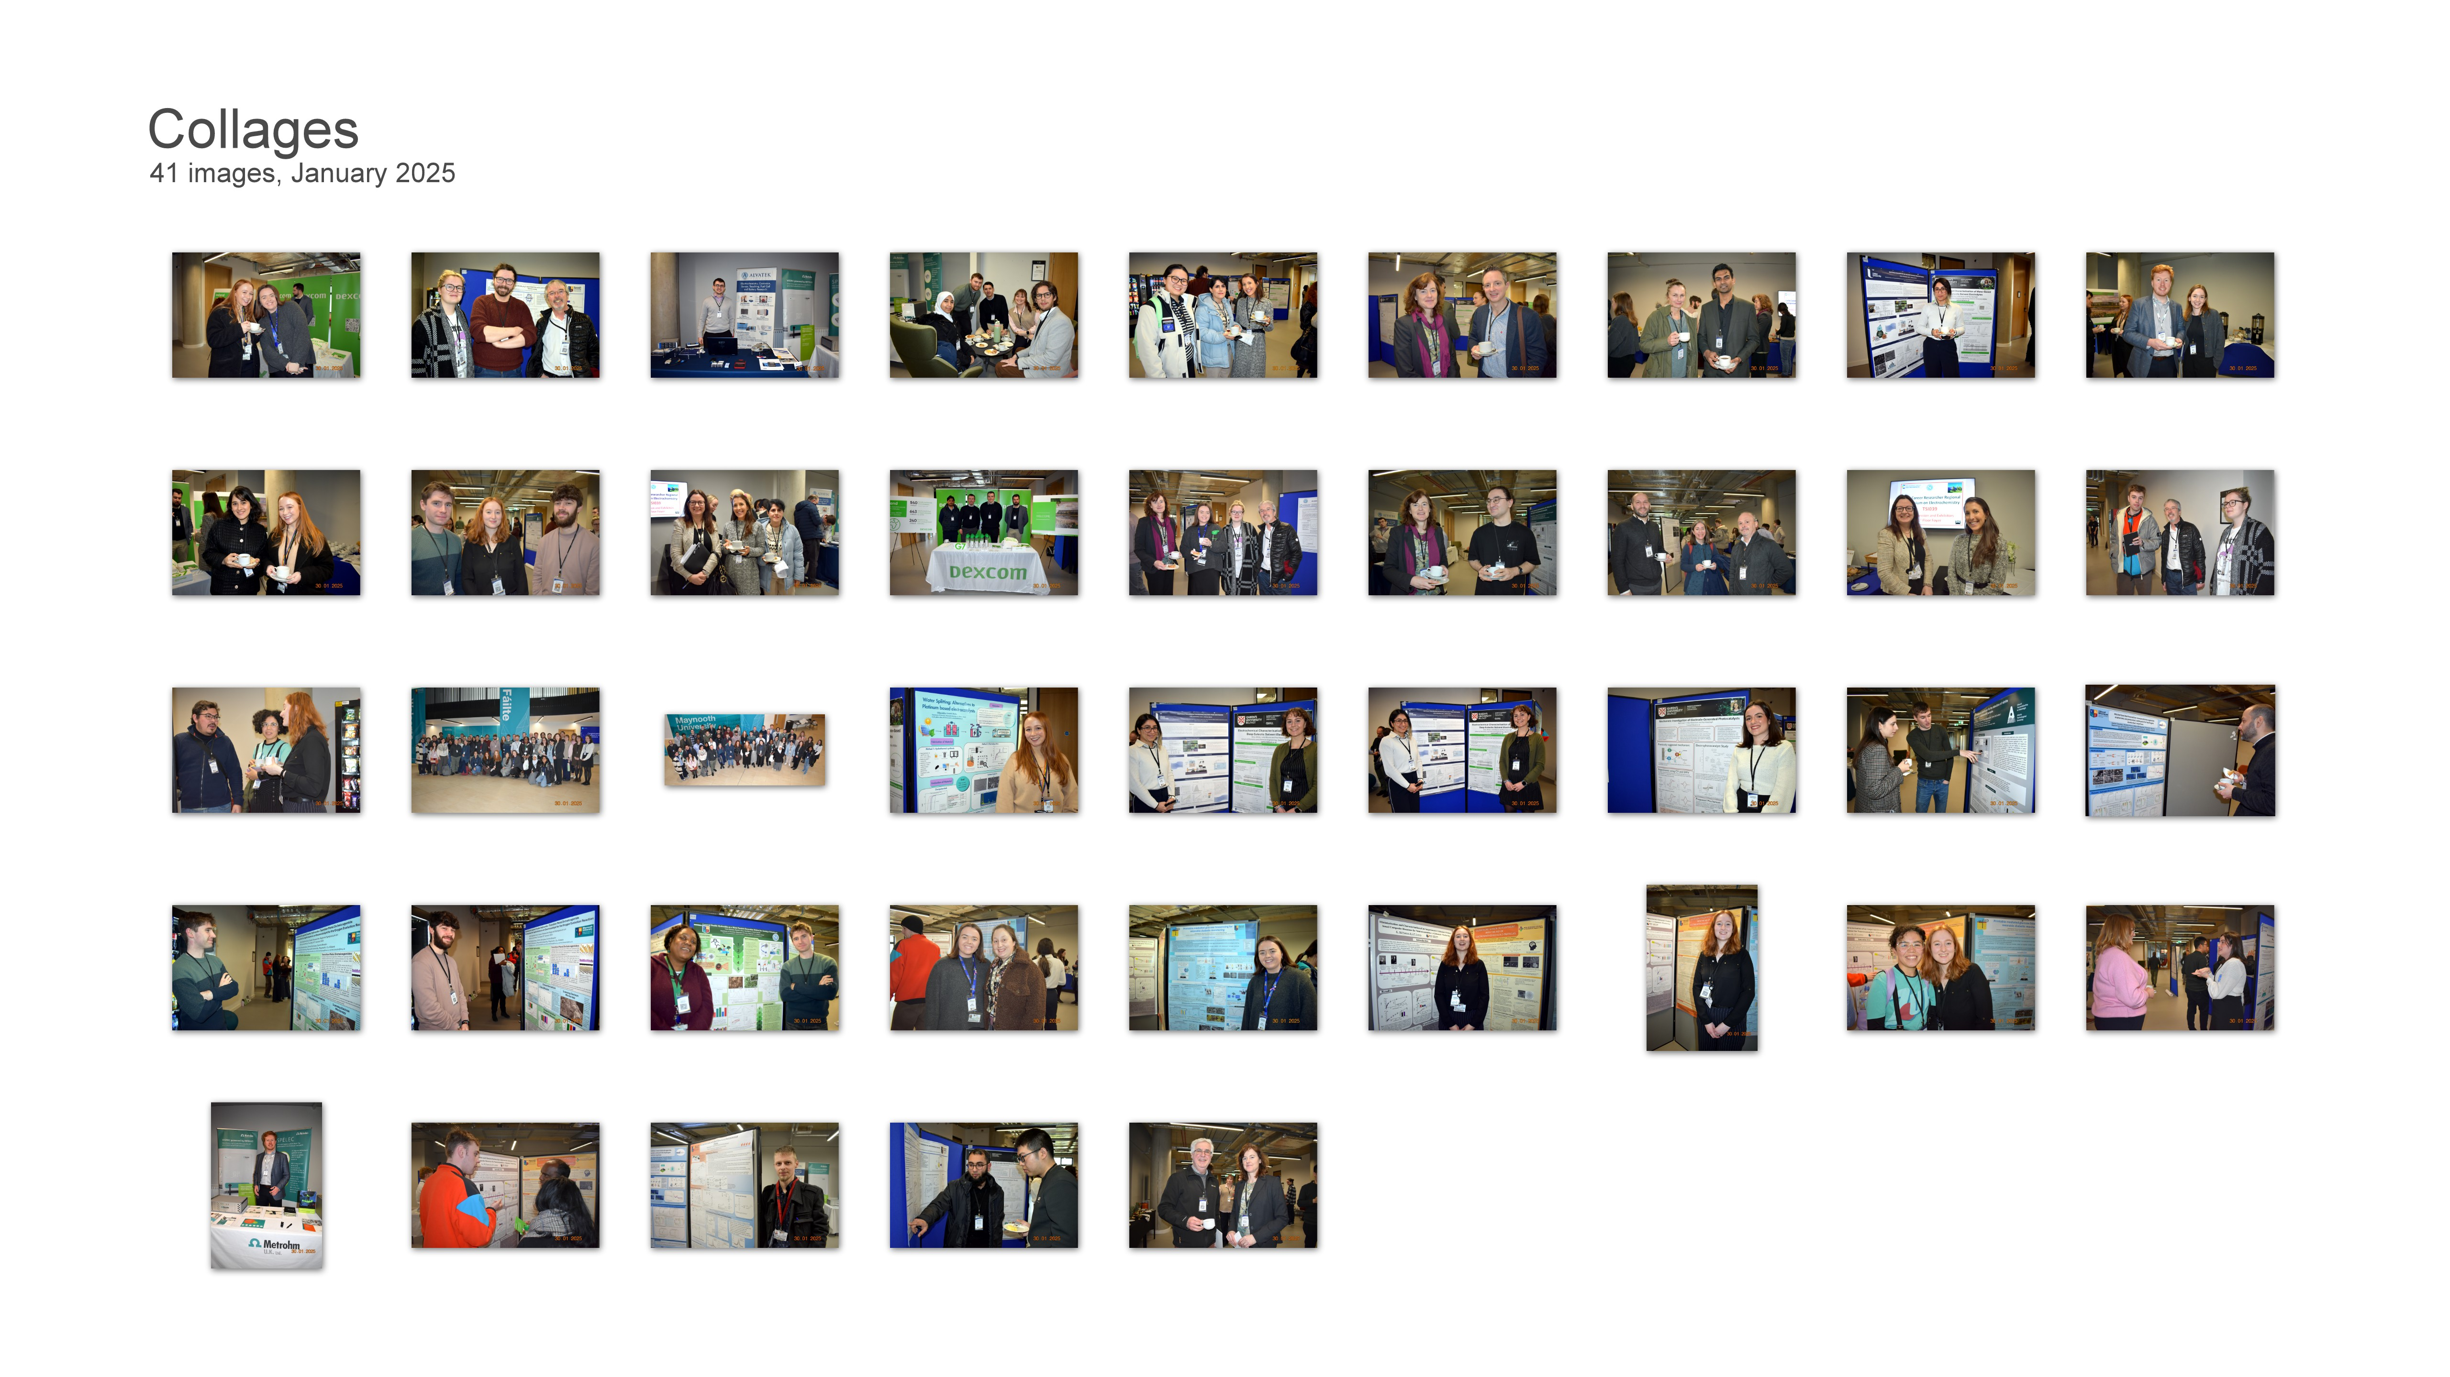
Electrochemistry Symposium Maynooth University 2025

