Slide 1




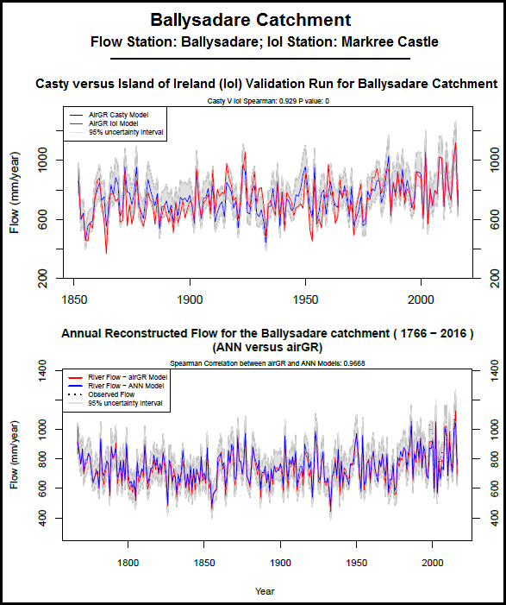
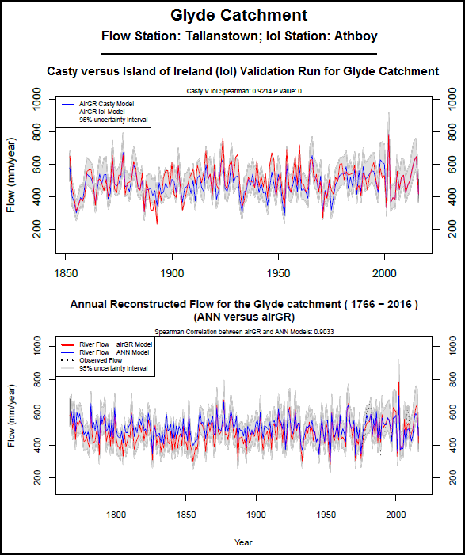
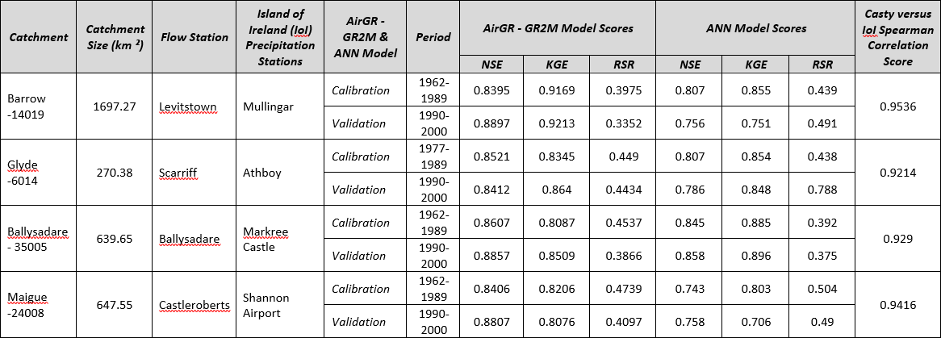
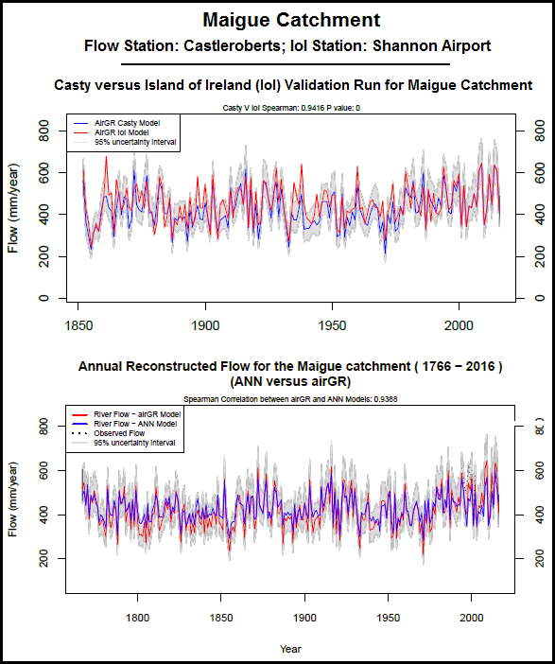
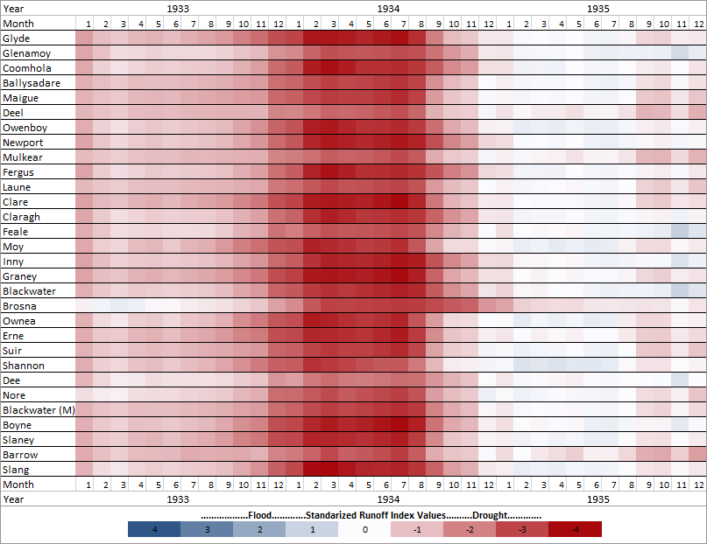
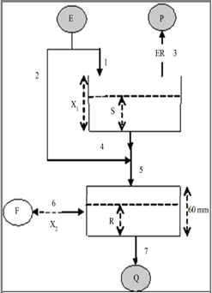
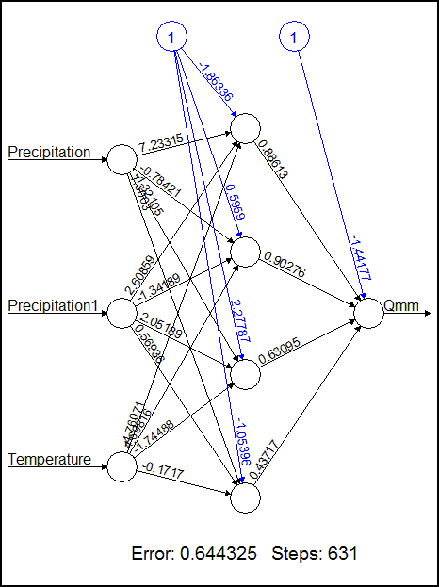
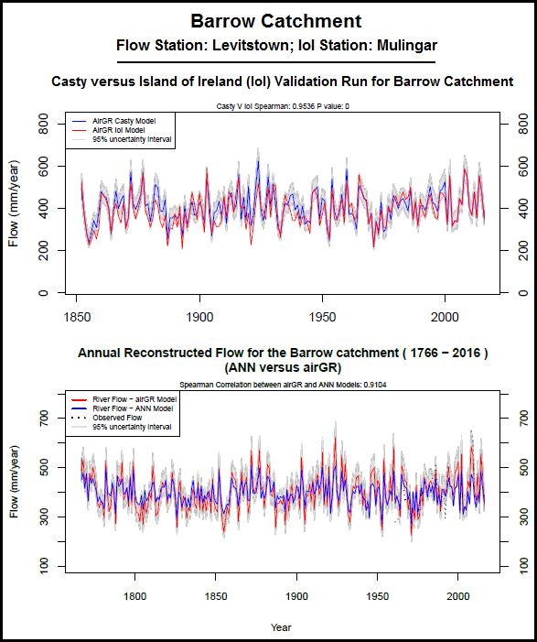
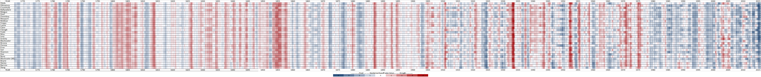
Ensemble Reconstruction of Historic River Flows for the Island of Ireland
Paul O’Connor¹, Conor Murphy¹, Tom Matthews²
¹ Irish Climate Analysis and Research Units, Department of Geography, National University of Ireland, Maynooth, County Kildare, Ireland.
² School of Geography and Environment, Loughborough University, Loughborough, UK.
European Geoscience Union (EGU) General Assembly 2019, Vienna, Austria. 7th – 14th April 2019
Introduction
Long-term river flow data are essential for understanding the risks posed by fluvial flooding and drought events. They assist in providing greater understanding of the drivers of hydrological variability. They also offer a means by which emerging climate signals can be identified. In Ireland long river flow records are lacking with gauged records typically going back 50 years. The lack of long-term river flow records results in a reduced understanding of the hydro-climatological impacts on river catchments on the island. This IRC funded research addresses this knowledge gap by generating probabilistic long term river flows for 30 catchments contained in the Irish Hydrometric Reference Network.
Validation Results
Figure 1 shows a map of Ireland and displays flow plots for four of the thirty sample catchments. The top plot in each case compares the modelled flow generated using the reconstructed (Casty) and observed (IoI) precipitation data series. The bottom plot displays the ANN and AirGR modelled flow for the 1766-2016 time period. Table 1 below shows the correlation scores between the Casty and IoI flows as well as the NSE, KGE and RSR scores of the ANN and AirGR models.
Main Observations:
1). Correlation values between the Casty and IoI
flows indicate good agreement.
2). ANN and AirGR model output shows excellent
agreement with ANN output contained within
the AirGR error bounds.
3). The methodology for reconstructing flow is
robust and has potential to be used in other
catchments across the island and further afield.
Table 1: Catchment details and model efficiency scores of sample catchment runs.
Why do This?
1). Contextualize historical drought events:
  There have been 7 major drought periods in last 165 years (Noone et al. 2017). A methodology is required to identify how such droughts propagate to river flows.
2). Examining past flooding events:
To assess flows for flood rich/poor periods such as those identified by (Harrigan et al. 2015).
3). Understanding impacts of past variability:
Determine the implications of research for planning and management of water resources.
Drought and Flood Assessment
Figure 3 displays a heat map of the drought indices values obtained when the Standardized Runoff Index (SRI) is applied to the 250 year monthly flow series obtained for each of the thirty river catchments. The specific time periods when both drought and flood events occur can be easily pulled out and analyzed as demonstrated in figure 4.
Main Observations:
1). Considerable periods of drought are identifiable
in the 250 year time series.
2). The 1933-34 drought is the most intense event.
3). The recent history of high flow, flooding events
is not representative of the long term pattern.
4). Catchments respond differently to both drought
and flood events.
5). Long term droughts of over 5 years are apparent
in the early record (real or data biases?)
Datasets and Models
1). Casty data (Casty et al. 2005a):
Monthly gridded (0.5°x 0.5°) surface temperature & precipitation (from 1766).
Values are generated by principle component regression of a spatial network of station data against reanalysis data which is independent (no common predictors between series).
2). Island of Ireland data (Noone et al. 2016):
Homogenized Island of Ireland (IoI) precipitation network for 25 stations across Ireland (1850-2010) with bridging of stations to complete series.
3). AirGR GR2M:
GR2M monthly model with two parameters.
GLUE methodology employed to account for uncertainty.
20,000 parameter sets generated with top 100 sets used
based on KGE, NSE and RSR scores.
4). ANN Model:
Neural network model with temperature, precipitation and precipitation from proceeding month as inputs, one hidden layer with four neurons and one output (flow).
Figure 4: Example plot showing monthly SRI values for 30 catchments during the 1933-1934 historic drought event.
Figure 2: Diagrams of AirGR GR2M and ANN Model structure
Conclusions
The methodology presented in this poster provides a simple and robust means for generating historic river flow values. Validation of the Casty dataset against known observed values has been carried out using the Island of Ireland series, with modelled flow values showing good agreement between both data sources. Results suggest that the method is transferable to other regions of Europe and will perform just as well once observed data is available for the catchment of interest. Future work will entail employing the methodology to generate daily river flow data from 1900 to date.
Methodology
1). Extract monthly precipitation and temperature values for the catchment using Casty gridded dataset.
2). Bias correct precipitation and temperature values against observed and then apply Oudin technique on temperature values to determine potential evapo-transpiration (PET).
3). Calibrate and validate ANN and AirGR Flow models and then generate river flow values for the chosen catchments (1766-2016).
4). Validate process by repeating the steps above replacing Casty precipitation data with the Island of Ireland (IoI) observed station data and compare the output with Casty reconstructs.
5). Apply standardized indices to Casty flow dataset to assess for drought and flood rich periods.
References
Casty, C., Handorf, D. and Sempf, M., 2005. Combined winter climate regimes over the North Atlantic/European sector 1766–2000. Geophysical research letters, 32(13)
Harrigan, S., Murphy, C. and Wilby, R.L., 2015, April. Development of a flood index for Ireland. In EGU General Assembly Conference Abstracts (Vol. 17)
Noone, S., Murphy, C., Coll, J., Matthews, T., Mullan, D., Wilby, R.L. and Walsh, S., 2016. Homogenization and analysis of an expanded long‐term monthly rainfall network for the Island of Ireland (1850–2010). International Journal of Climatology, 36(8), pp.2837-2853.
Noone, S., Broderick, C., Duffy, C., Matthews, T., Wilby, R.L. and Murphy, C., 2017. A 250‐year drought catalogue for the island of Ireland (1765-2015). International Journal of Climatology, 37(S1), pp.239-254.
Figure 1: Map showing the 30 catchments investigated in this study together with four sample dual plots were reconstructed flow data has been analysed in more detail for validation purposes.
Figure 3: Colour plot of monthly Standardised Runoff Index (SRI) values for the 1767 to 2016 time period for the 30 catchments (listed on y-axis) which were investigated as part of this study.

