Slide 1
Future Funding of Higher Education: The Policy Framework for Higher Education and Implications for Access
Delma Byrne
Maynooth University, Ireland
Paper prepared for Higher Education Conference, 30th Sep 2015

Slide 2
Access
Two key policy instruments
  Entry schemes (HEAR, DARE, Mature Student Route) and reduction in LC points
  Grant system (financial aid)
What measures are necessary to further advance the access to higher education of less represented social groups? (Expert Group, Discussion Paper, Jan 2015)

Slide 3
Alternative Entry Routes to Higher Education
Strong and increasing demand for the schemes
  88% of mainstream second level schools had submitted applications to HEAR in 2012.
  78% of mainstream second level schools had submitted applications to DARE in 2012.
Under-representation in accessing the schemes
Vocational schools in applications to the HEAR scheme,
DEIS schools in applications to the DARE scheme (Byrne et al., 2013)
Byrne, D., Doris, A., Sweetman, O., Casey, R., and Raffe, D. 2013. https://www.researchgate.net/publication/281066622_An_Evaluation_of_the_HEAR_and_DARE_Supplementary_Admission_Routes_to_Higher_Education

Slide 4
Alternative Entry Routes to Higher Education
Limited effective use of the reduced points mechanism offered by the HEAR and DARE schemes on the part of HEIs.
The total number of students accessing higher education via reduced point mechanism has increased between 2010 and 2012,
  HEAR reduced point applicants accounted for just 44% of HEAR eligible entrants in 2010 and 33% in 2012.
  DARE reduced point applicants accounted for just 45% of DARE eligible applicants in 2010 and 36% in 2012. (Byrne et al., 2013)
Byrne, D., Doris, A., Sweetman, O., Casey, R., and Raffe, D. 2013. https://www.researchgate.net/publication/281066622_An_Evaluation_of_the_HEAR_and_DARE_Supplementary_Admission_Routes_to_Higher_Education
Notes:
In 2010 In 2010, HEAR eligible applicants represented almost 5% of new entrants in higher education and DARE eligible applicants represented almost 2% of new entrants in higher education in that year, contributing to the realisation of national targets.

Slide 5
Grant
Free Fees introduced in 1995/96
  Standard Registration charge to cover costs of examination, provision of student services €190
  2011/12 Student Contribution Charge €2,000
  2015/16 Student Contribution Charge €3,000
Notes:
The theoretical basis for the provision of the system of government financial aid is to ensure that students whose decisions are most affected by tight family finances receive the most aid. The state financial aid system is restricted to a grant system in the Irish context, but such financial aid is widely understood to be insufficient for various reasons. The cost of college attendance has risen substantially over the past few years through the student contribution charge which has increased to 3,000 in the current academic year. When the registration fees were introduced in 1994, shortly before Ireland became a free-fee country, the fee was €190 per academic year, the current amount payable is €3,000, representing a 1500% increase in twenty years.

Slide 6
Means Tested Grant System
Student support funding, otherwise known as student grants, is made up of two components—a maintenance element and a grant to cover the student contribution charge.
The level of grant available depends on the means of the student’s family.
Rates of grant support: Special rate, 100%, 75%, 50% and 25% and of course 0%

Slide 7
Financial barrier to applying to go to college (McCoy, Byrne et al., 2010)
90% and 86% of those from professional and farming backgrounds respectively applied to the CAO in 2004/05, this was true for just approximately 66% of those from other non manual, skilled manual and unskilled manual groups.
Non-application was predominately driven by perceptions of HE as being ‘not for me’, or alternatively, the pull of working and earning or low academic self-image and low performance expectations, 15% indicated issues relating to lack of affordability
McCoy, S., Byrne, D., O’Connell, P.J., Kelly, E. and Doherty, C. (2010) Hidden Disadvantage? A Study of the Low Participation in Higher Education by the Non Manual Group, Dublin: Higher Education Authority

Slide 8
Financial barrier to applying to go to college (McCoy, Byrne et al., 2010)
Financial concerns surface for all groups, either in the sense of a priority to secure earnings or concern over being able to afford to attend higher education.
When it comes to accepting a CAO offer, the intermediate non-manual group and the skilled/unskilled manual groups financial concerns were at the fore, suggesting that this group are more likely to seriously consider HE but fall at the final hurdle owing to financial pressures or ineligibility for state financial support.
McCoy, S., Byrne, D., O’Connell, P.J., Kelly, E. and Doherty, C. (2010) Hidden Disadvantage? A Study of the Low Participation in Higher Education by the Non Manual Group, Dublin: Higher Education Authority

Slide 9
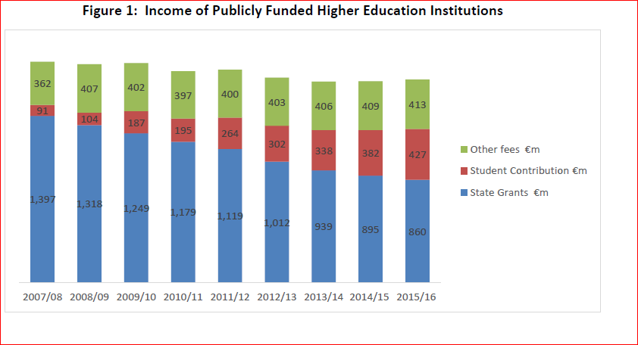
The Overall Level of Funding of Public HEIs has declined since 2007/08
Expert Group on Future Funding for Higher Education: The Role, Value and Scale of Higher Education in Ireland

Slide 10
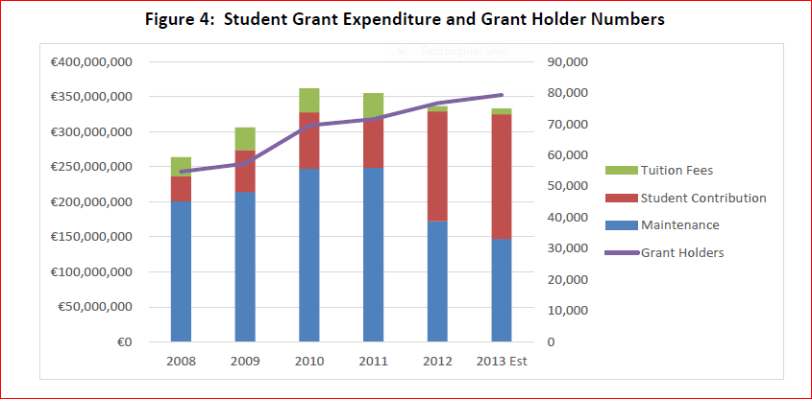
Proportion of students requiring HE grant support to pay the increased fee rose from 37% in 2008 to 51% in 2013
Expert Group on Future Funding for Higher Education: The Role, Value and Scale of Higher Education in Ireland

Slide 11
Considerable Legacy Issues…Prior to mid 2000’s the grant system had been covering fewer students, and grant levels covering only part of the costs
% of full-time students in receipt of a grant fell by nearly a third between 1992 and 2004, a period which saw a growth in participation of students from lower socio-economic backgrounds in Higher Education (McCoy et al., 2009)
the higher education maintenance grant – had increased only marginally in real (as opposed to nominal) terms between 1973 and 2006 when inflation adjustment is taken into account (see McCoy et al., 2009).
Decline in grant receipt was greatest among the non manual group- only group to experience a decline in participation rates.

Slide 12
Reduction in Grant Levels (Special rate and 100% rates)

Slide 13
Costs of Attending HE: Monthly Expenditure (Eurostudent Survey, taken from HEA 2014)
Expenditure Item | Living with Parents | Not Living with Parents | All Students
Accommodation | 107 | 443 | 334
Food | 125 | 202 | 177
Transportation | 110 | 94 | 99
Communication | 28 | 35 | 33
Health Costs | 15 | 19 | 18
Childcare | 3 | 16 | 12
Debt Payment (except mortgage) | 22 | 39 | 34
Social and Leisure activities | 69 | 72 | 71
Other regular living costs | 55 | 71 | 66
Total | 535 | 992 | 843

Slide 14
Student Perspectives
39% of students estimated that their family household gross annual income was less than the average industrial wage, approximately €35,000 (Eurostudent survey 2013)
The level of financial difficulty increases in line with lower income levels. Overall approximately 18% of students indicated that they are in serious financial difficulty.
  25% for students from families whose household family income is between 20,000-35,0000,
  36% for students whose household income is less than 20,000 per year.
  A clear social gradient was also evident between social class and the extent to which students feel they have sufficient funds to cover monthly costs, with students from the manual social classes indicating a higher level of difficulty than those from the non-manual or professional groups.

Slide 15
Purchasing Power
the ‘purchasing power’ or ‘bang for your buck’ that the grant offers is likely to have declined, as the costs of attending college rise and grant levels fall.
  Using Eurostudent survey: estimates of the costs of attending college, against means-tested income thresholds for grant receipt

Slide 16
% of college costs that are covered by the grant
Byrne, D., and Byrne, J.P.

Slide 17
Implication of limited purchasing power…
‘At the same time that the purchasing power of financial student support is limited, real family income has eroded for many families living in Ireland. We suggest that a college education may be increasingly out of financial reach for low income families given that the special rate maintenance grant covers just 27% of the costs for those who live within the 45km threshold distance between parental home and college, but who do not live with their parents (and even less for all those at lower maintenance level thresholds). This trend is not unique to Ireland. In the American context, research suggests that the leading needs-based aid programme, the Pell Grant, has diminished substantially over time from covering almost 80% of the costs of going to college in the early 1970s to barely 30% more recently (Goldrick Rab and Kendall 2014)’
Taken from Byrne and Byrne, working draft in progress
Byrne, D. and Byrne, J.P

Slide 18
% of Annual Household Income that needs to be used/borrowed to pay for every year of college
Byrne, D., and Byrne, J.P.
Notes:
Using the household income thresholds for each of the grant levels, we can estimate the share of household income that is required to cover the outstanding costs of higher education per year. In order to attend college and meet the remaining costs of college attendance, families must borrow or spend an average of 13% of household income per year

Slide 19
% of Annual Household Income that needs to be used/borrowed to pay for every year of college
Byrne, D., and Byrne, J.P.
Notes:
However, we also find that low-income families that experience the greatest economic hardship (i.e. those who are eligible for the special rate) must borrow or spend up to 29 per cent of their annual income to attend one year of higher education, particularly those classified as ‘adjacent, not living with parents’. For those at all other maintenance grant rates they must spend/borrow up to 19% of their annual income per year to meet the costs of attending higher education.
Cullinan et al., (2013) found that while travel distance does not emerge as significant in influencing higher education participation on average, geographic accessibility is significant in the higher education entry rates of school leavers from lower social classes, particularly among those who perform less well in the Leaving Certificate examination.

Slide 20
Implications for the experience of being a student
Irish and international research indicates that inadequate finances to cover the costs of higher education is likely to impinge substantially on the higher education experience, with the result that there is pressure on students (both with and without a grant) to work part-time and borrow money from family members. This need to work part time affects participation and educational outcomes as the student struggles with the multiple demands on his or her time (Lynch and O’Riordan 1998; Darmody and Smyth 2008). As a result, a decreasing proportion of students are gaining the skills and knowledge and experience that the higher education experience can offer.
Lynch, K and C. O'Riordan; (1998) Inequality in Higher Education: A Study of Class Barriers. British Journal of Sociology of Education, 19 (4):445-478
Darmody, M., and Smyth (2008) ‘Full-time students? Term-time employment among Higher Education Students in Ireland’, Journal of Education and Work, 21(4): 349-362
,

Slide 21
Student Contribution should not be subsidising capital expenditure needs !
‘Research in the US indicates that the quality of students’ experiences on campuses is being compromised by incentives that institutions face to cater to wealthy students. Absent the ability to charge tuition and fees, institutions will be hard pressed to do this. This change may have positive ripple effects for all: studies have found that all students’ success is enhanced when schools focus on creating community rather than dividing students according to what they can afford,’ from Goldrick-Rab and Kendall, 2014
Goldrick-Rab, S., and Kendall, N. (2014) Redefining College Affordability: Securing America’s Future with a Free Two Year College Option
http://www.luminafoundation.org/files/publications/ideas_summit/Redefining_College_Affordability.pdf

Slide 22
Conclusion
2 key policy instruments that seek to facilitate access are clearly compromised
  Alternative entry routes
  Affordability
  These should be key considerations in any discussion about student contribution

