Slide 1

#BeSeptemberReady
Exams, Progression and Transfer from Y1 BA/BCL
Professor Fergus Ryan
Head of the School of Law and Criminology
April 2025
law@mu.ie

Slide 2

Purpose of this talk
General advice on approaching the final exams and assessments in year 1
Advice if things don’t work out as planned
Discussion of how progression works (how do I get to year 2)
Discussion of how transfer works (how to transfer to the LLB or BCL)

Slide 3

Don’t panic!
First year is a big adjustment – we realise this! We were once first years too!
It’s particularly challenging given that these are anxious times
Sometimes anxiety freezes us into inaction
A good start is half the work – rip off the bandage!
Better to try and not succeed than not to try at all.
A submitted essay is better than no essay

Slide 4
Failure and success
“It’s not what happens to us in life, it’s what we do about it that is the true measure of success. How we fail and how we recover says much about the character of our achievements.”
“It’s okay to miss the bed on the first jump…It’s okay to try another route. It is not okay to lose sight of the top of the bed and surrender our goal.”

Slide 5
Plan B – try another route
If things are going awry and you know you won’t make a deadline
  Talk to your lecturer
  Ask for an extension – give reasons for seeking the extension and be ready to provide evidence
  Consider delaying completion of the module until the Summer re-sits/supplementals
  But don’t put everything off – try to get some work done/out of the way

Slide 6
Tips for Assessments and Exams –
Clarity of mind and focus
Don’t run yourself into the ground - get plenty of breaks and exercise.
Get plenty of sleep.
Reduce or eliminate alcohol, caffeine
Remove or switch off distractions
Plan and schedule – make sure you know what is due when
Don’t get bamboozled by the quantity of work you have to do across all modules.
If studying a specific topic, give that topic your focus. Ignore all else for that period of time.

Slide 7

Pomodoro Technique
Pomodoro technique – study for 25 minutes, focusing on a specific issue, followed by a 5-minute break.
Study for another 25 minutes, followed by another break (maybe taking longer breaks as you go along)

Slide 8
Studying and preparation
Check for the deadlines/dates of assessments
Read the instructions carefully. Make sure you are doing what you are being asked to do
Read before writing – class notes, recommended readings, textbooks, articles
Do a search on databases (e.g. Westlaw, SSRN, VLexJustis) for relevant journal articles, cases, legislation
In law, remember you will almost always need to cite cases and (if relevant) refer to legislation

Slide 9
Technique in writing
Write in short sentences – keep it simple and clear
No need to swallow a dictionary – small words work as well as big ones.
If you use a word, make sure you know what it means
Include cases – the facts (briefly), decision and reasons for the decision (the last of these being the most important)
Make sure to reference (acknowledge your sources)
Write as much as possible in your own words, but write formally
If you state an opinion, make sure to back it up with argument
Give yourself time to edit and proof-read

Slide 10
Progression and transfer – what we mean
To progress means to get out of one year and successfully progress to the next year of a programme of study e.g. to progress from year 1 to year 2 of the BCL
The basic rule is that to progress from year 1 to year 2, ordinarily you must pass ALL modules in year 1, i.e. 60 credits.
Transfer means to change programme e.g. from year 1 of the BA to year 2 of the BCL or year 2 of the LLB

Slide 11
Progression (passing year 1 and getting into year 2)
To progress, ordinarily you must pass 60 credits from year 1, i.e. pass all your year 1 modules
The pass mark is 40% for each module

Slide 12

Exceptions
There are some exceptions:
  The pass by compensation rule: you can pass by compensation and therefore progress if (a) you pass at least half your credits AND (b) you get no less than 35% in every module AND (c) you get an average of 40% or higher overall for the year
  Allowed progression/carrying a deficit (exceptionally rare for law/criminology): You may be able to carry a deficit in modules other than law/criminology modules. You may also be allowed to carry a deficit in law or criminology modules if you drop law/criminology and progress with other subjects in year 2 – but you cannot carry more than 10 unpassed credits

Slide 13
Carrying a deficit
Every year in September, a small number of students learn to their surprise that they cannot progress to year 2 and must repeat incomplete modules from year 1.
They often wrongly assume that they can carry the incomplete modules into year 2 but, often, they cannot do so.
First, it is never possible to progress into year 2 having failed more than 10 credits in year 1 (including in re-sits)
Second, you cannot carry a deficit in an LW module (law or criminology) if you are progressing in law/criminology or transferring to the BCL or LLB.

Slide 14
What if I don’t pass my January or May assessments? THE SUPPLEMENTALS!
A student who does not pass a module in January or May may take supplemental assessments (’re-sits’) in that module (sometimes called re-sits) in July and August
There is ordinarily a fee for doing so.
There is no cap on your mark if you re-sit
For Law and Criminology, you carry forward any assessment you have already passed – you only have to re-sit the elements/components that you did not pass already
You still have the same transfer and progression options if you pass the year during the supplementals
Repeating a module you have already passed – generally not possible in year 1.

Slide 15

The ‘big red hand’ point
If you are taking any supplemental assessment, you must, must, must register with the Exams Office in late June/early July for re-sits/supplementals
If you do not register, your re-sit mark will not be recorded by the Exams Office, even if we correct your paper.
This applies even if you are just re-sitting an assignment, MCQ, or part of continuous assessment. Even if the –re-sit does not include an exam, you must register to re-sit.

Slide 16
What about my award/degree classification?
There are different classifications or grades:
  1st class honours: 69.1% and higher
  2nd class, upper division (2:1): 59.1% - 69.0%
  2nd class, lower division (2:2): 49.1% - 59.0%
  Pass 40-49.0%
Your award mark for your degree is calculated as follows:
1st year and Erasmus/study abroad/placement years do not count towards your degree award mark
On the BA/BCL, year 2 contributes 30% of your award mark and the final year contributes 70%
On the LLB, year 2 contributes 10% of your award mark, year 3 = 20%, and the final year contributes 70%
If you take an Erasmus year or placement in year 3 of the LLB, year 2 = 10% and year 4 = 90%

Slide 17
Erasmus/study abroad and work placements
General principles
  Erasmus involves a year abroad within the EU. Study Abroad involves a year abroad outside the EU e.g. Australia, Canada, US
  For most students, an Erasmus/study abroad year is optional (the exception being where you are studying a foreign language)
  Erasmus/Study Abroad/Work Placements are for one academic year
  Unless you are taking a language as part of your degree, Erasmus/Study Abroad options are usually available entirely through English in the host country
  Entry is competitive; there is no guarantee you will be offered an Erasmus/Study Abroad place or a work placement

Slide 18
Erasmus/study abroad and placements
On the LLB:
  You can apply in year 2 to take a placement or study abroad/Erasmus year in year 3 of your degree. Study abroad/Erasmus must be in law.
  The year is integrated, i.e. part of your degree and you must pass 60 credits to progress to year 4
  The Erasmus/year abroad/placement mark does not count towards your degree award mark
  If you pass your degree having successfully completed the placement you get an LLB (Clinical)
  If you pass your degree having successfully completed the year abroad/Erasmus year you get an LLB (International)
On the BCL/BA:
  You can apply in year 2 to take a placement or study abroad/Erasmus year between years 2 and 3 of your degree. Study abroad/Erasmus need not be in law.
  The year is not integrated, i.e. you can still get a BCL even if you fail the year. To pass the year, you must pass at least 45 credits
  The Erasmus/year abroad/placement mark does not count towards your degree award mark
  If you pass your degree having successfully completed the placement you get a BCL(Clinical)
  If you pass your degree having successfully completed the year abroad/Erasmus year you get a BCL (International)

Slide 19
Lots of different options
Bachelor of Laws
Law on its own
LLB - MH501
4 years
BCL Law and Business
BCL Law and Accounting
MH502
3 years
Law or Criminology as part of an Arts degree
BA - MH101
3 years
BCL Law and Arts
MH502
3 years
BCL Law and Criminology
MH502
3 years
From 2025:
BA Criminology
Single Major
MH504
BCL Law and Languages
MH503
4 years

Slide 20
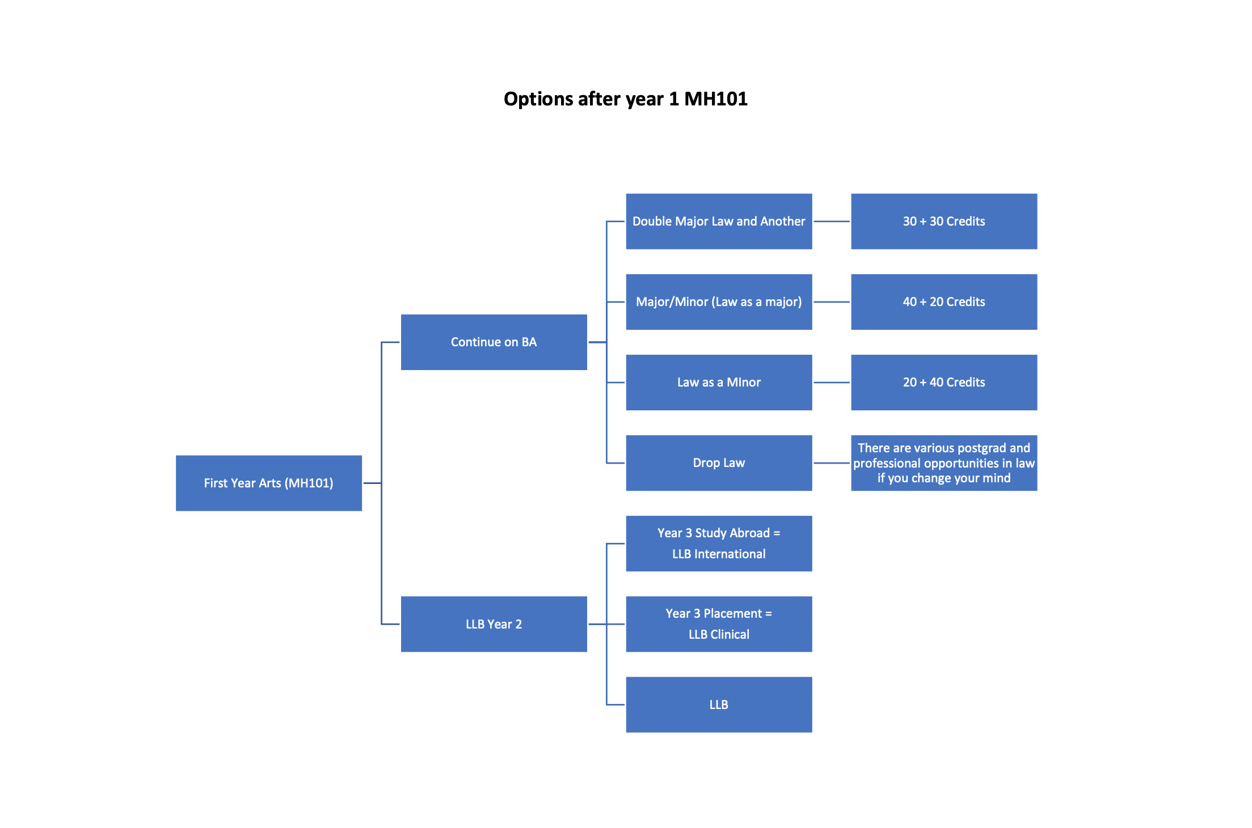

Slide 21
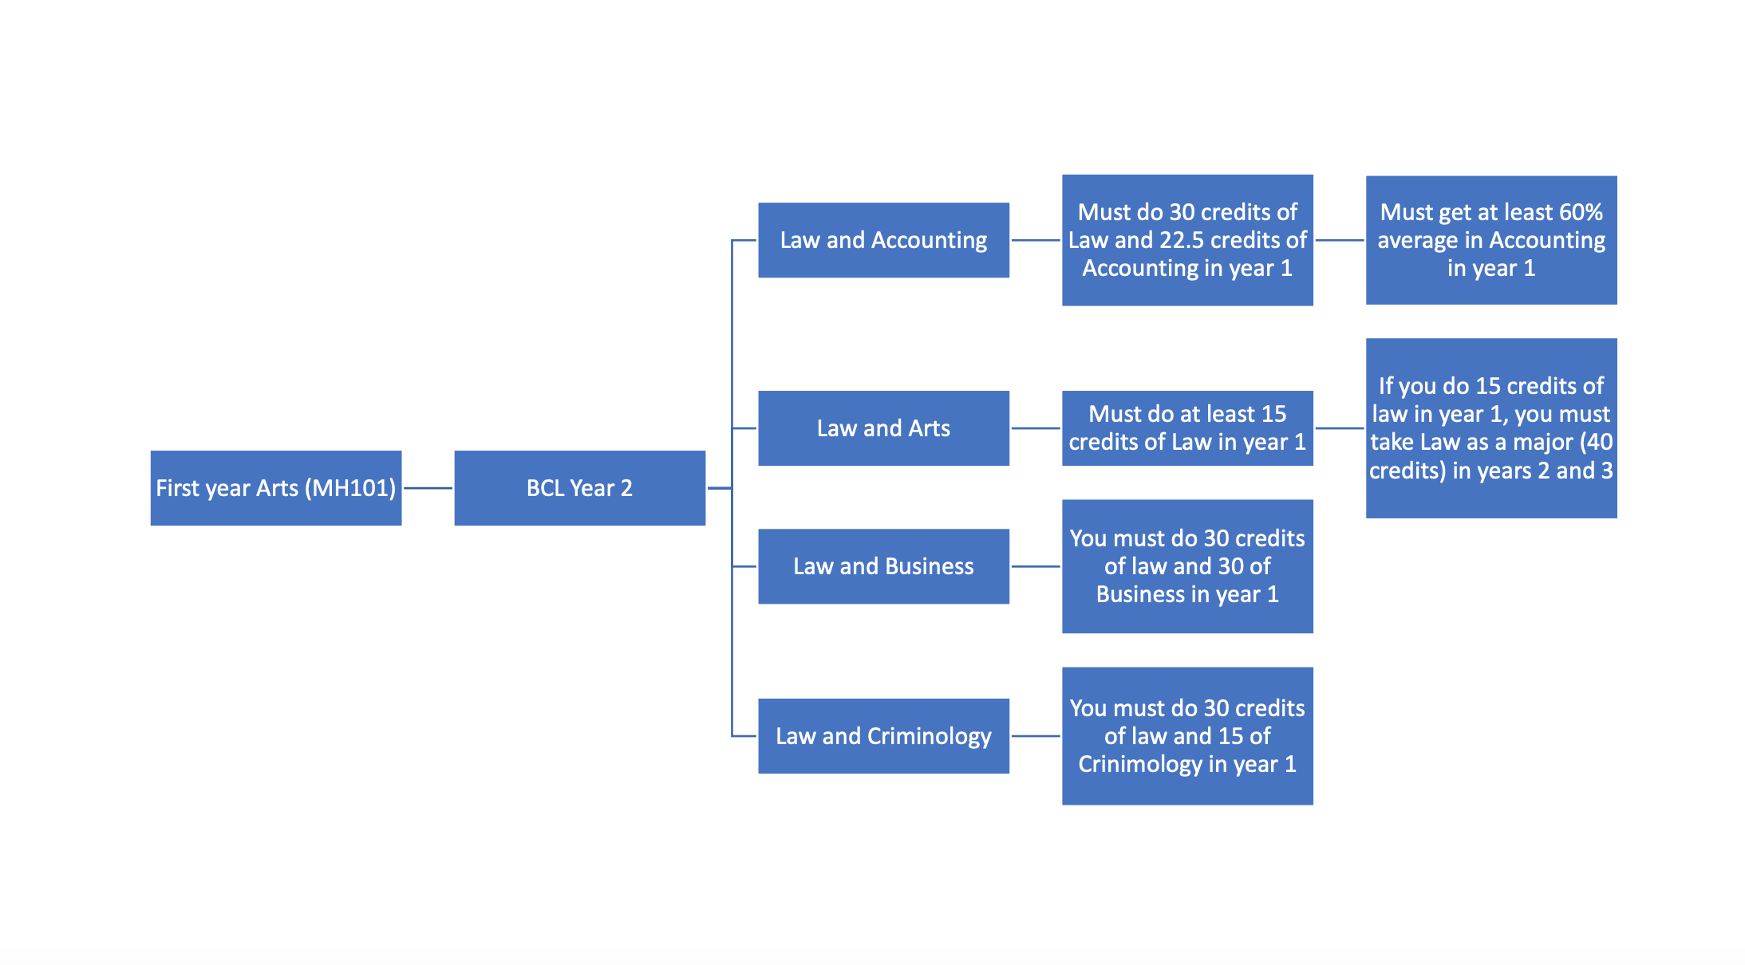
This has changed. You are now recommended to take 30 credits of Accounting in year 1.
NB: If you have taken Law with Irish, French, German or Spanish in year 1 and you are interested in transferring to the BCL Law and Languages, please contact us directly to discuss.
NB. It is also possible to transfer to BCL Law and Crim with 15 credits of Law and 15 credits of Crim but you must take Law as a major in years 2 and 3.

Slide 22

Summary
Year 1 BA
Year 1 BCL
Year 2 BA (law minor or drop law)
Year 2 BCL
Year 2 LLB
Transfer options/requirements:
From year 1 of the BA (MH101) or BCL (MH502) to year 2 of the LLB (MH501)
From year 1 of the BA (MH101) to year 2 of the BCL Law and Arts/Criminology (15 and 30 credit routes)
From year 1 of the BA into year 2 BCL Law and Accounting, BCL Law and Business, BCL Law and Criminology or BCL Law and Languages (special conditions apply in relation to your year 1 modules)
From the BCL to the BA or LLB
From the St Patrick’s College BA in Theology and Arts to the BCL/LLB (but special requirements apply to such a transfer – see below)

Slide 23
Some core principles and points
You cannot progress in or transfer to a subject in year 1 if you did not take at least 15 credits of that subject in year 1
  E.g. if you take only Law, Irish and Critical Skills in year 1, you cannot take e.g. Psychological Studies or French as a brand new subject in year 2
There are no caps on transfers. There is no limit on the number of students who may transfer from year 1 BA to the BCL or LLB.
In most cases* you do not need to formally apply for a transfer. If you are eligible/meet the requirements, you will be offered the opportunity to transfer at registration in September
*The main exception is if you are transferring from St. Patrick’s Maynooth – you must formally apply to the Admissions Office in MU by mid-July at the latest. The same applies to external transfers (transferring from outside MU). Please contact Admissions if you want to transfer from the BCL to the BA.

Slide 24

Transferring from the MU BA MH101 to the LLB MH501
To transfer to year 2 of the LLB (Bachelor of Laws), students must :
1. Take at least 15 credits of law in year 1 and pass all their law modules
AND
2. Maintain an average of 40% across all year 1 Law modules
AND
3. Pass all other first year subjects (there are some very limited exceptions where you may be allowed to ‘carry a deficit’ into year 2)
N.B. The LLB is 4 years in total, as opposed to the BCL programmes, which are 3 year programmes.

Slide 25
Transferring from year 1 MU Arts into year 2 BCL MH502 – 30 credit routes
Students in Arts (MH101) who complete 30 credits of Law in year 1 and pass year 1 also have the option of transferring into year 2 of the:
BCL Law and Accounting
BCL Law and Arts
BCL Law and Business
BCL Law and Criminology
BCL Law and Languages
if they successfully complete first year (and complete the requirements of Accounting, Business, Criminology and, for MH503,of the relevant language)

Slide 26
Transferring from year 1 MU Arts into year 2 BCL Law and Accounting
Students who wish to transfer into year two of the BCL (Law and Accounting) must:
Pass 30 credits of Law in year 1 AND
(a) Achieve an average of 60% in 30 credits of Accounting in year 1 OR
OR (b) Achieve an average of 60% in 22.5 credits of Accounting in year 1, namely AC151, AC152 and AC160

Slide 27
Transferring to year 2 BCL Law and Business/
Criminology
To transfer into year 2 of BCL (Law and Business), students must take 30 credits of Law and 30 credits of Business (either stream of Business) in first year. The 30 ECTS Business subject can be MN1MV30, MN1KV30 or MN1IV30, and includes four modules: MN155, AC151, EC101M and one of MN151/MN152/MN159.
To transfer into year 2 of BCL (Law and Criminology), students must take at least 15 credits of Law and 15 credits of Criminology in first year (and up to 30 credits of any other subject(s)).

Slide 28
Transferring to year 2 BCL Law and Languages
To transfer into year 2 of BCL (Law and Languages), students must take 30 credits of Law and at least 15 credits of the relevant language (Irish, French, German or Spanish) in first year.
There may be additional requirements imposed by the relevant language School. To discuss further, please contact the relevant language School – smllc@mu.ie for French, German and Spanish and nua.ghaeilge@mu.ie for Irish.

Slide 29
Transferring from year 1 Arts into year 2 BCL – 15 credit routes (i.e. if you did fewer than 30 credits of law in year 1)
Arts (MH101) students who complete at least 15 ECTS of Law in first year may transfer into the BCL (Law and Arts) or the BCL (Law and Criminology) or the LLB.
Students with just 15 or 22.5 credits of law from year 1 who transfer to the BCL must major in Law (40 credits of Law each year) in years 2 and 3 in order to graduate with a BCL
If students who did fewer than 30 credits of law in year 1 do not want to major in Law in year 2, they can instead undertake a BA Double Major, which is not an approved Law degree for the purpose of becoming a Barrister (the BCL and LLB are both approved law degrees)
BA students may take law as a Minor in year 2 (20 credits)

Slide 30
Transfer and the Supplementals/Re-sits: Resitting does not disadvantage you in relation to transfer options
To be eligible to transfer, it doesn’t matter whether you have passed what you need to pass in January and May, or whether you pass the remaining modules as part of the Supplementals
To be eligible to transfer, it doesn't matter whether you meet the requirements after the first sitting exams (in January and May) or after the re-sits. A student can still transfer if they meet the requirements following the re-sits.
Therefore, if you have to re-sit a module and then pass it over the Summer, you should be eligible to transfer (once you have passed law and passed year 1 by the end of the supplementals.)

Slide 31
How do I apply for Transfer?
If you are eligible for an internal transfer option (BA to BCL, BA to LLB, BCL to LLB, BCL to BA), it will be offered to you automatically on registration in September 2024. You don’t need to indicate your interest to the School or otherwise apply for the transfer.
Please note: for transfers from BA Theology and Arts (St Patrick’s University) to the BCL or LLB at Maynooth – you may apply to transfer, but you must apply for an external transfer through transfers@mu.ie by June at the latest – not automatic, must be approved, and there may be a limit on numbers. This is because the BA Theology and Arts is an external transfer from a different university (while Maynooth University and St Patrick’s University share a campus, they are separate universities).

Slide 32
Particular transfer arrangements
BCL to BA? Yes, if you pass year 1 of the BCL. For instance, if you are on the BCL Law and Criminology, taking Irish as your third subject, you may be able to apply to transfer to the BA and take a double major in Criminology and Irish. If you have a pathway to the BA, it should be offered to you at registration in September 2024 though you may need to contact Registrations if the option is not automatically available.
BCL to LLB? Yes –this is possible if you pass year 1 of the BCL. If you have a pathway, this will be offered to you at registration in September 2024.

Slide 33
If I’m on the BA, may I continue on the BA, and still take Law?
Yes. In some cases, some students continue into year 2 of the BA with law.
In such a case you can take law and one other subject from year 1 as a major/minor or as a double major.
This is your only option if you want to take law as a minor (law as a minor is not available on the BCL or LLB)
You may have a bit more flexibility in doing law on the BA
But remember the BA is not an approved law degree if you are thinking of becoming a barrister
In general, if you wish to continue with law as a major or double major, you are better off switching to the BCL/LLB

Slide 34


TRANSFER OPTIONS: LLB OR BCL?

Slide 35

WHAT THE BCL AND LLB HAVE IN COMMON
Both are level 8 honours degrees
Both are King’s Inns approved law degrees (provided you cover the required modules as part of your degrees)
Both cover all the examinable subjects for the Law Society of Ireland (though the LLB does so more comprehensively)
Study Abroad/Work Placement options (year 3 LLB/ between years 2 and 3 BCL)

Slide 36
LLB
4 years, intense study of law
Almost all modules are law modules (though there are some interesting non-law modules available)
Greater quantity and range of law modules than on BCL
Includes skill-based modules such as moot court, law and technology, dispute resolution
More advanced modules, and more options, particularly in year 4 – e.g. Tax Law, Transnational Litigation, Intellectual Property Law, Banking and Finance Law, Public Health and the Law
Research Project in Year 4 (optional)

Slide 37

BCL
Law and one other of your year 1 subjects for 2 more years (3 if you do a placement or study abroad)
Usually shorter than the LLB
Opportunity to combine law and another discipline
Less law but you keep your options open
Fewer options in law, and no access to advanced options of year 4 LLB (but you can take similar options on an LLM)
No research project option in law
Approved by King’s Inns and covers you for FE1 exams (though BCL probably won’t cover you for the New York Bar)

Slide 38
Merits of the LLB v BCL
Clearly, if you are very interested in and focussed on law, there may be benefits in doing the LLB over the BCL
If you want to keep your options open, the BCL may be a better bet, particularly if you like your other subject and have done well in it
Remember that the LLB is three more years of (mainly) *just* law after year 1.
There are more options on the LLB, more skills-based modules, and more advanced modules (particularly in year 4)…but you graduate quicker and with more focus on core modules on the BCL
Employers don’t necessarily favour the LLB over the BCL. Some law firms say that they prefer well-rounded graduates with a mix of good transferable skills (i.e. they are not necessarily looking for someone who is just good at law; they also value business and IT skills, good communication, languages, and teamwork skills)

Slide 39
Transferring to the LLB
A good idea if
  You really like law and you are sure you want to study it in depth
  You like the idea of doing advanced study in law
  You’re not pushed about the other subjects you took in year 1
  You want to stay at least 3 more years in university after year 1
  You have performed reasonably well in year 1 law
Might be best to avoid if
  You want to keep your options open
  You like one or more of your other year 1 subjects as much as or more than law
  You want to finish your degree as soon as you can.
  You have struggled with law or did not enjoy it in year 1

Slide 40
Transferring to the BCL
A good idea if
  You like law, but you want to keep your options open
  You like one or more of your other year 1 subjects
  You want to finish your degree as soon as you can.
Might be best to avoid if
  You have struggled with law or did not enjoy it in year 1
  You performed much better in your other two subjects than in law.

Slide 41

Thank you law@mu.ie

