Slide 1


Ollscoil Mhá Nuad
Maynooth University
Introducing the BA Criminology, School of Law and Criminology, Maynooth University
September 2024

Slide 2
What is Criminology?
Not forensic science or forensic psychology!
In short, ‘the study of crime, criminals and criminal justice’.
‘Criminology explores the bases and implications of criminal laws- how they emerge, how they work, how they are violated and what happens to violators’ (Carrabine et al, 2013: 4).

Slide 3

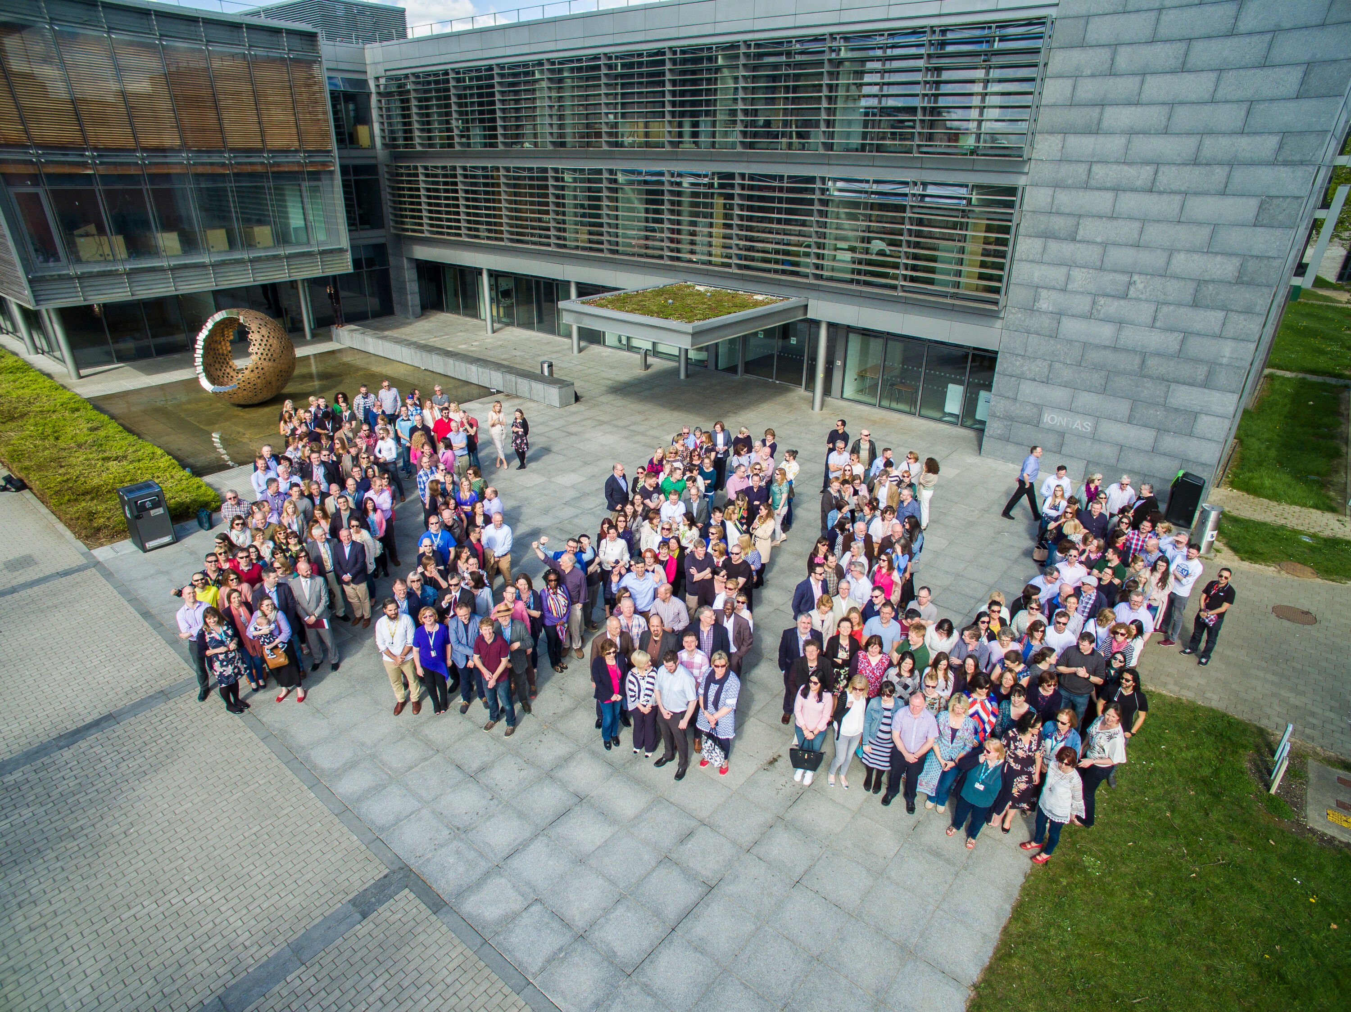

Introducing the MU School of Law and Criminology
Our aim is to produce law and criminology graduates who will have the skills, knowledge and confidence to thrive in the global economy whilst also being socially engaged and active citizens, wherever they live and work. Since 2011, we have graduated 2,500 law and criminology students.
We are the largest law school in Ireland (by student numbers) and first to combine law and criminology within one School. In 2023/24, there are more than 2,700 students (1722 FTE) supported by 58 full time staff.
In 2022 the School was recognised as the Law School of the Year by Irish Law Awards (nominated in 2023) and we are home to four Research Centres (Criminology, European Law, International Justice and Technology Law and Policy), and two ERC grant holders demonstrating the School’s academic excellence.

Slide 4
4. Largest student numbers on the island
2. Unique inter-disciplinary approach
1. New programmes: MA, BCL, BA
Criminology@ MU
3. Taught by leading experts in the field
5. Centre of Excellence in Criminology
Criminology@MU

Slide 5
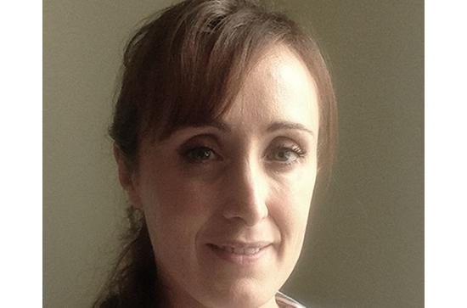

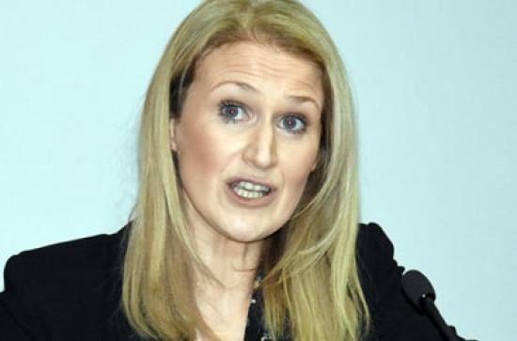
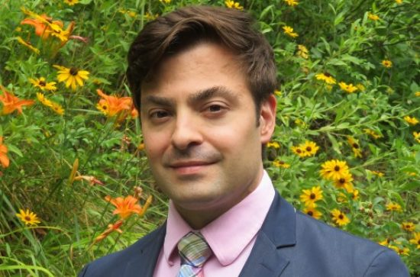
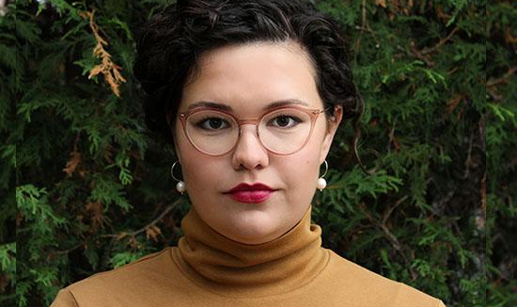
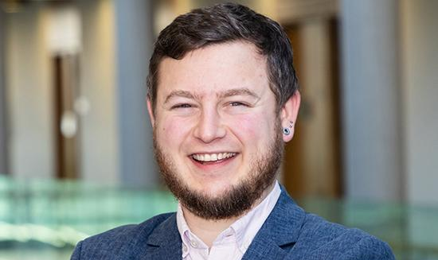
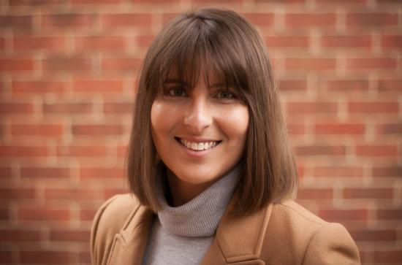
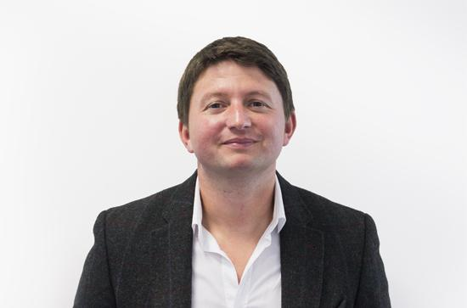
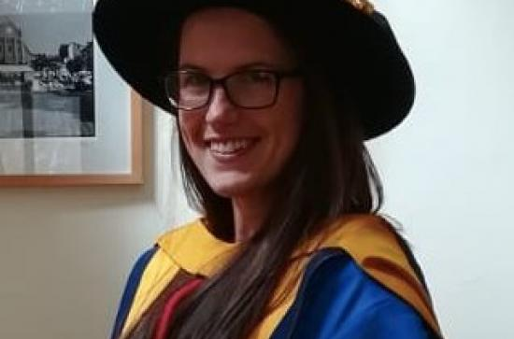
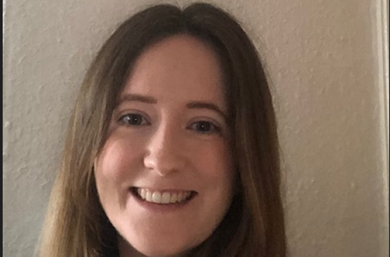
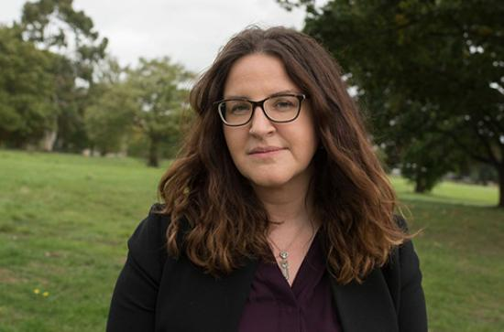

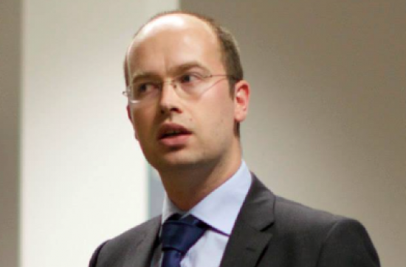
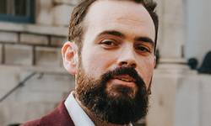
Maynooth Criminologists!

Slide 6
Ways to Study Criminology at Maynooth
BA Criminology
(MH504)
BCL (Law and Criminology) (MH502)
Criminology as part of an Arts degree
BA (MH101)

Slide 7
Rationale for BA
1. Consolidate MU’s position as a leader in the field
2. Demand from students who wish to specialise or pursue careers in the criminal justice system
3. No other provider of single major Criminology in Dublin area

Slide 8
Programme Structure
BA Criminology
Year 1
30 credits (plus 30 in another subject)
BCL (Law and Criminology)
Year 1
15 credits Criminology
Year 2
60 credits Criminology
Year 3
60 credits Criminology
BA (Arts) (Criminology & X)
Year 3
20/30/40 credits Criminology
Year 1
15 credits Criminology
Year 2
20/30/40 credits Criminology
Year 3
30 credits Criminology
Year 2
30 credits Criminology

Slide 9


So what’s new?
Opportunity to study Criminology in more depth than is currently possible.
Students must take 40 credits of optional modules in Years 2 and 3.
Two additional 7.5 credit modules in Year 1 (Thinking Like a Social Scientist, Criminological Classics).

Slide 10


First Year
30 credits of Criminology in first year (4 core modules)
Foundation for thinking critically about crime, its causes and how we should best respond to it.
Combine with one or two other subjects (30 credits)
  Valuable combinations include Sociology, Law, Psychological Studies, Anthropology, and Media and Cultural Studies.
  May take Critical Skills

Slide 11
Second and Third Year
Theoretical understanding of crime is built on in second and third year when students take core modules in subjects such as prisons, policing and research methods as well as optional modules in line with their interests.
Optional modules from sociology, psychology and anthropology, as well as law.
Possibility of pursuing a 10 credit elective stream to broaden intellectual horizons.

Slide 12
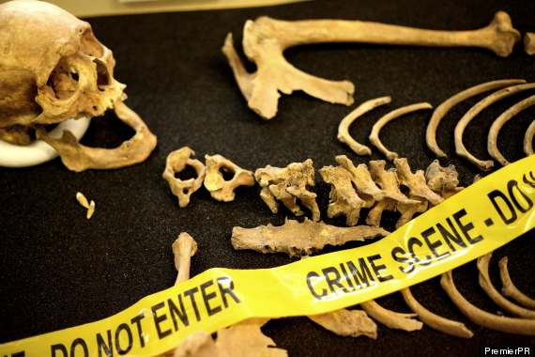





Optional modules

Slide 13
Career Options
An Garda Síochána
Security services
Data analytics
Probation
The Prison Service
Research institutes/academia
Journalism
Social research, social work, counselling, community work
Policy analysis
Non-Governmental Organisation (NGO) sector
Public administration.

Slide 14









Some places our graduates work..

Slide 15

Ollscoil Mhá Nuad
Maynooth University
Thank You

