Slide 1

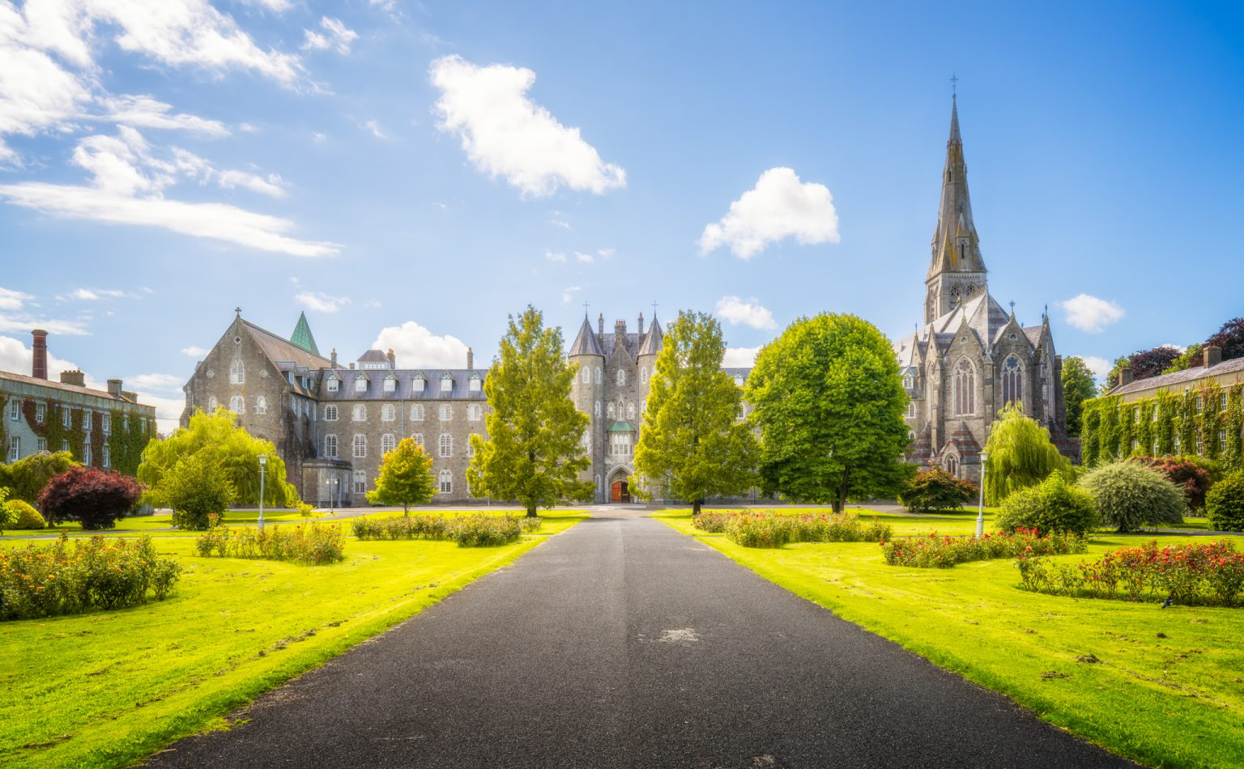
BA Creative writing and English at Maynooth university

Slide 2
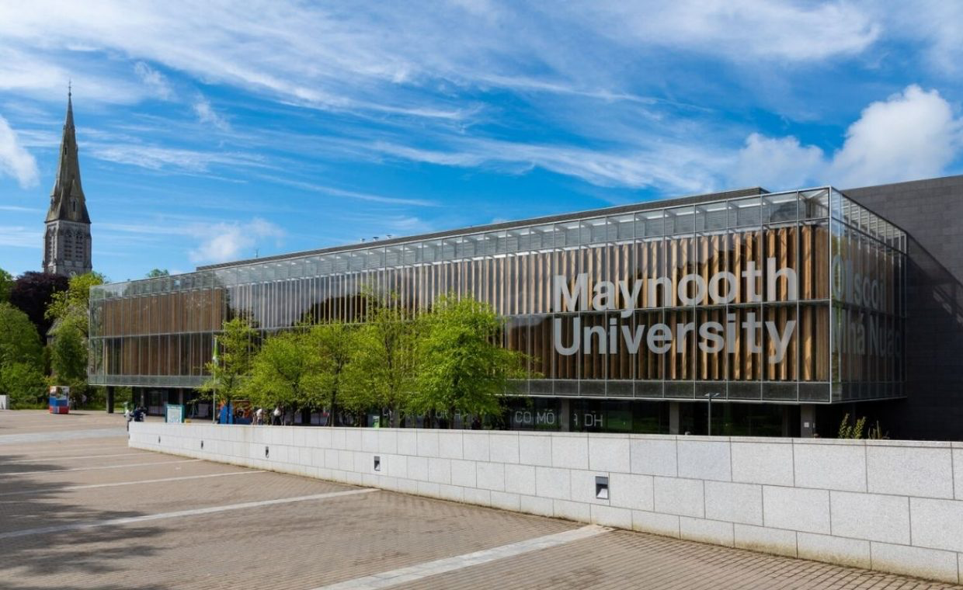
BA in Creative Writing and English
CAO Code MH111 (new in 2025)
Subject Overview
The BA in Creative Writing and English offers the opportunity to develop critical and creative skills within one programme, which is innovative not only for its integration of two intertwined subjects, but for its industry links and its teaching practices.
In Creative Writing and English, students will learn:
how to develop their creative writing (fiction/ poetry/ memoir/ creative non-fiction) through intensive workshops;
the practicalities of creative literary industries;
about the development of literary genres and practices;
about the conditions that shape literature – from history and geography to questions of gender, race, sexuality, and class.

Slide 3

Why study creative writing and English?
As a ‘future-focused’ degree, the BA in Creative Writing and English integrates real-world experience and creative-critical skill development.
Creative and cultural industries are an increasing part of global and local economies. The World Economic Forum’s 2023 report concluded that ‘Analytical thinking and creative thinking remain the most important skills for workers in 2023’ (World Economic Forum).
The Creative Industries Council, a UK-based forum, found that jobs in the creative industries were up 14.1% from 2019 to 2022 (CIC stats).

Slide 4

Why study creative writing and English?
In Ireland, the Creative Ireland programme was formed on the basis that ‘knowledge and creativity are equal partners’ (Future Jobs 2019).
‘Soft skills, transversal skills (e.g. communication skills, organisational skills, self-motivation) and the mastery of core competencies … are critical for work in all sectors, and opportunities to develop and enhance these skills are vital. Advanced cognitive skills, problem solving, logic, social and emotional skills are particularly important in the development of competences needed to adapt to and respond to the changes that may occur due to technological advancement... Creative skills will also be vital.’ (Future Jobs )

Slide 5
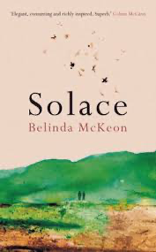
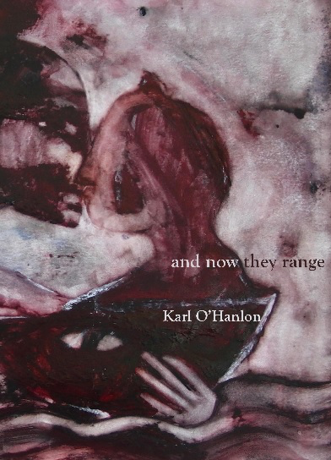
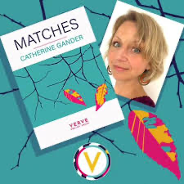
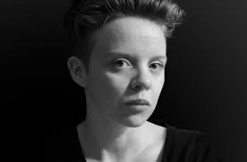
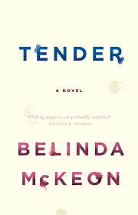
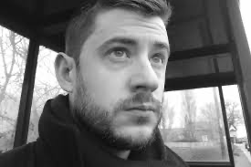
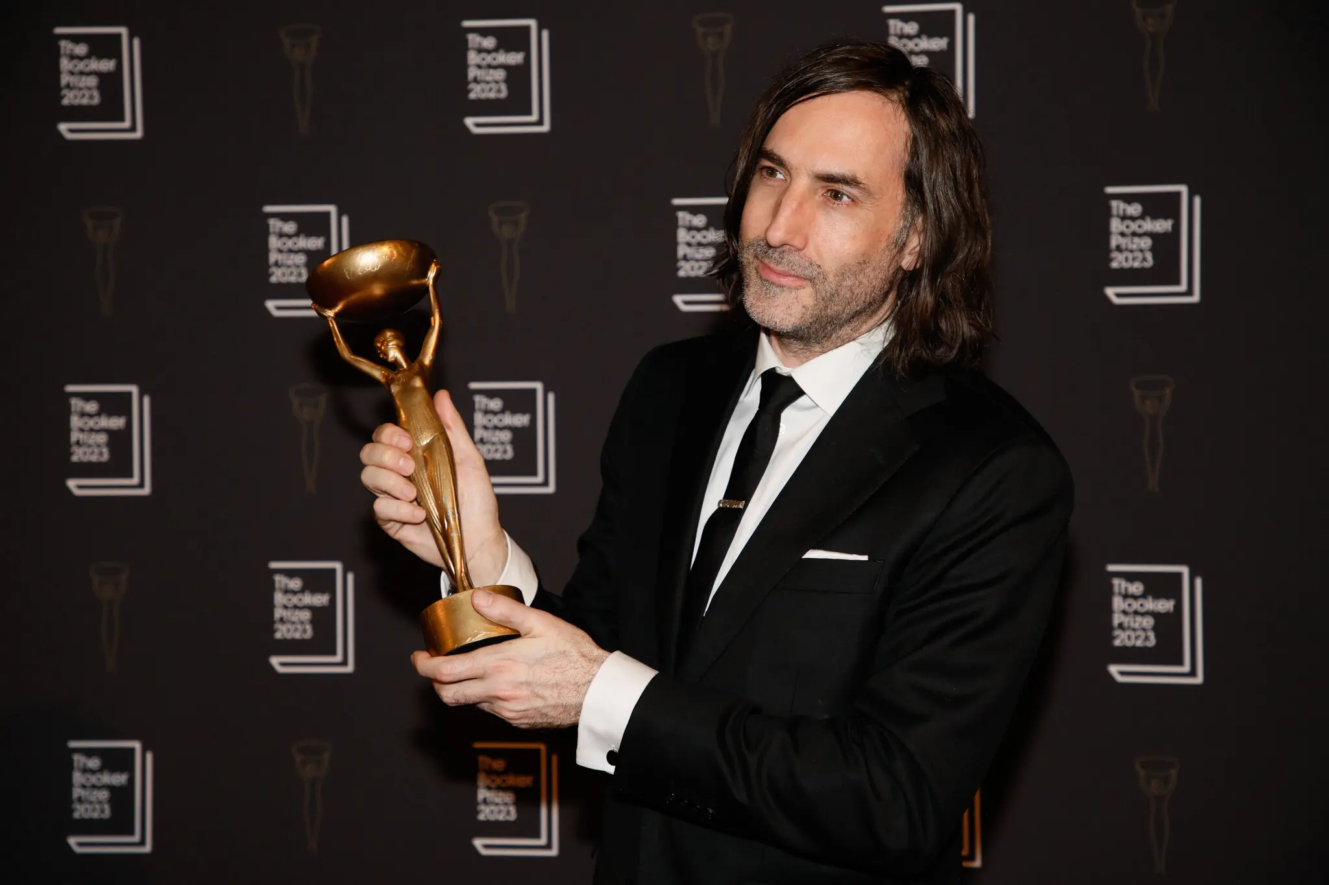

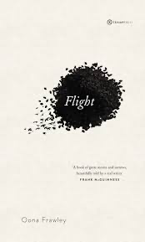
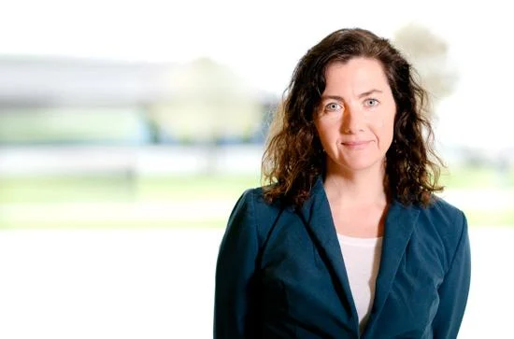
Why Maynooth university?

Slide 6

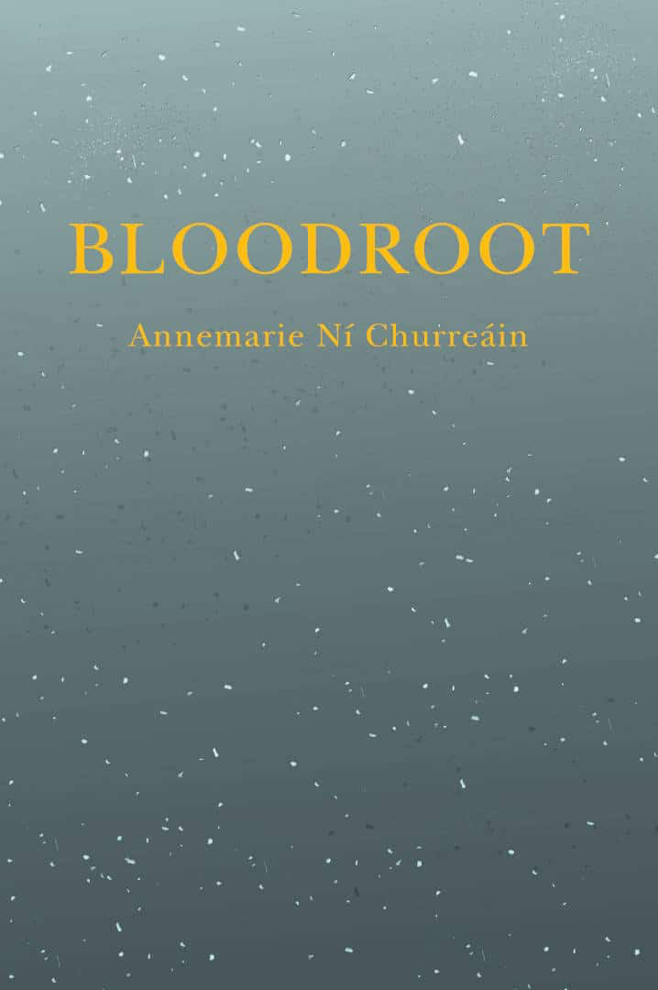
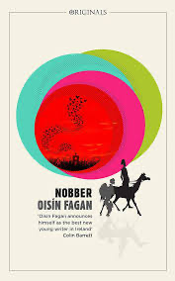
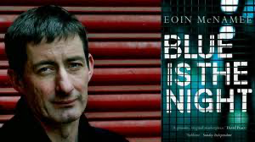
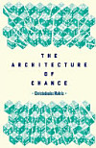
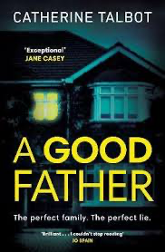
Why Maynooth university?
Award-winning permanent staff working in fiction, poetry, creative non-fiction, including Booker Prize-winner Paul Lynch, Belinda McKeon, Oona Frawley, Catherine Gander, and Colin Graham.
2 Writers-in-Residence appointed per year, providing exposure to renowned practitioners.
Previous Writers-in-Residence include Ryan Dennis, Rob Doyle, Oisín Fagan, Eoin McNamee, Annemarie Ní Churreain, Christodoulous Makris, Sue Rainsford, Fíona Scarlett, Catherine Talbot, Susan Tomaselli, and Joanna Walsh.
Established visiting guest lecture series providing consistent access to writers, editors, artists and agents of international caliber.
Previous visiting speakers include Christine Dwyer Hickey, Paul Muldoon, Donal Ryan, Shola Von Reinhold; the founders of acclaimed Tramp Press; editors of Banshee Lit, gorse, The Dublin Review; and many more.

Slide 7

1st Year Creative Writing and English
Semester 1
Take 3 x 7.5 credit modules of Creative Writing and English:
Introduction to Creative Writing
Foundational English 1 (Prose)
Climate Fiction
PLUS choose 1 other subject module, which may include Critical Skills, from the available groups.
Semester 2
Take 3 x 7.5 credit modules of Creative Writing and English:
Introduction to Creative Writing
Foundational English 2 (Poetry and Drama)
Literary Criticism and Theory
PLUS choose 1 other subject module, which may include Critical Skills, from the available groups.

Slide 8

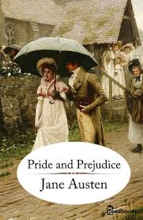
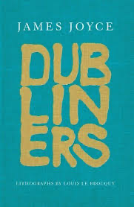
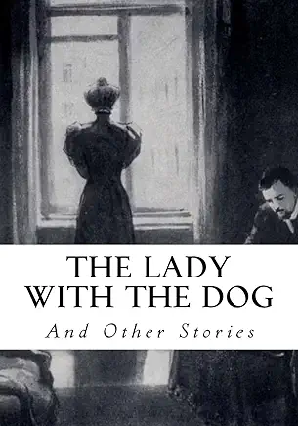
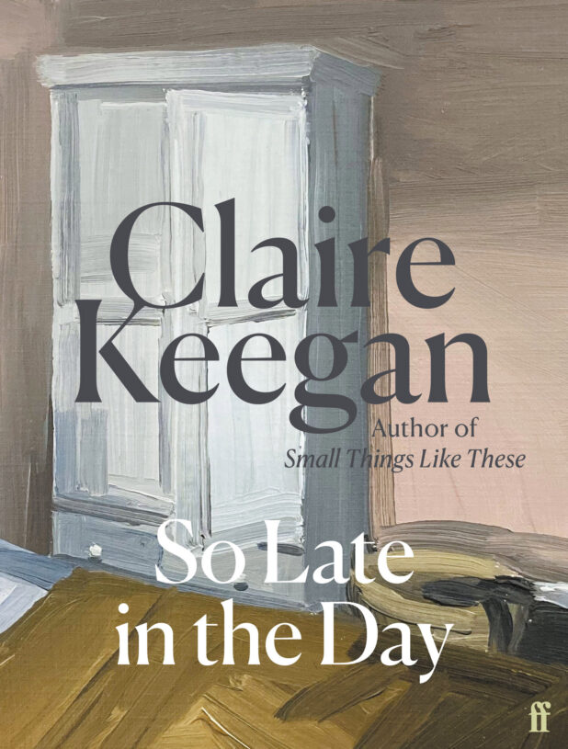
What might students read in 1st year?
Current course syllabi include:
short stories by James Joyce, Chimamanda Ngozi Adichie, Anton Chekov, Claire Keegan;
a novel by Jane Austen (Pride and Prejudice);
speeches/ essays by Martin Luther King, Jr, Joan Didion, Rachel Kushner.

Slide 9
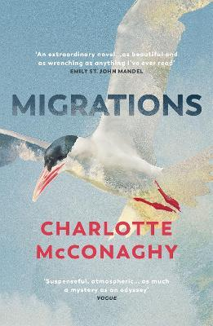
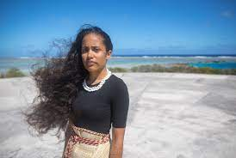
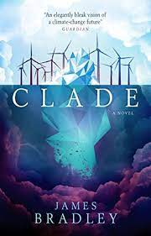

What might students read in first year?
Current course syllabi include:
James Bradley’s cli-fi novel Clade;
McConaghy’s novel Migrations;
an array of critical work, rap, spoken word poetry and written poetry, such as the work of poet and climate-change activist Kathy Jetñil-Kijiner.

Slide 10
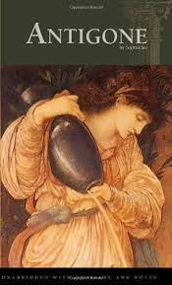
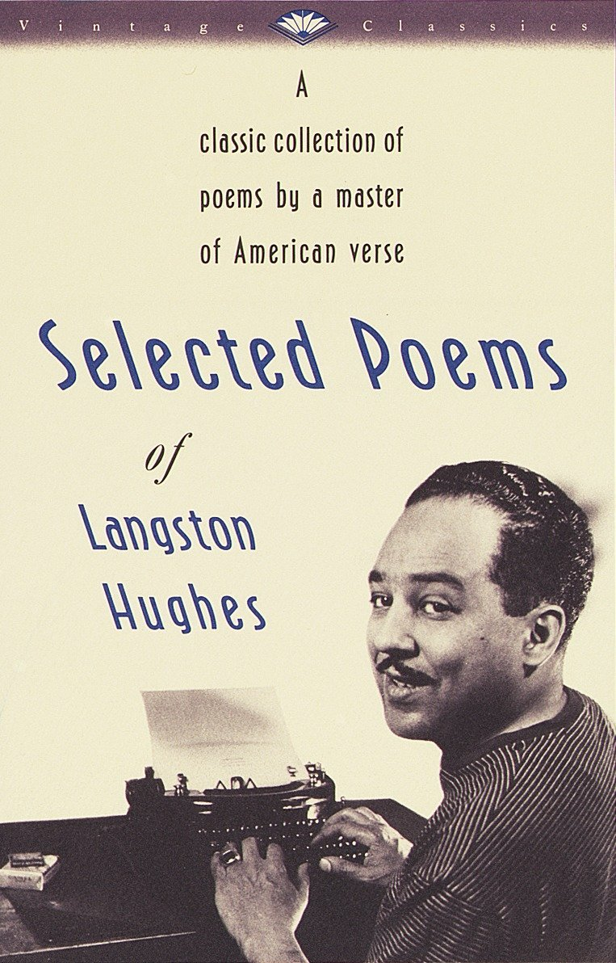
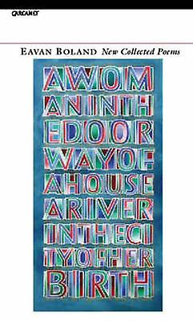


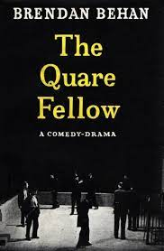
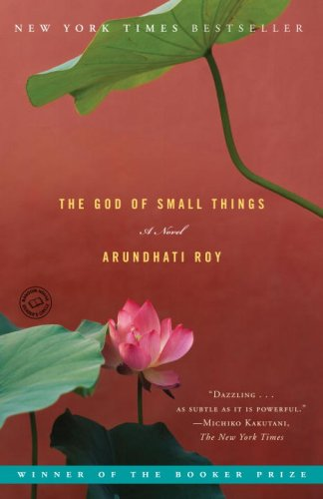
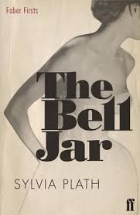
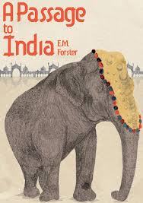
What might students read in first year?
Current course syllabi include: Sophocles’ Antigone, Hansberry’s A Raisin in the Sun, and Behan’s The Quare Fellow, while poets to be studied include Boland, L. Hughes, and Walcott; E.M. Forster, A Passage to India; Sylvia Plath, The Bell Jar; Arundhati Roy, The God of Small Things.

Slide 11
Second and Third year: creative writing and english
From second year, students can choose from a selection of options within English.
Modules include: Literatures of Place; Film and Screen Studies; Early Modern literature; Modernism; American Literature; Stories of Women in Africa and the Diaspora; Environmental Catastrophe; Shakespeare Across Media; Global Arab Migrant Literature; Writing Ireland.
From second year, option for elective courses (10 credits) outside of students’ degree subject.

Slide 12
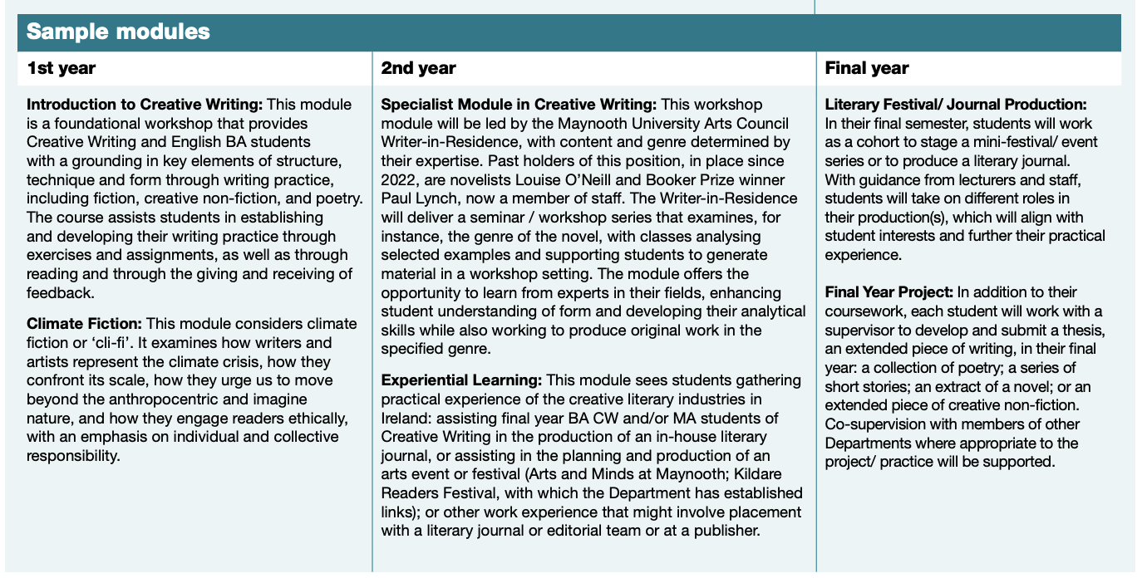

Slide 13
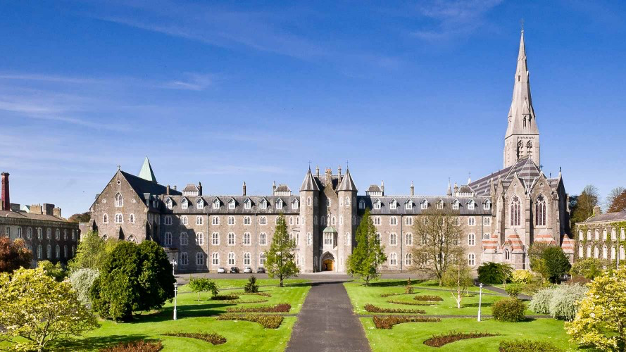
Graduate attributes
skilled in creative and critical thinking;
the ability to formulate, present and disseminate complex issues;
excellent communication skills;
a highly-tuned sensitivity to language usage;
the ability to tell and organise stories in compelling ways;
an understanding of a how to inhabit alternative viewpoints and outlooks.

Slide 14
Summary
As a ‘future-focused’ degree, graduates of the programme will be well-prepared for the world of work, with the capacity to be flexible, inventive and adaptable in their employment careers.
Particularly in a tech-driven world, creative thinking will only become more important. Since this BA involves direct industry links and practical experience modules including festival/event planning and organisation, editorial and organisational experience, it provides students with a degree that includes built-in practicums.

Slide 15
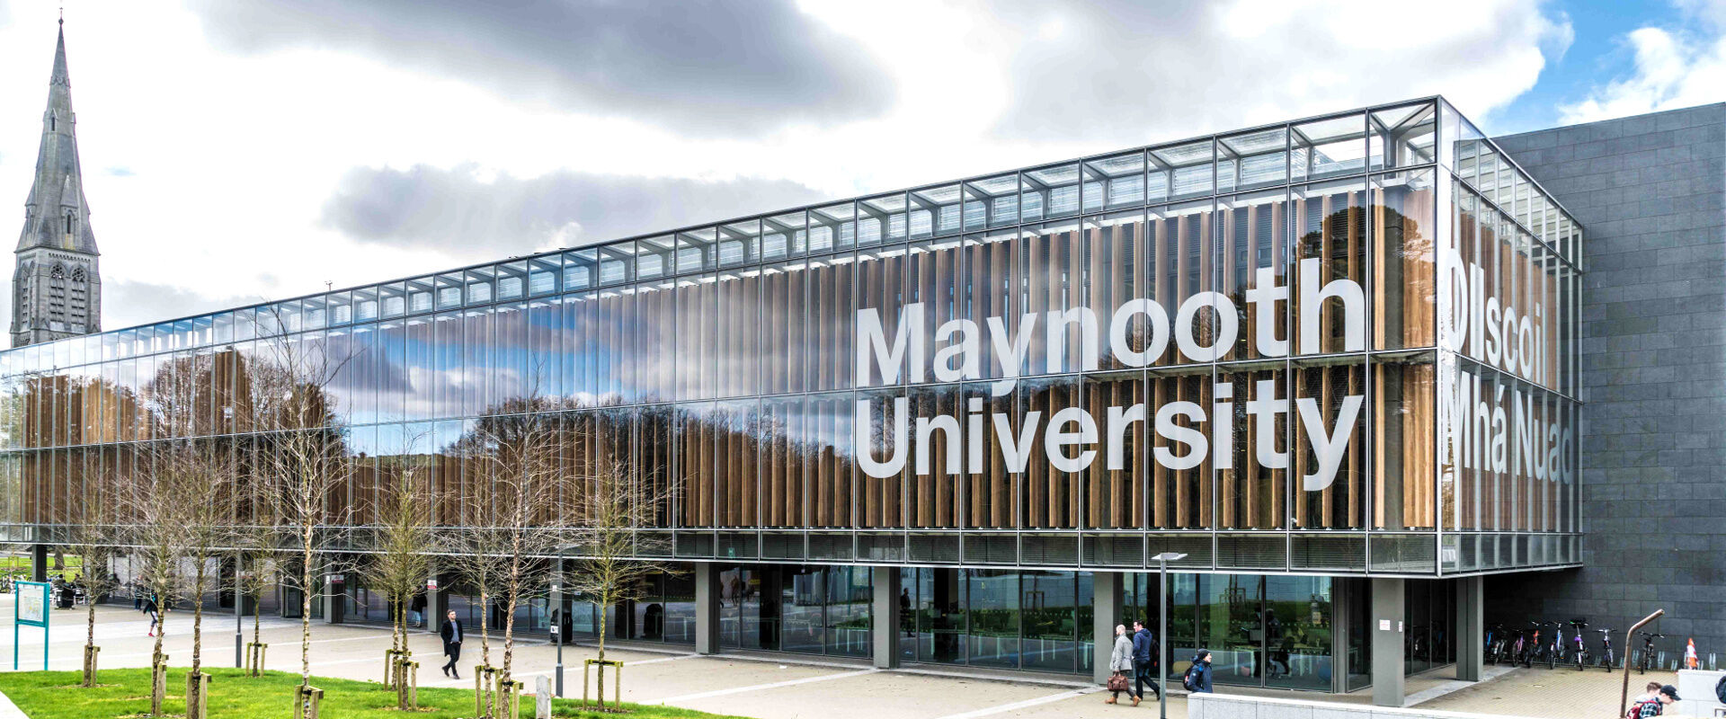
Course
Coordinator
Dr Oona Frawley
oona.frawley@mu.ie

