Slide 1
Mapping public employment services: key gaps
Anne-Marie McGauran
Presentation to
Leave No One Behind: Public Employment Services & Guidance for a 21st Century Ireland
17th June 2019: NUI Maynooth

Slide 2
NESC Study of ‘Jobless Households’
Jobless households? Those where the adults spent less than 20% of their time in employment
2016-17 in a disadvantaged suburb of Dublin
92 interviews, with
33 jobless households (34 people)
16 local services
11 county/regional services
11 local employers
12 government departments / agencies
9 national stakeholder groups
Notes:
The services included employment support services, training and education services, community services, a charity, a school
The government departments and agencies covered the policy areas of employment support, education, job creation, community, childcare, and funding.
The stakeholder groups covered these areas also, as well as issues relating particularly to employers, employees, migration, Travellers and people with a disability

Slide 3
Gaps we identified
Stress that these apply to most disadvantaged & LTU – they may not be gaps for the less disadvantaged
Grouped the gaps into:
Information
Training
Services that support employment
Services to support transitions

Slide 4
Gaps in information
Lots of myths – e.g. about splitting payments, reductions in rent supplement, loss of medical cards. CIB helps
Career guidance very patchy
Very difficult to navigate range of training on offer and the supports available for it
Qualified adults not contacted

Slide 5
Gaps in training
Gaps in volume of training
Not enough places on sought-after courses linking to labour market (warehousing & logistics, HGV driving)
English language training
Literacy training
Not much assessment of trainees’ pre-existing knowledge, so classes too mixed
No system to recognise equivalency of foreign qualifications

Slide 6
Gaps in services that support
Intreo not open to everyone. 12% of 15-24 year olds in 2016 were NEETs!
Childcare – cost, availability, particularly after-school and out-of-hours
Finance for training, particularly if you’ve a family
Transport – access & cost
IT - access & cost
Housing
Loss of medical card
No automatic move to WFP

Slide 7
Gaps in support through transitions
Links to employers missing
E.g. when moving off CE
Training provision not well linked to employers
Work experience missing, particularly for Travellers & Africans
Intreo data collection & analysis for employers
Flexibility applying eligibility criteria, and different eligibility criteria for different payments
Links between private/charity providers & state services
Case management for those accessing multiple services

Slide 8
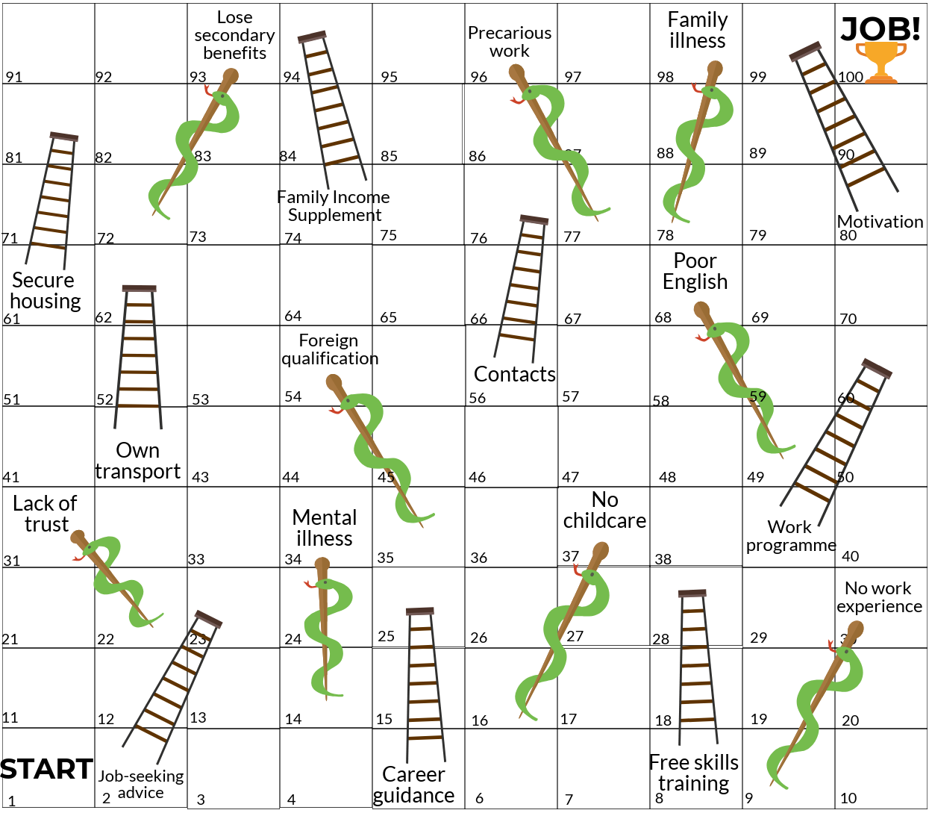
Key Barriers and Enablers in Transitioning from Welfare to Work

