Slide 1
ALL Meeting May 2018
Memory, Ageing, Dementia and Reminiscence
Dr Richard Roche
Department of Psychology, MU

Slide 2
Overview
Background; memory, dementia, reminiscence
IDR workshop (2015)
A pilot study
IRC New Horizons grant (2016)
Design: Experiment 1; Experiment 2
Progress to date
Implications

Slide 3
My Background
Cognitive Neuroscience – neural correlates of cognition and behaviour in normality/pathology
EEG/ERP markers of spatial processing, source memory, consolidation/reconsolidation, ageing
Markers of psychotic-like experiences (PLEs) in adolescents (with RCSI)
Cognitive predictors of falls in old age & post-stroke/CVA (with AMNCH)
Memory and memory decline…
Dept of Psychology

Slide 4

Memory: How we think about it
Notes:
The language of memory – a place, a repository, a store

Slide 5

How we think about memory
Notes:
5
The info processing influence – encoding, storage and retrieval

Slide 6
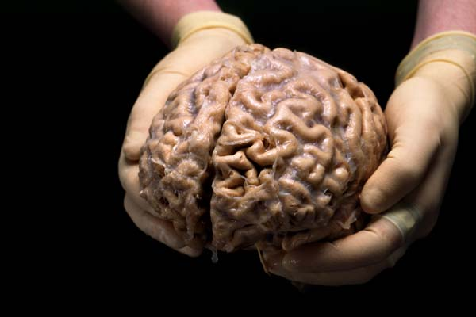
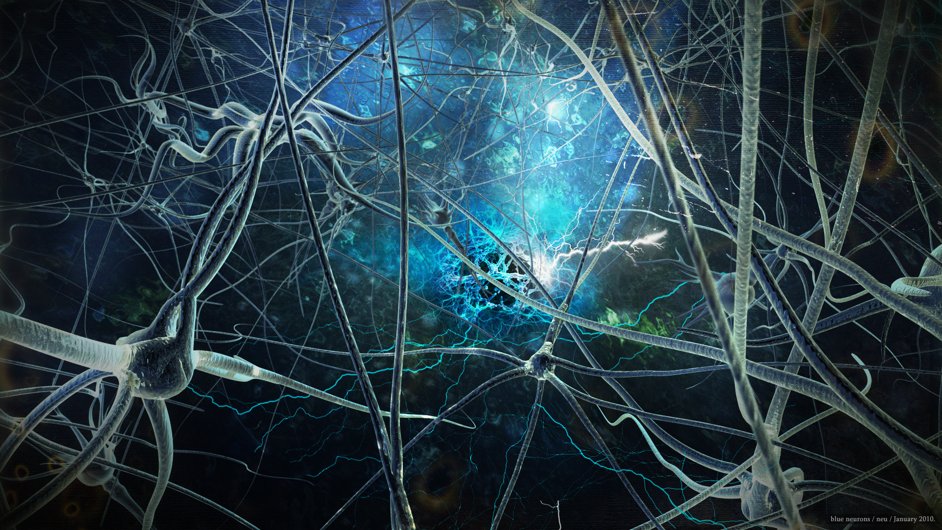
Memory in the Brain
Notes:
6

Slide 7
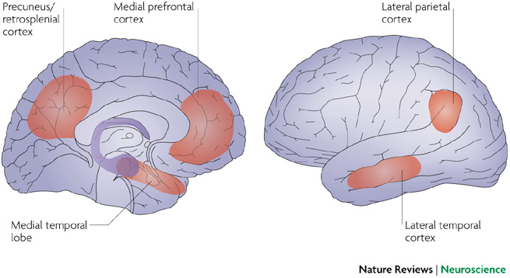
The Brain’s Memory Systems
Notes:
Lots of brain areas involved in memory

Slide 8
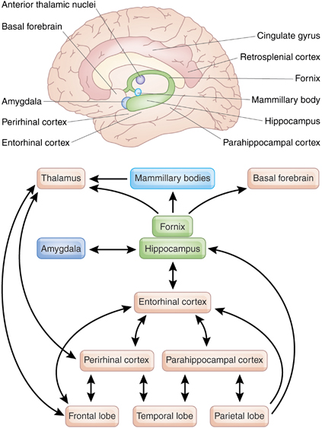
Notes:
Moving toward the idea that remembering is really internally re-living an event

Slide 9
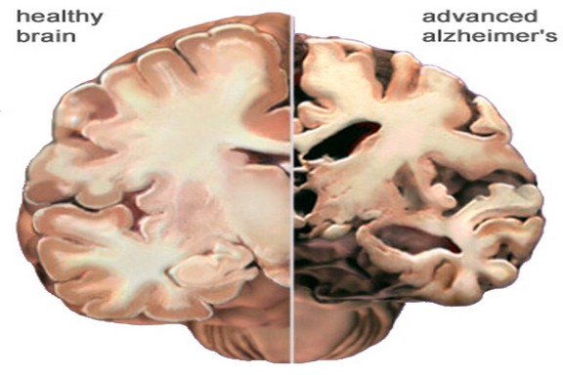

Slide 10
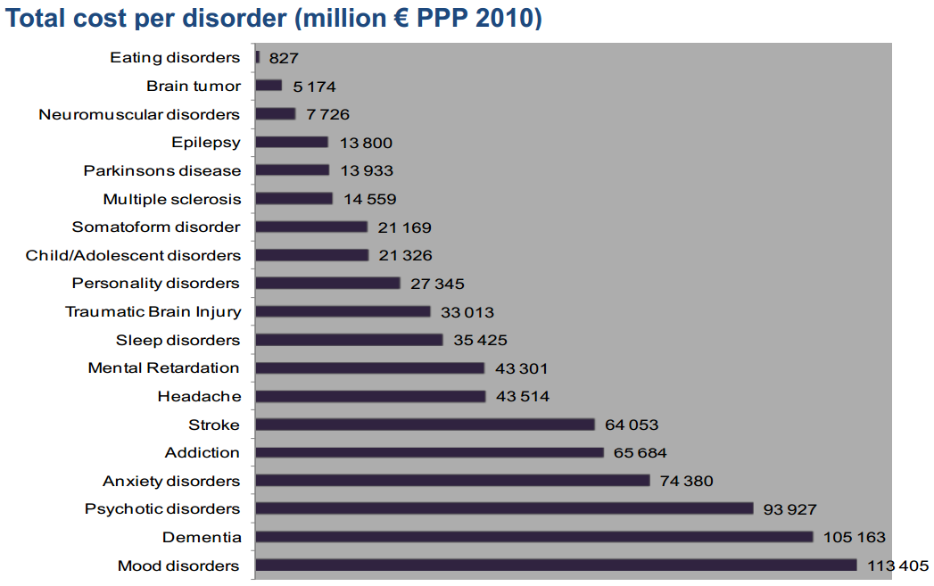
Gustavsson et al. Cost of disorders of the brain in Europe 2010.
Eur. Neuropsych. (2011). 21, 718-779

Slide 11
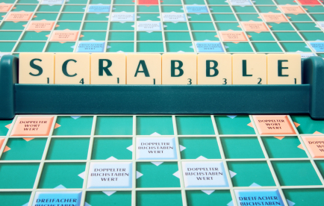
Memory Decline in Normal Ageing
Evidence suggests protective effect of keeping mind active in later life
“Nuns” studies (Snowdon et al., 1996,’ 97, ’00)
  Scrabble, Bridge, Crosswords etc
  Lower rate of dementia and AD
  Better memory retention
  Longer life expectancy

Slide 12
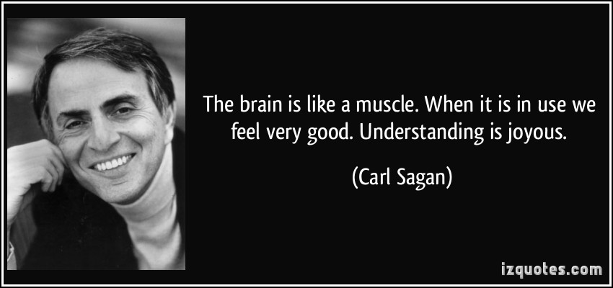

Slide 13
Reminiscence and RT
Until 1960s, reminiscing in old age seen as a negative sign (regressing)
Butler (1961) – adaptive means of resolving affairs, giving meaning to life etc.
-Benefits to mood, self-esteem, life satisfaction
Subsequent research on Reminiscence Therapy (RT)
Dept of Psychology

Slide 14
RT studies & observed effects
Paper | n | sample | Cog Benefits | Psych Benefits | Other
Lopez et al., 2016 | 41 | impaired | Memory | Dep/anxiety
Goldwasser, Auerbach and Harkins, 1987 | 27 | Demented | - | Affect
Baines, Saxby, and Elhert, 1987 | 15 | Older confused | Reduced memory decline | - | Comm’n
Yamagami, Oosawa, Ito and Yamaguchi, 2007 | 18 |  | Memory | - | Comm’n, interact’n
Wang, 2007 | 102 | Older demented | Cog F’n | Depression
Barban et al., 2015 | 348 | Mild AD, mMCI, Cntrl | Memory & Cog F’n | -

Slide 15
RT studies & observed effects
Paper | n | sample | Cog Benefits | Psych Benefits | Other
Okumura, Tanimukai and Asada, 2008 | 16 | Women with AD | Word recall | - | Non-verbal Comm’n
Chao et al., 2006 | 24 | Older nursing hm | - | - | Self-esteem
Aşiret and Kapucu, 2015 | 62 | Mild/mod AD | Cog F’n | Depression | Comm’n
Serrano, Latorre, Gatz, and Montanes, 2004 | 43 | Older w depression | Memory production | Depression
Serrani et al., 2012 | 135 | Older w AD | - | QoL | Soc Engagemt
Sock, 2015 | 78 | Older women | Memory | QoL

Slide 16
Spontaneous Narrative Production
Gola et al. (2015): conversational storytelling in n=46 neurodegenerative (FTD, PPA, AD + Controls)
Distinct patterns based on transcript content
PPA: more stories, but perseveration
AD: fewer AB stories than controls
PPA and FTD: failed to attend to social cues
fMRI: associated with atrophy in DMN, Limbic, Salience and Stable Task Control networks

Slide 17
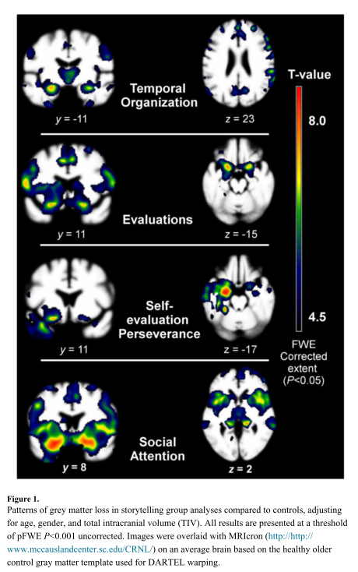

Slide 18
Interdisciplinary Research idea
May 2015 – IRC-funded workshop on IDR approaches to dementia (Des O’Neill)
Historians, Social Scientists, Geographers, Ethnographers, Health Psychologists (3 neuro)
Ideas around Oral History, Memory Studies, Ethnography, Social Geography
Dept of Psychology

Slide 19
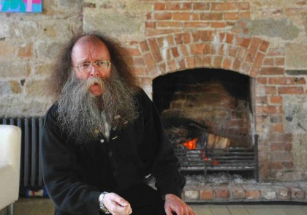
Reminiscence & Storytelling
Dept of Psychology

Slide 20
Interdisciplinary Research idea
We are a nation of storytellers…
Ideas of personal, societal and cultural memory are linked – impacts on identity, health and brain function
Every person >60 has a wealth of stories from childhood and after; most are lost, even in RT
Reminiscence seems to produce memory and/or psychological health gains in older adults
Dept of Psychology

Slide 21
MU Reminiscence Project
Implement widespread reminiscence programme for older adults in Ireland
Structured recollection of autobiographical events over 6 week period; pre/post measures.
Record interviews on specific events/epochs with a rolling window
Upload recordings into large digital archive (DRI)
Facilitate recollection by allowing Ps to listen back to own and similar recollections/stories
Dept of Psychology

Slide 22
Design
Pre/post measures incl: LTM, STM/WM, autobiographical memory (EAMI), QoL (CASP-19), Gen Health (GHQ), Mental Health/Mood/Loneliness, Social Engagement/activities.
Dept of Psychology

Slide 23
Design
Reminiscence interviews over 6 week period; guided interviews, free recollection, probes
Dept of Psychology

Slide 24
Design
E1
E2
E3
E4
E5
E6
Specific events from past 100 years of Irish history:
Civil War/War of Independence; Nth King St Massacre; Tuberculosis; WWII; Bloody Sunday
Dept of Psychology

Slide 25
Design
1920s 1950s 1970s
E1
E2
E3
E4
E5
E6
Progression from 2nd hand Semantic Memory (E1, E2) to 1st hand Autobiographical Memory (E5, E6)
Dept of Psychology

Slide 26


Design
E1
Each interview uploaded to digital archive; tagged for date, location, event, people and other identifiers
Allow each P to listen back to own stories, listen to related/comparable, or browse (add photos)
Keep memory diary for spontaneous recollection between interviews.
Dept of Psychology

Slide 27
Hypotheses
Regular reminiscence -> memory and brain health improvements via plasticity mechanisms, esp HF
Social interaction/sense of purpose -> improvements in QoL, mood, sense of engagement
Ability to search archive for own or other groups’ stories -> lead to enhanced recollection via triggers
Collation of digital archive on key societal events over last 100 years -> valuable resource for historians, geographers, sociologists, interest in memory as narrative or cultural vehicle
Dept of Psychology

Slide 28
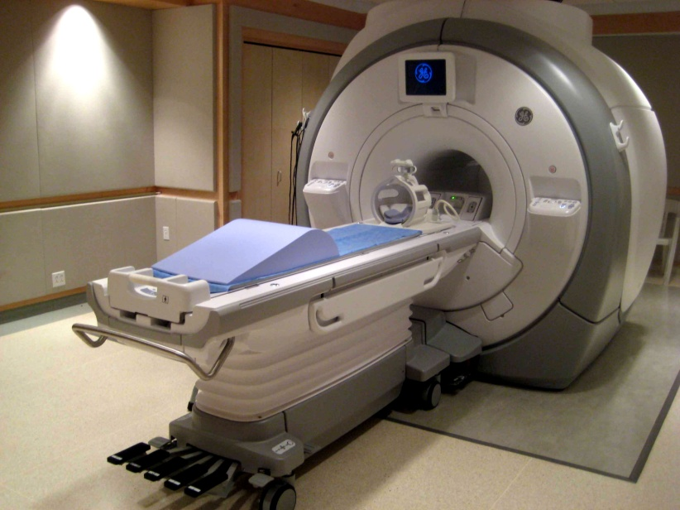
Hypotheses
Subset: fMRI-DTI study pre/post reminiscence period
  Structural & functional changes in key networks
fMRI during reminiscence?
Predicted networks based on
Gola paper
(cost of fMRI ~€400 per hour)
Dept of Psychology

Slide 29
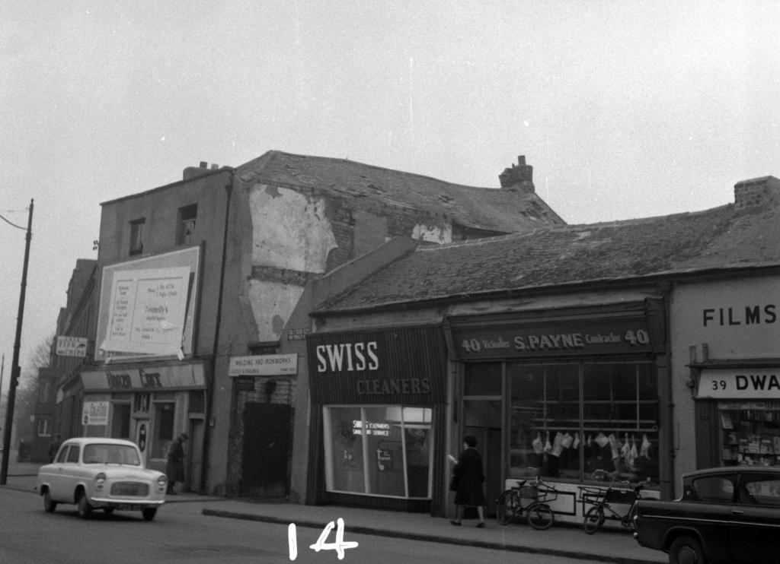
2015 Small Scale Pilot Study
Dept of Psychology

Slide 30
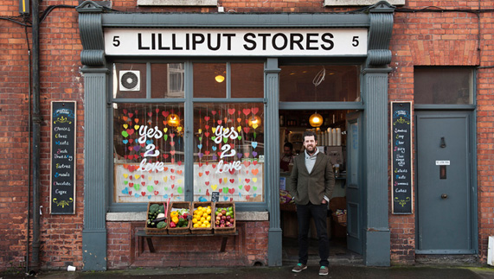
Small Scale Pilot Study
Dept of Psychology

Slide 31
IRC New Horizons project grant
2016 call – up to €220,000 for IDR projects
Sean Commins, Deirdre Desmond, Andy Cochrane, Cliodhna O’Connor, Laura Coffey, Michelle Kelly (Psychology)
Oona Frawley (English, IMSN)
Ronan Foley (Geography, IOHN)
Karen Till (Geography)
Gerry Kearns (Geography)
Aileen O’Carroll (MUSSI)
Louis Haugh (Brunswick St Artist Collective)
Angela McDonagh (MISA, St James’s)
Paul Dockree, Arun Bokde (TCD, TCIN)
Noel Fitzpatrick (DIT Grangegorman)
Liam Delaney (UCD)
Dept of Psychology

Slide 32
“SEAN-Key project”
‘Supported Episodic Autobiographical Noesis’
Awarded full €216,000 for 2~ experiments
Exp 1a: behav + fMRI of healthy controls
Exp 1b: develop + launch mobile app*
Exp 2: behav study with memory decline/dementia group (via AMNCH)
Postdoc (2 years); RA (1 year)
Dept of Psychology

Slide 33
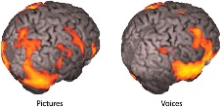
SEAN-Key objectives
Digital Archive
Gola analysis
Study Participants
IDR Team
Dept of Psychology

Slide 34
SEAN-Key objectives
Digital Archive
Study Participants
IDR Team
Mobile App

Slide 35
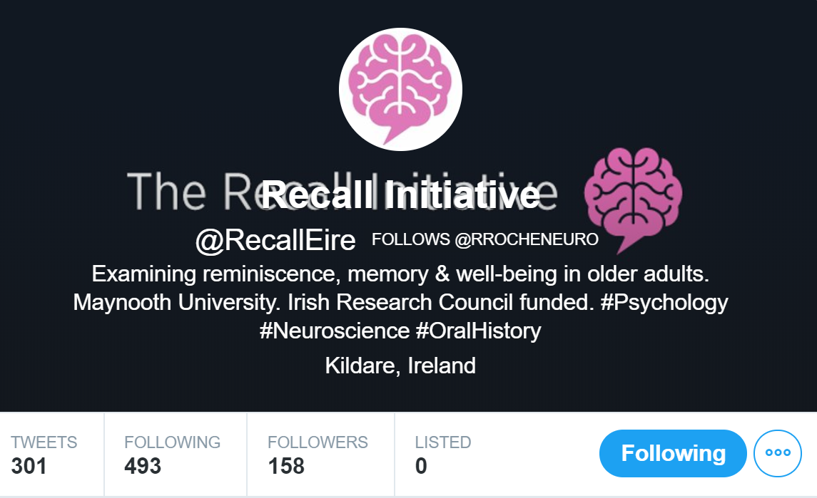
Recall Initiative
Less colloquial name for potential international expansion – “Recall Initiative”
Twitter account set up; website under construction
Dept of Psychology

Slide 36
Progress to date
Autumn 2017: pilot study (n=2), Swords group
Spring 2018: large scale behavioural study (multiple groups: Maynooth, Swords, Tallaght, city centre)
  Sub-sample n=14 pre/post fMRI
Autumn 2018: early dementia sample (AMNCH)
Dept of Psychology

Slide 37
Implications
Financial implications in relation to care and medical costs for memory-related and psychological issues of ageing
Implications for older communities in relation to housing, urban redevelopment, planning
Implications for nursing home practice
Role in SHAPES ?
Dept of Psychology

