Slide 1


The psychology of Mediation
People, tools, Organisations, Society.
Or “Confessions of a Sociocultural Psychologist”
Dr. Michael Cooke
Dept of Psychology
ALL Institute
MUSSI
michael.cooke@mu.ie

Slide 2
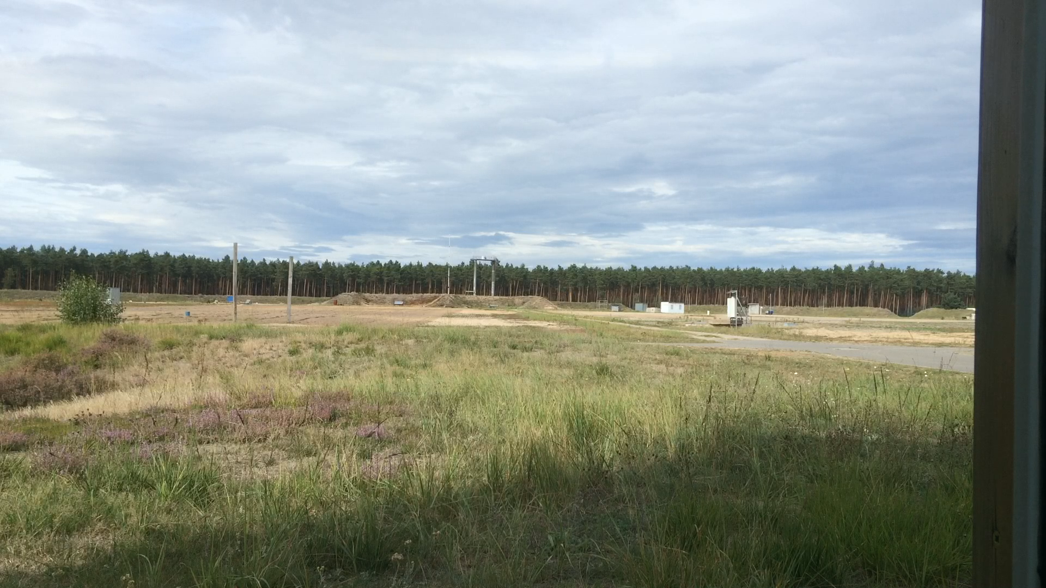
What I do (or what I can bring to your organisation)
Notes:
Why is question important? We tell students every year that psychology is not what they always thought it was.
So why are psychologists working on a project on HMEs?

Slide 3
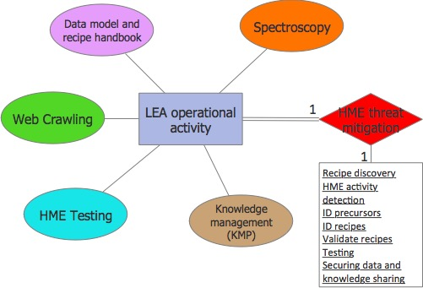


HOMER and the challenge of HME threat mitigation
Notes:
The HOMER (Homemade Explosives and Recipes Characterisation) project is an FP-7 project that aims to enhance the capability of LEAs to monitor and track the dissemination of HME recipes on the internet, build up a knowledge repository of recipes and precursors, along with a systematic approach to HME testing both in the field and in the lab or test range, and to securely share not only information about the recipes and precursors themselves but also end-user derived knowledge gained through experience.
The key elements to HOMER include:
The knowledge management platform (KMP);
Testing procedures and handbook;
Web-crawling capabilities for discovery of HME information and activity on the web;
HME data model and knowledge repository/handbook housed on the KMP;
Spectroscopy tools for the quick identification of substances in the fied
All of these capabilities have been researched, designed and developed with LEA operational activity at the centre meaning that we have set out to understand the needs of LEA operational staff in a human-centred way (experience) corresponding to difference functions related to the management and investigation of HMEs, mapped their informational needs and configured the tools based on the operational reality mindful of the various security constraints that are present. The ultimate goal is to reduce the threat pose by HMEs through supporting a variety of police and intelligence activities.

Slide 4
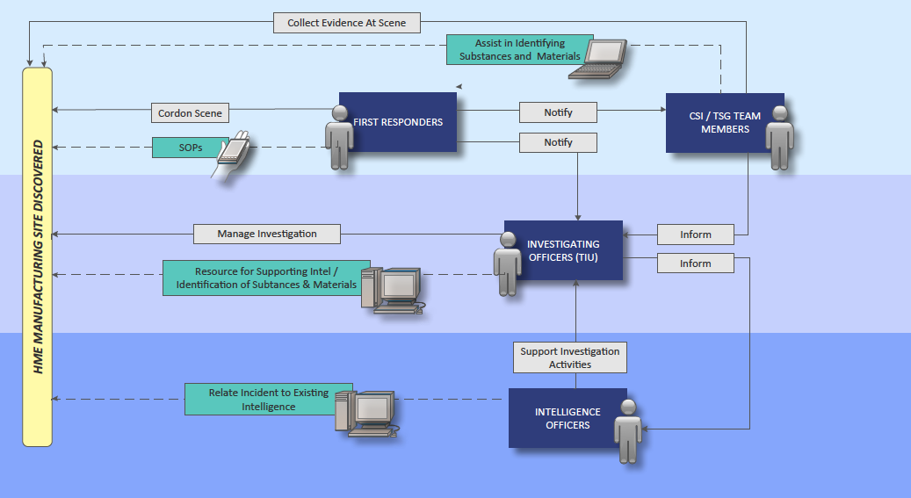
HOMER CONOPS – functions and roles
Notes:
This diagram represents a use-case involving different police actors at different levels with different operational roles. In this event, a suspected HME manufacturing site has been discovered. We examine the roles of first responders and CSI/search teams on the scene, then linking this with the activities of investigating officers, their goals and requirements and then also for intelligence officers.
The point of this is to concretely map the various activities, their intersections (division of labour) and the role that the HOMER system plays for them in mediating their individual activity and also the whole operational activity.

Slide 5
CONOPS HOMER
Situating the HOMER solution within operational contexts for different LEA/military users;
Allowing for the identification of key design challenges through the mapping of activities and identifying the key interdependencies and potential contradictions;
CONOPS as a methodology – an ongoing recursive activity which monitors change and its implications for activity
Challenges
Not only new technology and data but new culture/philosophy of interaction
Notes:
I summary…

Slide 6
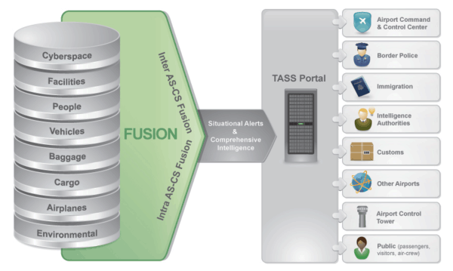
Total Airport Security System (TASS)

Slide 7
So TASS is about integration of Technologies?
Sensors
NPRS
Chemical sensors
Motion detection and video analytics
Face recognition
RFID
Long-range cameras
Smart fence technologies
Data fusion
Intelligence
Threat detection
Decision support
Weak signals
HMI
The interface between the human operator and the System as a whole
Not really!

Slide 8
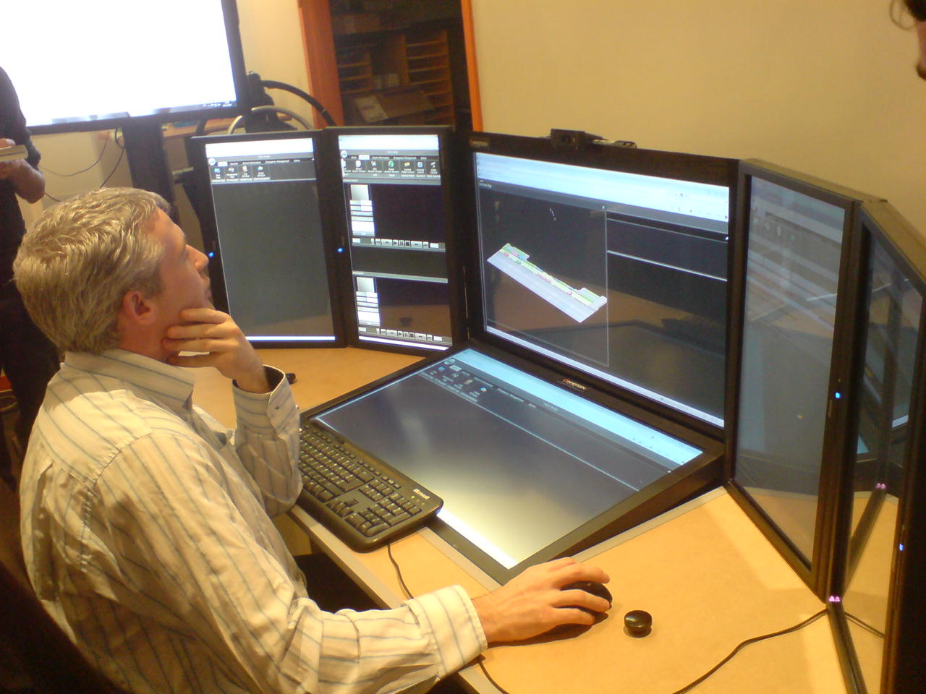
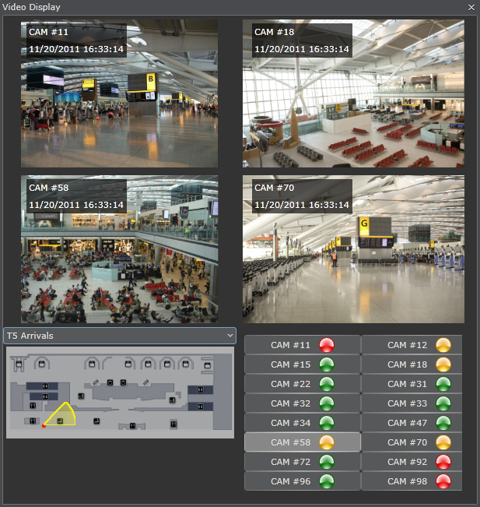
TASS is about the Human (and therefore the HMI)?
Yes, Partly!
But why is he there in the first place?
Human factors is not limited to the design of the HMI, which is often left until the end of a development process

Slide 9
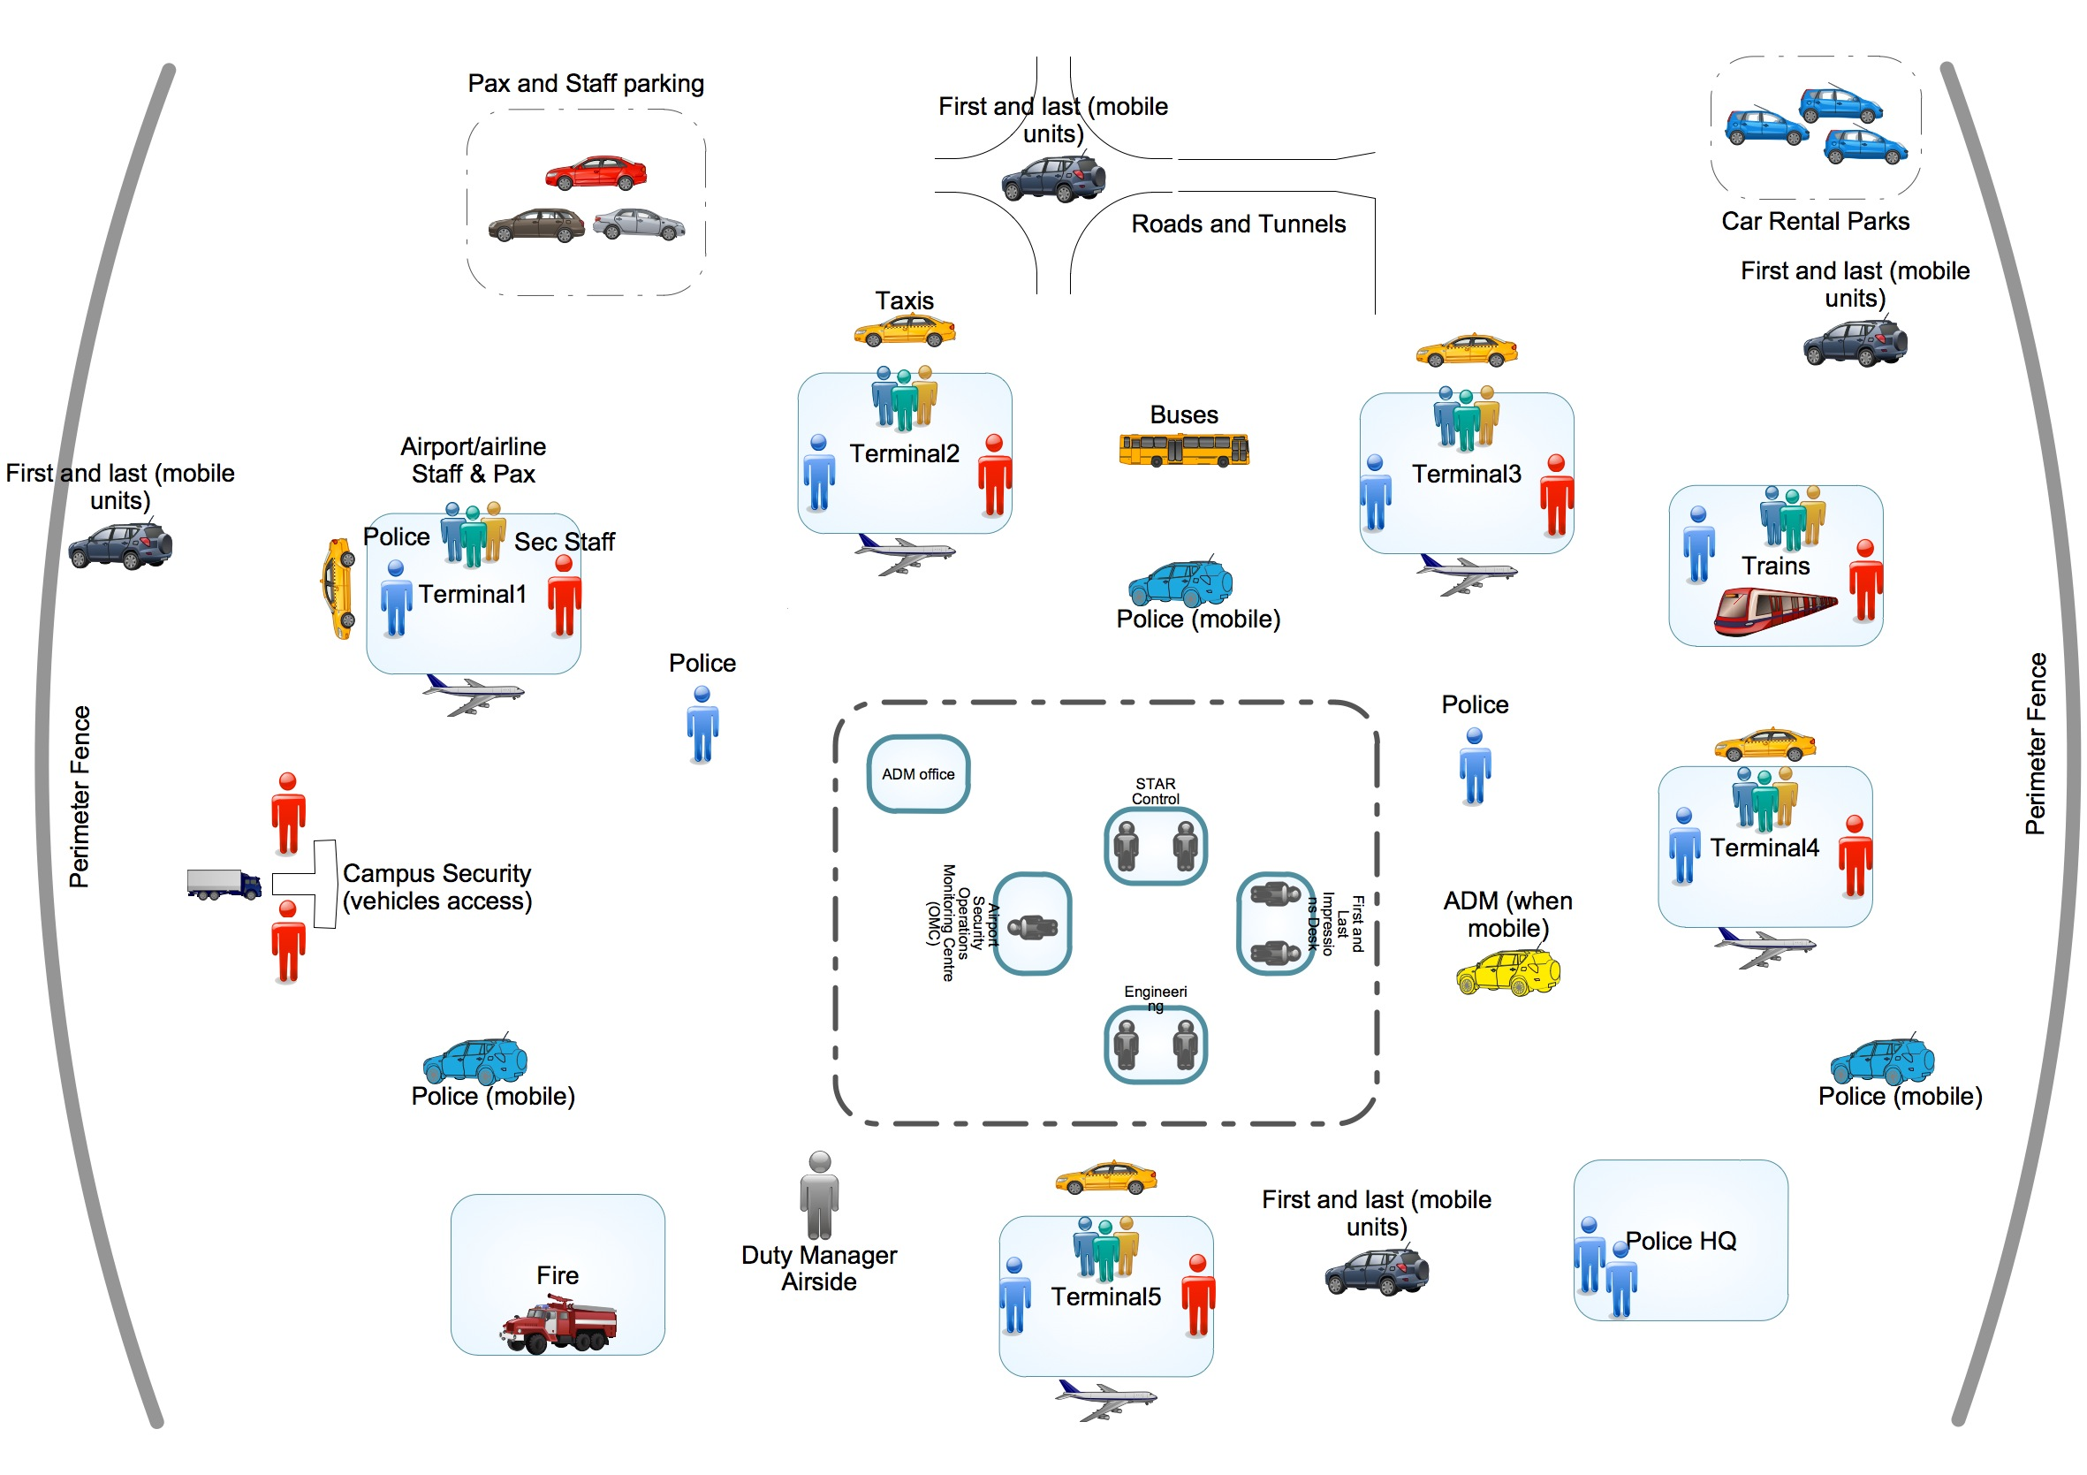
TASS is about the whole airport community!

Slide 10
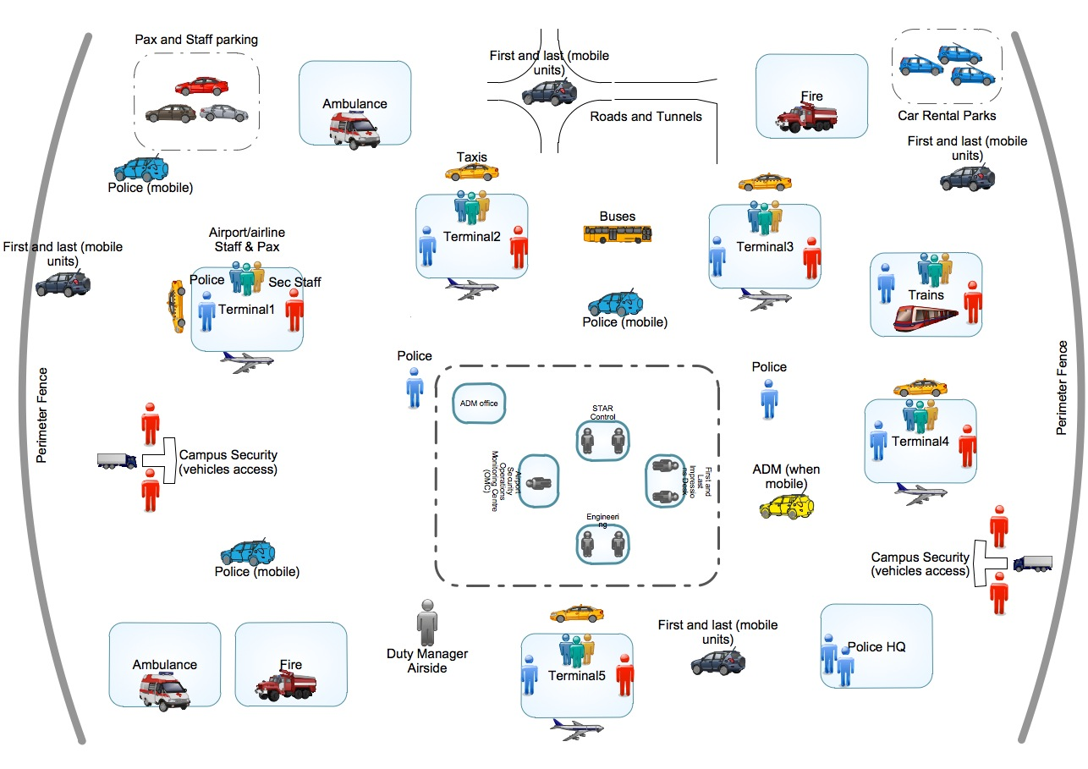
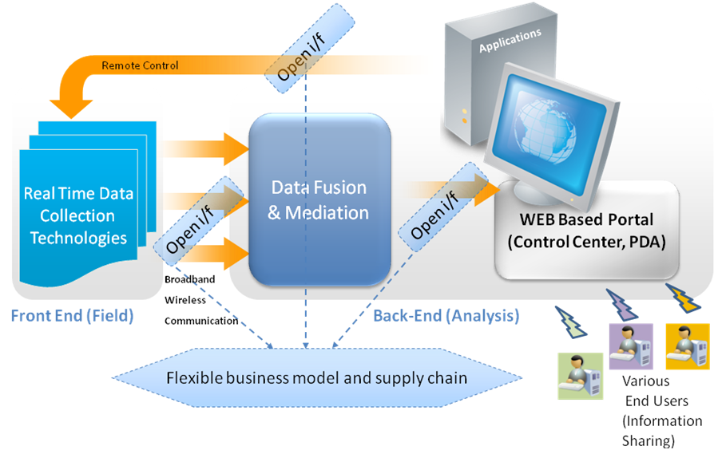

Slide 11
Asking the right questions up front
What is the TASS system?
A sociotechnical activity system
Why is it being developed?
Understanding threats and vulnerabilities
Understanding the benefits (and the costs)
Who will be affected by it?
Primary, secondary, tertiary users…
Upon whom does the system depend?
What do they need, why do they need it and how do they need it?
How will it impact on airport operations (the activities of others)
How do we measure its success (outcomes)?
What constraints are there from the start?
Legal, ethical, moral, cultural, privacy…

Slide 12
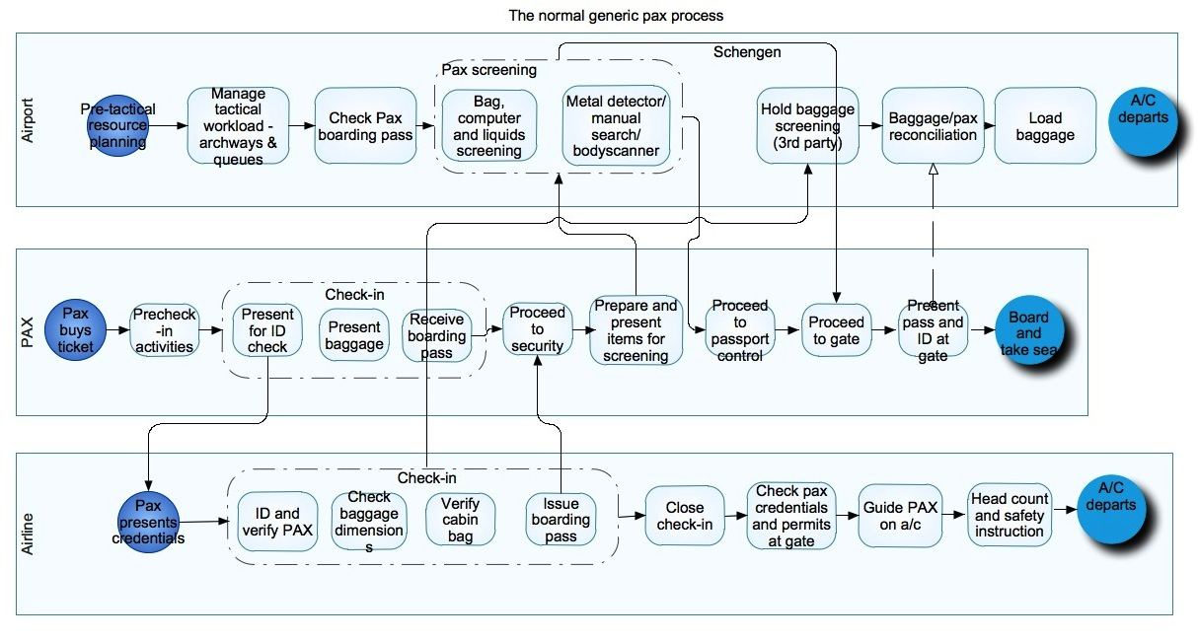
Understanding operations, as enacted by people

Slide 13
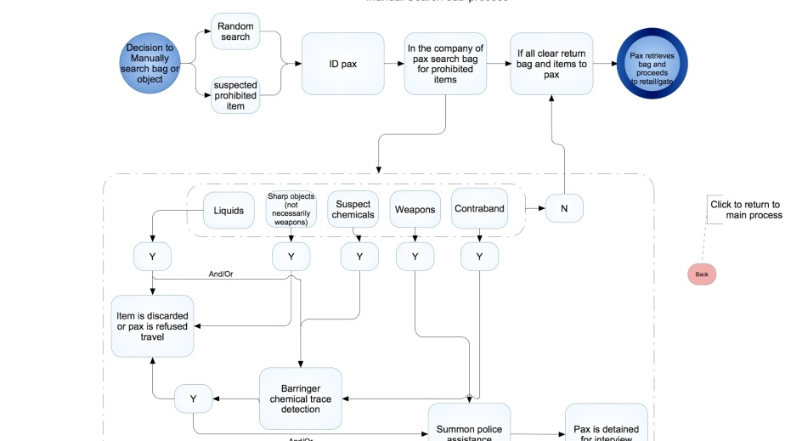
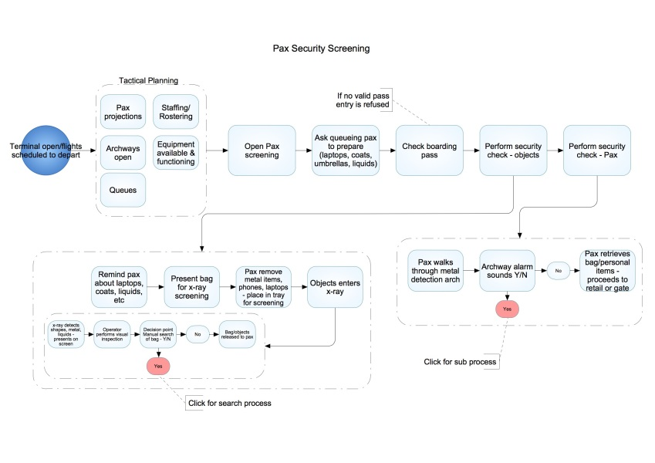
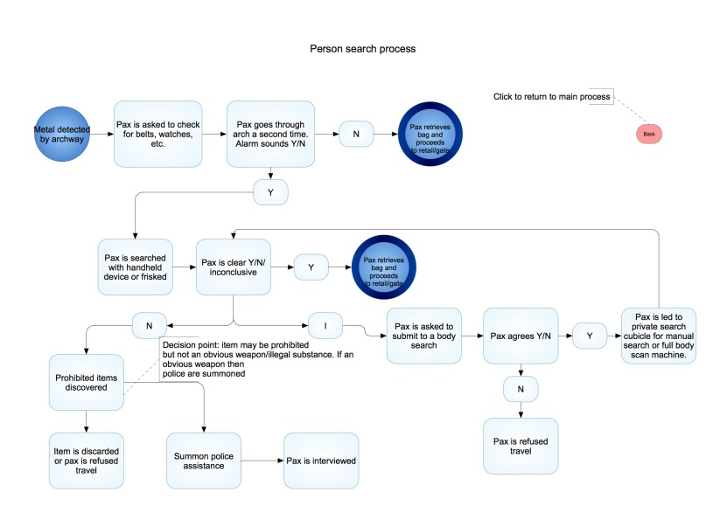

Slide 14
Activities
Activities are motivated
Activities are object-orientated
Activities are mediated by artefacts
Activities are both social and personally meaningful
Activities involve a division of labour – we rarely work/act alone. Action is articulated and coordinated.
Activities are often contradictory…

Slide 15
The Activity System approach
TASS
Mediator
Subject (TASS controller)
Object Suspect person/bag
Outcome Threats neutralised,
Disruption minimised
Constraints
Legal,
Ethical,
Privacy,
Cultural
Division of Labour
ADM
TDM
Security officers
Police
Etc…
Community
All airport staff,
Airlines,
Retailers,
Passengers
Notes:
First we start with the notion of a person (subject) attempting to achieve a goal (object).
This object-orientation has a basic motivation which is linked to the outcome. We know our activity has been successful when we have achieved our desired outcome (or not as the case may be). This very simple scheme allows us to understand what an individual is doing by looking at what his object and motivation is. This a deeper understanding than that which you get from simply observing his behaviour. Think about the difference between observing a suspect loitering in an airport and knowing that he subscribes to a particular radical ideology. It puts the loitering behaviour into a much more meaningful context. By understanding this motivation we can start to anticipate a set of possible outcomes that he is trying to achieve, and therefore understand what his object may be (e.g., detonate a bomb).
Of course his attempt to achieve his object will be mediated by tools and methods at his disposal. This is critical as the choice of mediating artefact (tool) will have a determining effect on the object and outcome. For example, a terrorist that decides to create carnage (outcome) in an airport may choose to use an automatic weapon or a chemical/biological weapon (mediator). This will determine how he will deploy it, e.g., shoot up a check-in area (object) or infiltrate the ventilation system (object). In either case the means used will influence the object and the outcome as well as the response by police, etc.
We are rarely dealing with someone who is acting entirely alone. They are usually part of a larger organisation, even if it is just a small conspiracy. There is usually a political or religious ideology linked to that community (cultural). Even in the case of a “lone nut” attacker, someone may help them to acquire a weapon, gain access, they may have gotten the idea from some literature they read or from TV.
People working within an organisation also have a division of labour. People on whom their activities depend and are dependent. A person’s activity is rarely self-sufficient and therefore we need to factor in this social organisation and coordination of activities between people who are working towards different objects but aiming for the same overall outcome (at least that is the assumption, it may not work). So, Police, security personnel, ADMs, etc., all have different objects (detection, suspect apprehension, management of situation, etc.) but all (presumable) are acting to achieve the same overall outcome, the resolution of a security threat.
People in the course of pursuing their activities are also governed by constraints or rules which are limits within which their activities can expand. These include ethical, legal and privacy constraints, SOPs, codes or practice, as example of formal constraints but also social mores and cultural norms can act as constraints on a person’s activity.
The overall critical aspect to this framework though is not the nodes in themselves as we have just outlined but is is the interactions between them that are particularly crucial to understand. In other words, the line between them are just as important as the nodes themselves.

Slide 16
What is CONOPS?
A user-oriented document that describes the characteristics for a proposed asset or system from the viewpoint of any individual or organizational entity that will use it in their daily work activities or who will operate or interact directly with it.
Not a detailed requirements specification document. It communicates the vision for the future operation and where the innovation fits in and affects it.
The DHS define a CONOPS as, “…both an analysis and a formal document that describes how an asset, system, or capability will be employed and supported…The CONOPS is a communication vehicle to inform…stakeholders of the intended uses and methods of support of assets, systems, or capabilities,”
From a defence point of view a CONOPS is “A verbal or graphic statement that clearly and concisely expresses what the joint force commander intends to accomplish and how it will be done using available resources”.
The essence of CONOPS is communicating the vision or intention or basic motivation behind the operation or design project.
Napoleon and the Austerlitz campaign
Notes:
Towards achieving our aims in HOMER we have been working with a methodology based on the notion of Concept of Operations (CONOPS).
These are a number of different definitions or perspectives on what a CONOPS is. It is used within software development as a document that communicates the Vision for a proposed system. It is not a detailed requirements specification document but it does allow the user to see clearly how the proposed innovations will affect them and how the various human and technical aspects of a system interact with each other in operational context.
In military and crisis management, where you have joint forces and various collaborating agencies, a CONOPS represents an operational plan or schema that allows the participating actors to see what the goals of the operation are, what their roles are and how their activities intersect with those of others involved in the operation.

Slide 17
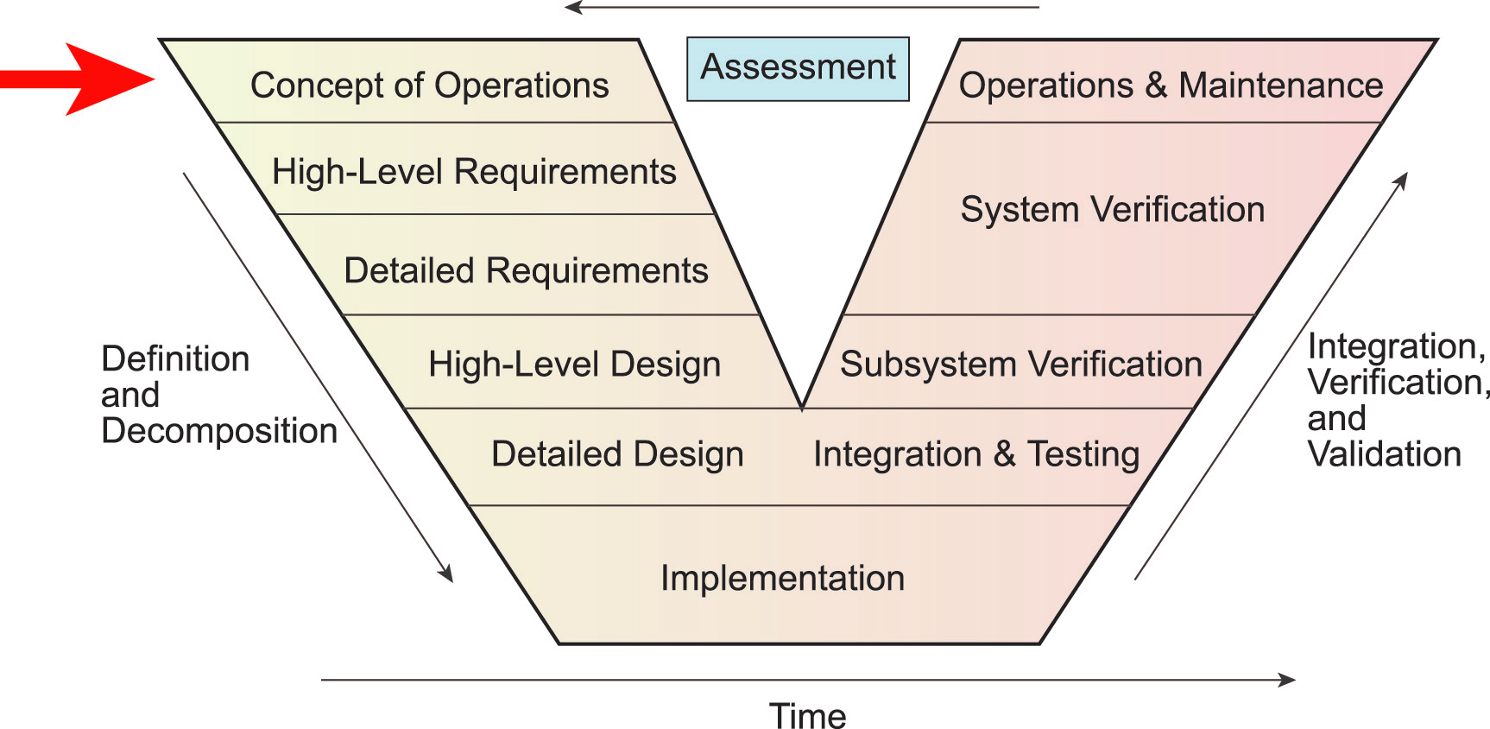
CONOPS and the V cycle
Notes:
Typically within the systems development V cycle, a CONOPS is developed at the start of the process and provides a conceptual basis for exploring the problem space and the further definition of specific requirements. In reality however, due to the cyclical nature of most real-world design processes, the CONOPS can be defined following a process of fieldwork orientated towards understanding the reality of operational work and activity and identifying the opportunities for change. Of course, change may also result from an external impetus such as security or regulatory requirements and thus the CONOPS may be partly defined with reference to outcome targets associated with change, but there needs to be a clear relationship and trajectory between the current or as-is system and the proposed or “to-be” system.

Slide 18
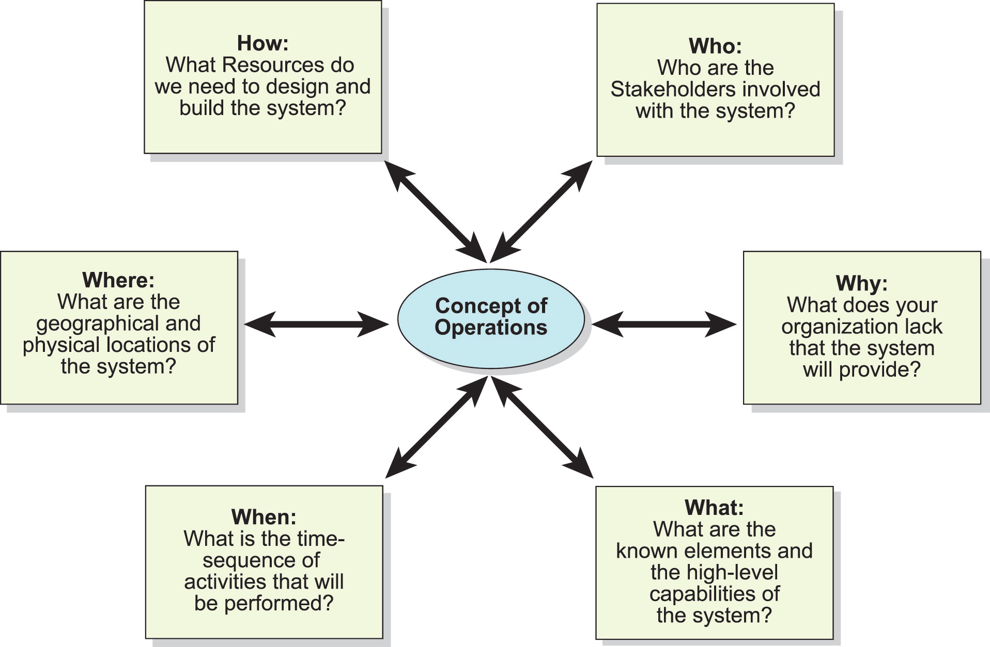
What does a CONOPS include?
Notes:
In general terms a CONOPS is developed by asking a number of basic questions related to the operational vision of the proposed system based on the who, why, what, how, when and where. It doesn’t matter about the order of the questions but the integration of the answers to them is very important.

Slide 19
An Activity-centred CONOPS
From user-oriented to activity-centred;
Defining the operational conditions from the perspective of the people in the system and the relative roles of tools and resources;
Anticipating the impact of changes of users:
capability changes – adding deleting and modifying functions;
System processing changes
Interface changes
Personnel changes
Environmental changes;
Operational changes, such as changes to the user’s operational policies, procedures or methods;
Support
Notes:
The IEEE standard template for CONOPS development is user oriented document. Our approach within HOMER is to take this further with an Activity-Centred approach which seeks to map or describe the activity of operational personal relative to their operational objectives and the overall motivation for this. We then seek to map the relationship between one actor’s activity with the intersecting activity of other operational staff with different operational goals.
Our first step is to describe in detail current practive (the “as is”) including the personnel roles, their objectives, resources, task structure, etc, and then to identify the opportunities for change and improvement and map the innovations described earlier into this operational picture.

Slide 20
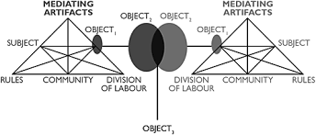
Boundary objects and contradictions
Notes:
Having mapped the activities of various operational staff with their distinct roles we are then concerned with how they intersect, which is sometimes highly complementary and contiguous but sometimes involves contradiction or conflict. For example, security restrictions where officers may have a certain need-to-know status which limits the extent to which they can have access to information about an investigation.
Contradictions are tensions or inconsistencies in the activity system or between systems
Primary: are contradictions within a node, for example using a tool that is intrinsically inadequate, faulty or obsolete;
Secondary: are contradictions between nodes, such as a well made and designed tool being used for the wrong task;
Tertiary: contradiction between an existing activity and target stage activity in the future, which may be manifest in the organisation’s preparedness for change or external challenges;
Quaternary : between parallel activities where there is an interdependency (e.g. the activity of gathering forensic evidence and making a scene safe) ).
Such contradictions need to be identified and solutions found through design. For example, with the HOMER KMO, this involves assigning personnel to different user-groups corresponding to their clearance level and need-to-know.

Slide 21
Contradictions
Contradictions are tensions or inconsistencies in the activity system
Primary: located within each constituent component (e.g. quality)
Secondary: occurring between nodes e.g., contradiction between competence and tool or task and tool design
Tertiary: contradiction between an existing activity and target stage activity (change context such as upscaling or system replacement)
Quaternary : between parallel activities where there is an interdependency.

Slide 22
Contradictions
Contradictions can be identified as disturbances in the free running of the activity (Engeström, 1999).
Therefore, such disturbances are the symptoms of the underlying contradictions.
Understanding the functioning of a complex sociotechnical organisation requires looking at much more than the technical system
This is of critical importance for design

Slide 23
Common themes
Complex operational reality
Different stakeholders with different aims and objectives
Complex technological space
Intra and inter organisational cooperation and coordination
Technological innovation
New technologies
New uses for technologies
Emergence
Not everything that happens is planned for
Not everything that is planned for happens
Not everything the that is planned, and that happens, happens in quite the way you expected
Meaning and value are emergent
The Dark Matter
Tacit knowledge
Black books
The taken-for-granted fabric of everyday life
The professionals know their job better than anyone else but sometimes it takes an outsider perspective to ask the silly, obvious questions, about which the practitioners rarely reflect on.

Slide 24
Thank you
Questions?

