Slide 1
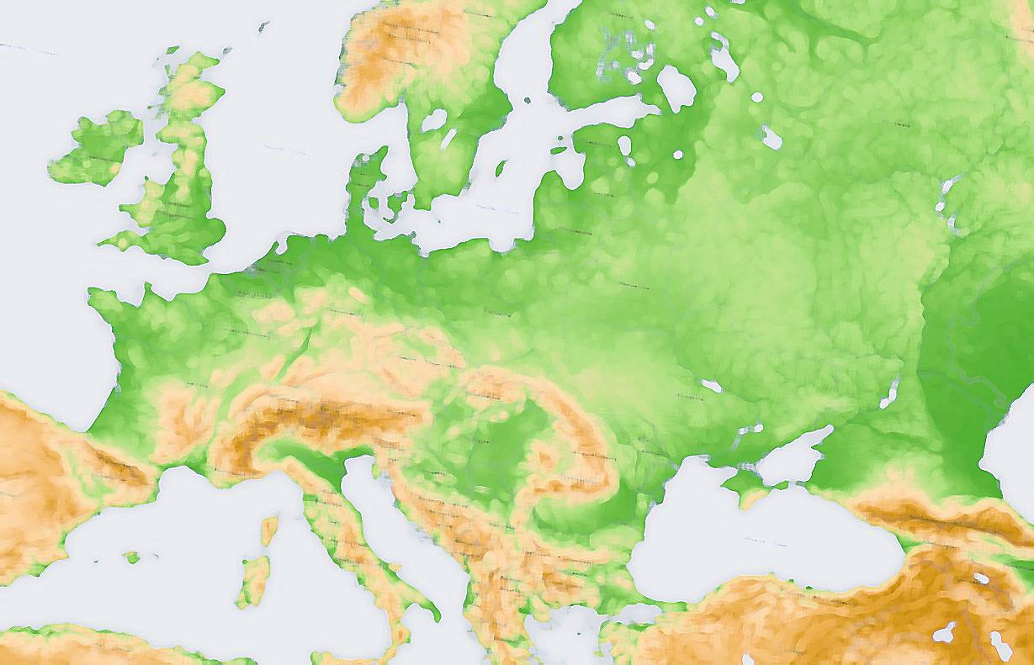
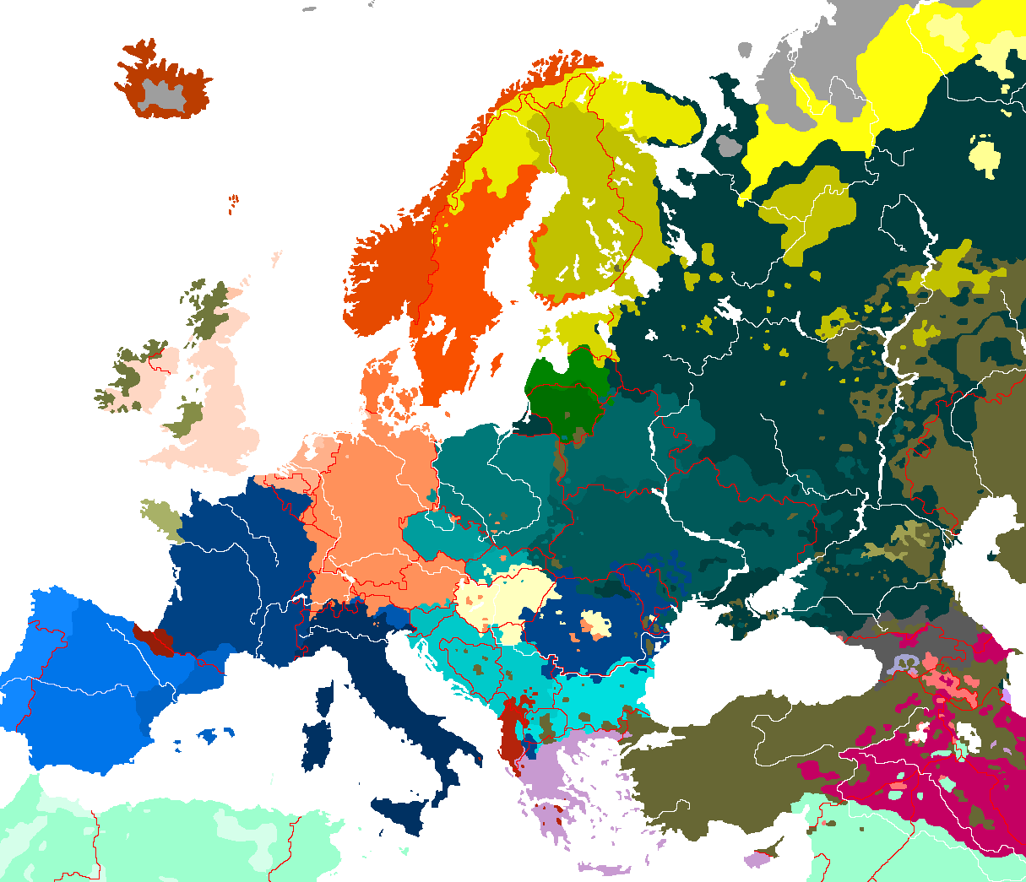
Maynooth Centre for European and Eurasian Studies Seminar Series 2014-2015
25th November, Tuesday, 4pm-6pm
Dr Timofey Agarin
(Queen’s University Belfast)
Why democratisation is not a panacea:
National and ethnic conflict after communism
Seminar Room (First Floor), Iontas Building,
Maynooth University
All Welcome

