Slide 1
Dept. Finance Report Training
Sept 2022
Cheryl Forde - Business Partner Academic Departments
Treasa Lawler -Business Partner Support Areas

Slide 2
Business Partner Role
The role is to act as a ‘translator’ and is the first point of contact with finance queries
Provide 'real time' support and analysis, to be a trusted adviser and to add value that will assist in decision making.
Assist and liaise with Deans; Heads of Departments/Support Areas and Administrators on all financial and policy matters
Quarterly Review; monitoring income, expenditure and reserves (balances carried forward if applicable) and compare these to budget, forecasting to end of year
Review operational budgets and requests for new resources
New Business Unit set up
Advise and guidance on operational issues e.g. forms and codes
Training on financial reports

Slide 3
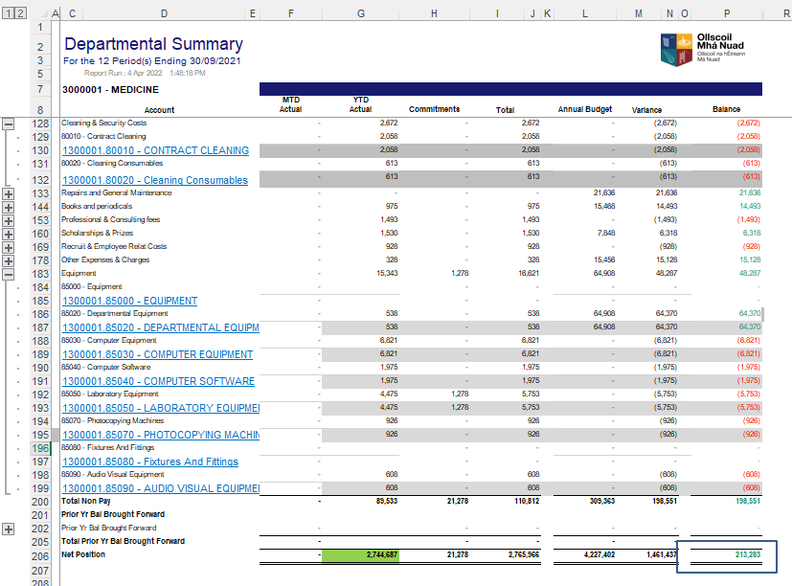
Recap: Department Summary (Recurrent)
- DRILL DOWN
- BALANCE

Slide 4

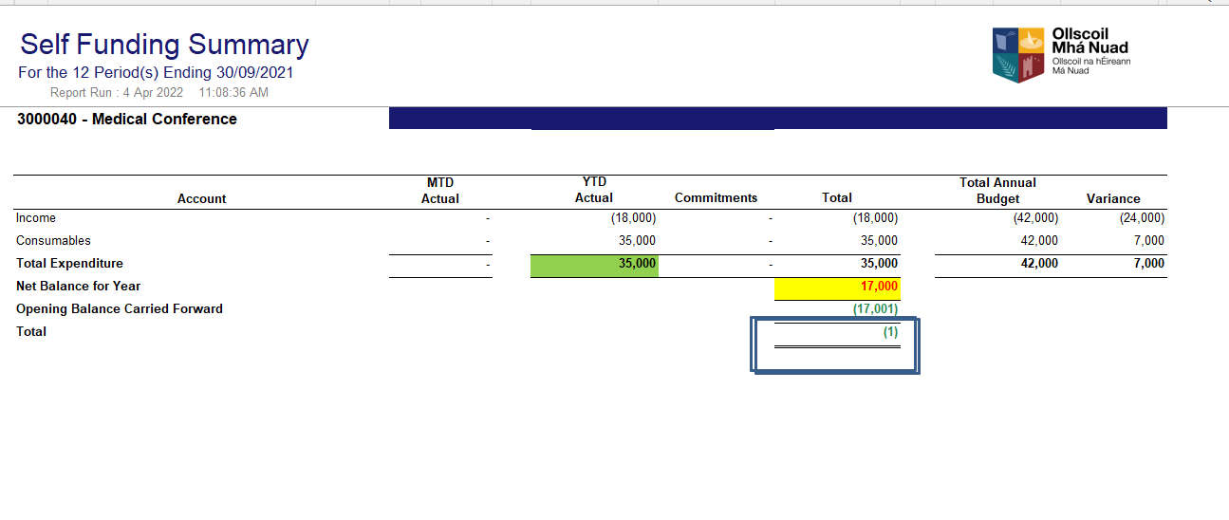

Recap: Summary Self-Funded
- Drill Down - Total Actual
-Actual Income & Spend

Slide 5
Recap: Transaction Reports
It is a list of all income and expenditure transactions. There are no balances forward or budget amounts shown in this report.
There are 2 options: Transaction by Period (month) or Transactions by Account ( spend type)
Depending on the parameters – assume you run it to period 12, it will show you the list of all transactions to date for the current FY ( fiscal/financial year)
  Year 2022 1st Oct 22 to 31st Sept 23
  2022/23 From: Year Period 2022-01 To: Year Period 2022-12
Income is shown as a minus (-) on the report
Spend is shown as a plus (+) on the report

Slide 6
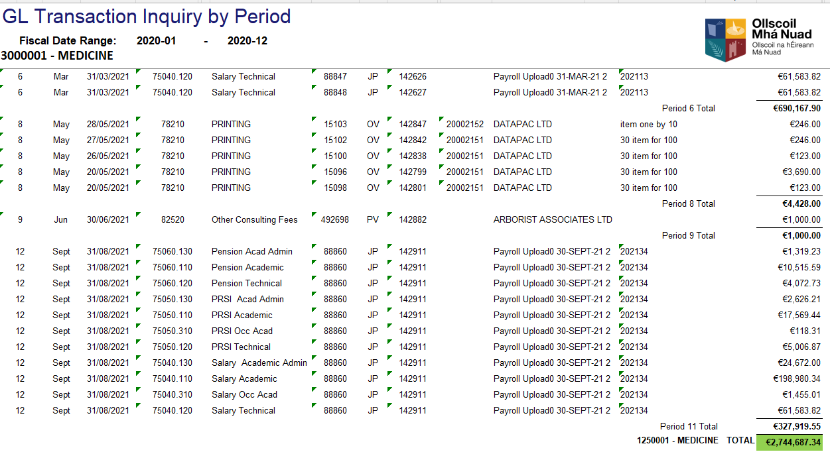
Recap: Transaction by Period – linked to Financial Summary

Slide 7
Cut-Off: Very Important to know
September is very important in Finance as it is the cut-off between the end of one financial year and the beginning of another. Financial year: e.g. 01 Oct 21 to 30 Sept 22 (21/22) Or 01 Oct 22 to 30 Sept 23 (22/23)
Periods go from : Oct= Period 1, Nov= Period 2 …Sept= Period 12
You will see adjustments in the transaction reports – accrual/deferral
Expenditure: Sept Electricity Bill (21/22) is not received and paid until Oct (22/23). We need to recognise this before it was paid as it relates to the financial year 21/22 . Take it out of 22/23 = credit (-). Put it into 21/22 = debit it (+). Description on system will be Accrued expenditure/Accruals

Slide 8
More Examples…Expenditure
Expenditure which is POP Exempt You order and are invoiced and then pay for water coolers in Sept 2022 (21/22) but do not get delivery until Oct 2022 (22/23). We need to recognise this after it was delivered as it relates to the future financial year 22/23. This is when it will be “consumed/used”. We need to take it out of 21/22= credit (-) and put it into 22/23= debit(+). System description will be Deferred Expenditure.
Expenditure: Subscriptions (Prepayment),paid for in 21/22 but which relate in full or in part to 22/23. We need to push out the portion of the cost that relates to 22/23. Prepaid Expenditure.

Slide 9
More Examples…Income
Income: You are owed fee income from the HEA relating to 21/22. You receive the fee income in Oct 2022 (22/23). We need to recognise this fee income in 21/22 as it relates to this financial year. We need to reduce the Fee income in 22/23 = debit ( +) and increase the Fee income in 21/22 = credit (-) System description will be Accrued Income.
Income: You receive an advance payment/payment up front for a new course in Sept 2022. We need to push this out to the next financial year. Reduce income in 21/22= debit(+) and increase income in 22/23= credit (-). System description will be Deferred Income.

Slide 10
Things to Remember – Let us Know
Changes to the Core pay budget that will increase the Occasional pay budget – recruitment delays, sabbatical leave, staff on long-term sick pay, maternity leave.
Visiting professors – these will impact the budget both pay and non-pay.
If you believe you will run a deficit- let us know as soon as possible
“New Asks”- position paper to the UE member/Dean for approval. We will facilitate you with the costings for the submission.
If in doubt about anything pick up the phone.

Slide 11
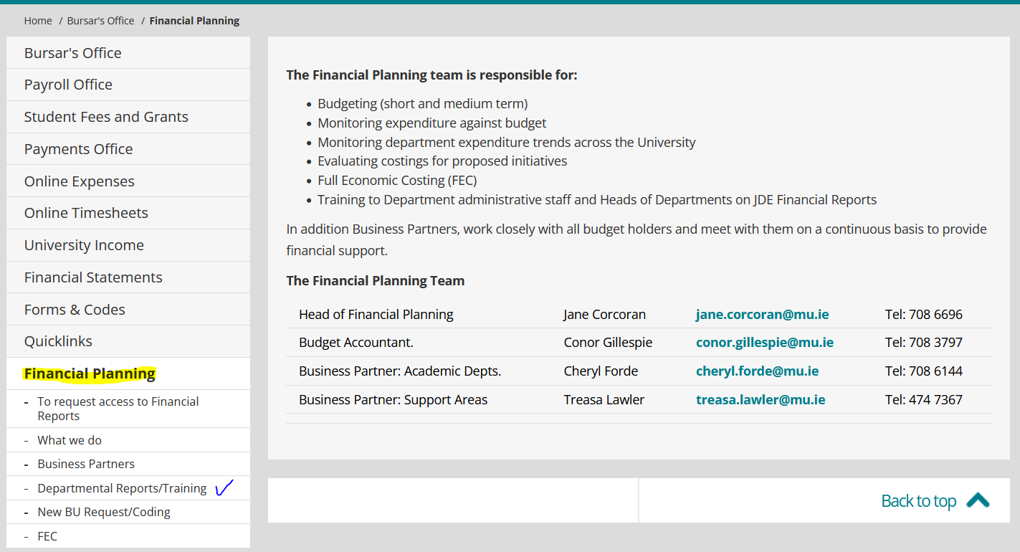
Where to go for help – Financial Planning

Slide 12
Where to go for Help - Finance
To check if a supplier has been paid/ general payment query – Email Accounts Payable Enquires (apenquiries@mu.ie)
All invoices are to be raised through the Income Office. To raise an invoice or to query income coded/miscoded- Email Ray Dully (ray.dully@mu.ie)
On-line time sheet queries or access to reports should be directed towards the Payroll Office – help-sheets on Bursar’s webpage
On-line expense queries should also be directed towards the Accounts Payable Office – help-sheets on the Bursar’s webpage

Slide 13
Procurement Recap
Order value less than €1,000 - goes straight to supplier automatically: Requistioner Supplier
All Requisitions are approved net of VAT: Requisition-PO +VAT PO to Supplier
OV (the new PV): to confirm payment contact the Payment’s Office
Delivery charges of less than €50 are automatically approved
Matching tolerance of 1% or (€100) is allowed by system
No Splitting of Costs: 1 Requisition to 1 BU
All specific POP related queries to be directed towards the Procurement Office – (pophelpdesk@mu.ie)

Slide 14
Purchase Order Process (POP)
“ No PO, No PAY POLICY” – Only Supplier invoices with a valid PO number which has been created before the receipt of any goods or any service will be paid from 01 Sept 2022. A limited number of exemptions would include e.g. utilities, taxi fares, conference fees, professional memberships et..
Non-POP purchases (exempt/outside the scope of POP) included – UIs: personal expenses, payroll, postage etc
Best practice: Keep on top of Receipting – it keeps the Commitments figure low. Commitments convert to an actual once they are receipted. System provides no reminders/alerts. You can only receipt once the goods or services are received/consumed.
Create Draw Down orders where possible. These are POs for an estimated amount to cover for spend throughout the year ( max 12 months), with an agreed supplier for a single service. i.e. consultancy fees, subscriptions etc…

Slide 15
Going Forward
Keep in touch – any questions just ask
Quarterly reviews with all areas. This information feeds into the quarterly HEA forecasts which college must submit.
Training available – online as per webpage https://www.maynoothuniversity.ie/bursar/finance-projects/departmental-reportstraining. Additional group training available on request.
Feedback is always welcome.

Slide 16
People: Who we are?
The Financial Planning Team
  Jane Corcoran, Head of Financial Planning Ext. 6696
  Cheryl Forde, Business Partner – Academic Depts. Ext. 6144
  Conor Gillespie, Budget Accountant Ext. 3797
  Treasa Lawler, Business Partner – Support Areas Ext. 7367

Slide 17
Questions ???
Q&A

