Slide 1
Timetable Questions & Answers

Slide 2
Key points
What are the timetabled hours in Maynooth University?
Monday-Thursday 9.00-18.00 and Friday 09.00-17.00
Classes can be scheduled any time between these hours
When will I see my personal timetable?
Students will begin to see modules on their timetable once their registration is processed by the Student Records & Registration Office.
It will take a few days for all modules to appear
Changes to registration will result in changes to your timetable
Where can I find my timetable?
Timetable :: Home - Home (maynoothuniversity.ie)
Timetabling Office – Timetable@mu.ie

Slide 3
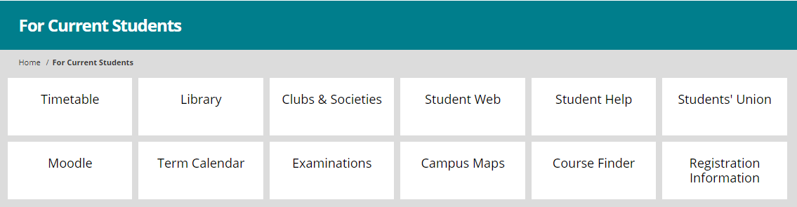
General timetable information
Click on the ‘Current Students’ link on the Maynooth University home page.
The course finder brings you to detailed information in relation to your course – including semester information, how the module will be assessed, what modules are required, etc.
Important dates are outlined in the term calendar – including breaks and exam dates!
The timetable link will bring you to the academic timetable
Timetabling Office – Timetable@mu.ie

Slide 4
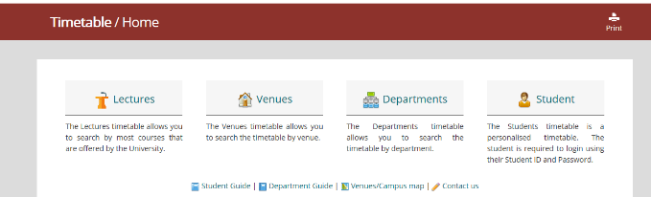
Accessing your timetable - Timetable :: Home - Home (maynoothuniversity.ie)
Timetabling Office – Timetable@mu.ie
Notes:
Timetable :: Home - Home (maynoothuniversity.ie)
Student – personal timetable
Departments – e.g. English, History, School of Law and Criminology, etc
) Lectures - allows you to search by course e.g. BACHELOR OF ARTS 1 (MH101)
2) Venues – allows you to search to see what’s in a room at a given time (more relevant for academic departments than students)
3) Departments – allows you to see every activity i.e. both Lectures and Tutorials for the Department
4) Students – this is a personalised timetable that you need to log in to view. There is work involved in allocating students to classes to make the personalised timetable work and this takes some timeThere are guides and useful information available at the bottom of the page.

Slide 5
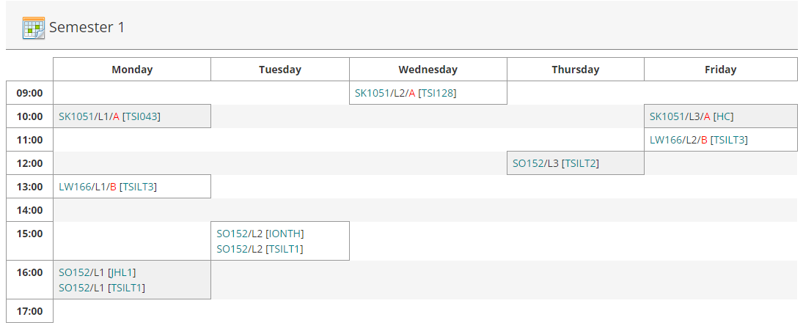
Understanding your personalised timetable
Timetabling Office – Timetable@mu.ie
Notes:
Module code appears first – L1 means lecture one (of 2 or 3)
Venue appears in square brackets [JHL1 – John Hume Lecture Theatre 1], TSILT3 is TSI Lecture Theatre 3.

Slide 6
‘Reading’ the timetable- key points
L1/L2/L3, etc. refer to Lecture 1, Lecture 2, Lecture 3. Most modules have 2 lectures per week and students need to attend all of these.
Classes are generally 1 hour long with the lectures as two separate hours in the week. However, sometimes the lecture will be 2 hours long occurring only once a week.
T1/T2 or TUT1, TUT 2 refers to tutorials. (In general students do not need to attend all of these, but will have a choice about which to attend – see your academic department for further information)
E.g. EN243 has 3 of tutorials – EN243/T1 – that show on the timetable, but students will choose one of these 3 tutorial
P1, P2, P3 refers to practicals. These are managed by the relevant academic department.
The registration system will allow students register to modules that may have a timetable clash. The student must check the times of modules before they register to ensure there is no clash.
Timetabling Office – Timetable@mu.ie

Slide 7
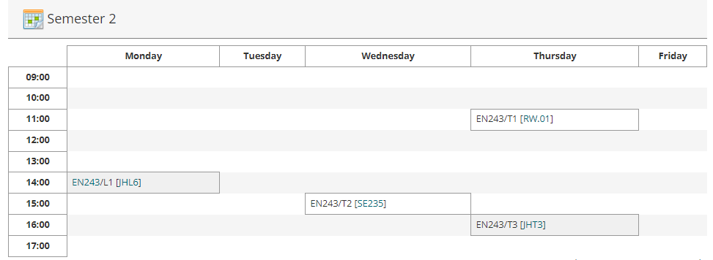
Example of Tutorials

Slide 8
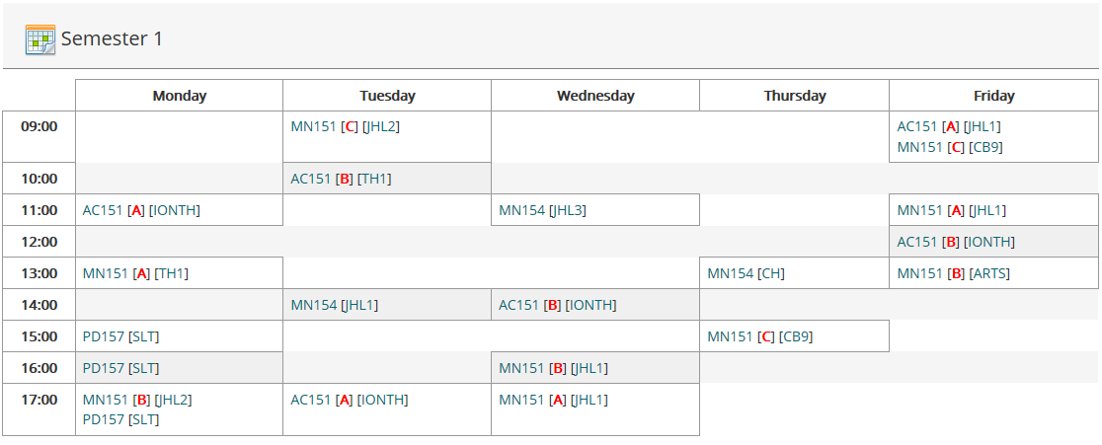
Modules and classgroups
Some Business, Maths, Economics and Law modules are delivered more than once; on the general timetable, they will appear with [A] or [B] or [C] after the module code
They are not clashing! Students registered to classgroup A of MN151 will be registered to either classgroup B or C of AC151, and so on.
Your personalised timetable will only show the group you are registered to and these are the lectures you should attend!
If you require to be in a different classgroup, please email the Timetable Department and we will move you where possible.
Timetabling Office – Timetable@mu.ie

Slide 9
Critical Skills
If you are doing Critical Skills you will have registered to a particular group through the registration system (a different core hour group) . SK1051, SK1052, SK1053, SK1054, SK1055, or SK1056.
All classes in each group are on at the same time. You will be further allocated into classgroups, (such as SK1051/A or SK1051/B). See your personalised timetable to see which class you have been allocated to.
As all classes in your group are on at the same time we will not be able to facilitate moves between classes.
If, for any reason, you need to move to a different group (e.g. from SK1051 to SK1052) you will need to deregister from SK1051 and reregister for SK1052.
Timetabling Office – Timetable@mu.ie

Slide 10
Other points
The timetable is subject to change – especially venues
Not all contact hours are scheduled centrally and so will not appear on your personalised timetable – e.g. practicals, language labs, and tutorials.
Students must familiarise themselves with their own tutorial and practical timetable. Students are responsible for checking their own timetable prior to going to class.
Some modules – e.g. Business, some languages, are delivered more than once; students must attend their assigned times.
When emailing any office in the University(Timetabling, Student Records, etc.) always include your student number!
Note that this is not always available*; there will be an advisory message indicating if it is down for maintenance, etc.
Lots of change – especially to venues – in the first couple of weeks of term.
Timetabling Office – Timetable@mu.ie

Slide 11
Need help with your timetable?
Email: timetable@mu.ie
Phone : 01 7083626
https://www.maynoothuniversity.ie/timetabling
Timetabling Office – Timetable@mu.ie

