Slide 1
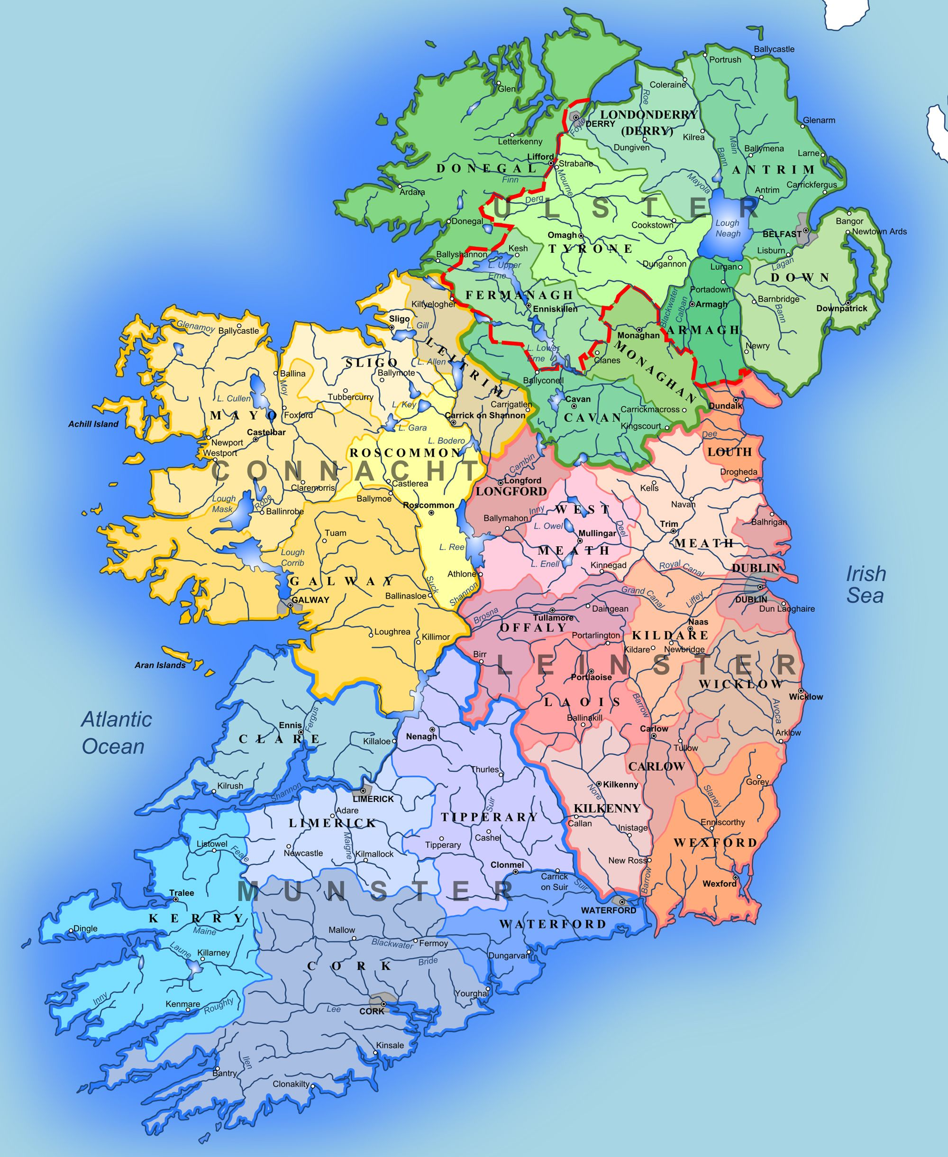
Blackrock Education Centre
Director: Dr Susan Gibney
Coordinator: Harry Freeman
Schools (7)
Sancta Maria College, Rathfarnham
Our Lady’s Terenure
Holy Child, KIlliney
Wesley College, Sandyford
St. Louis High School, Rathmines
High School, Rathgar
Rosemount, Sandyford
TL21 Centres and Schools
2019-2021
Wexford Education Centre
Director: Lorraine O’Gorman
Coordinator: Tommy Lanigan
Schools (5)
Knockbeg College, Carlow,
Presentation Secondary, Askea, Carlow
FCJ Bunclody
Good Counsel, New Ross
Gaelcholaiste na Mara, Arklow.
Sligo:
Formerly involved
Navan Education Centre
Director: Eadaoin McGovern
Coordinator: Sharon Kiely
Schools (5)
Athboy Community School
Ashbourne Community School
Eureka, Kells
Dundalk Grammar School
St. Joseph’s, Navan
MonaghanFormerly involved
Carrick-on-Shannon Education Centre
Director: Karen Devine
Coordinator: Gerry Kielty
Schools (7)
Castlepollard Community College St Finian’s, Mullingar Templemichael College, Longford Ardscoil Padraig, Longford Columba College, Killucan Ballymahon Vocational School Moyne College, LOngford
Carrick-on-Sh.
Athlone:
Formerly involved
Navan
Drumcondra
Drumcondra Education Centre
Director: Therese Gamble
Coordinator: Gavin Beirne / Lori Fields
Schools (8)
Balbriggan CC
Hartstown Community College
Manor House School, Raheny
Mercy Beaumont
Portmarnock Community School
St. David's CBS
Santa Sabina, Howth
St. Kevin's College, Ballygall
Dublin West
Kildare North
Dublin West Education Centre
Director: To be appointed
Coordinator: Mark Fennell
Schools (5)
Blessington Community College
St Kevin’s C.C., Clondalkin
Coláiste Bride, Clondalkin
Old Bawn Community School
Kingswood Community College
Kildare South
Laois
Kilkenny
Wexford
Kildare (North) Education Centre
Director: Siobhan Kavanagh
Coordinator: Martin Quirke
Schools (7)
Pipers Hill College, Naas
Meanscoil Iognaid Ris
Celbridge C.S.
Maynooth PP
St Mary’s College, Naas
Maynooth CC
Scoil Mhuire, Clane
Kildare (South) Education Centre
Director: Siobhan Kavanagh
Coordinator: Harry Freeman
Schools (7/8)
Cross and Passion, Kilcullen
Newbridge College
St Paul’s, Monasterevin
Patrician Secondary School, Kildare Town (2 cohorts)
Kildare Town Community School
Athy College
Gaelcholáiste Chill Dara, Naas
Kilkenny Education Centre
Director: John O’Sullivan
Coordinator: Martin Quirke
Schools (7)
Castlecomer Community School
CBS Thurles.
Colaiste Eamonn Ris, Callan
Coláiste Pobail Osrai, Kilkenny
Presentation Secondary School, Thurles
St. Joseph's College, Borrisoleigh
St. Mary's Academy, CBS, Carlow
Laois Education Centre
Director: Catherin Doolan
Coordinator: Leo Hogan
Schools (5)
Colaiste Choilm, Tullamore
Colaiste Iosagain, Portarlington
Killana Presentation, Rahan
Portaloise Colllege
St. Fergal’s, Rathdowney

