Slide 1

What is the point of the EU?
Summer School 2022
School of Law and Criminology
Prof Tobias Lock, Jean Monnet Chair in EU Law
@tobiaslock

Slide 2
What is the point of the EU?
  www.sli.do
    #EU1957

Slide 3
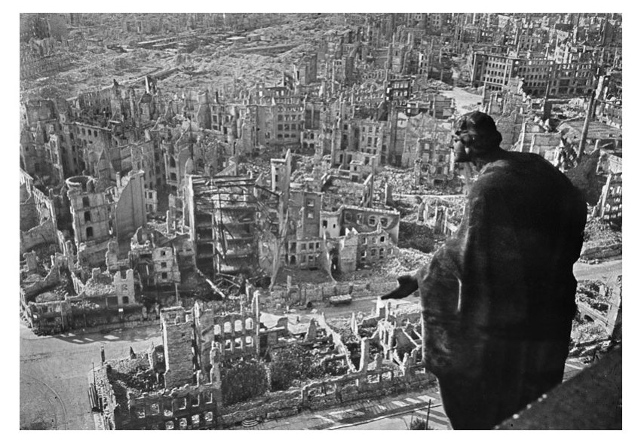
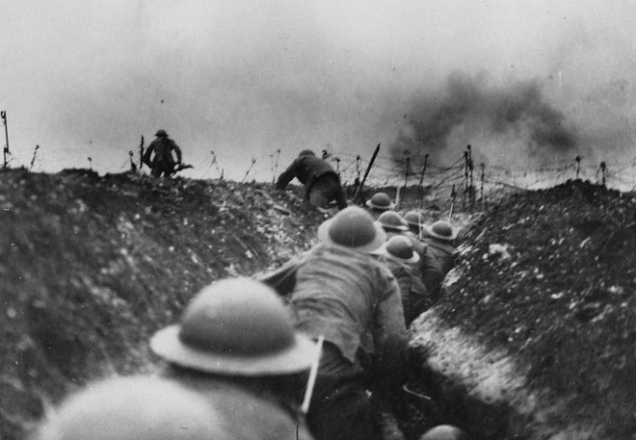
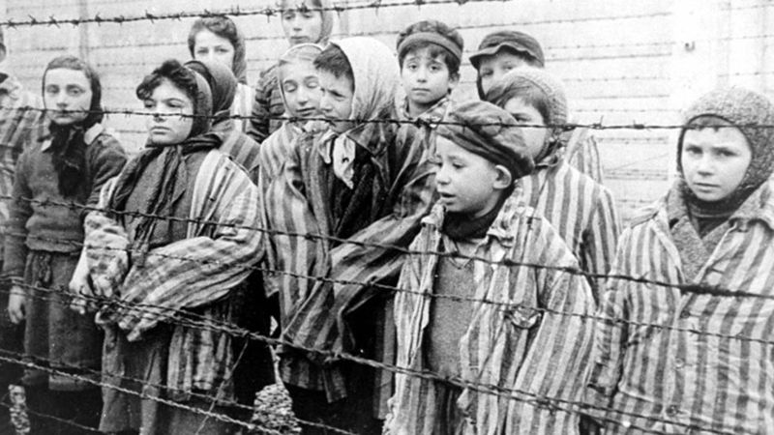
Where it started

Slide 4
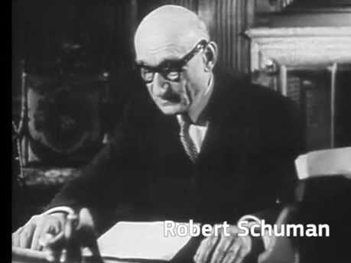
Origins of European Integration
Key: Schuman declaration
Robert Schuman (French foreign minister)
  https://youtu.be/c0dsdgpFjGo
  Franco-German production of coal and
  steel to be placed under a common
  High Authority.
  “The solidarity in production thus
  established will make it plain that any
  war between France and Germany
  becomes not merely unthinkable, but
  materially impossible.”

Slide 5
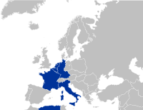
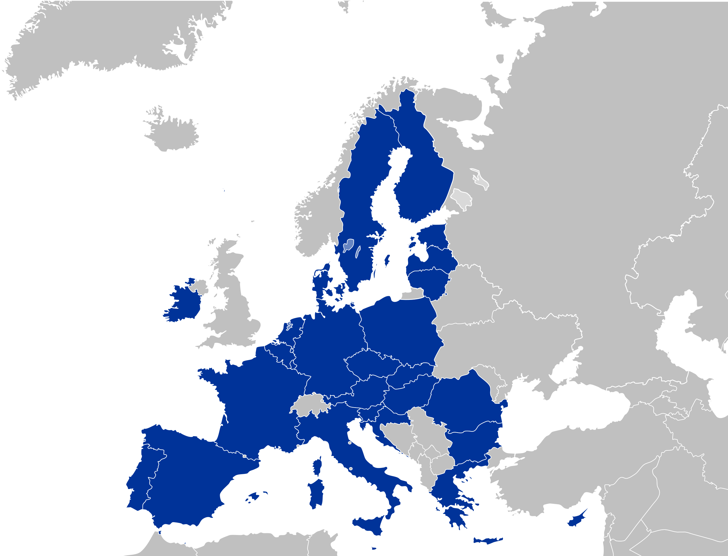
Beginnings
European Coal and Steel Community 1952
  Six Member States (but open to all)
    Germany
    France
    Italy
    Belgium
    Netherlands
    Luxembourg
1957: Treaty of Rome – European Economic Community
  became the European Union of today

Slide 6

So how does it work?
we now call it the
Single Market
At its heart: economic integration - the Common Market
  free movement of goods
  free movement of services
  free movement of factors of production:
    persons (=workers, but also companies)
    capital

Slide 7
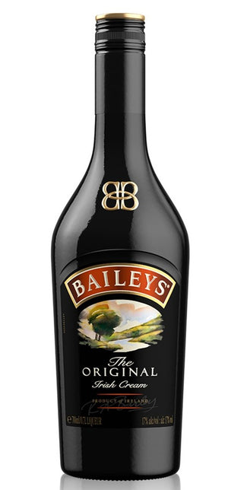
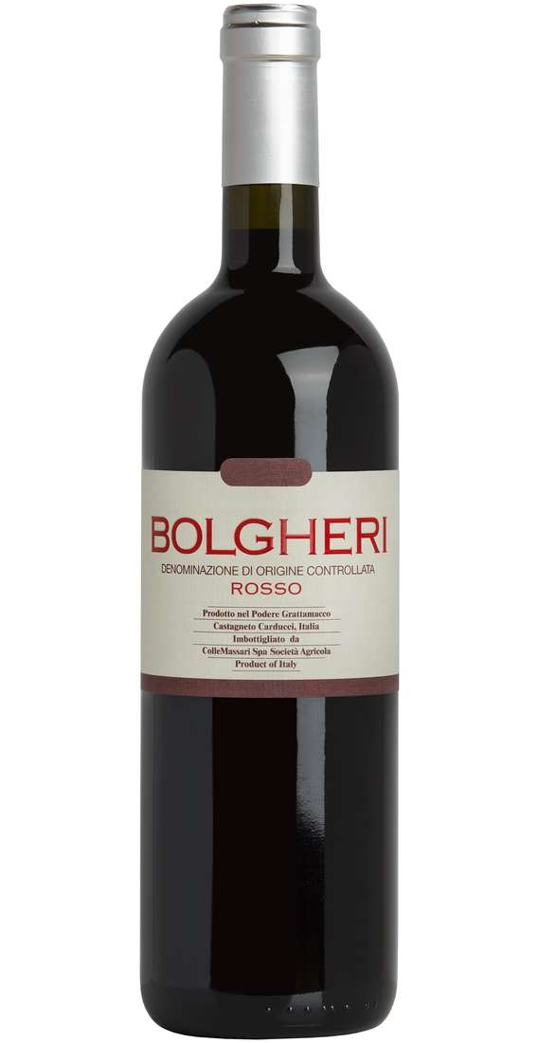
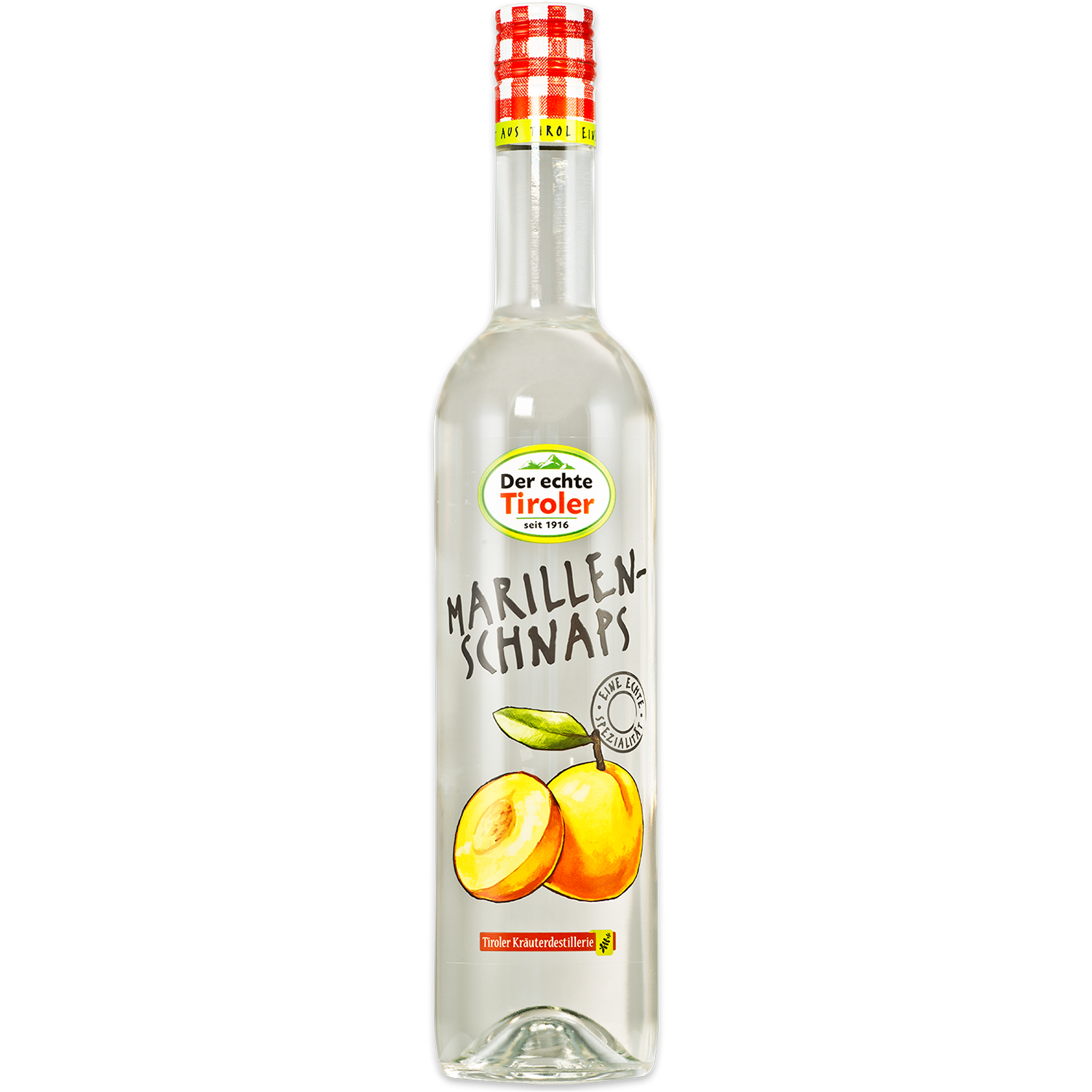
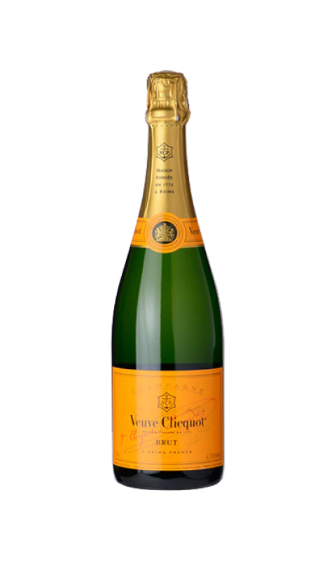
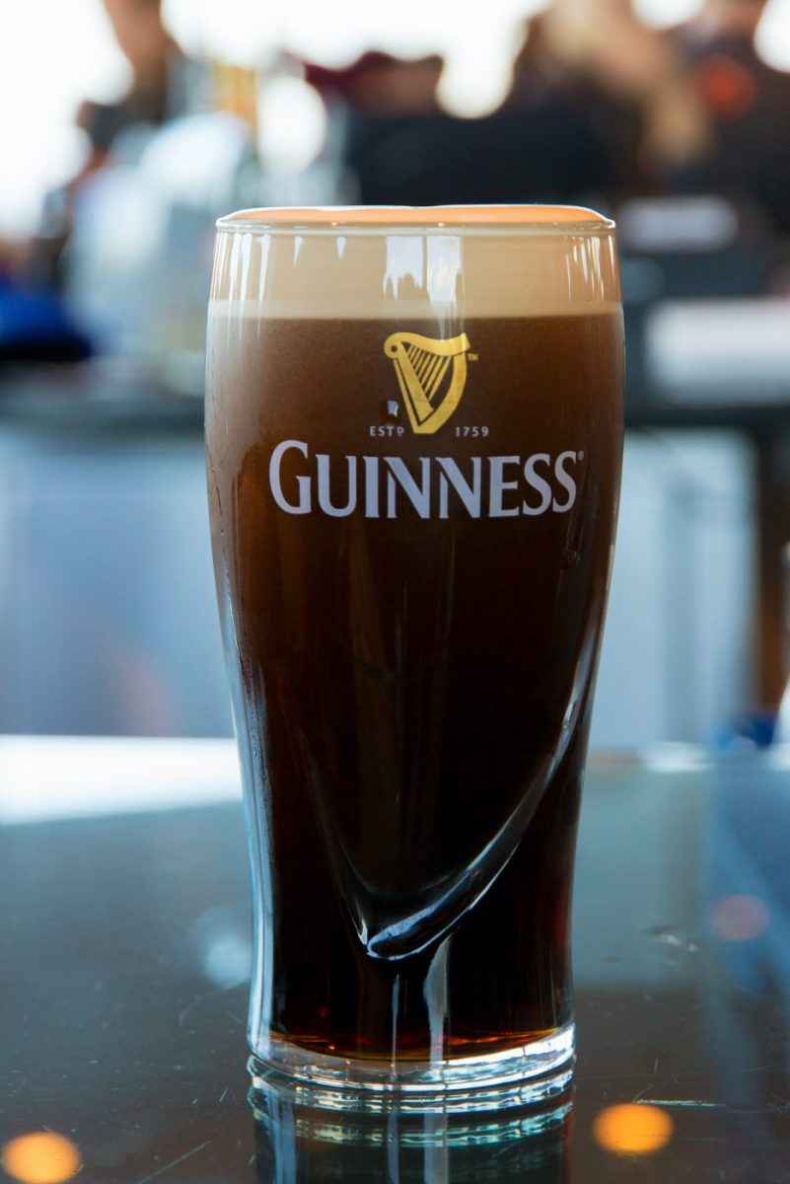
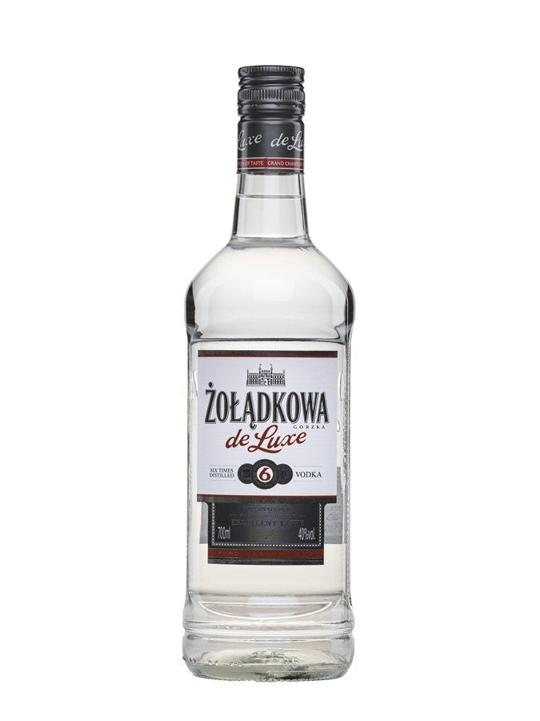
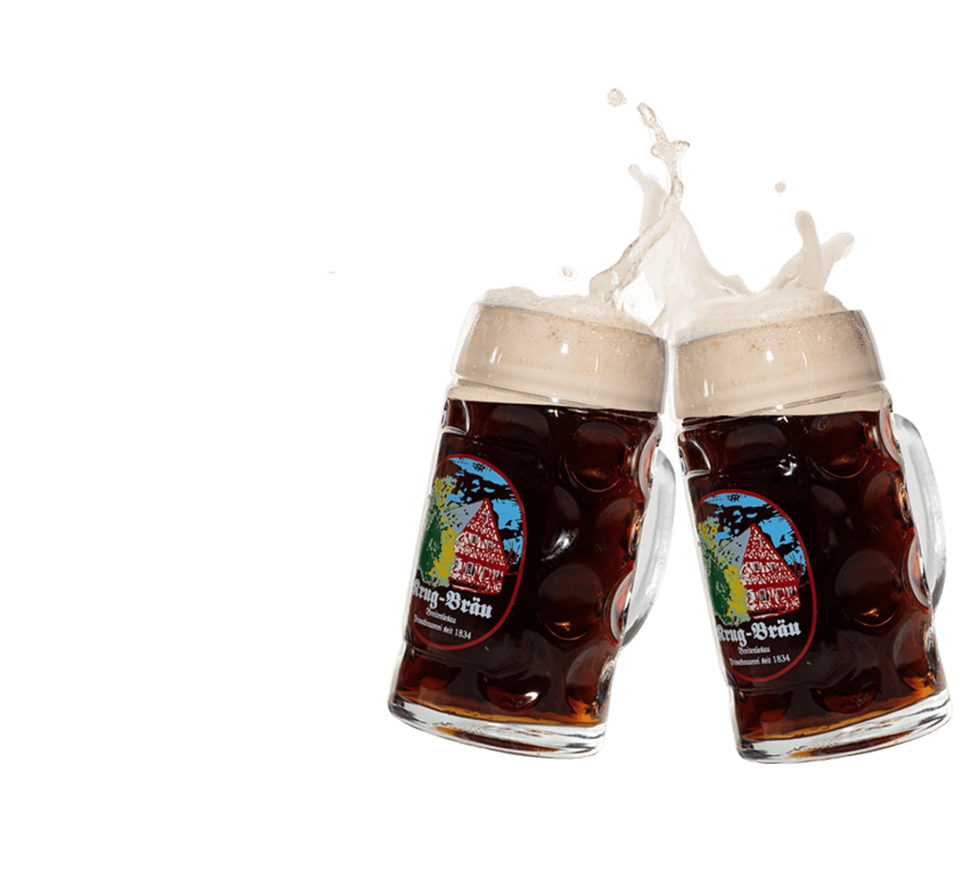
Example: goods
Imagine you are the producer of a high quality alcoholic drink, which is very popular in your home country.
You now want to export it to other countries.
What obstacles might you encounter when trying to sell your drink in other countries?

Slide 8
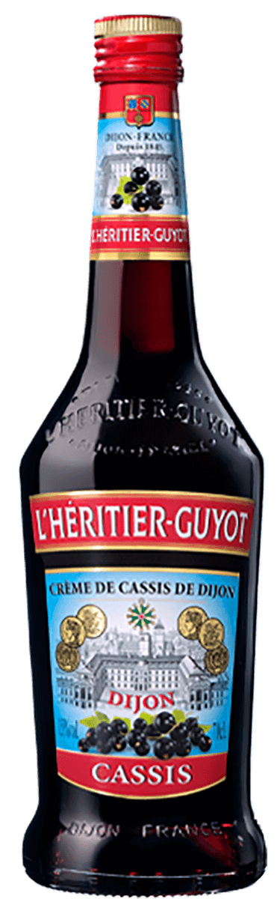
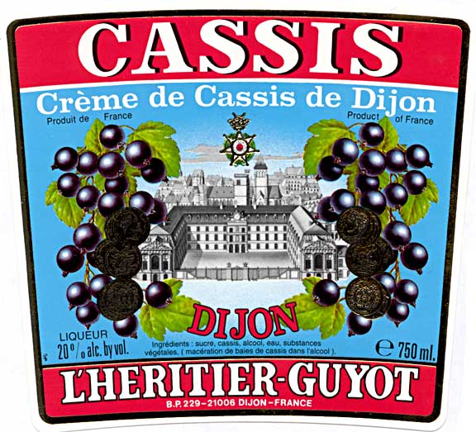
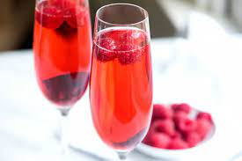

Cassis de Dijon
German supermarket chain wanted to import French liqueur Cassis de Dijon into Germany
Not possible: German legislation requires a minimum of 32% alcohol content for wine-spirits like cassis!
Article 34 of the Treaty on the Functioning of the European Union (TFEU):
  “Quantitative restrictions on imports and all measures having equivalent effect shall be prohibited between Member States”.

Slide 9
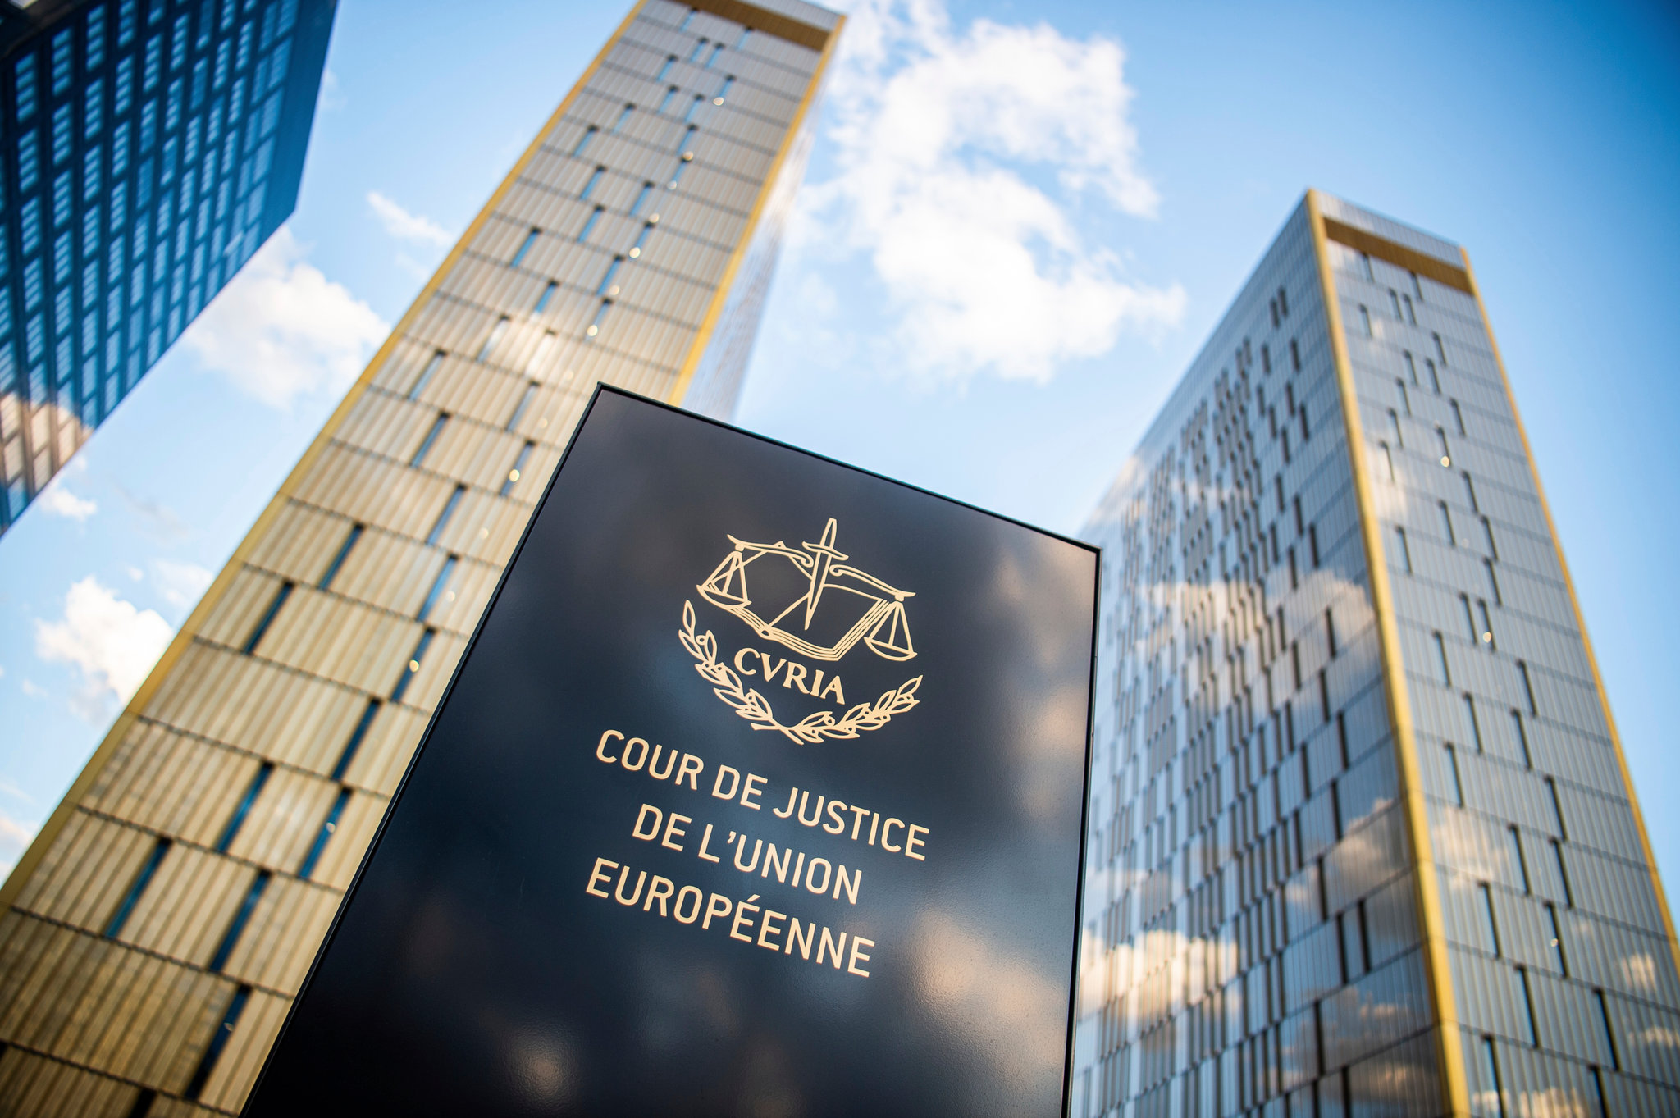

Cassis de Dijon
Case went to the European Court of Justice (CJEU)
Decided that goods lawfully marketed in one Member State may be lawfully marketed in all MS
Unless there are good reasons (mandatory requirements), such as: public health protection, consumer protection, environmental protection…
Here: health of consumers?
  in theory perhaps, but not convincing that Germany argued that the alcohol content was not high enough!

Slide 10

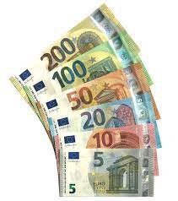




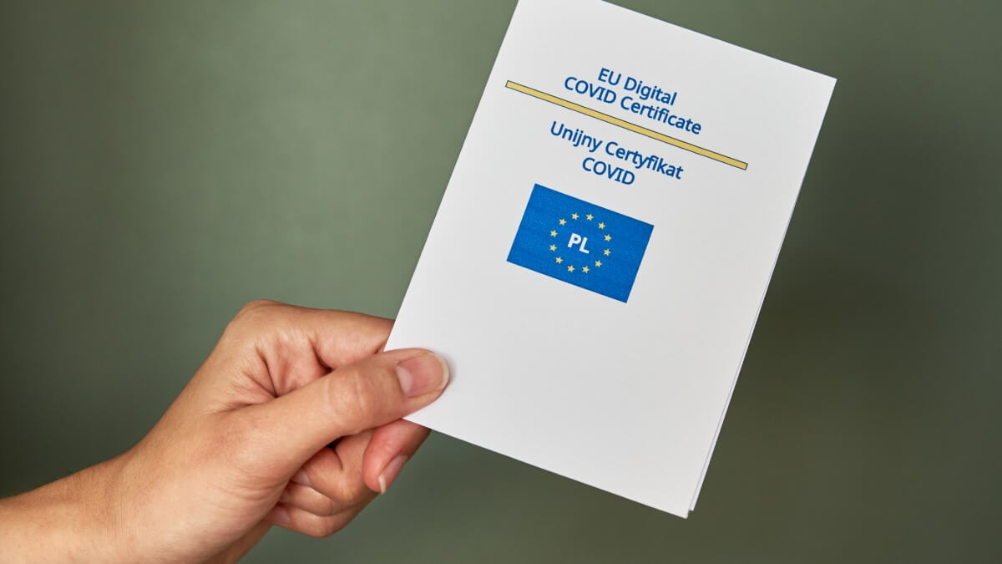
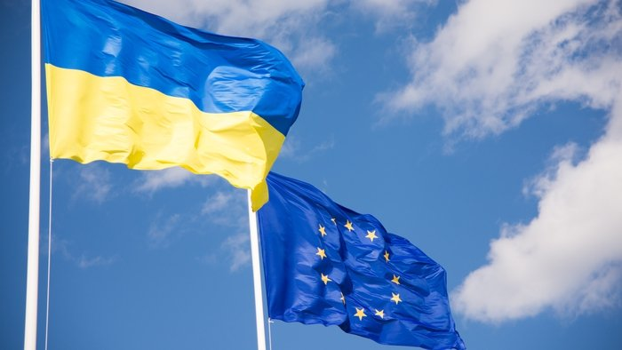
What else does the EU do?
Now far more areas of EU activity, e.g.
Economic and monetary union (the Euro)
EU environmental law
EU criminal law
EU labour law
Intellectual property law
Data protection law
Common Foreign and Security Policy
EU cooperation in public health (remember Covid?)
and so on…

Slide 11
So what’s the point of the EU?
  www.sli.do
    #EU1957

Slide 12
Any questions?

