Slide 1
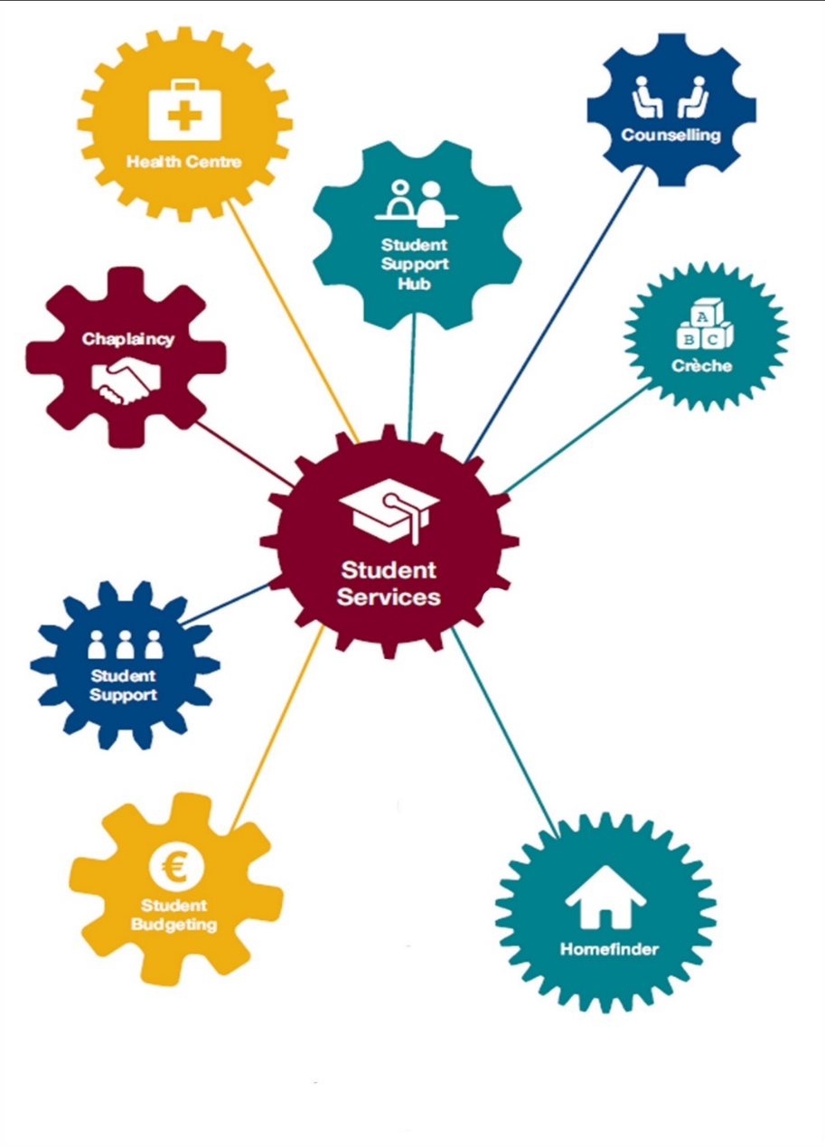
Maynooth University
Student Services
Welcome
www.maynoothuniversity.ie/student-services
@ MU_StudentServ
@ MUStudentServices_
Location: North Campus, close to the John Hume Building and Maynooth Access Programme. Number 47 on your foldable map

Slide 2
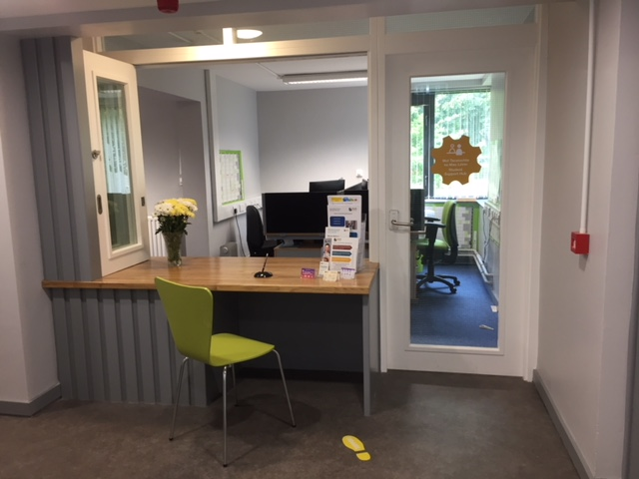
mu.ie/student-services/hub
Opening Hours:
Monday to Friday 9.30am to 5.00pm
Student Services Centre
Upper Ground Floor
just follow the yellow feet!
Phone: 01 708 4729
Email: student.services@mu.ie
All queries welcome

Slide 3
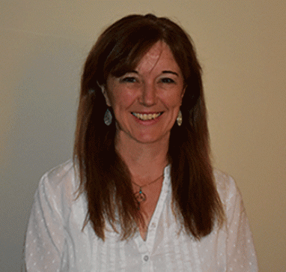
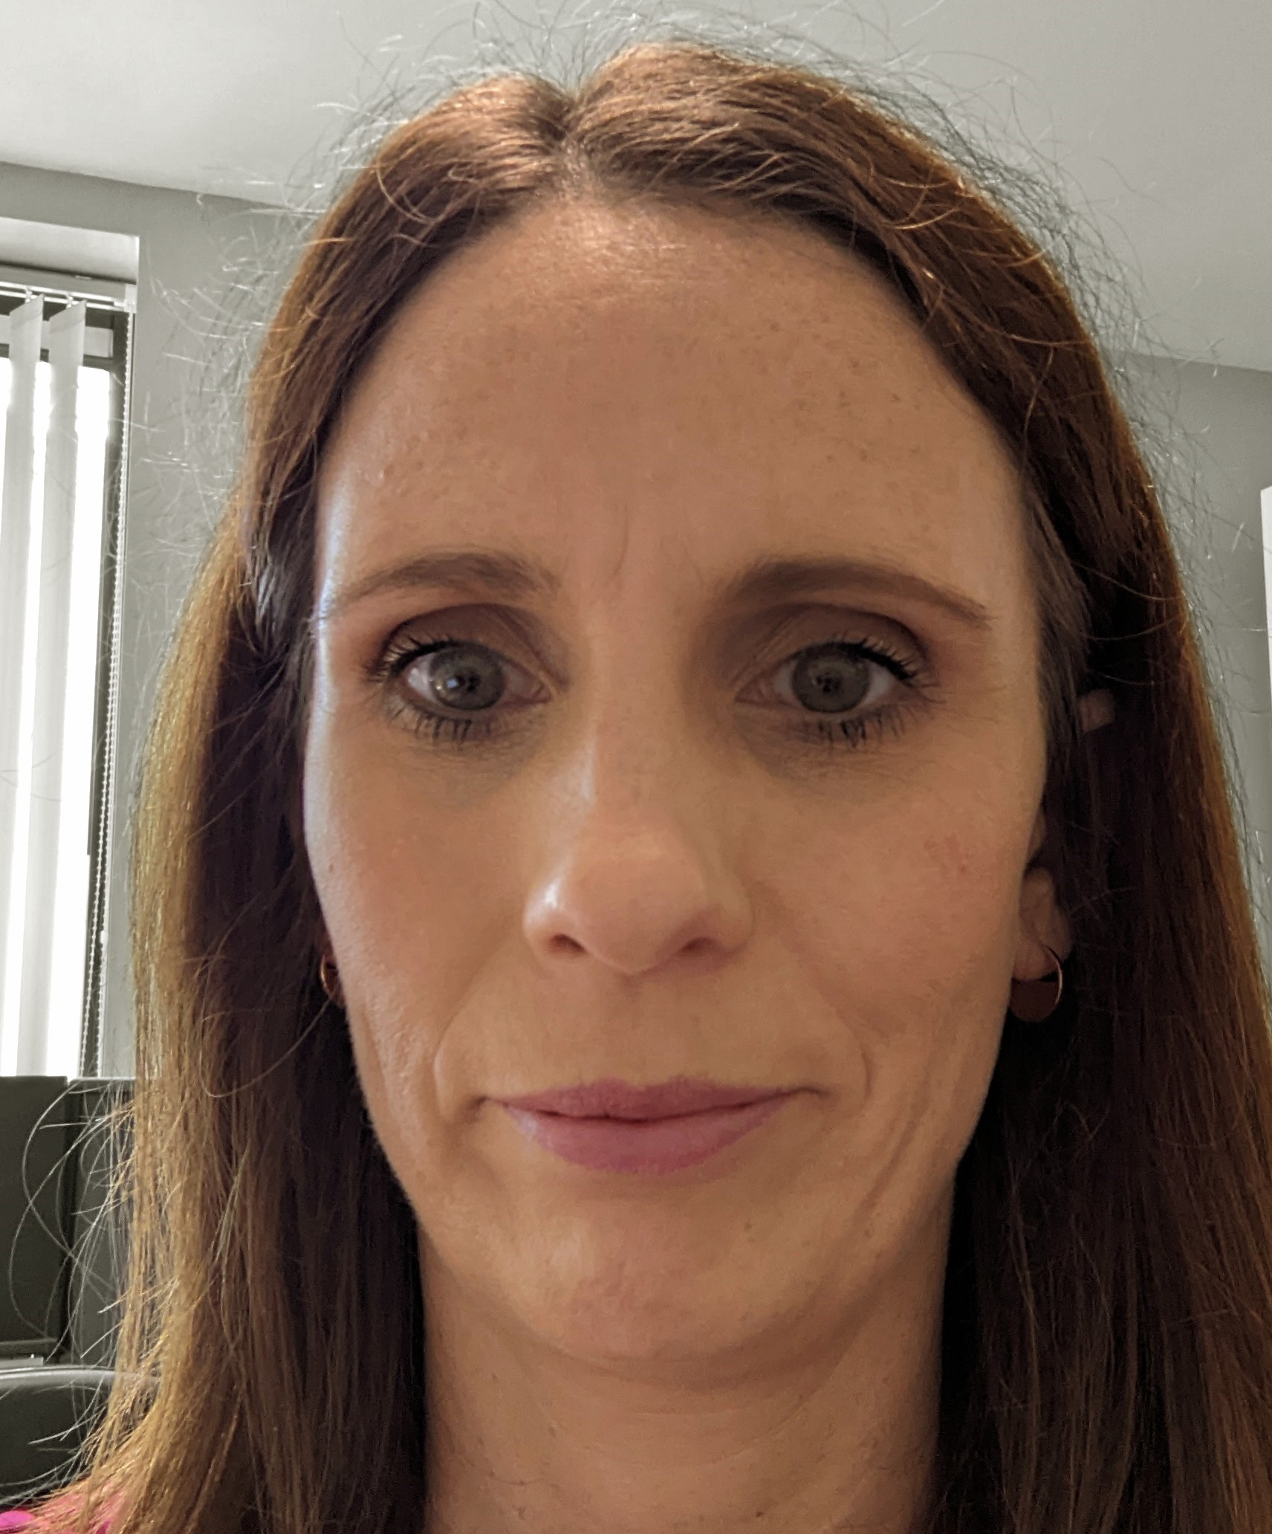
mu.ie/homefinder
We offer the following service to University students and prospective/new students:
Listing service of the private accommodation available locally available on maynoothstudentpad site
Information sessions for new Student Tenants
Guidance and resources to help you get the best from your search for accommodation off-campus
Student Services Centre
Upper Ground Floor
just follow the yellow feet!
Phone: 01 708 3479
Email: homefinder.service@mu.ie
Visit our database: www.maynoothstudentpad.ie

Slide 4
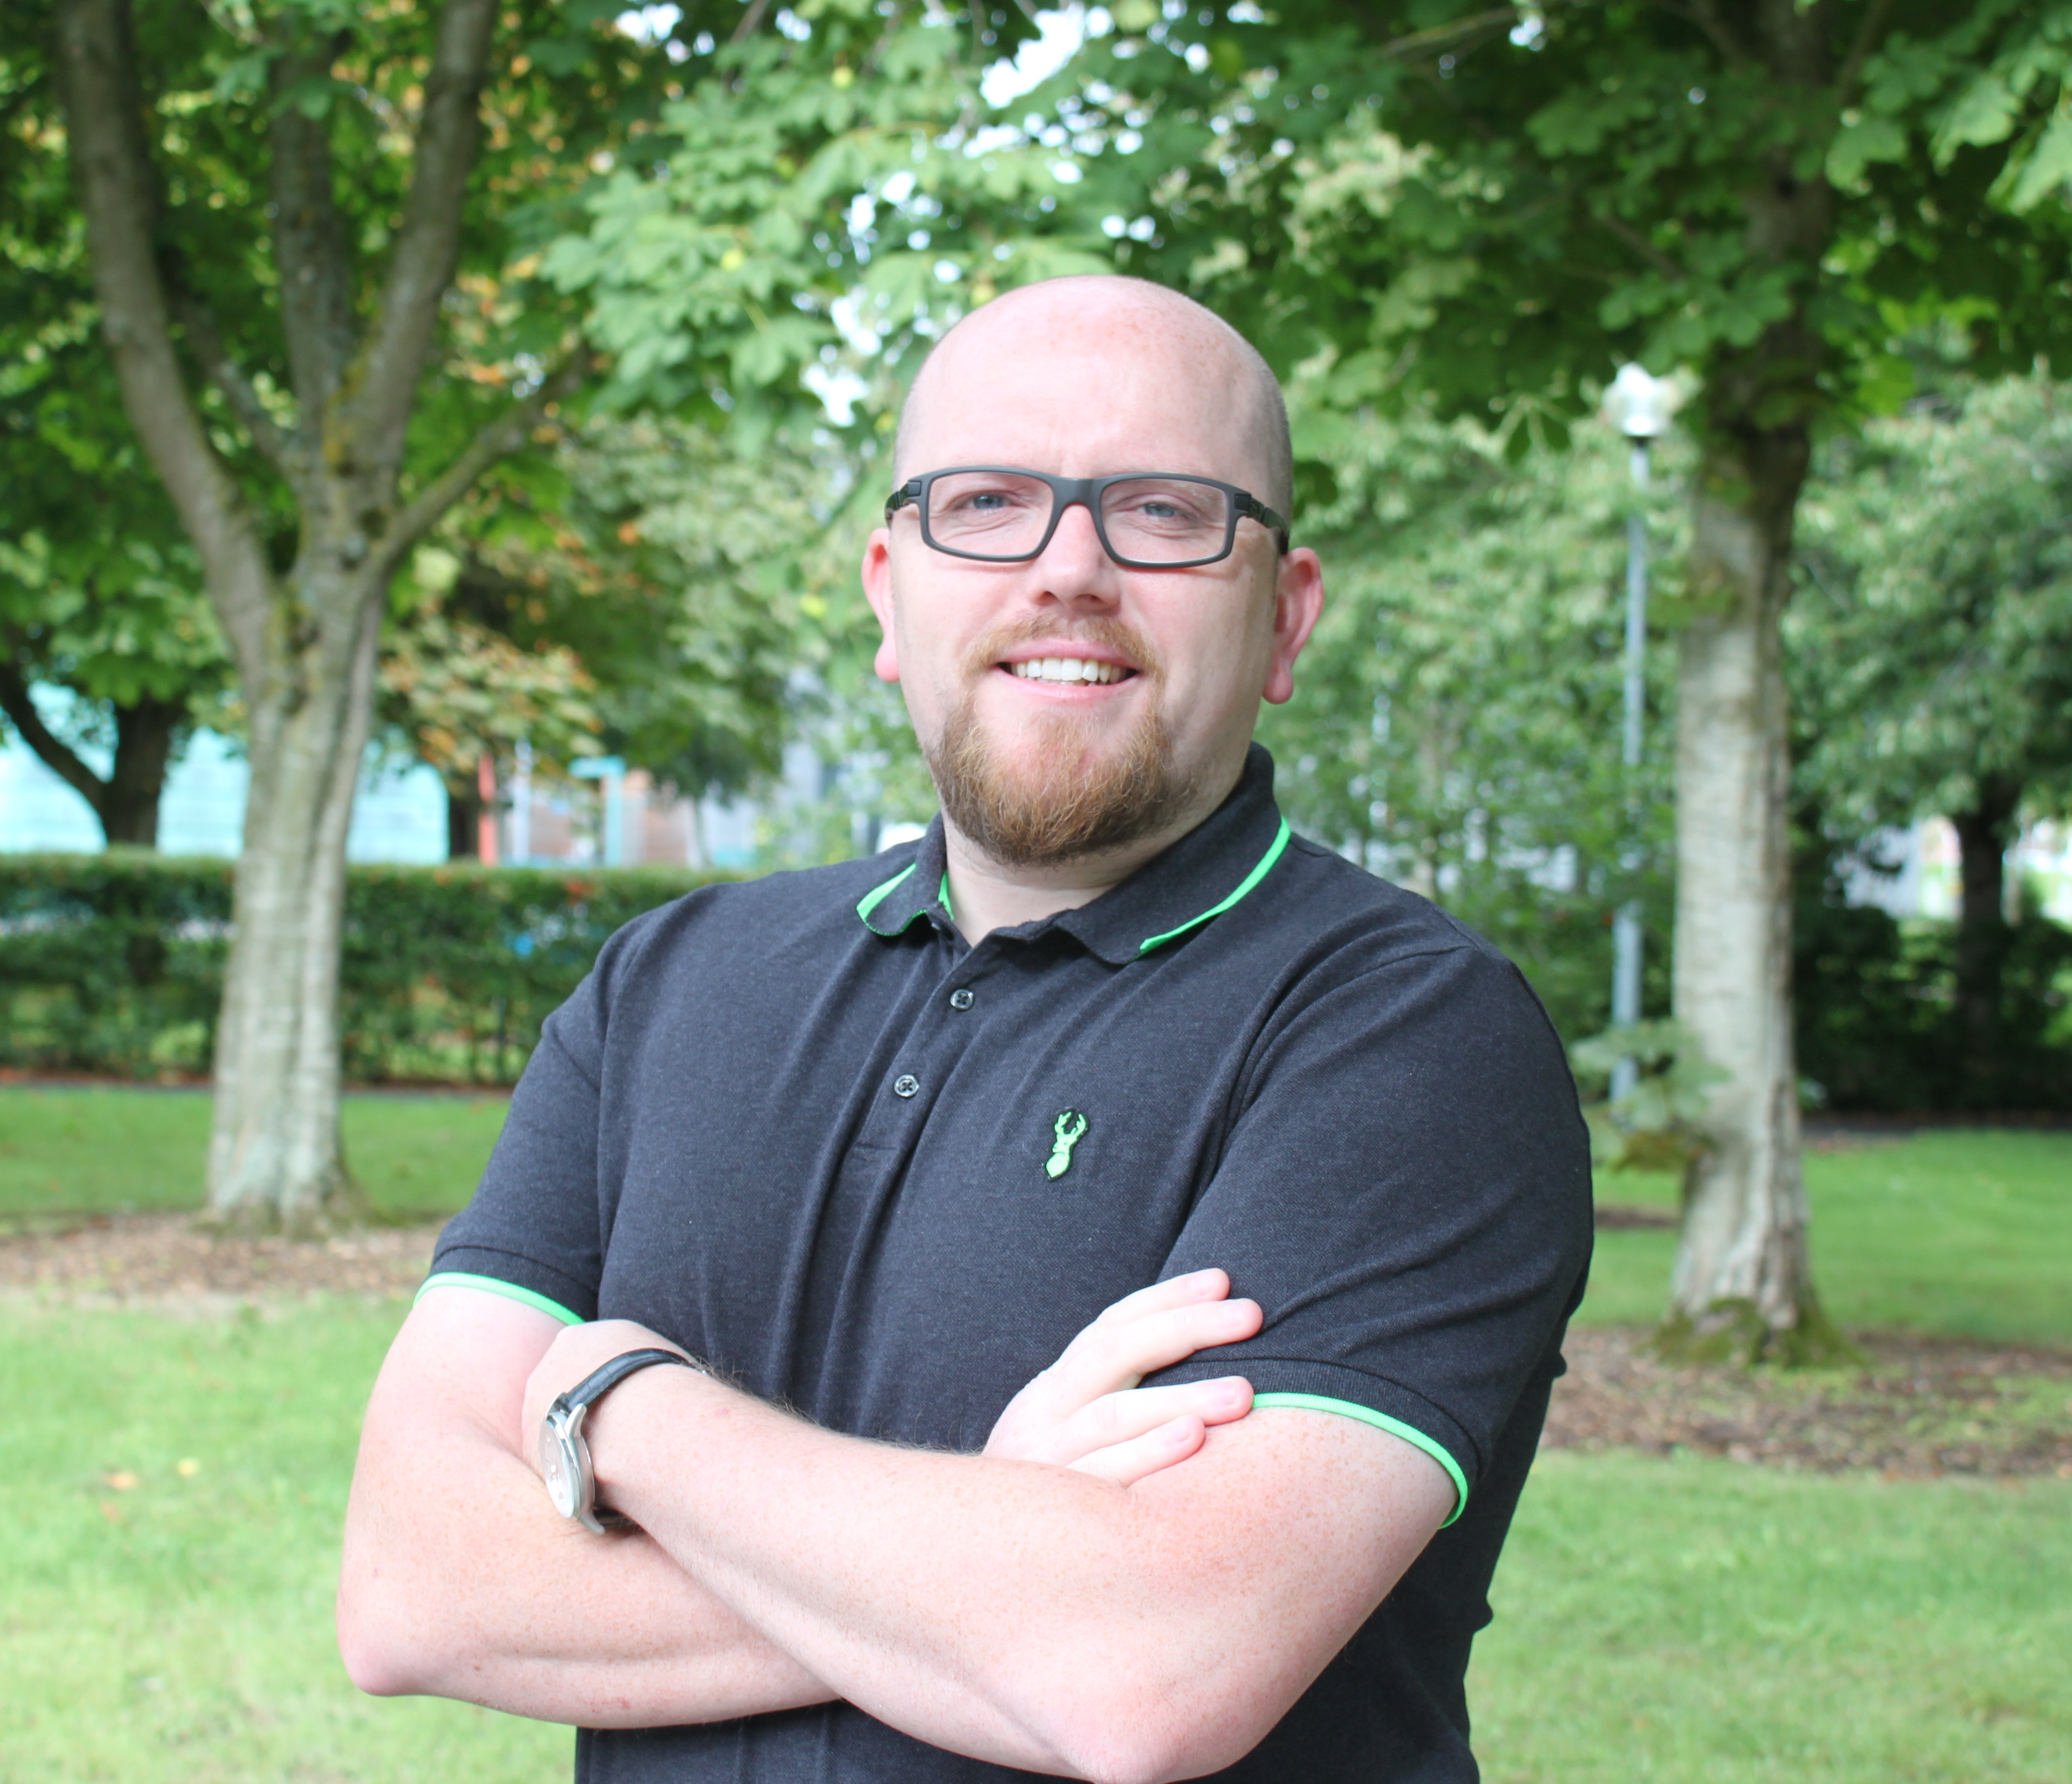
mu.ie/student-services/chaplaincy
Opening Hours:
Monday to Friday 9.00am to 5.00pm
Arts Building
Room 49
Phone: 01 708 3469 or
Email: chaplaincy@mu.ie for:
1-to-1 appointments for support
to find out more about getting involved
to register for events
BE INVOLVED
Chaplaincy brings students together for events & activities throughout the semester.
Join us, meet fellow students & take time out to look after your spiritual wellbeing.
Community ¦ Conversation ¦ Contemplation ¦ Compassion

Slide 5
mu.ie/student-services/money-matters
Monday to Friday
Student Services Centre
Upper Ground Floor
1:1 Appointments and weekly drop-in clinic
Visit website to:
Book an appointment
Access information relating to college costs and budgeting
Explore emergency supports
We provide a confidential service, offering advice and help with budgeting, and financial issues.
Free guidance, information or help with college finances.

Slide 6
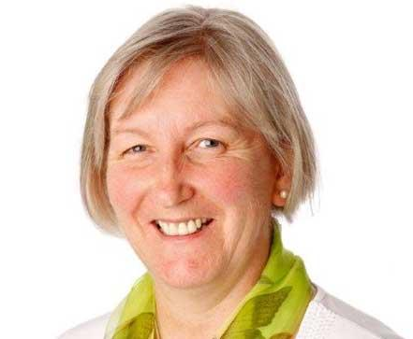
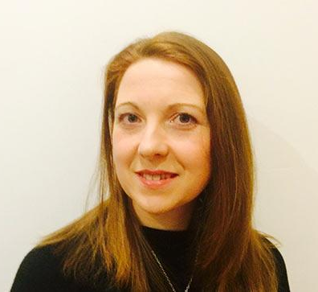
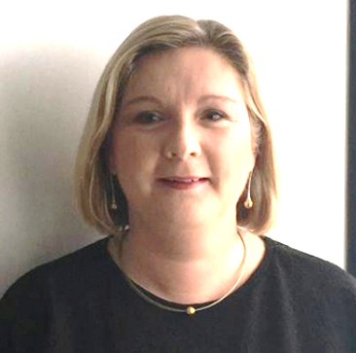
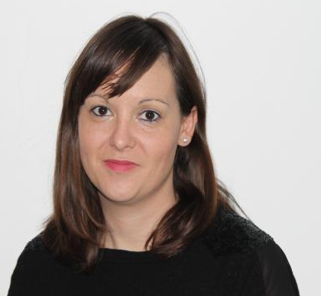
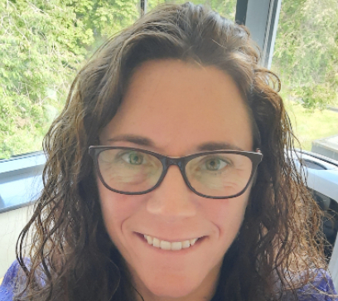
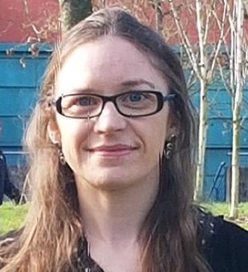
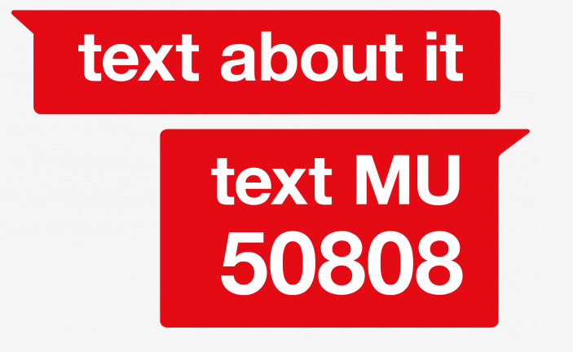
mu.ie/counselling
Counselling is available for all registered students.
Strictly confidential service & free of charge
Appointment based
Student Services Centre
Second Floor
Phone: 01 708 3554
Callback request: via website
Visit our website for access to Online Resources, Silvercloud, Speakout Reporting Tool, Workshop Information and lots more self-help resources

Slide 7
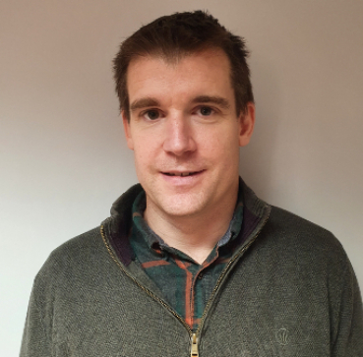
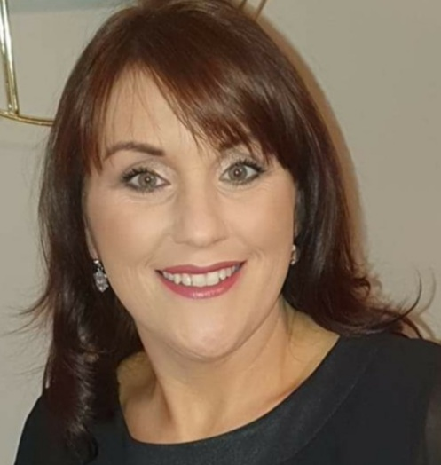
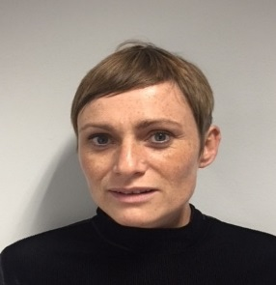
mu.ie/student-services/student-health-centre
Monday to Friday
Student Services Centre
Ground Floor
Follow the Green Feet!
Opening Hours Academic Year:
Visit the website for information on our services, health topics and to access our FAQ’s
The Health Centre offers a free, friendly, caring and confidential health service during the Students time in University
Monday | 9.15am – 12.45pm | 2.00pm – 4.30pm
Tuesday | 9.15am – 12.45pm | 2.00pm – 4.30pm
Wednesday | 9.15am – 12.45pm | 2.00pm – 4.30pm
Thursday | 9.15am – 11.30am* | 2.00pm – 4.30pm
Friday | 9.15am – 12.45pm | 2.00pm – 4.30pm
Phone: 01 708 3878
Email: healthcentre@mu.ie
Out of Hours KDoc: 045 848701*
*practice meeting 11.30am – 1.00pm
* please note this service is external to MU and fees apply)

Slide 8
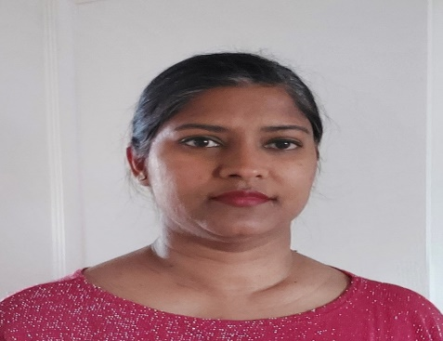
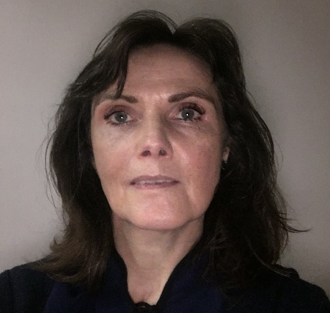
mu.ie/studenthelp
Visit the website to access our helpful info-tiles for information and guidance on personal and academic supports that you might need.
Monday to Friday: 9.30am to 4.45pm
On-Campus: TSI Building, Ground Floor
On-Campus: John Hume Building, Ground Floor
Email: studenthelp@mu.ie
Phone: 01 474 7444
Live chat: mu.ie/studenthelp
Info Tiles: mu.ie/studenthelp
The Student Helpdesk team aim to deliver a high quality, engaging and supportive service to our students, where you can seek information, guidance, and support in a welcoming space.

Slide 9
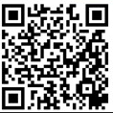
Counselling
T: 01 708 3554
‘Call Back’ via Web
www.maynoothuniversity.ie/student-services
@ MU_StudentServ
@ MUStudentServices_
Student Budgeting Advice Service
E: student.budget@mu.ie
FAQ’s at mu.ie/money-matters
Crèche
T: 01 708 3319
E: creche.care@mu.ie
Student Support Officer
T: 01 474 7627
E: student.support@mu.ie
Chaplaincy
E: chaplaincy@mu.ie
T: 01 708 3469
T: 087 1482196
Student Health Centre
T: 01 708 3878
Out of Hours: 848 701
Homefinder Service
T: 01 708 4726
E: homefinder.service@mu.ie
W: maynoothstudentpad.ie
Student Support Hub
T: 01 708 4729
E: student.services@mu.ie
Student Helpdesk
T: 01 474 7444
E: studenthelp@mu.ie
Info Tiles: mu.ie/studenthelp

