Slide 1
SPLG 2022: EU Law Update
Prof Tobias Lock
Jean Monnet Chair in EU Law&Fundamental Rights
tobias.lock@mu.ie

Slide 2
Overview
Relevance of EU Law in Scotland today
EU Citizenship update
Case C-709/20 CG v Dept for Communities in Northern Ireland
Case C-673/20 EP v Préfet du Gers, Institut National de la Statistique et des Études Économiques [pending]
Retained EU Law update
Continuity Act update

Slide 3
Relevance of EU law in Scotland today
Withdrawal Agreement – EU (Withdrawal Agreement) Act 2020
citizens’ rights (with direct effect)
‘hangover’ of EU membership
ongoing procedures
continued protection of IP rights, incl. geographic indications
potential ‘reach back’ of EU state aid rules in the Protocol on IRL/NI
Retained EU Law – EU (Withdrawal) Act 2018 (as amended)
continued relevance of pre-Brexit case law
persuasive character of post-Brexit case law
Trade and Cooperation Agreement (TCA) – EU (Future Relationship) Act 2020
‘general implementation’ clause, s. 29 – automatic modification of domestic law, incl. retained EU law
UK Withdrawal from the European Union (Continuity) (Scotland) Act 2021
s. 1 power to make provision corresponding to EU law

Slide 4
material facts arose during the transition period
Citizenship - benefits
Case C-709/20 CG
dual NL/Croatian national resident in Northern Ireland
arrived there accompanying her Dutch partner in 2018; never in work
has 2 children and now lives in a women’s refuge with them
had no source of income and applied for Universal Credit in the UK
had pre-settled status under the EU Settlement Scheme
= temporary right of residence under national law
Universal Credit Regulations (Northern Ireland) 2016 as amended: will only be paid to persons ‘being in Northern Ireland’
a person is not in Northern Ireland if they are not habitually resident in either the UK, Isle of Man, Channel Islands or IRL;
habitual residence means having a right to reside
CG was not considered to be habitually resident in the UK because under these Regulations persons with pre-settled status do not have a right to reside

Slide 5
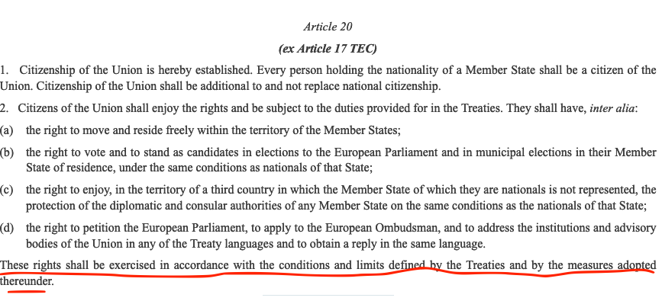
benefit cases
Question before CJEU:
can she rely on Article 18 TFEU (non-discrimination)?
Court (following an established line of case law, e.g. C-333/13 Dano)
she has made use of her right to move and thus is in the scope of Art 18
BUT: Article 18 only applies where the TFEU does not contain special provisions.
Here: Article 20 (2) TFEU + Directive 2004/38 (CRD) contain special rules

Slide 6
Citizenship - benefits
Case C-709/20 CG
There is a special rule: Article 24 Citizens’ Rights Directive
Hence the general non-discrimination provision of Article 18 TFEU does not apply
Article 24 CRD, however, requires:
residence ‘on the basis of this Directive’
i.e.: either as a worker, student, self-sufficient person or spouse
none applied here
Hence she does not have a right to equal treatment.
Hence she is not entitled to receive universal credit following this route.

Slide 7
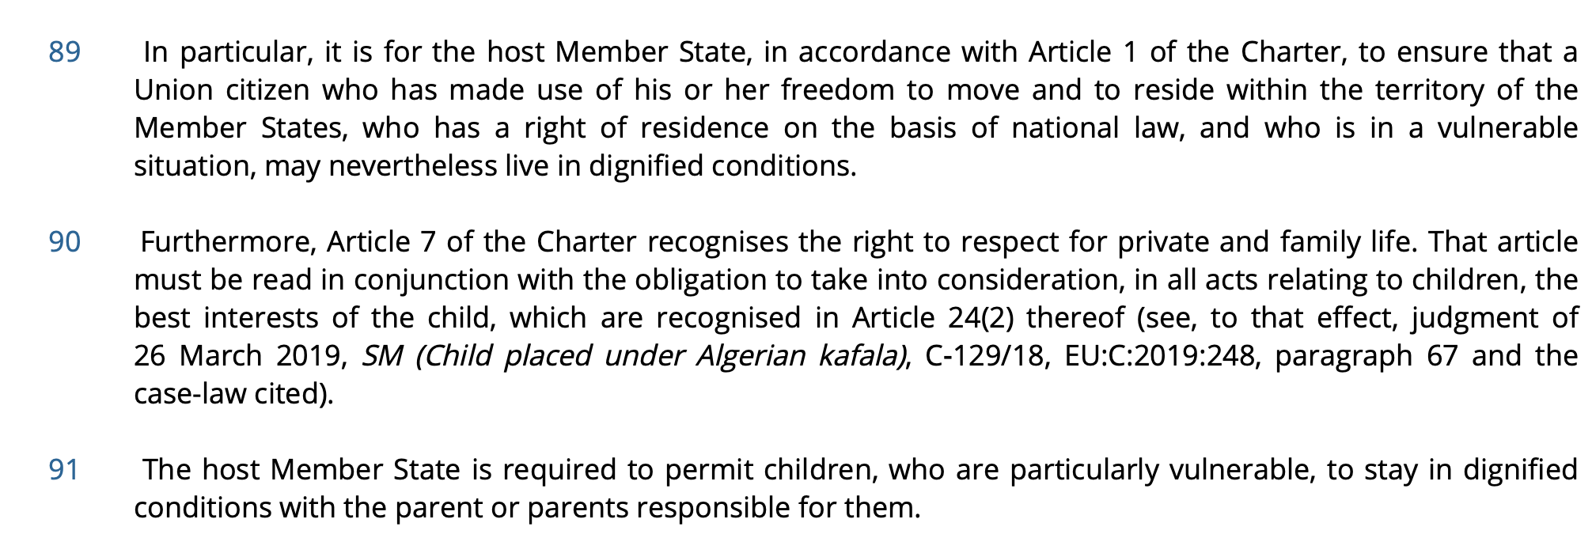
Citizenship - benefits
This is new!
A glimmer of hope in CG?
Charter of Fundamental Rights applies because she is ‘in the scope of EU law’ (see Article 51 (1) CFR)
NB: in previous cases (Dano) the Court had held that the Charter did not even apply
Hence the UK must protect her rights in Article 1 (human dignity) and Art 7 (private and family life) and the rights of the child (Art 24 CFR)

Slide 8
Citizenship - benefits
Relevance of CG in Scotland today?
for EU/EEA nationals who exercised Treaty rights before 31 Dec 2021:
rights arising under the Charter of Fundamental Rights apply [notwithstanding that the Charter is not part of retained EU Law]: see Art 2 WA (“Union law” includes the Charter) and s. 7A EU (Withdrawal) Act 2018 gives direct effect to the WA domestically
Art. 89 WA – CG judgments is binding on the UK even though handed down after the end of the transition period
what does ‘binding’ mean?
it is not retained EU case law as per s. 6 EUWA 2018 (no ‘effect before IP completion day’)
but could it be binding in the same manner by virtue of the WA?
certainly binding ‘inter partes’
question: beyond the concrete case?

Slide 9
Citizenship
Judgment due
on 9 June
Case C‑673/20 Préfet du Gers and Institut national de la statistique et des études économiques
Have UK citizens lost their EU citizenship if they had made use of their right to free movement before the end of the transition period?
If so, do they retain their citizenship rights nonetheless?
Is the WA invalid?
AG Collins:
EU citizenship of UK citizens ended on 31 January 2020
no residual rights either

Slide 10
Retained EU law
Supremacy over domestic law passed or made before
IP completion day (31 December 2020 at 11pm)
European Union (Withdrawal) Act 2018, ss. 2-4
Types of retained EU Law | Examples
EU-derived domestic legislation | Implemented EU Directives, e.g. Equality Act 2010, Working Time Regulations 1998, The Town and Country Planning (Environmental Impact Assessment) (Scotland) Regulations 2017
Direct EU legislation | EU Regulations, e.g. Regulation 261/2004 on air passenger rights (but also ‘Decisions’ and ‘tertiary EU legislation’)
Rights etc. under section 2(1) of the ECA | EU Treaties (exception: Charter of Fundamental Rights); also general principles of EU Law

Slide 11
Retained EU Law
Lipton v BA City Flyer Ltd. [2021] EWCA Civ 454
interpretation of Regulation 264/2004 (flight passenger rights) = direct EU legislation
Had been amended according to s. 8 EUWA (by way of regulations)
EWCA did not pronounce on whether these amendments affected the operation of ‘supremacy’ principle
Test: was the application of supremacy consistent with the intention of the modification (s. 5 (3) EUWA)?
Relationship with the Trade and Cooperation Agreement (TCA)?
Art 5 TCA: no direct effect
But: s. 29 (1) EU (Future Relationship) Act 2020 = ‘automatic modification’
s. 29 (1)
Existing domestic law has effect on and after the relevant day with such modifications as are required for the purposes of implementing in that law the Trade and Cooperation Agreement […] so far as the agreement concerned is not otherwise so implemented and so far as such implementation is necessary for the purposes of complying with the international obligations of the United Kingdom under the agreement.
Notes:
s. 5 (3) EUWA
Subsection (1) does not prevent the principle of the supremacy of EU law from applying to a modification made on or after exit day of any enactment or rule of law passed or made before exit day if the application of the principle is consistent with the intention of the modification.
Art 5 TCA:
“nothing in this Agreement or any supplementing agreement shall be construed as conferring rights or imposing obligations on persons other than those created between the Parties under public international law, nor as permitting this Agreement or any supplementing agreement to be directly invoked in the domestic legal systems of the Parties.”

Slide 12
Retained EU Law
Article 438
Consumer protection
1. The Parties share the objective of achieving a high level of consumer protection and shall cooperate to that effect.
2. The Parties shall ensure that effective and non-discriminatory measures are taken to protect the interests of consumers in air transport. Such measures shall include […] compensation in case of denied boarding, cancellation or delays, and efficient complaint handling procedures.
3. […]
Lipton v BA City Flyer Ltd. [2021] EWCA Civ 454
Relationship with the Trade and Cooperation Agreement (TCA)?
Art 5 TCA: no direct effect
But: s. 29 (1) EU (Future Relationship) Act 2020
Art 438 TCA
Scottish courts – have applied retained EU law and retained EU case law, e.g.Outer House, Trees for Life [2021] CSOH 108
Notes:
Art

Slide 13
Retained EU case law
S. 6 (7) EUWA 2018:
“retained EU case law” means any principles laid down by, and any decisions of, the European Court, as they have effect in EU law immediately before exit day and so far as they—
(a) relate to anything to which section 2, 3 or 4 applies, and
(b) are not excluded by section 5 or Schedule 1
S. 6 (3) EUWA 2018
Supreme Court & High Court of Justiciary not bound by any retained EU case law
extended to EWCA, Inner House & NICA (plus a few more) by the European Union (Withdrawal) Act 2018 (Relevant Court) (Retained EU Case Law) Regulations 2020
s. 6 (5) EUWA 2018: ‘In deciding whether to depart from any retained EU case law, the Supreme Court or the High Court of Justiciary must apply the same test as it would apply in deciding whether to depart from its own case law.’
same applies to Inner House, EWCA, etc.

Slide 14
Retained EU case law
Criteria for departure from retained EU case law: Warner v TuneIn EWCA [2021] EWCA Civ 441
Substantive question: what is ‘communication to the public’?
EU derived domestic legislation at issue (right of communication to the public, Information Society Directive, s. 20 Copyright Designs and Patent Act 1988)
long line of CJEU case law on this matter (24 decisions of ‘retained EU case law’ altogether + 1 decision handed down after IP completion day)
Should EWCA depart from the jurisprudence of the CJEU?
consistent case law of UKSC and HL that ‘this is a power to be exercised with great caution’

Slide 15
Retained EU case law
Arnold LJ on criteria that militate against departure, inter alia:
no change in the domestic legislation
no change in the international legislative framework
CJEU has unrivalled experience in the matter
academic commentary on CJEU’s case law is divided
fact that other jurisdictions (USA etc) approach the question differently not given much attention as the statutory framework differs in those countries
would result in considerable legal uncertainty
Criteria formulated by Vos MR:
IP law derived from international treaties
Supreme Court approach should be followed, i.e. departure only if earlier decisions ‘were generally thought to be impeding the proper development of the law or to have led to results which were unjust or contrary to public policy’: not the case here
departure would thus ‘create legal uncertainty for no good reason’

Slide 16
Retained EU case law
This cautious approach was confirmed by EWCA in Chelluri v Air India [2021] EWCA Civ 1953
Coulson LJ:
no departure from CJEU precedent (retained case law):
no change to the relevant legislation
no recent authority which could justify such departure
precedent has been repeatedly followed by the CJEU
consequences of such a departure would be profound (in that they would increase the liability of airlines considerably) and it would not be appropriate to bring about such consequences without express consideration of this point by the legislature

Slide 17
What about post-Brexit case law?
s. 6(2) EUWA 2018: ‘[…] a court or tribunal may have regard to anything done on or after exit day by the European Court […] so far as it is relevant to any matter before the court or tribunal.
EWCA in TuneIn: CJEU post-IP completion day judgment considered ‘highly persuasive’ because:
it is part of a series of 25 judgments on the matter, 24 of which are retained EU case law
it builds upon and further refines the CJEU’s previous jurisprudence
it is a Grand Chamber decision
it is directly relevant to the question before the EWCA (and addresses two earlier decisions also at issue here)

Slide 18
Next step? Brexit Freedoms Bill
Queen’s speech: “A bill will enable law inherited from the European Union to be more easily amended [Brexit Freedoms Bill].”
HMG:
“The Bill will make it easier to amend or remove outdated ‘retained EU law’ - legacy EU law kept on the statute book after Brexit as a bridging measure – and will accompany a major cross-government drive to reform, repeal and replace outdated EU law.”
“The Bill is also expected to end the special status that EU law still enjoys in our legal framework. Despite our exit from the bloc, EU laws made before 1 January 2020 continue to have precedence in our domestic framework. This is simply not compatible with our status as a sovereign, independent country and the government will bring it to an end as quickly as possible.”

Slide 19
Continuity Act
Scot Gov Annual Report to the Scottish Parliament:
Ministers have no current plans to use the power under section 1(1) of the Act, however use of the power may be considered within the upcoming reporting period as necessary.
Power has not been used

Slide 20
Thank you for your attention!

