Slide 1
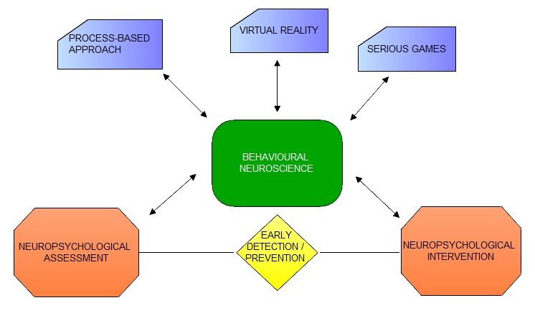
1. Research interests (core and satellite)

Slide 2
Recent past (and ongoing) Research
MSCA-IF Postdoctoral Research Fellow
Application of the process-based approach to neuropsychological assessment to Mild Cognitive Impairment (MCI) and Dementia
E-SPACE Project

Slide 3
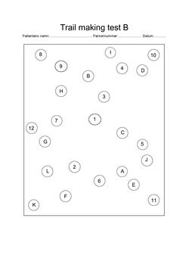
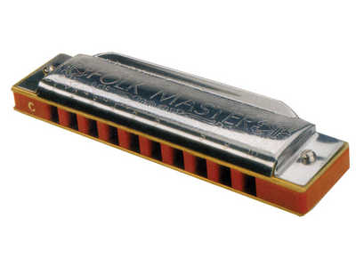

Slide 4
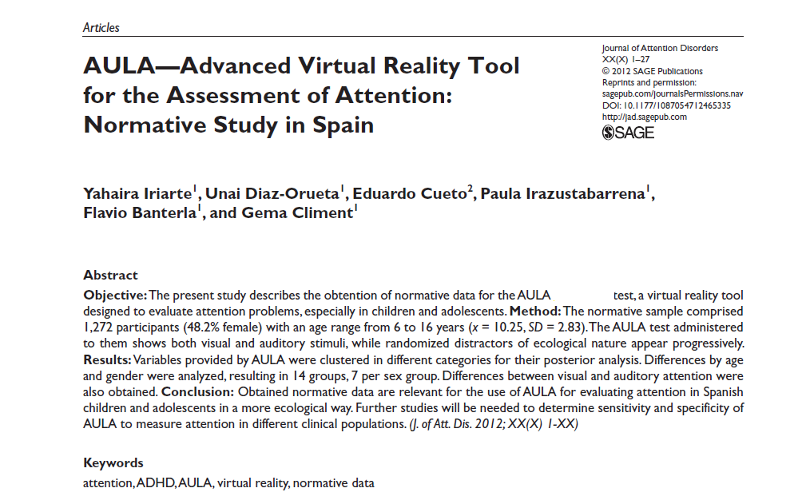
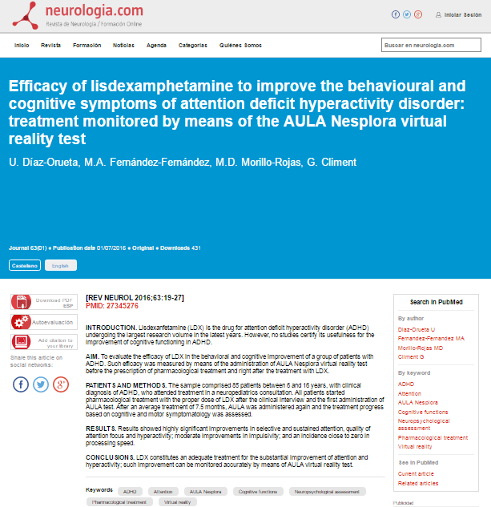
Original Research Articles - on VR based Neuropsychological Assessment (sample)

Slide 5
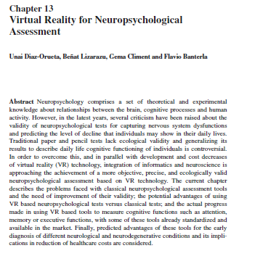
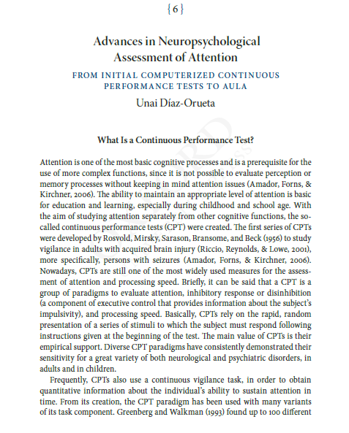
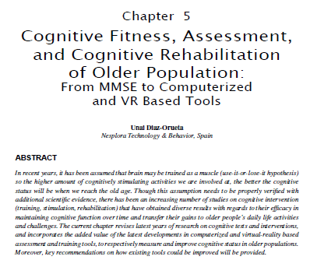
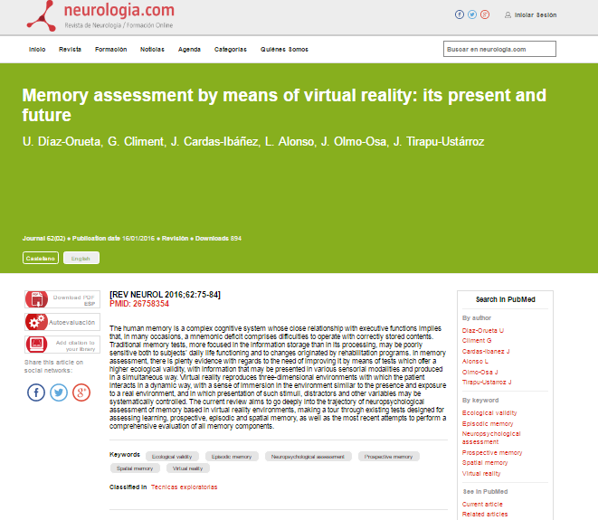
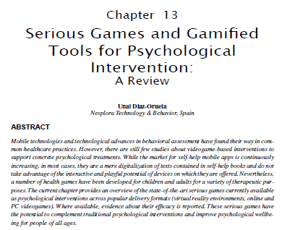
Review Papers / Book Chapters - on selected Research Interests:
Virtual Reality; Serious Gaming; Cognitive Assessment and Intervention (sample)

Slide 6
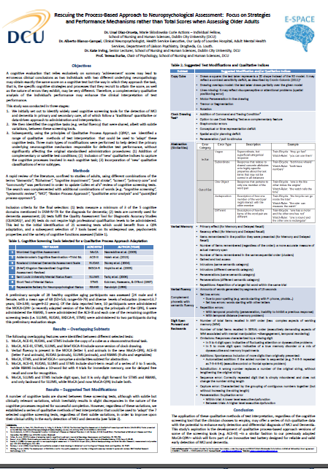
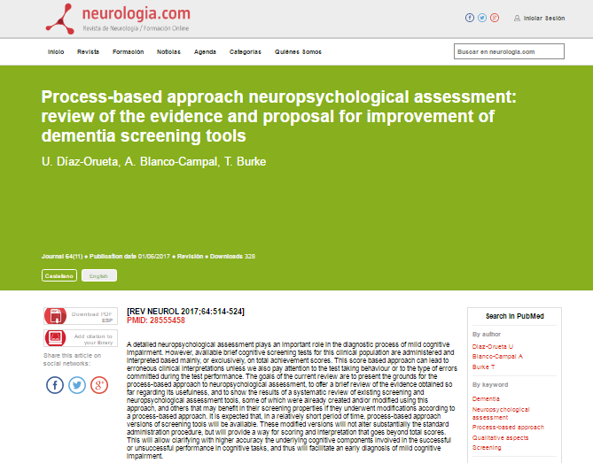
Articles and papers on Process-based Approach to Neuropsychological Assessment (sample)

Slide 7
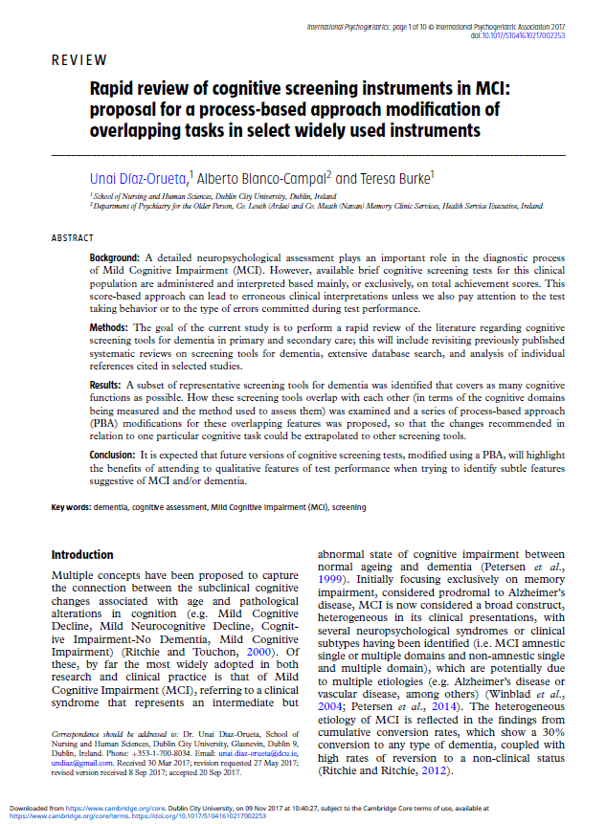

Slide 8
Recent and upcoming conferences (sample)

Slide 9
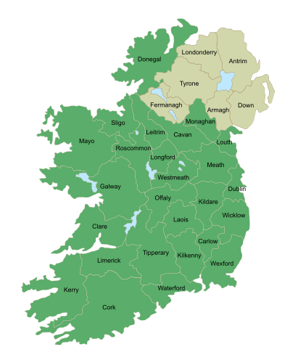
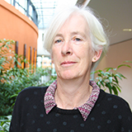
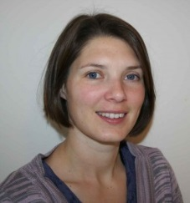
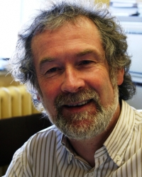
Research Network: Ireland

Slide 10
Research Network: European
Spain
Netherlands
CAPTAIN consortium
Greece
Estonia
France
Italy
Germany
Cyprus
Spain
Switzerland
Switzerland

Slide 11
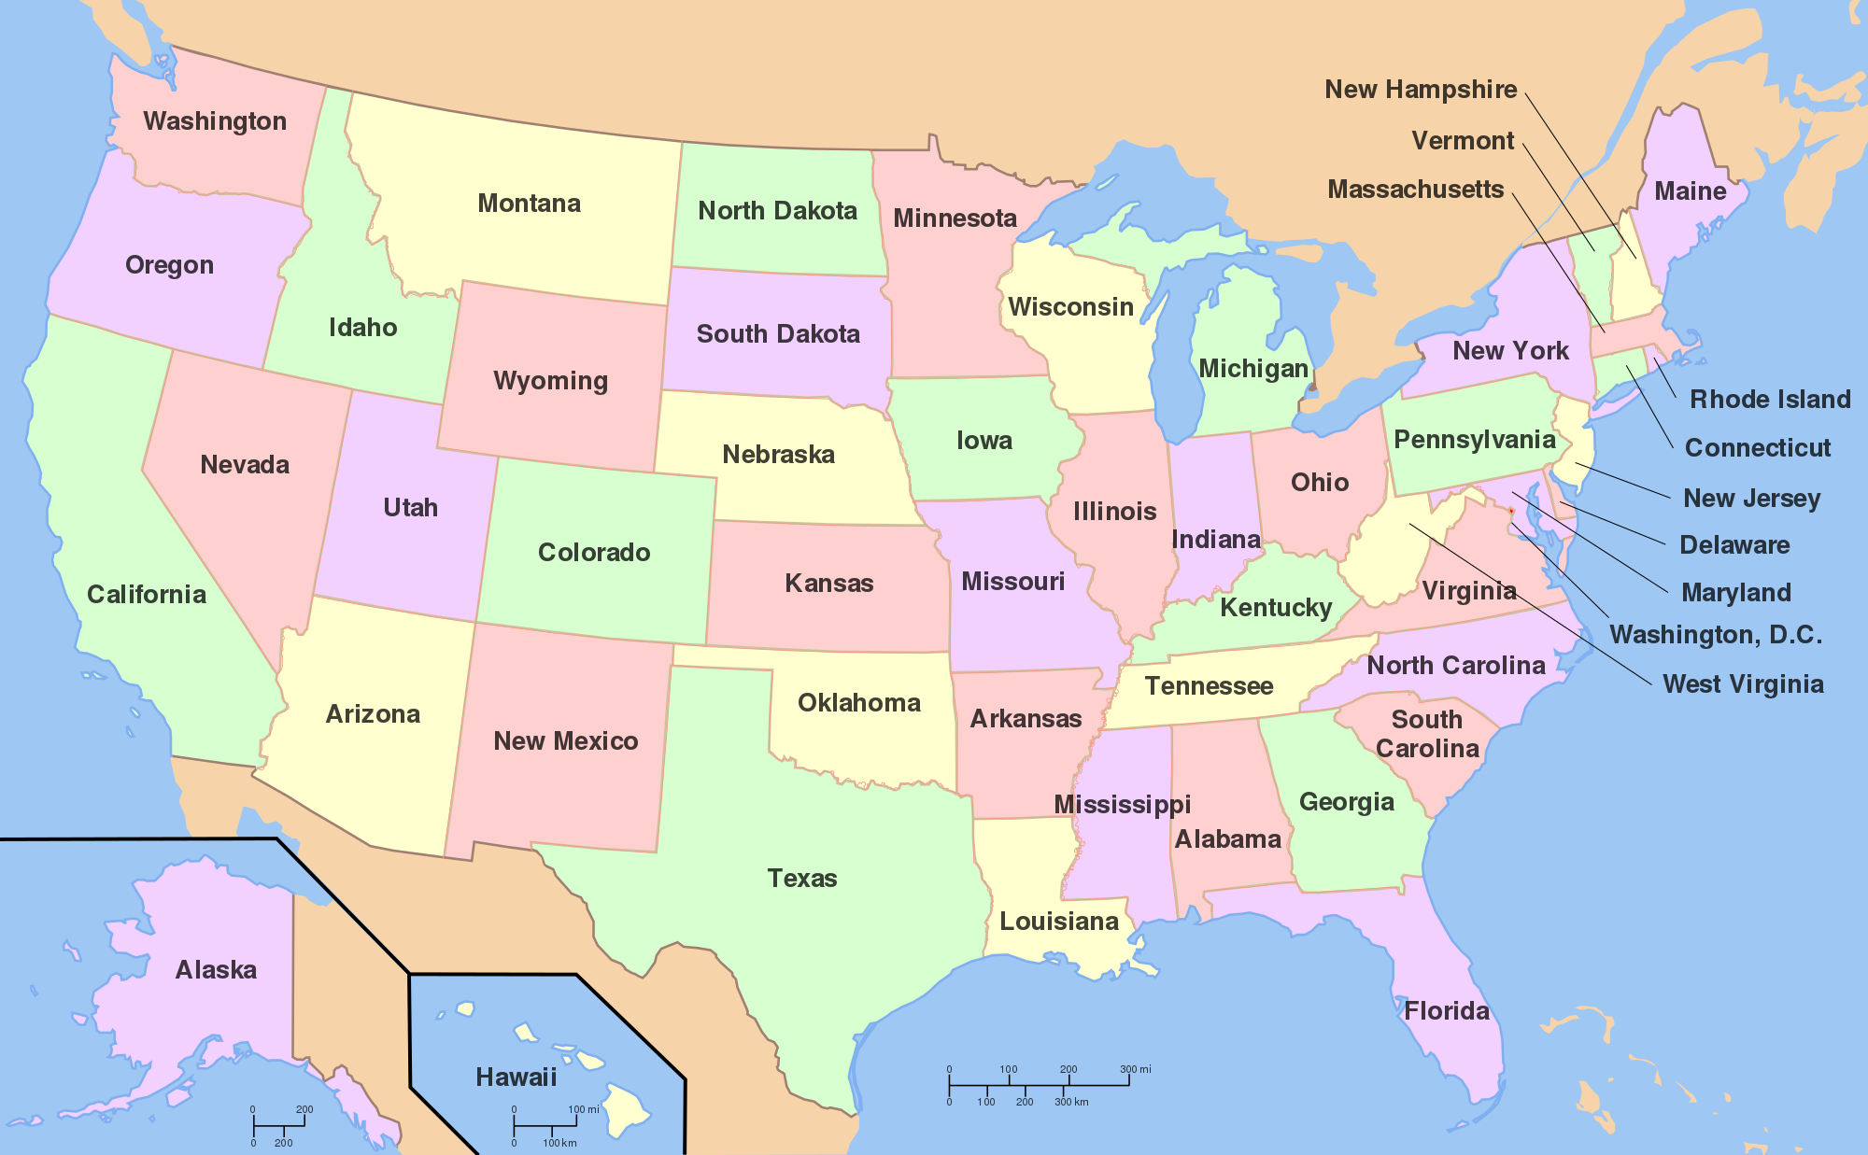
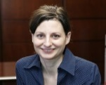
Research Networks: USA

Slide 12
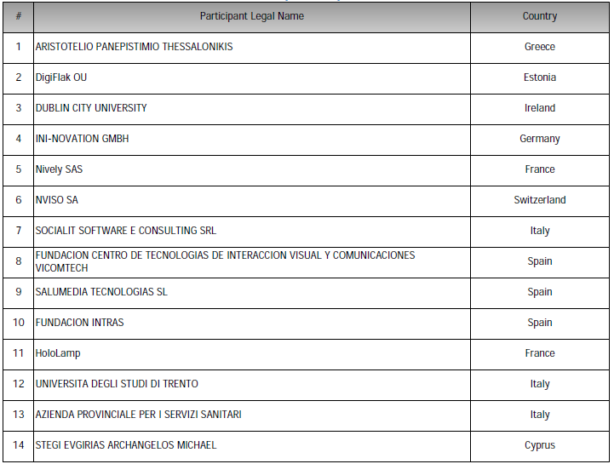
Research funding
Current: H2020-MSCA-IF-2014
Latest secured funding: 2017-2020
CAPTAIN- Coach Assistant via Projected and Tangible Interface. (Activity: SC1-PM-15-2017 RIA).
36 months project . €4M project
Role: PI: - leading pilot evaluations with older users.

Slide 13
Current and future research
E-SPACE project continues (www.e-spacedementiaproject.eu)
Additional MSCA-ITN proposal submitted
Recently invited to a proposal on this call:
SC1-DTH-03-2018: Adaptive smart working and living environments supporting active and healthy ageing
Interest in ICT-25-2018-2020 (on VR and AR, starting July, submission deadline November)

