Slide 1
emerging models of health and social care
Engagement, Expertise and Electronic Meet Patients, Power and Participation

Slide 2
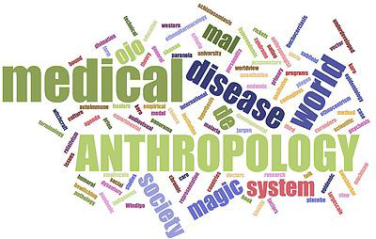
Medical Anthropology
Medical anthropology is that field of the discipline that holistically
investigates the factors that influence health and well-being (broadly defined), including the experience and distribution of illness, the prevention and treatment of sickness, healing processes, the social relations of therapy management, and the cultural importance and utilization of pluralistic medical systems. It draws on social, cultural, biological, and linguistic anthropology, but it necessarily engages everything from Studies of Science and Technology through Policy Analysis and Medical Humanities.

Slide 3
Why Ethnography?
Medical Anthropology understands Health as both an individual and collective good. In real life, people live in meaningful context(s) that inform the ways that they experience illness and seek help, support and care, but also the manner in which professional and lay understandings interact with this process. These include, but are not limited to, social and cultural ideas, local human and financial resources, and the particular institutional configuration of health and social services provision (broadly understood).
Ethnography starts from the premise that all the people interacting in such a ”system of systems” model these interactions largely from their particular perspectives. This partiality creates both mutual misunderstandings and productive ambiguities.
Finally, Ethnographers also ask “dumb” questions, in other words, the kinds of question that yield surprising, but useful, insights. Put more simply: people are approached as an expert in their own lives.

Slide 4
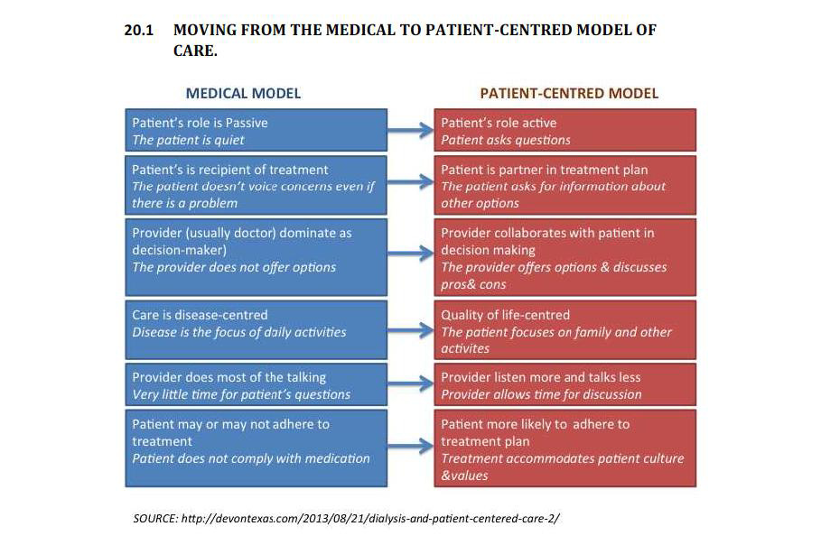
Person and Patient at the Heart of Care
Patient/Person-Centered Care is now central to various Health strategies the world-over, even if its precise form (or, indeed, its achievability) is a subject of some debate. With such ambitions the scope for systems-thinking and interest in the experience of care should be evident, but ethnographic approaches are still the exception in most research.

Slide 5
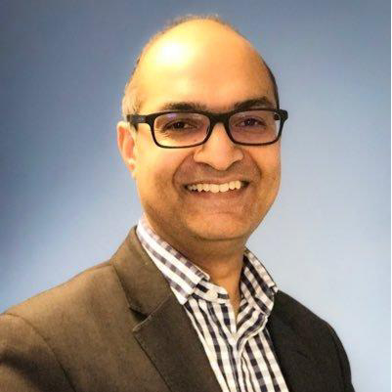
E for Electronic and the Promise of Technology
The dream of the E-record
Lighthouse Projects
New forms of advocacy
E.g., Dr Amir Hannan, Twitter: @amirhannan), the GP who took over Shipman͛s practice in the UK). He has become a champion for ͞turning the computer screen around and allowing the patient to co-write his/her medical record and share in most aspects of decision-making.

Slide 6
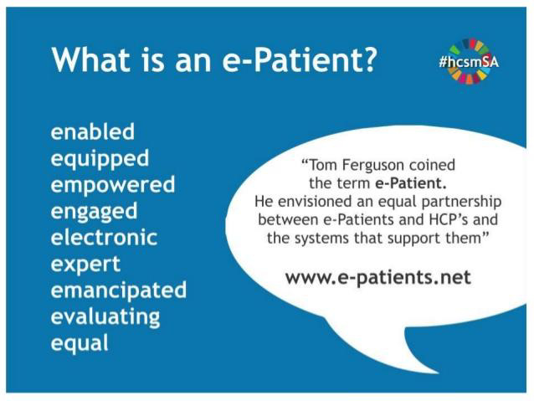
Patients, experts and expertise
Another kind of these emerging experts refer to themselves as ePatients (slide credit: Vanessa Carter, (www.vanessacarter.co.za)
Understanding the role of Dr Google and social media (from Mumsnet through closed FB Pages for Chronic Syndromes)
New forms of Expertise and Advocacy

Slide 7
Co-Design as THE Health Challenge of the 21stC
The slogan at large in a variety of global patient engagement and advocacy groups, ͞No Decision About Me, Without Me has profound, but still very much unrealized, implications for the research into, and delivery of, every level of health and social care.
Older advocacy NGOs now exist in a complex ecology of emerging experts, ͞converted practitioners and technologically-mediated information flows that blur the lines between provider and user, researcher and subject, public and private and even the subject and the object of knowledge. This concatenation is not well understood and even more poorly researched.

Slide 8
What questions can Anthropologists brings to Co-Design?
Patient/Persons are not only incompletely understood as ͞”individuals” Especially if we mean by that the sort of individual we imagine when we think of ͞ ͞”consumer choice”. In your own life, you are not the same “͞you” when (a) shopping for shoes, (b) figuring out who to date, (c) seeking help for a vulnerable loved one, and (d) signing a mortgage (at least I hope you are not).
Power and its various linguistic transformations (empower/-ment, powerful, etc.) are NOT simple ideas and they change contextually and temporally. One is not ͞”empowered” as an event

Slide 9
What Dumb Ideas can Ethnography help systems to avoid?
Vulnerability is an irreducible aspect of human life that should be recognized rather than thought of as an unfortunate condition that can be banished by policy or technology. Humans evolved in groups, one of whose primary functions was ͞care. The model of an agentive individual-in-full-control-of-his/her-destiny is a fortunate fiction for a global few that is at best an abstraction of any real human life which is defined by (often long) periods of dependency and care-giving.
Change (and its range of meanings that shade from highly-valued terms like ͞innovation and disruption to stressed and failing) is no doubt a constant, from the transformations of the users and providers of care through the new possibilities (and expenses) that research and technology make possible. Most technologically-driven change seems to me better modeled by ideas like catalysis. It’s crazy to “value” change in the absence of actually knowing what one is doing.
Most of all we need to interrupt the tendency in health and social care to proliferate solutions before (or in lieu of) understanding problems, based on naïve usages of these key terms.

Slide 10
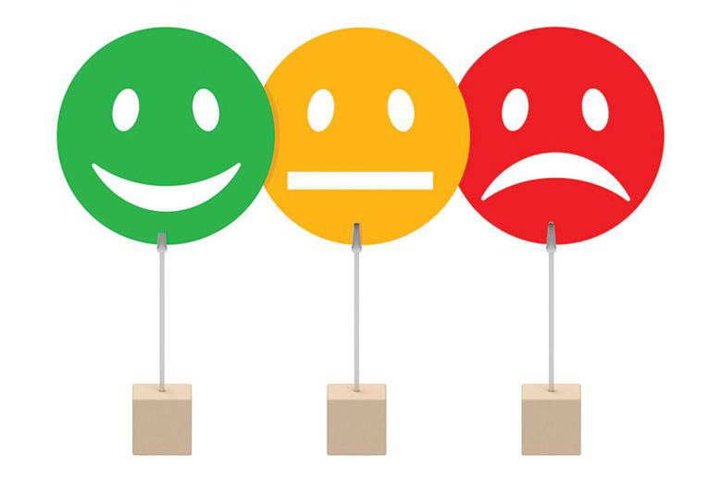
What Dumb Ideas can Ethnography help systems to avoid?
Experience is a big word, one that is thrown around far too casually in healthcare design/assessment. Humans (and their creations) are, in the final analysis, defined by and through their experience. Nothing in human life is deserving of more attention than a 3-4 button measuring of satisfaction". Yet, far too much of the care experience is reduced to this metric. The new terrain of care, expertise and advocacy/involvement that is now coming into view needs MUCH more detailed maps than the ones currently available.
Users and providers are confronting unprecedented opportunities in this emerging ecology, but also clear dangers, as a facile technological optimism, policymakers͛ desire to cut costs and increase ͞quality͟, and many patients looking to shoulder more responsibilities meet various providers of care moving in as many different directions. There is also a policy/institutional/funding infrastructure that oftentimes seems genuinely unsure of the difference between ͞costs͟ and ͞investments͟. Much more needs to be done to get all parties to stop occasionally and take their bearings. Anthropology, a discipline that begins with the assumption that the researcher has a lot to learn in every contact and in every situation, is well-suited to facilitate this dialogue.

Slide 11
Towards a Future
Health research that connects basic science, clinical knowledge and the actual behavior of people in their community(ies) [form the lab to the living-room) has never been more important, as lifestyle emerges as both a key risk factor in morbidity and mortality (with associated costs that make the delivery of modern health and social care increasingly prohibitive), AND as the fundamental platform on which both preventative strategies and therapeutic interventions are supposed to be formulated.
Lifestyle will remain a sort of black-box until we change our research strategies and our understandings of interventions. Ethnography, therefore, is fundamental to a process of affecting achievable change AND promoting the habit of this kind of reflection in service provision and enhancement.

