Slide 1
Introduction ALL Institute
Fleur Heleen Boot
Dept. of Psychology

Slide 2


Background
PhD Neuroscience & Intellectual Disability Medicine
Intellectual Disability Physician
Marie Curie ASSISTID Research Fellow
Assistive Technologies for people with Intellectual Disability and Autism

Slide 3

Current Research Project
WHO Global Cooperation on Assistive Technology programme
GATE-ID
Identify the facilitators and barriers for people with Intellectual Disabilities to effectively access assistive technology.
Identify how access and use can be promoted across high, medium and low resourced settings.

Slide 4
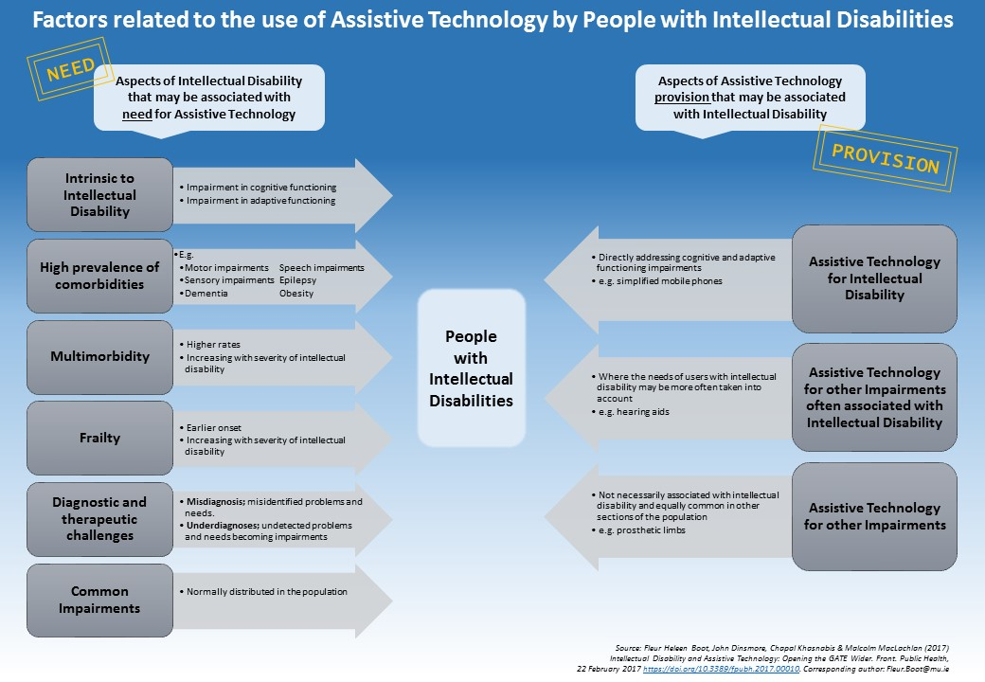

Slide 5
Research Interests
People with Intellectual Disabilities
Inclusion
Access to healthcare and assistive products
Health inequity
Global Health

Slide 6
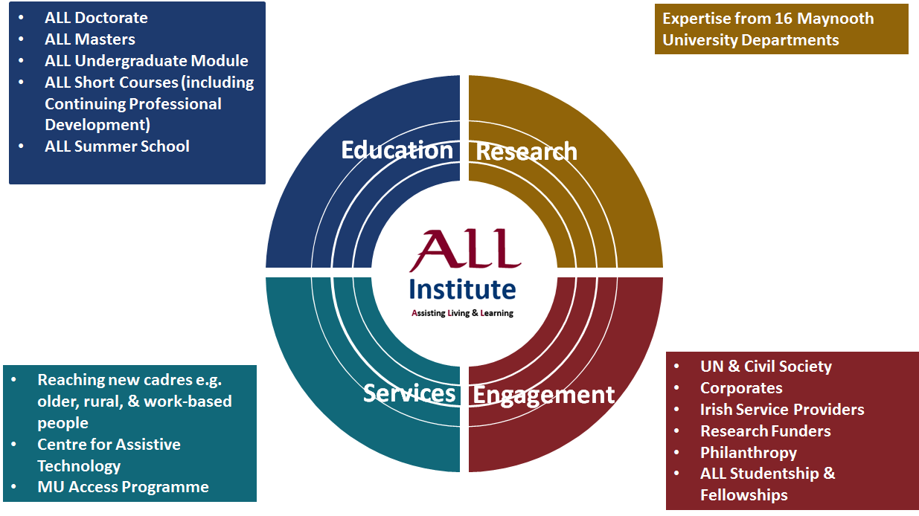
Link to ALL

