Slide 1

The Charter of Fundamental Rights in NI under the Protocol
Protocol Workshop, Maynooth, 22 June 2023
Dr Eleni Frantziou, Durham University
Prof Tobias Lock, Jean Monnet Chair in EU Law and Fundamental Rights

Slide 2
Overview
Background
The Charter in the UK post-Brexit
The Protocol on Ireland/Northern Ireland
Avenue 1: Article 4 WA
Avenue 2: Article 2 Protocol

Slide 3
Background
NIHRC-commissioned research (with E. Frantziou and A. Deb) regarding the application of the Charter in NI after Brexit and its interaction with the Protocol on Ireland/Northern Ireland, annexed to the EU-UK Withdrawal Agreement
Three key areas:
  Integral provisions of Withdrawal Agreement
  Protocol Annex 1
  Other
Already some litigation on the Protocol (SPUC, Ní Chuinneagain, Allister and Peeples)

Slide 4
Why does it matter whether the Charter applies?
Remedies – disapplication of legislation (incl. UK primary legislation) if violation
  E.g. Benkharbouche case: disapplication of state immunity act 1978
Far-reaching duties of consistent interpretation
  Pfeiffer: duty to look beyond the implementing legislation and consider the entire legal order
  Dansk Industri: “Neither the principles of legal certainty and the protection of legitimate expectations nor the fact that it is possible for the private person who considers that he has been wronged by the application of a provision of national law that is at odds with EU law to bring proceedings to establish the liability of the Member State concerned for breach of EU law can alter that obligation”.
Application to private actors (Mangold; Egenberger; Bauer)
State liability in damages (Francovich) => Article 47 EUCFR (Egenberger; Braathens)

Slide 5
The Charter in the UK post-Brexit
s. 5 (4) WA: “The Charter of Fundamental Rights is not part of domestic law on or after exit day”.
  However: general principles of EU law (= fundamental rights) saved, but they can no longer create a ‘right of action’ (Schedule 1(3)(1) WA)
  ‘No court or tribunal’ may (a) ‘disapply or quash any enactment or other rule of law’, or (b) ‘quash any conduct or otherwise decide that it is unlawful’ (Schedule 1(3)(2) WA)
  No state liability (Schedule 1(4))
Interpretation? (Schedule 1(5)):
  (1)References in section 5 and this Schedule to the principle of the supremacy of EU law, the Charter of Fundamental Rights, any general principle of EU law or the rule in Francovich are to be read as references to that principle, Charter or rule so far as it would otherwise continue to be, or form part of, domestic law on or after exit day in accordance with this Act.
  (2)Accordingly (among other things) the references to the principle of the supremacy of EU law in section 5(2) and (3) do not include anything which would bring into domestic law any modification of EU law which is adopted or notified, comes into force or only applies on or after exit day.

Slide 6
The Protocol on Ireland/Northern Ireland
Section 7A EUWA 2018:
(1) Subsection (2) applies to—
(a) all such rights, powers, liabilities, obligations and restrictions from time to time created or arising by or under the withdrawal agreement, and
(b) all such remedies and procedures from time to time provided for by or under the withdrawal agreement,
as in accordance with the withdrawal agreement are without further enactment to be given legal effect or used in the United Kingdom.
(2) The rights, powers, liabilities, obligations, restrictions, remedies and procedures concerned are to be—
(a) recognised and available in domestic law, and
(b) enforced, allowed and followed accordingly.
(3) Every enactment (including an enactment contained in this Act) is to be read and has effect subject to subsection (2).
Shows that some provisions of the WA have the same effects in the UK as EU law had under the ECA 1972
Hence NI Protocol provisions may have such effects, including all EU law made applicable by it
Question: in theory, this must also cover the Charter (confirmed by Schedule 1(5)), but how and to what extent?

Slide 7
(How) does the Charter apply in NI via the Protocol?
Two avenues:
Section 4 (3) WA
  The provisions of this Agreement referring to Union law or to concepts or provisions thereof shall be interpreted and applied in accordance with the methods and general principles of Union law.
  => NI single market for goods incl. rules on VAT; single electricity market; state aid etc, so that numerous EU legal acts remain applicable as EU law
Article 2 NIP
The United Kingdom shall ensure that no diminution of rights, safeguards or equality of opportunity, as set out in that part of the 1998 Agreement entitled Rights, Safeguards and Equality of Opportunity results from its withdrawal from the Union, including in the area of protection against discrimination, as enshrined in the provisions of Union law listed in Annex 1 to this Protocol, and shall implement this paragraph through dedicated mechanisms.
  => Annex 1
  => RSEO beyond Annex 1

Slide 8
Applicability via Article 4 (3) WA
Article 4 (3) WA
  The provisions of this Agreement referring to Union law or to concepts or provisions thereof shall be interpreted and applied in accordance with the methods and general principles of Union law.
Includes the provisions of the Protocol (=part of the WA)
  Hence all EU law referenced in the Protocol (be it directly or in its annexes)
    Duty to interpret in accordance with the methods of EU law (i.e. in conformity with the Charter)
    Duty to apply provisions referencing EU Law in accordance with Union law
      Gateway for further-reaching Charter effects

Slide 9
Applicability via Article 4 (3) WA
Consequences: three scenarios
Charter informs the interpretation of EU law made applicable by the NIP
Charter may be invoked where provisions of EU law are applied, i.e. beyond the interpretation of the provisions themselves
  Relevant e.g. for remedies
Charter can be invoked to challenge the validity of secondary law made (dynamically) applicable by the NIP
  Possibility of NI courts to request preliminary rulings from CJEU here – Art 12 (4) NIP

Slide 10
Applicability via Article 4 (3) WA
Duty to apply provisions referencing EU law in accordance with Union law
  Article 51 (1) CFR: Charter applies to the Member States ‘when they are implementing Union law’
    i.e. when they are acting within the scope of EU law (Case C-617/10 Fransson)
    Hence when MS apply EU law, they must apply the Charter
    But Art 51 itself contentious see, eg, pending case C-769/22 Commission v Hungary
  Argument thus: the Charter applies in NI (and to NI/UK authorities) when they are applying one of the provisions of EU law referenced by the NIP
(Potentially) far-reaching, notably re Article 47 CFR (right to an effective remedy)
  Coupled with the principle of primacy (and associated EU law remedies)

Slide 11
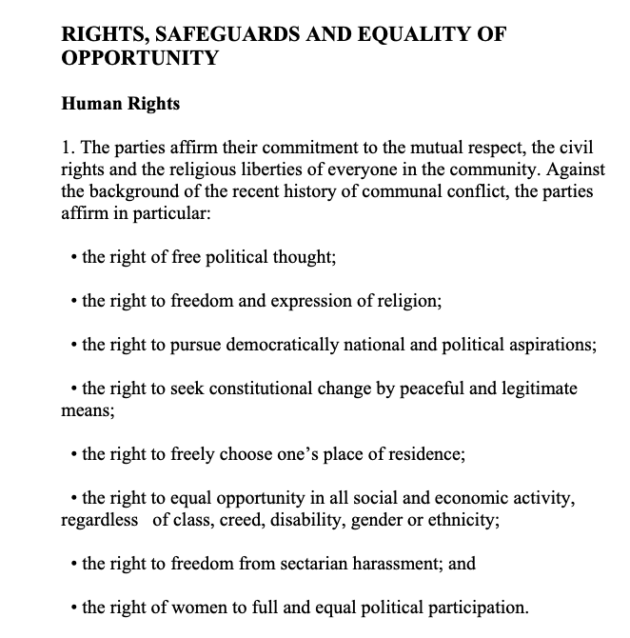
Applicability via Article 2 NIP
Article 2 NIP
The United Kingdom shall ensure that no diminution of rights, safeguards or equality of opportunity, as set out in that part of the 1998 Agreement entitled Rights, Safeguards and Equality of Opportunity results from its withdrawal from the Union, including in the area of protection against discrimination, as enshrined in the provisions of Union law listed in Annex 1 to this Protocol, and shall implement this paragraph through dedicated mechanisms.

Slide 12
Applicability via Article 2 NIP
Test (NI Court of Appeal in SPUC):
A right (or equality of opportunity protection) included in the relevant part of the Belfast/Good Friday 1998 Agreement is engaged.
That right was given effect (in whole or in part) in Northern Ireland, on or before 31 December 2020.
That Northern Ireland law was underpinned by EU law.
That underpinning has been removed, in whole or in part, following withdrawal from the EU.
This has resulted in a diminution in enjoyment of this right; and
This diminution would not have occurred had the UK remained in the EU.
Article 2 NIP
The United Kingdom shall ensure that no diminution of rights, safeguards or equality of opportunity, as set out in that part of the 1998 Agreement entitled Rights, Safeguards and Equality of Opportunity results from its withdrawal from the Union, including in the area of protection against discrimination, as enshrined in the provisions of Union law listed in Annex 1 to this Protocol, and shall implement this paragraph through dedicated mechanisms.

Slide 13
Applicability via Article 2 NIP
Test (NI Court of Appeal in SPUC):
A right (or equality of opportunity protection) included in the relevant part of the Belfast/Good Friday 1998 Agreement is engaged.
That right was given effect (in whole or in part) in Northern Ireland, on or before 31 December 2020.
That Northern Ireland law was underpinned by EU law.
That underpinning has been removed, in whole or in part, following withdrawal from the EU.
This has resulted in a diminution in enjoyment of this right; and
This diminution would not have occurred had the UK remained in the EU.
Difficulty: Charter only applies when MS is ‘implementing Union law’
Where Annex 1 directives are concerned – fairly straightforward
Outside Annex 1 directives:
  Clear that Charter rights do not apply in and of themselves
  Careful consideration therefore necessary if a provision of EU (secondary) law ‘underpins’ NI law giving effect to a RSEO right
  Once established: Charter may come into play

Slide 14
Applicability via Article 2 NIP - Examples
Parental Leave Directive 2010/18 – mentioned in UK Gov explainer
  Interpretation in light of Art 33 (2) CFR (right to parental leave)
  E.g. Case C-129/20 Caisse pour l’avenir des enfants
2. Rights contained in the ECHR (as ratified by the UK)
  E.g. data protection covered by Art 8 ECHR (S and Marper v UK, etc)
  GDPR to be interpreted in light of Art. 7 and 8 CFR
3. Rights in the ECHR (but not ratified by the UK)?
  Ne bis in idem, Article 4 Prot 7 ECHR (=50 CFR) – RSEO commitment?
    Common law basis and Criminal Justice Act 2003; Art 14 (7) ICCPR; ART 54 CISA
  Fast-developing area of the Charter, e.g. Case C-435/22 PPU Generalstaatsanwaltschaft München: extradition of Serbian national (finally convicted of the offence in Slovenia) to USA under US-German extradition treaty?

Slide 15
Applicability via Article 2 NIP
Open questions at this stage:
If the previous is correct, then does the entire Charter apply as soon as an ‘underpinning’ provision of EU law is engaged, or do we need to close the loop by checking whether the Charter right in question is itself an iteration of one of the rights mentioned by the RSEO section?

Slide 16
Thank you very much for listening

