Slide 1
Maynooth Green Campus
Solar Eclipse 10.00am-12.20pm
Maximum: 11.05am
Thursday 10th June 2021

Slide 2
In 2015
a rare event
caught our imagination …
A Solar Eclipse

Slide 3
Maynooth Green Campus organised a viewing

Slide 4
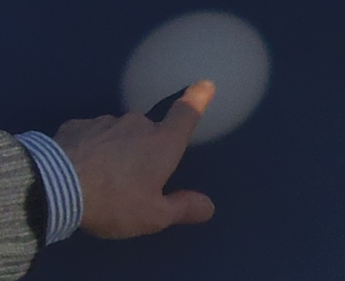
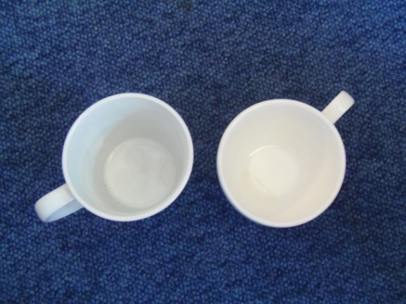
Solar eclipse event
Maynooth Green Campus
Base camp:
Hume Rooftop 8.30-10.30,
20th March 2015

Slide 5
Solar eclipse event
Maynooth Green Campus
The sky was was cloudy
Rooftop, atmosphere was convivial
… we looked and we hoped
… ran out of cups
People came and went – classes!

Slide 6
Solar eclipse event
Maynooth Green Campus
Inside,
Créidhe O’Sullivan, Physics, spoke about the sun.
But then the clouds thinned
We were outside again!
Tea & coffee on standby

Slide 7
But would we see it?
We all know about Irish skies…
You can rely on them…
to be cloudy…
or rainy
We would certainly try!

Slide 8
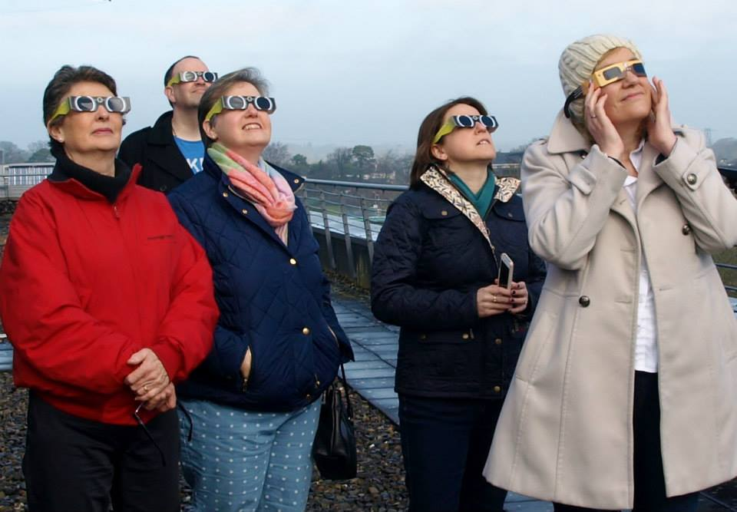
and then…

Slide 9
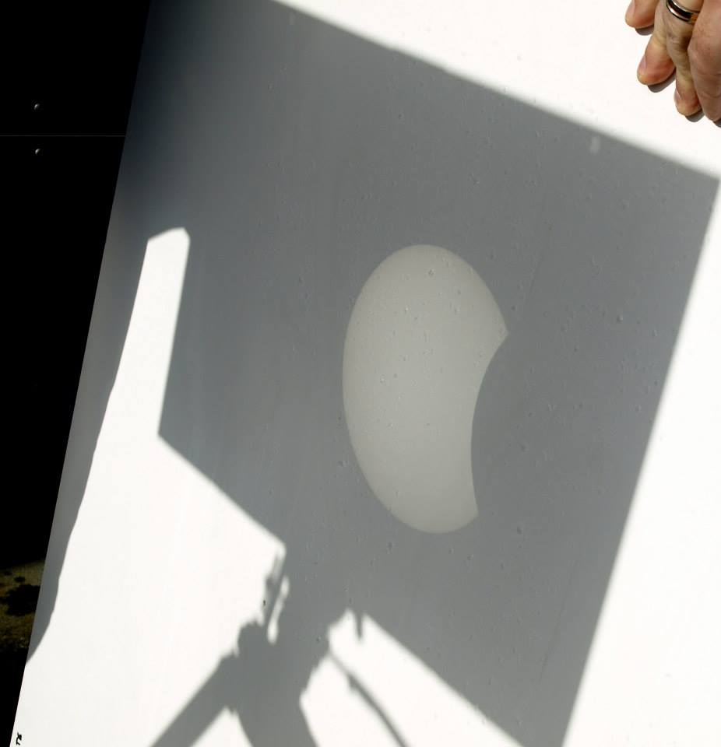
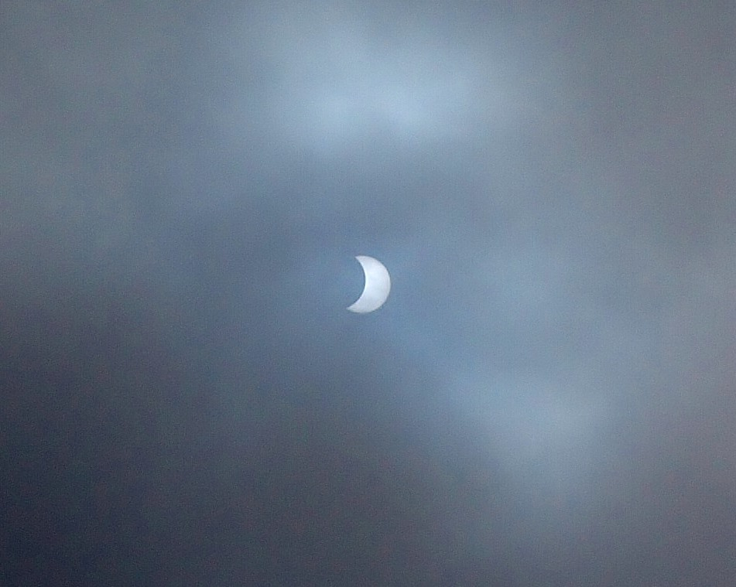
We saw it!

Slide 10
Think solar!
The sun can provide unlimited amounts of renewable energy
Fossil fuel emissions threaten our eclipse as a species.
Don’t let it happen!
photos – Maura Boyle

Slide 11
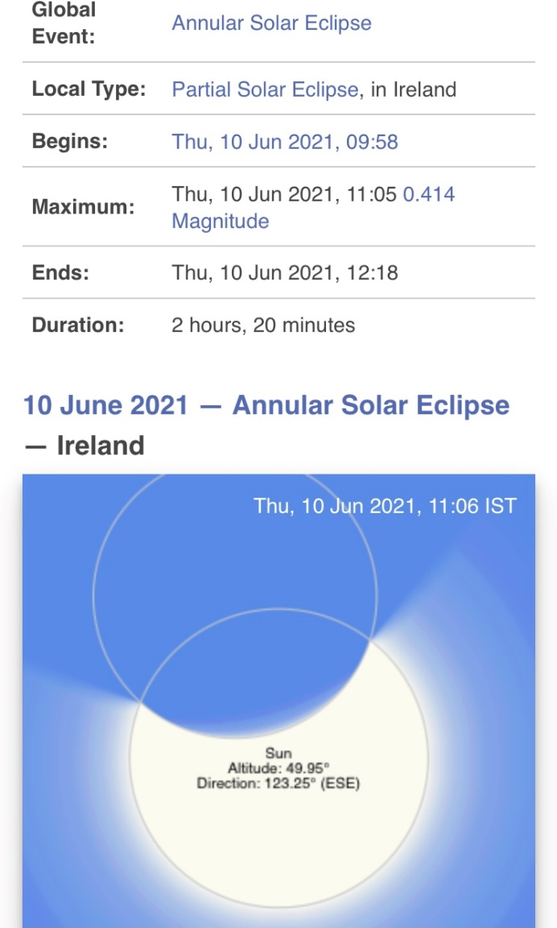
June 2021
Another eclipse
six years since Paris
Tempus fugit

