Slide 1
Welcome Erasmus & Study Abroad students
International Office, Maynooth University

Slide 2
President's Welcome
Professor Eeva Leinonen

Slide 3
Presentation Summary
Welcome!
Introduction to the International Office
Practical Matters
Supports
Emergencies & important contact numbers
Getting online
Modules
Timetables
Registration
Your Address
Exams & Assessments
Covid19 & MU Response Team

Slide 4
Céad Míle Fáilte! One Hundred Thousand Welcomes!
We are delighted that you have chosen Maynooth University for your Erasmus & Study Abroad experience. This year, unfortunately the number of Study Abroad and Erasmus students who could travel to study with us was greatly impacted by Covid 19.
We are delighted that there are over 220 Erasmus & Study Abroad students new to Maynooth this January. There will also be hundreds of returning students and other international students for you to meet and interact with during the semester.
Please watch and listen to ALL orientation talks. They are for YOUR benefit and will help you adjust to life at Maynooth.

Slide 5
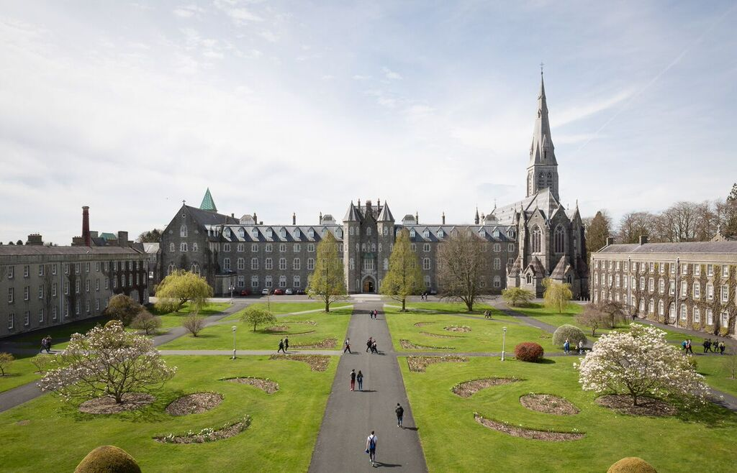
The International Office
We are one of your main points of contact while at Maynooth University!
ERASMUS: erasmus.incoming@mu.ie
STUDY ABROAD: studyabroad@mu.ie
We are primarily working from home so please understand our working hours vary.
REACH US ANYTIME ON:

Slide 6
How to contact the International Office
Please refer to the ‘Contacting the International Office’ tile in the After You Arrive section of the International Office website for current arrangements.​
General hours of work 9am – 5pm (when to expect a response).
Virtual office hours will be held daily from January 26th – Feb. 4th for you to connect with IO staff and have questions answered immediately.
Letter Requests: opening bank account, confirming student status and details.
Please do not arrive to the International Office without an appointment in advance.

Slide 7
After You Arrive Webpage

Slide 8
Pre-Arrival Guide
Maynooth University Pre- Arrival Guide for International Students Semester 2, 2022
Last updated 19 January 2022
Go to this Sway

Slide 9
Getting Online – Your MU Account
YOU NEED:
MU STUDENT NUMBER
MU PASSWORD
Your unique MU student number (username), email (mumail) and password were emailed to you by the Student Records & Registration Office.
Your student number and password will provide you with access to Email (outlook), Microsoft 365, Moodle and campus wifi.
If you have any access/technical issues email servicedesk@mu.ie

Slide 10
For Current Students section of MU website: https://www.maynoothuniversity.ie/current-students

Slide 11
Your Personal Details
Please always ensure that your details are accurate and up to date on your registration.
To update details log into ‘Student Web’ found on the For Current Students webpage.
Example of an Irish address:
ELM 9A, COURTYARD APARTMENTS, MAYNOOTH UNIVERSITY, MAYNOOTH, CO. KILDARE, W23 F3F1, Ireland.
7 STRAFFAN GREEN, STRAFFAN WOOD, MAYNOOTH, CO. KILDARE, W23 Y2W9, Ireland.
STUDY ADDRESS
HOME ADDRESS
EMERGENCY CONTACT

Slide 12
Modules
MODULE
=
CLASS
As a visiting student you can take modules across all Departments at MU.
It is your responsibility to ensure you take the necessary or required modules and credits that will be approved by your home university.
We recommend that you take no more than 30 ECTS per semester.
CHANGING MODULES:
Identify Department International Coordinator
Email & Request Approval (Incl. student no. & transcript etc.)
Complete the CHANGE MODULE form on the Student Records Office webpage
Student Records will register you for new approved module
To remove a module from your registration, email: registration.docs@mu.ie

Slide 13
Changing Modules: https://www.maynoothuniversity.ie/records

Slide 14
Understanding the Timetable
How to access your personalized timetable? Go to the 'For Current Students' section of MU website.
Allow time for your registration and timetable to update if you are making changes to your modules.
What does that mean?
L1/L2/L3, etc. refer to Lecture 1, Lecture 2, Lecture 3. Students need to attend ALL of these.
T1/T2 or TUT1, TUT 2 refers to tutorials. (In general students do not need to attend all of these – see your academic department for further information)
P1, P2, P3 refers to practicals. These are managed by the relevant academic department.
Where /A or /B or /C appears after the Module code, that means the module is delivered more than once. You will be allocated to one of the groups and will attend either A or B for each lecture.
You will only see the class groups relevant to you on your personalized timetable.
Classes are generally 50-55 minutes in duration, or a double (2 hours).

Slide 15
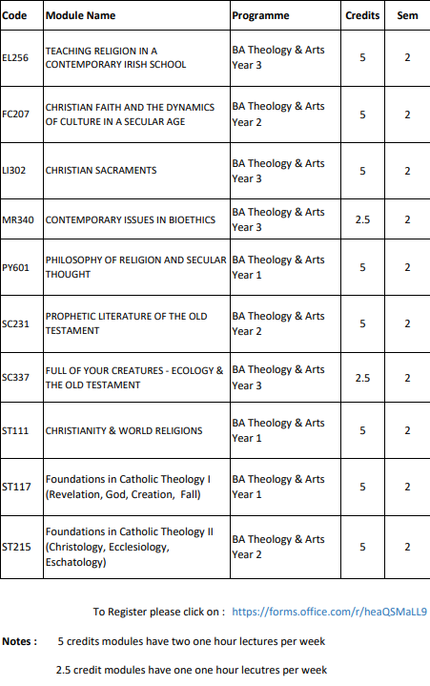
Theology modules
Students can register with St. Patrick's Pontifical University to take theology modules.
Limited places are available in the modules and it is first come, first served.
You can submit a request to register for theology modules (link on IO website)
Deadline 12noon on Thursday Jan. 27th.

Slide 16
Examinations
Semester two students: you will sit the university scheduled exams in May 2022.
Exams may be in-person and/or online
No exceptions to this policy.
The Exams Office will release the timetable in April.
If you require exam accommodations or learning support, register with the MU Access Office (access.office@mu.ie) as soon as possible.

Slide 17
Emergency / Need Assistance
999 or 112 – Police, Ambulance, Fire Services
Campus Security 24/7: 00353 1708 3929 or 00353 1708 3333 (Emergency)
Sick?
Doctor on campus: 003531708 3878
Off Campus Doctor: Dr. Denis Gaffney 00353 16291169
KDOC Appointments: 1890 599 362
Call ambulance 112 or 999
Nearest Hospital: Connolly Blanchardstown
Need the Police? Dial 999 or 112
Call campus security to notify them of ambulance arriving on campus. If you need to attend A&E - the wait times can be 8+ hours. Be prepared.
If you need help ASK FOR IT!

Slide 18
What to do if you develop symptoms of Covid19
If you have symptoms of covid19 - Stay in your accommodation and isolate yourself from others.
Get a PCR test. You can book one at: https://www2.hse.ie/conditions/covid19/testing/get-tested/.
Continue to self-isolate until you receive your test result.
If your test result is ‘Positive’ email the COVID Response Team at covid.response@mu.ie with the following information:
Your Name & Your Student Number
Your contact number
Date your test was taken
Date your symptoms started (if applicable)
Date you were last on campus
Do you live on campus?
A list of classes/locations attended in the 48hrs prior to the onset of symptoms/date test taken (whichever came first). Include module code, date, time and venue of the class.
Details of any other activities on campus in the 48hr period e.g. Library, Sports Hall, meeting with lecturer etc.
Follow the advice given to you by the HSE and self-isolate as per their instruction.
If your symptoms get worse and you require medical advice contact your GP or the Student Health Centre on (01) 708 3878.

Slide 19
MU Covid Response Team
The Covid Response Team can be contacted by email covid.response@mu.ie. This is monitored 7 days a week.
For on-campus issues, the Covid Response Team can be contacted on (01) 474 7999 from 9am to 6pm Monday to Friday. Outside of these hours, this number will be answered by Campus Security, who will be able to help with urgent on-campus issues.
Rules on self-isolating, close contacts etc. are regularly changing. You must adhere to the latest guidelines.
See https://www2.hse.ie/conditions/covid19/

Slide 20
What Next?
Join all the orientation presentations this week.
Ensure you are happy with your modules and timetable.
If needed check in with the International Office – we are here to help and support.
Become involved in campus life – MSU, Clubs & Societies, Chaplaincy.
Avail of supports from the beginning – free Medical Centre, free counselling service, academic advisory, Maths support centre, and more! IMPORTANT!
Keep up to date with current guidelines and recommendations on covid-19.
www.gov.ie & www.hse.ie & www.maynoothuniversity/coronavirus are your main sources of information

Slide 21
Thank You for Listening!
We wish you the best of luck as you begin your studies at Maynooth University

