Slide 1

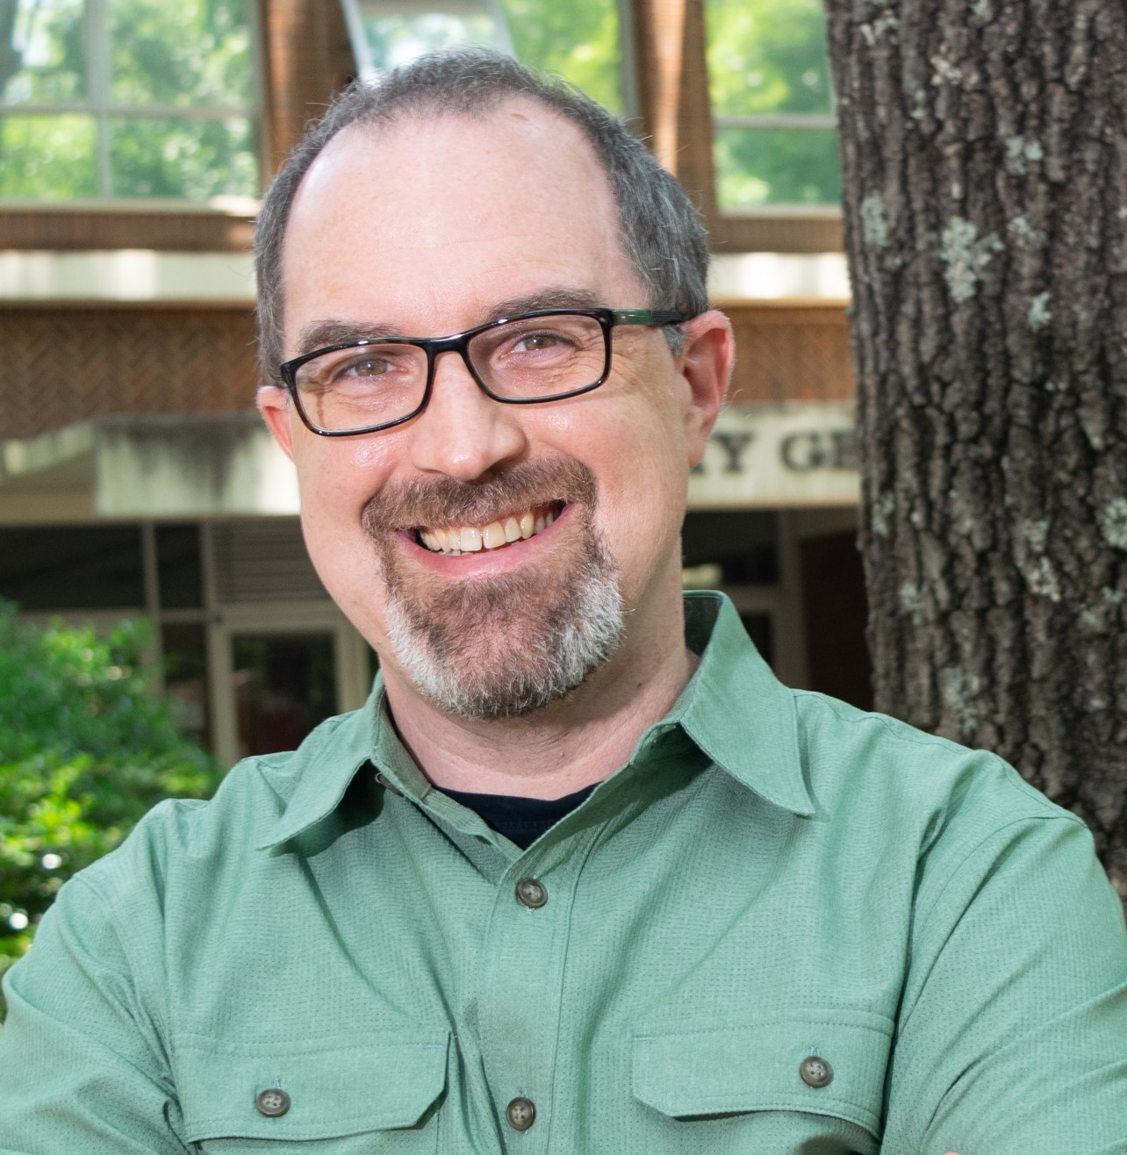

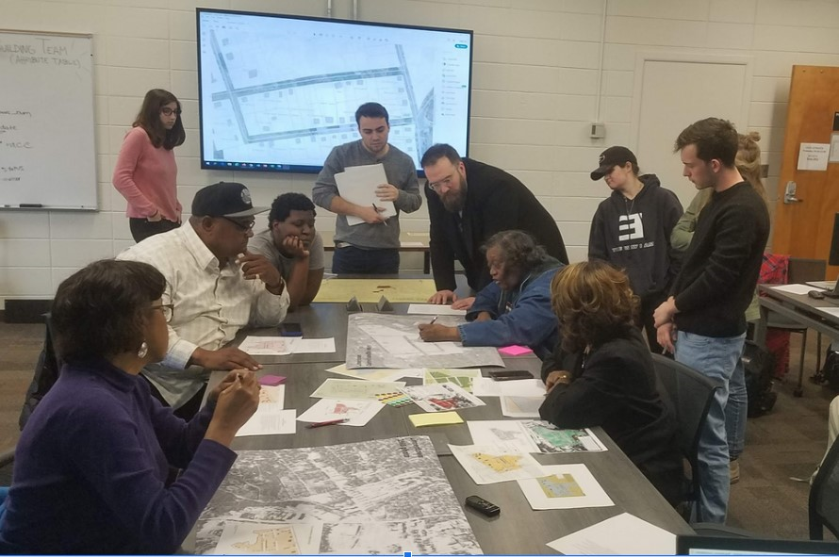


Dean of Teaching & Learning Seminar Series 2023/24
Learning through Praxis: Developing community partnerships for holistic education and social change.
Wednesday 6th March, 10am – 2pm
MUSSI Seminar Room, Iontas Building,
The Dean of Teaching and Learning is delighted to host this event in conjunction with Department of Geography.
The AX1 Sessions:
A Masterclass Series in Good Design & its transferability into
the Higher Education Classroom
‘Joining the Dots: Supporting the Student Throughout the Student Journey’
Caitriona McGrattan and Oisin Hassan
This seminar is intended to develop a toolkit for HEIs to conduct their own ‘Plotting the Students’
Journey’ activity that would underpin their institutional Student Success Strategy.
Masterclass Details:
9:30am -10:00am: Welcome Refreshments.
10:00am -11:30am: Session 1: Community geography, social engagement,
and the public university classroom.
11:30am -12:15pm: Lunch and informal discussion.
12:15pm -1:45pm: Session 2: Workshop: Building equitable partnerships for
engaged learning and social change.
1:45pm -2:15pm: Refreshments and informal discussion.
Dr Jerry Shannon, Associate Professor in Geography and Financial Planning, Housing, and Consumer Economics at the University of Georgia. His broad interests are in urban development and inequality, geographic information systems, and place effects on health.
More specifically, his research focuses on the role of maps and spatial analysis in shaping our understanding of hunger, housing, poverty, and neighbourhood development. He is also interested in the role of participatory research methods in mobilizing community action around these issues. He is Director of the Community Mapping Lab at UGA.
To attend, please email Gemma.Middleton@mu.ie.

