Slide 1
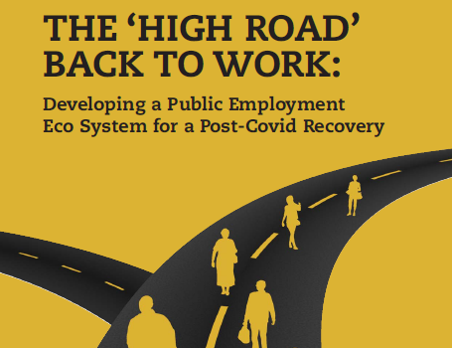



Dr Mary P. Murphy, Dr Nuala Whelan,
and Dr Michael McGann
Maynooth University Social Sciences Institute
and Department of Sociology
5 June, 2020

Slide 2
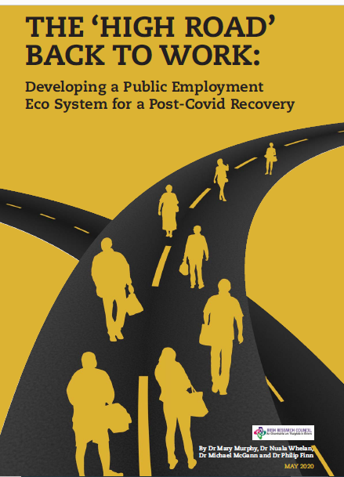
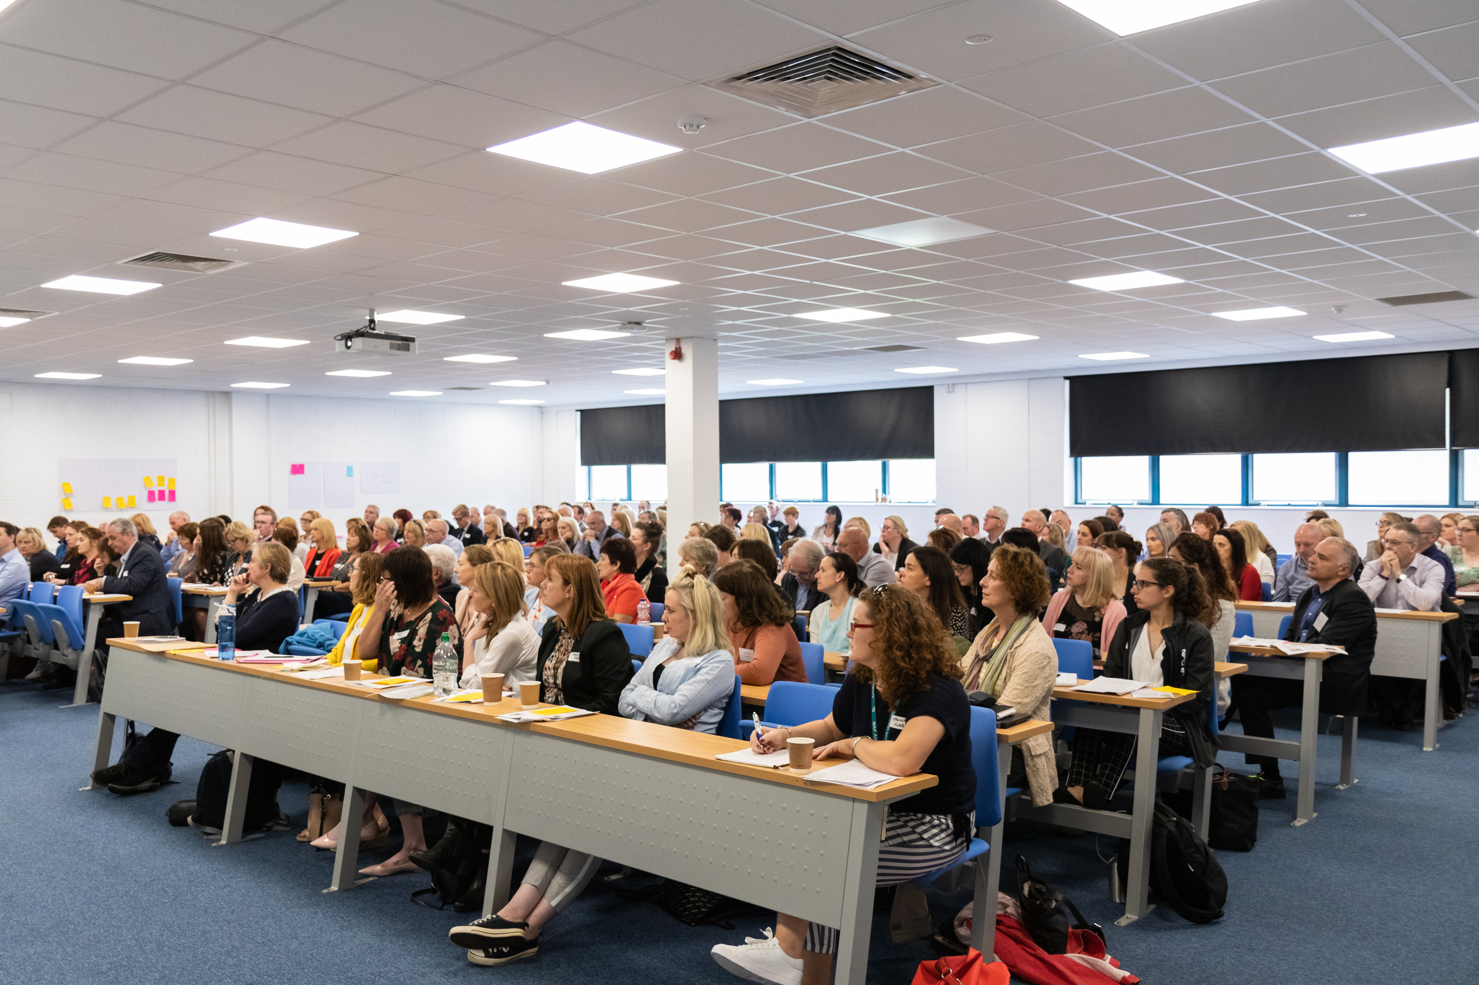
10:05: | Introduction: Who: Dr Mary Murphy
10:15: | What is needed: Dr Nuala Whelan
10:25: | How to do it: Dr Michael McGann
10:40: | Discussant Prof Rory O’Donnell (former Director National Economic and Social Council)
11:00: | Discussion
11:20: | Conclusion and Wrap-up
The IRC Coalesce funded research project, based in Maynooth University, is led by Dr Mary Murphy (PI), Dr Nuala Whelan (Post Doc) and Dr Philip Finn (Research Assistant).
An advisory committee including ILDN, LESN, INOU collaborates to support the research. Neither Maynooth University nor the IRC are responsible for any use that may be made of the information in this report. The views expressed in this report are those of the authors alone

Slide 3
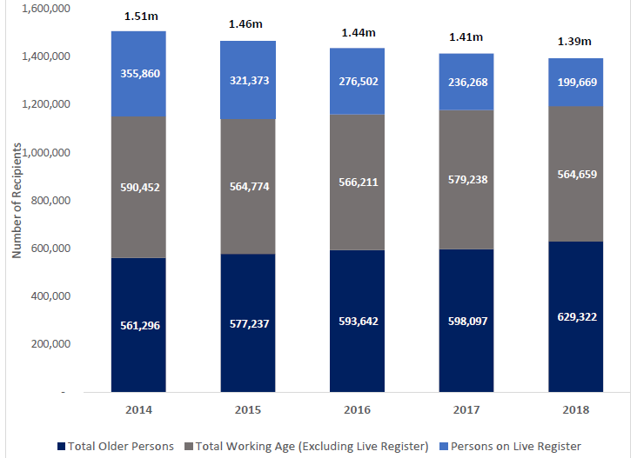
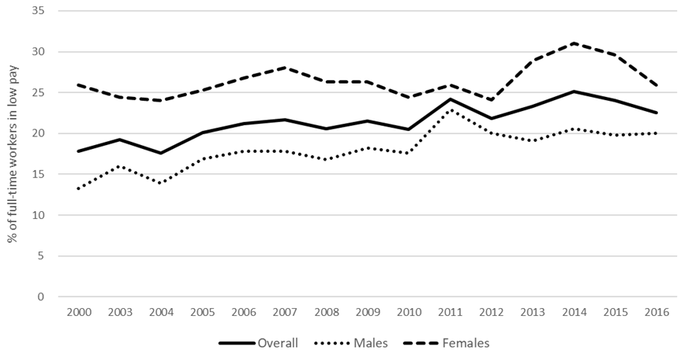
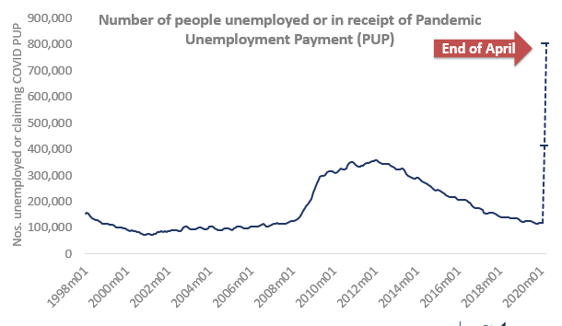
What was normal like? Were institutions fit for purpose?
Numbers of working age not in employment
Number of low paid, poor quality jobs
OECD – low pay in full time jobs
Covid era escalation of unemployment
What works? Integrated, quality, tailored, case management focus , local
Post 2011 reforms, questions of ‘competence, capacity, culture
’

Slide 4
Scale of Covid job loss enormous - women, young people and migrants, low paid, low skilled
Focus on PUP, TWSS, LR – 1.2m
But wider lens shows 1.8m working age are in receipt of some form of state income,
Sources:
Live Register and Emergency Covid-19 payment data taken from monthly CSO and DEASP administrative data.
Labour force size is based on CSO Labour Force Survey data for Q4 2019.
Population on other working age payments (non Live Register) is based on 2018 DEASP Administrative data
564,659 – Working-age on other payments, 214,700 – Live register
579,400 – PUP, 482,800 / 56,300 employers – Temporary Wage Subsidy

Slide 5
WHO – tailored - not once size fits all
Decent work and pay
LLL and training, progression
Job Ready
Upskilling
Work experience
Avoid/reduce Long Term Unemployment
Class – SES
Gender (Care, PT)
Young (scars, YG)
Disability
Ethnicity
Equality
Homelessness
Addiction
Criminality
Location
Migrants
Structural Barriers
VOICE, RIGHTS, RESPECT: Co-Production, Co- Creation

Slide 6
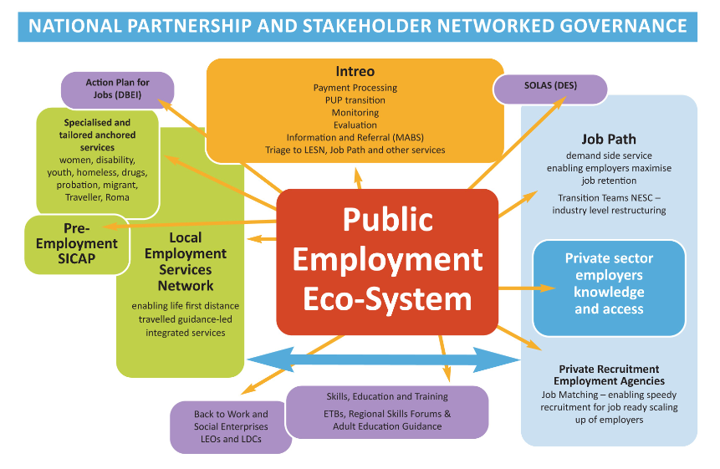
Jobs Clubs
Employability
WHAT –Nuala
How – Michael

Slide 7
What?
Reimagining a Capability-led, post-Covid, Work-Life PEES
Dr Nuala Whelan

Slide 8


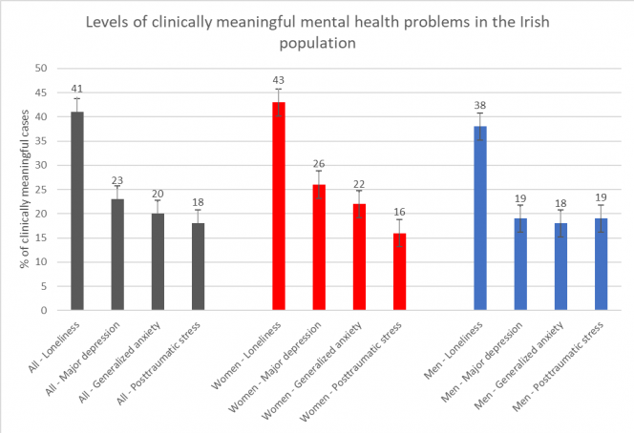
Psychological Impact of Covid-19
…in lockdown
…physical distancing
…health care staff
…students
‘Coronavirus lockdown means we are now running the risk of a whole generation ‘failing to launch’
Tristram Hooley (May, 2020)
Mental health problems are common
41% of people reported feeling lonely
23% reported clinically meaningful levels of depression
20% reported clinically meaningful levels of anxiety
18% reported clinically meaningful levels of post-traumatic stress
Surveys: mental health(MU)/working from home (UL/ESRI)
https://www.maynoothuniversity.ie/news-events/covid-19-mental-health-survey-maynooth-university-and-trinity-college-finds-high-rates-anxiety
Notes:
We’ve heard a lot about the psychological impacts of the Covid crisis – an its impact more generally

Slide 9

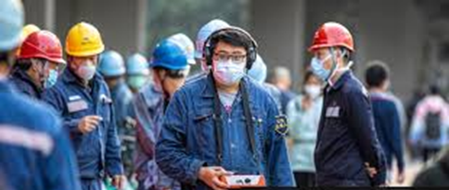
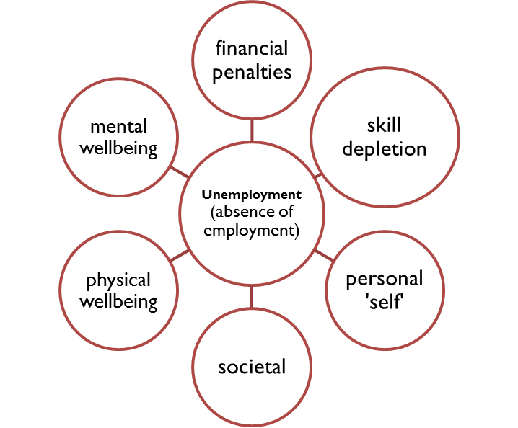
Caring for a recovering labour force
What about the Psychological health of labour force?
Response of PES will be important – approach, supports
China one month into Covid outbreak – unemployed/stopped working – worse mental and physical health, distress (Zhang et al., 2020)
Unemployment Health and societal impacts psychological well-being and re-employment negatively affected
Responding to crisis induced mass unemployment
  Collective trauma – overwhelming, triggering
  stress and anxiety
  Individual trauma – intensified existing traumas,
  grief and loss
  Responses must not be trauma inducing
While not everyone has been traumatised, lives have been severely disrupted, need to debrief before exploring options
.
Notes:
Retail, restaurants, hospitality – security of jobs, delivery of services, reopening
Youth and graduate employment market
Services must not be trauma inducing
Health and societal impacts of unemployment – psychological well-being and re-employment negatively affected
Unemployment linked to over 100 psychological variables (anxiety, poor cognitive performance, suicidal ideation, low motivation, psychosomatic problems, etc.) Lower levels of psychological well-being amongst the unemployed when compared to their employed counterparts and general population
Effects are often multiple – decreased well-being, high levels of psychological stress, loss of confidence, low self esteem…
Manifest / latent benefits (Jahoda, Fryer, Warr)

Slide 10


Labour Market Policy Options
Human Capital Development
Work-First Activation
Holistic
Prioritising life needs
Capability / Wellbeing
Networked / Flexible
Capability, Wellbeing
Empowering
Freedom to choose
Co-design
Skill / Competence development
Sustainable access
In-work transitions/
career development
Avoids prolonged unemployment
Intensive job search
Speedy return to work
Monitoring Activity/compliance
Work-Life approach for those more distant from the labour market
Decent ‘work-first’ sustainable approach for the job ready - ALMP

Slide 11
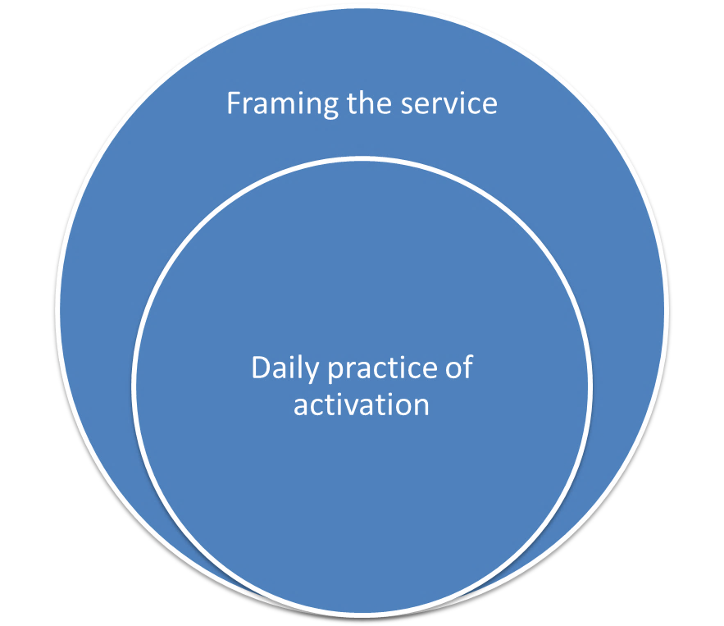
Supply side services…
Framing services
Post-disaster psychosocial interventions (Hobfoll et al., 2007)
  Sense of safety
  Calming
  Sense of self and community
  efficacy
  Connectedness
  Hope
Trauma informed care
  Safety
  Trustworthiness and transparency
  Collaboration
  Empowerment
  Choice
  Intersectionality
Daily practice of activation
Career Development- promotes life effects, ability effects, self perception effects, opportunity-perception effects, opportunity effects (Redekopp & Huston, 2020)
Mental health – three Rs of anxiety management (Resilience, Reframing, Recovery) (Lucey, 2020)
Approach – Solidarity, Hope, Positive, positive personal and psychosocial outcomes
Capacity and Competence
Robust Triage and Profiling
Notes:
Providing adequate psychosocial supports for the labour force should be evidence informed
but
Opportunities to develop and test effective responses are rare
So gather related evidence to inform our decisions

Slide 12
Demand Side Supports:
Sustainable Job Recovery & Recruitment
Shaping change
National Strategy to promote a return to employment – quality work
New forms of work – digital, remote
Promote job sustainability and well-being
ALMP & employers
Gender, disability, low-pay, apprenticeships, job-retention, in-work progression, up-skilling
Environment and Green Economy
Supply side measures
Demand Side Supports
Leaving no one behind
PES greater role in job creation
Retention and enterprise – Future Jobs Ireland, Action Plan for Jobs
Local Employment Partnerships
Co-production, building an inclusive labour force – PEES diagram
Maximise Procurement of Local Services
including LEOs, LCDCs

Slide 13
How?
Institutions, Governance
Welfare Architecture
This research has received funding from the European Union’s Horizon 2020 research and innovation programme under the Marie-Sklodowska-Curie grant agreement no. 841477.
The views expressed are those of the author alone.
Dr Michael McGann
Marie Sklodowska-Curie Fellow

Slide 14
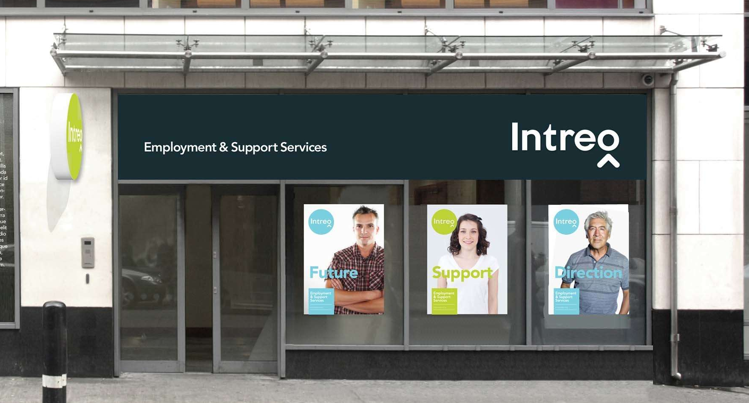




Contracted PES
PbR
Yearly referrals ~75,0000
Circa 600 staff (DPER 2018)
Fee-for-service
Annual referrals ~45,000
Circa 170 staff
Circa 700 activation staff
Short-term unemployed
Further institutional reform essential for a post-Covid recovery
{ 50% on PuP return to work by early 2021 }
{ ‘Great Lockdown’ }
{ Last recovery }
Five fold rise in LTU?

Slide 15


Will marketisation work (again)?
Job Path performed will in helping to reduce LTU claimants, especially for groups nearer employment
Attractiveness of PbR? - Shifts responsibility & risk from state to market and NGOs
But series of inbuilt tensions (Greet et al. 2017; Considine et al. 2019, 2020)
Service Investment (Payment Risk v. Quality) | Access (Equity v. Performance)
‘No cure, no payment’ drives ‘tried and tested’ approaches
Investments in long-term, integrated approaches hampered by short-time horizon for payments | Danger of services being narrowly targeted on those more likely to realise an outcome
Approaches that move people towards employment but not all the way there are not rewarded | Smaller, NFPs lack the capital to take on level of financial and contractual risk
Role for digitalisation?
Digital-first/by-default seen as ‘freeing-up’ resources for personalised support elsewhere (e.g. BEL, AUS) BUT
Issues of profiling / triaging become even more critical
Some left behind by digital divide and algorithmic bias?

Slide 16
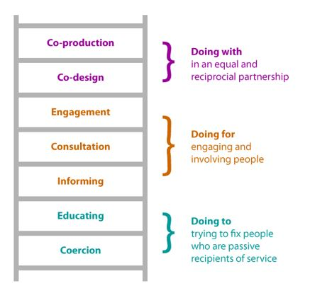


Network / Partnership Governance
Services and outcomes are invariably co-produced:
By networks of organisations within and across sectors
In collaboration with clients as active partners and sources of expertise rather than passive recipients
Inter-agency partnerships
Address information gaps between services
Bring wider pool of ideas to solve problems
Build joint ownership and implementation of new approaches
Agencies as service ‘facilitators’ not ‘providers’
Governance modelled on Trust and Reciprocity
Rather than Competitive / Transactional modes

Slide 17
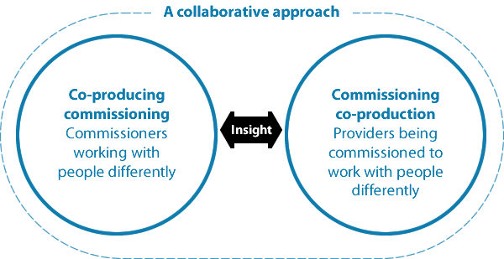
Design and Planning
Resourcing and Delivery
Frontline Practice
New Economic Foundation (2014)
Commissioning for co-production
Mutually agreed aims, priorities, standards
Processes for signposting, pooling, coordinating
Users, agencies (+others) involved early in design vs. bidding for already designed services
Substantive personalization Choice-responsive
What outcomes (not outputs) matter?
How will they be measured?
Locally available assets and resources?
How can these be aligned to ‘add value’ between / across services?
Shared risk and accountability?
Lindsay et al. (2018)
‘Co-production as a route to employability’

Slide 18
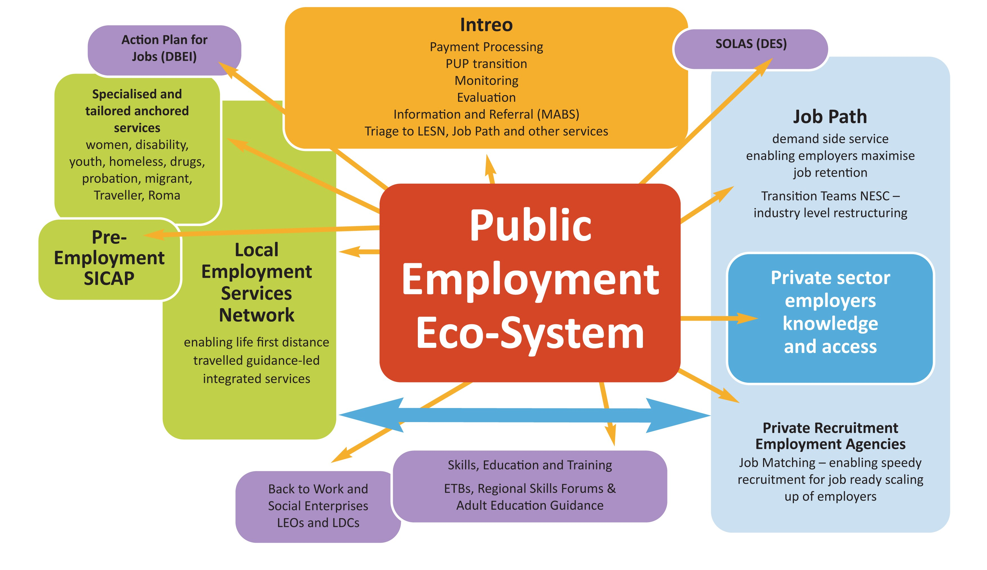


Local Employability Partnerships
Joined-up funding
Cross-sectoral (Public, FP, NFPs)
Regionally aligned
Integration of employability and other systems
Right job, at the right time
Municipal Job Services
Jobs Clubs
Employability
Increasing co-production & local autonomy in PES
Partnership contracting built on sustained relationships
Underpinned by Co-production, collaboration, and partnerships, e.g.;
  Intreo and Job Path with employers, recruitment agencies, ETBs, SOLAS, as well as with LESN
  LESN and SICAP with specialised welfare services, Jobs Clubs, Employability, LDCs, Social Enterprises
Locally and regionally aligned (horizontal not vertical) commissioning
Dialogue with social partners, civil society, associated gov. agencies (ETB’s, Solas, DBEI, DES), service providers
Builds on history of deliberative & integrated approaches (task forces, partnerships) - blended with idea of enabling and capacitating state

Slide 19
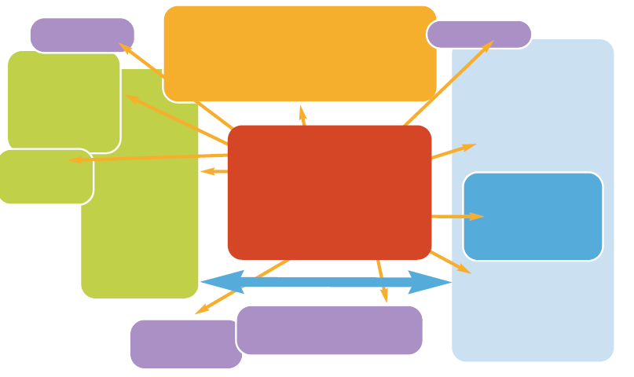
Local Public Employment Eco System
New welfare architecture
A local high road recovery – challenge of integrating all actors – public, private, not for profit - to enable people work in inclusive labour market with sustainable that progresses well being
Fill it in and send it back!
Facilitating / capacitating national and local state
Participation Income
enabling social value and tapering exits
Universal Basic Services underpinning life transitions
Including PES

Slide 20
WHAT
Capability-led
PEES
Post trauma capability informed activation
Decent work-first for sustainable well being
WHO
Leave No
One Behind
Low paid – in work progression
Long term unemployed
HOW
Institutions
Governance
Architecture
Network governance, collaboration rather than competition in marketisation
Co-production with service users and job seekers
Work-life guidance-led model for those most distant from labour market
Demand side employer engagement for sustainable and jobs recovery
Equality – women, young, ethnicity, disability, socio- economic
Barriers – location, addiction, homelessness, criminal record
Inclusive digitalisation that enhances rather than reduces capacity
Addressing stigma; rethinking conditionality, universal basic services, participation income

Slide 21
Dr Mary P. Murphy, Dr Nuala Whelan, and Dr Michael McGann
THANK YOU!

