Slide 1
Welcome International Students
International Office, Maynooth University

Slide 2
Céad Míle Fáilte! One Hundred Thousand Welcomes!
We are delighted that you have chosen Maynooth University for your studies.
There are almost 250 new Erasmus and Study Abroad students starting at MU this semester. There will also be hundreds of returning students and other international students for you to meet and interact with during the semester.
Please attend and listen to ALL orientation talks. They are for YOUR benefit and will help you adjust to life at Maynooth.
ALL sessions will take place in this venue.

Slide 3
74% female
Nobody’s first name begins with U or Y
4 Daniel
&
4 Jacob/Jakob
42 students were born in the 90s
102 US
35 French
30 German
9 students share their birthday with another student
(1 set of twins!)
25 from University of Dayton
19 from Saint Mary’s College
7 from University of Tübingen, Jean Monnet University & Catholique de Lyon University
43%
US citizens
7 Mary/Marie/
Maria
&
7 Sophie/
Sophia

Slide 4
Orientation Schedule
EU Students start @ 11:15am

Slide 5
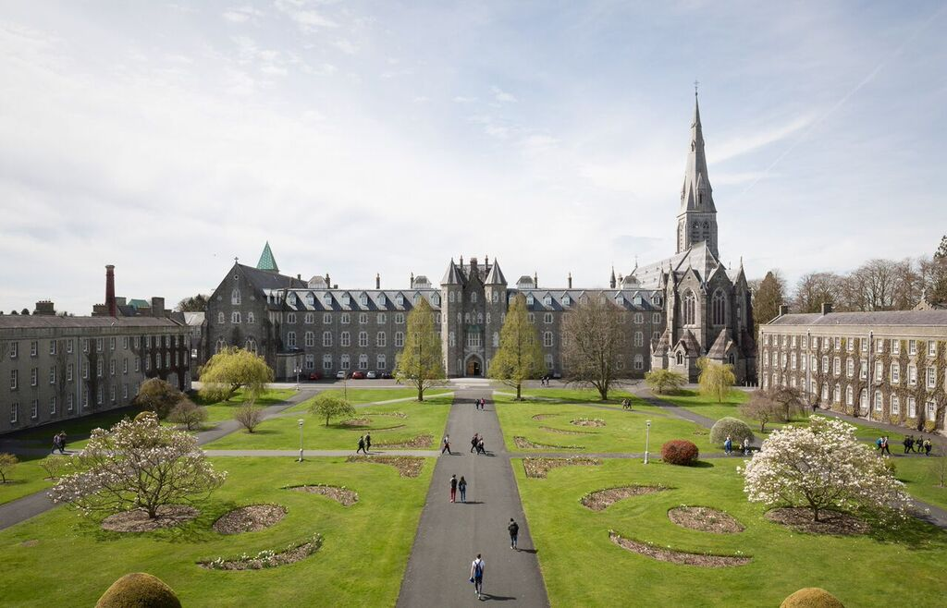
The International Office
We are one of your main points of contact while at Maynooth University!
We are an office of 12 staff members and 2 Student Assistants. We look after Erasmus, Study Abroad (incoming & outgoing), full degree UG & PG, Summer Schools, and more!
Blend of on campus and work from home for staff so please understand our working hours vary.
REACH US ANYTIME ON:

Slide 6
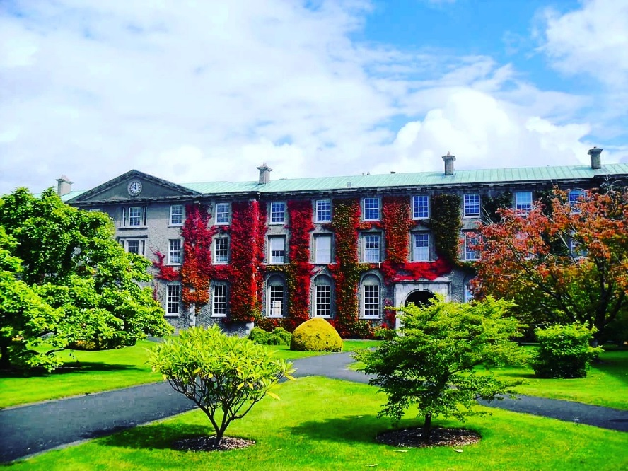
How to contact the International Office
Where?
Top floor, Humanity House, South Campus
Front Office
When?
Drop-in times: Monday to Friday:
10am to 12pm and 2:30pm to 3:30pm
Closed for lunch every day from 1pm to 2pm
Who?
Front Office: Megan Walsh – international.office@mu.ie
Study Abroad: Jodi Killackey – studyabroad@mu.ie
Erasmus: Emma Ward & Alena Jurikova Erasmus.incoming@mu.ie

Slide 7
Other Points of Contact
Student Records & Registration Office
Ground floor, Humanity House, South Campus
Email: registration@mu.ie
Module registration, change of modules, changes to registration status
Residence Office
Courtyard reception, north campus
Email: residence.office@mu.ie
Anything related to on-campus housing (maintenance, mail, access to portal)
IT Services
Helpdesk, Eolas building, north campus
Email: servicedesk@mu.ie
MU email access, password/login issues

Slide 8
Letters
If you need a letter to confirm that you are a registered student, once registered, please email international.office@mu.ie to request a letter
This letter can be used as proof of registration for opening a bank account, for registering for a PPS Number, for your immigration appointment, etc.
Study Abroad students’ letters will be sent to the Immigration Officer, you do NOT need to request.
Letters can be sent electronically or collected from the office - please state in your email if a physical copy is required
Please allow up to 3 working days to receive your letter

Slide 9
After You Arrive Webpage

Slide 10
Getting Online – Your MU Account
YOU NEED:
MU STUDENT NUMBER
MU PASSWORD
Your unique MU student number (username), email (mumail) and password were emailed to you by the Student Records & Registration Office.
Your student number and password will provide you with access to Email (outlook), Microsoft 365, Moodle and campus wifi.
If you have any access/technical issues email servicedesk@mu.ie

Slide 11
Your Personal Details
Please always ensure that your details are accurate and up to date on your registration.
To update details log into ‘Student Web’ found on the For Current Students webpage.
Example of an Irish address:
ELM 9A, COURTYARD APARTMENTS, MAYNOOTH UNIVERSITY, MAYNOOTH, CO. KILDARE, W23 F3F1, Ireland.
7 STRAFFAN GREEN, STRAFFAN WOOD, MAYNOOTH, CO. KILDARE, W23 Y2W9, Ireland.
STUDY ADDRESS
HOME ADDRESS
EMERGENCY CONTACT

Slide 12
For Current Students section of MU website: https://www.maynoothuniversity.ie/current-students

Slide 13
Modules
MODULE
=
CLASS
As a visiting student you can take modules across all Departments at MU.
It is your responsibility to ensure you take the necessary or required modules and credits that will be approved by your home university.
We recommend that you take no more than 30 ECTS per semester.
CHANGING MODULES:
Identify Department International Coordinator
Email & Request Approval (Incl. student no. & transcript etc.)
Complete the CHANGE MODULE form on the Student Records Office webpage
Student Records will register you for new approved module
To remove a module from your registration, email: registration.docs@mu.ie

Slide 14
Changing Modules: https://www.maynoothuniversity.ie/records

Slide 15
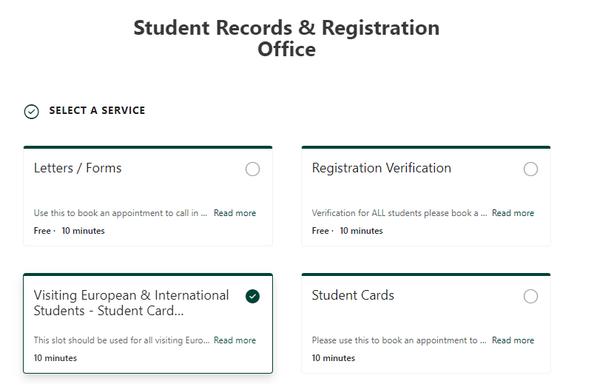
MU Student ID Card
You MUST book an appointment to attend the Student Records & Registration Office to collect your student card.
You received an email about this directly from the Student Records & Registration Office.

Slide 16
Understanding the Timetable
How to access your personalized timetable?
Go to the 'For Current Students' section of MU website.
Allow time for your registration and timetable to update if you are making changes to your modules.
Allow 2-3 days for changes to be reflected on your Moodle.
The Timetabling Office will speak to you later this morning to explain everything further.

Slide 17
Theology modules
Students can register with St. Patrick's Pontifical University to take theology modules.
Link to form to register for modules sent to you via email.
Please note numbers on modules are limited to 10 students. Places will be offered on a first come first served basis. This form must be submitted by 5pm on Thursday 26th January. You will receive an email on or before Monday 30th January informing you if you are being offered a place on the course.
Email: registry@spcm.ie

Slide 18
Examinations
You will sit the university scheduled exams in May.
No exceptions to this policy.
The Exams Office will release the timetable in April.
If you require exam accommodations or learning support, register with the MU Access Office (access.office@mu.ie) as soon as possible.
Do not make summer arrangements that begin before May 27^{th.}
Examination period: May 12th - 27th 2023

Slide 19
Emergency / Need Assistance
999 or 112 – Police, Ambulance, Fire Services
Campus Security 24/7: 00353 1708 3929 or 00353 1708 3333 (Emergency)
Sick?
Doctor on campus: 003531708 3878
Off Campus Doctor: Dr. Denis Gaffney 00353 16291169
KDOC Appointments: 1890 599 362
Call ambulance 112 or 999
Nearest Hospital: Connolly Blanchardstown
Need the Police? Dial 999 or 112
Call campus security to notify them of ambulance arriving on campus. If you need to attend A&E - the wait times can be 8+ hours. Be prepared.
If you need help ASK FOR IT!

Slide 20
MU Covid Response Team
The Covid Response Team can be contacted by email covid.response@mu.ie. This is monitored 7 days a week.
For on-campus issues, the Covid Response Team can be contacted on (01) 474 7999 from 9am to 6pm Monday to Friday. Outside of these hours, this number will be answered by Campus Security, who will be able to help with urgent on-campus issues.
Rules on self-isolating, close contacts etc. are regularly changing. You must adhere to the latest guidelines.
www.gov.ie & www.hse.ie & www.maynoothuniversity/coronavirus are your main sources of information

Slide 21
Thank You for Listening!
We wish you the best of luck as you begin your studies at Maynooth University

