Slide 1

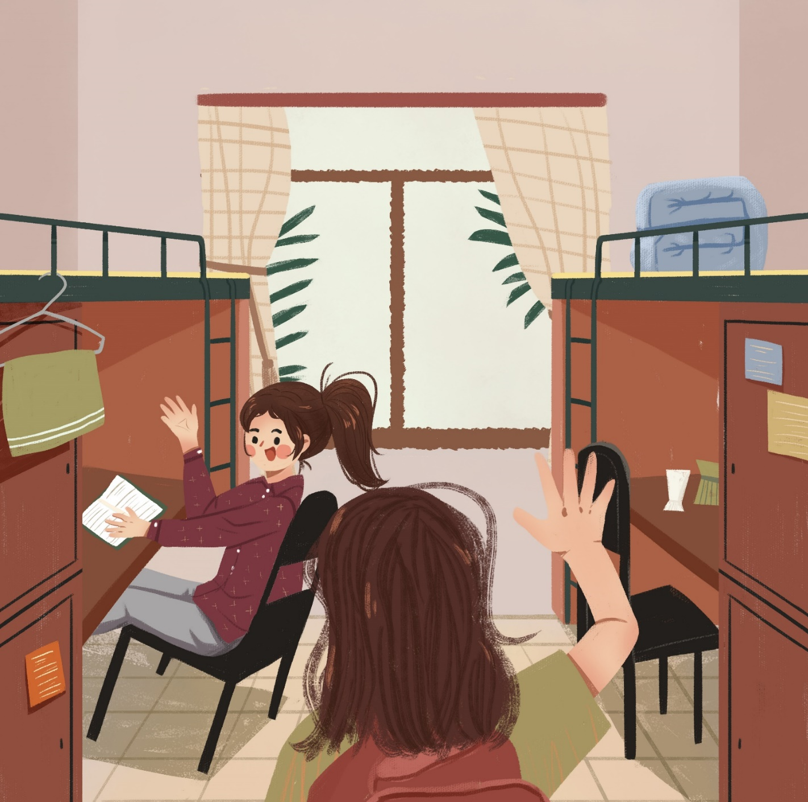
中国大学生的校园生活
Campus life in Chinese universities

Slide 2





CONTENTS
个人介绍
Self-introduction
生活篇
Daily life
学习篇
Study
问答
Q&A

Slide 3



出生：江西
Born in Jiangxi
Province
学校：成都，四川
University: Chengdu
Sichuan Province

Slide 4
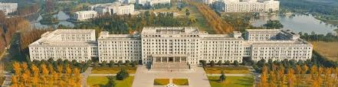

电子科技大学
University of Electronic Science and Technology of China (UESTC)
在梅努斯大学硕士联合培养一年
研究方向：国别与区域研究
A visiting postgraduate student in MU for one year
Research direction: International and Regional Studies
(Chinese Scholarship Council: https://www.campuschina.org/zh/)

Slide 5
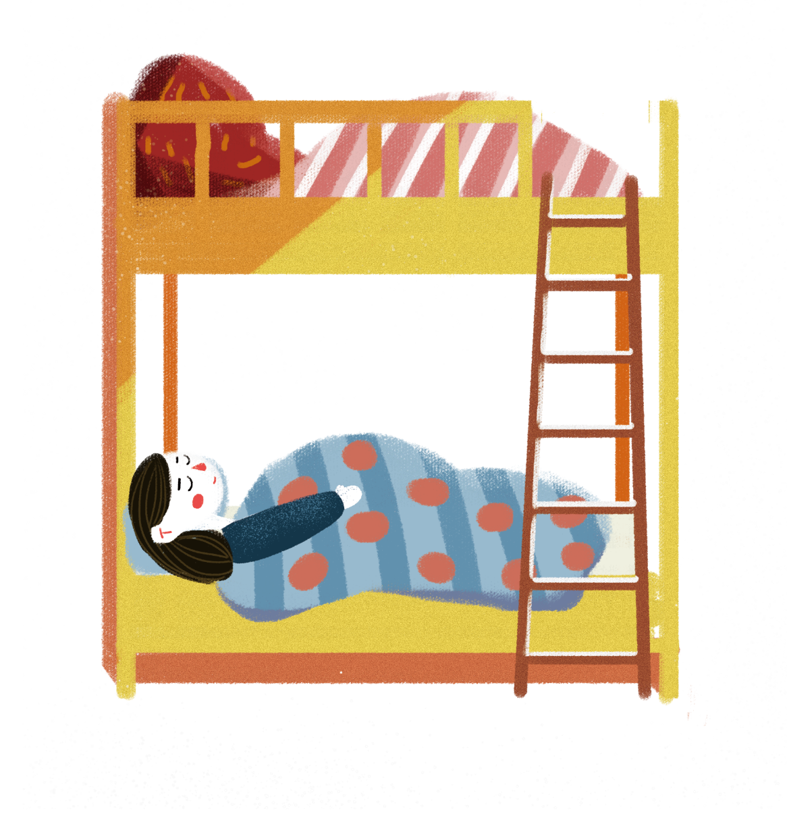
生活篇
Daily Life

Slide 6
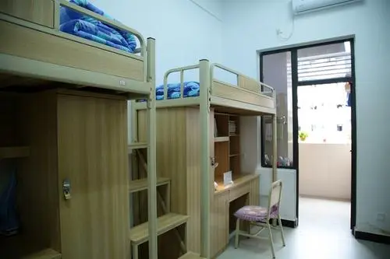
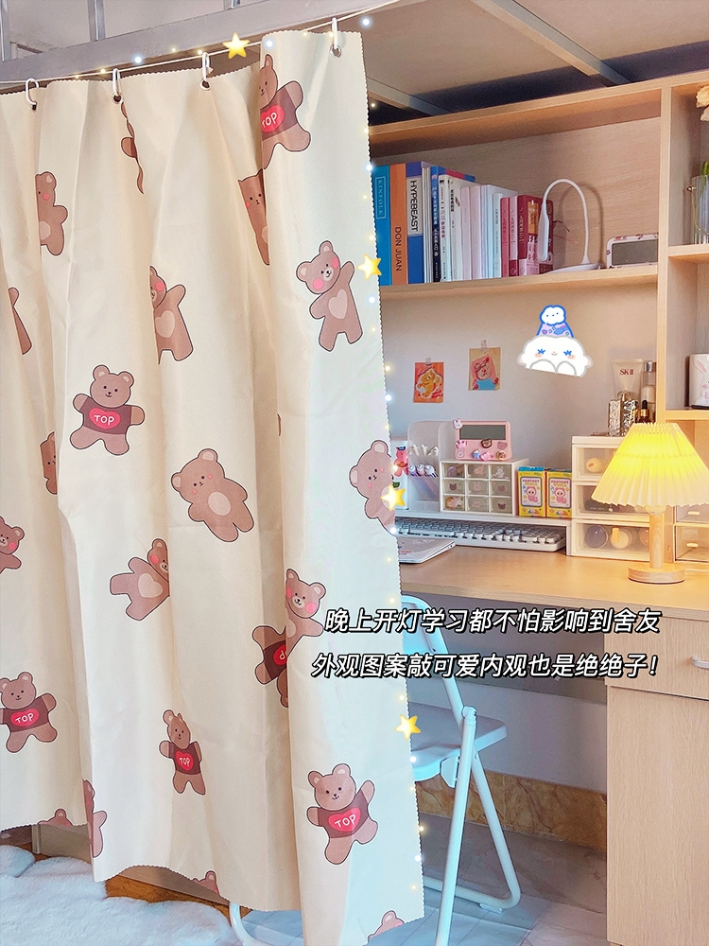
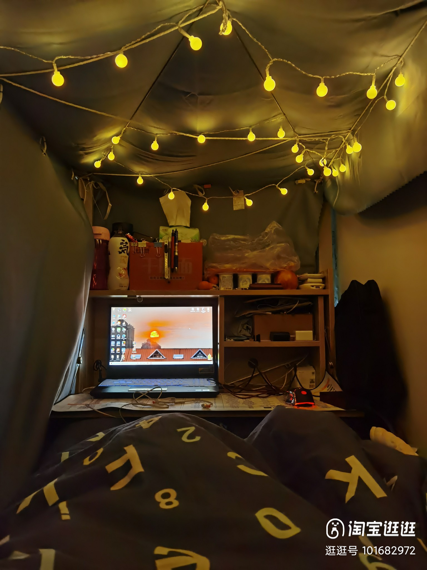
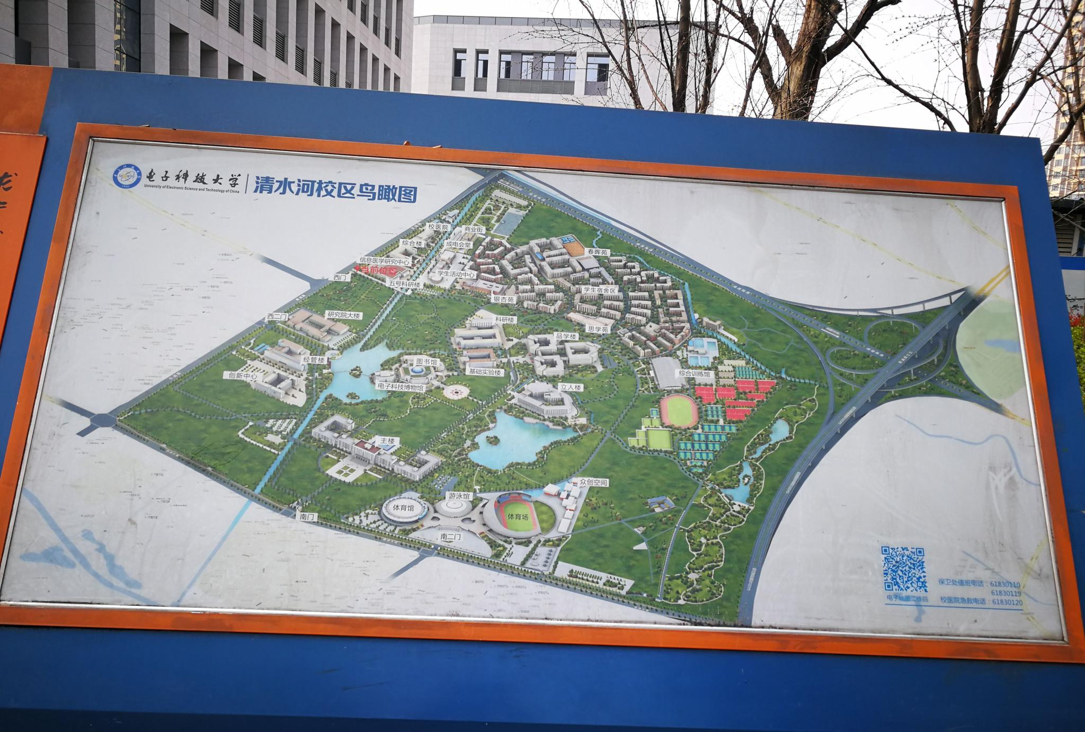
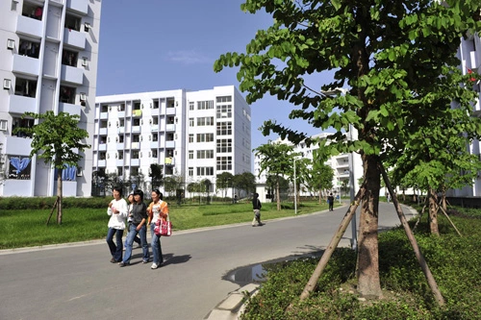
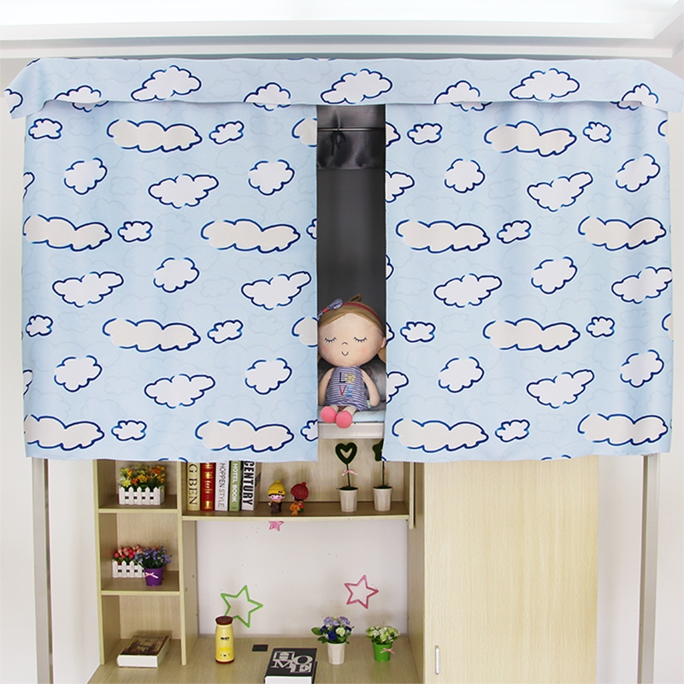
1200RMB/Year
≈164€

Slide 7
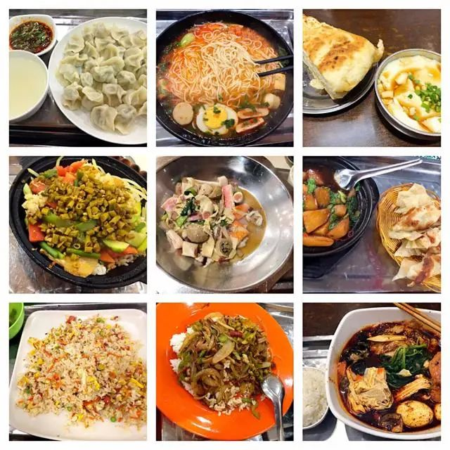
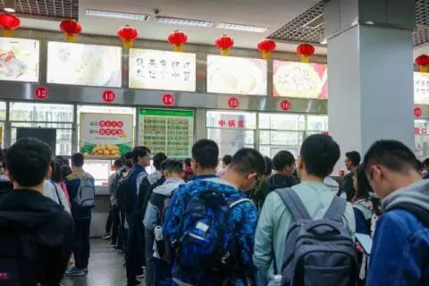
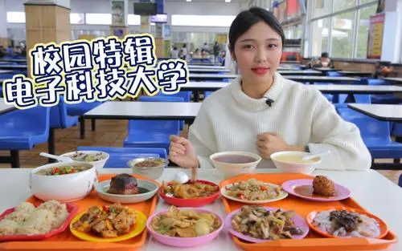
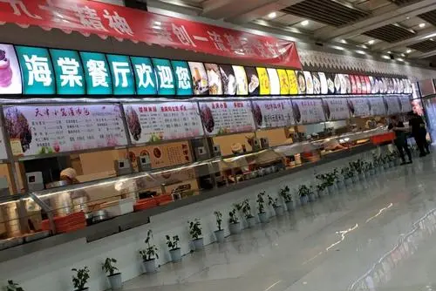
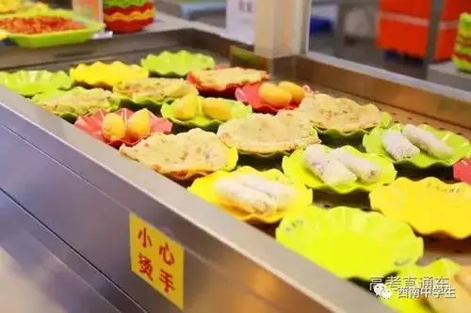
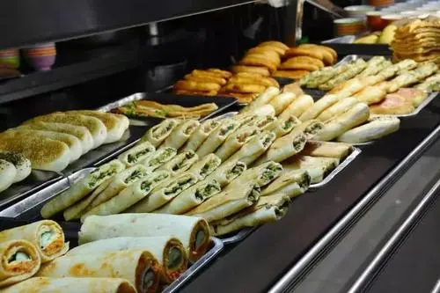
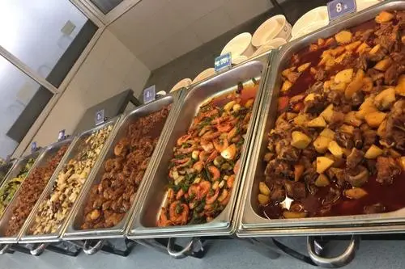

Slide 8
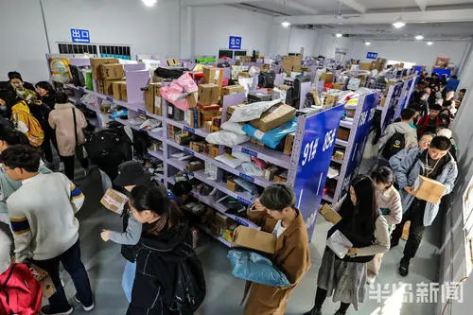
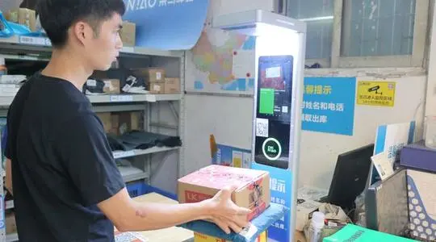
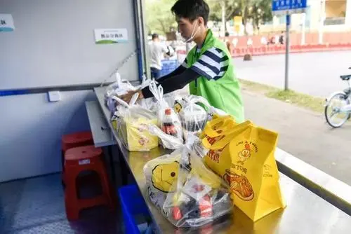

Slide 9
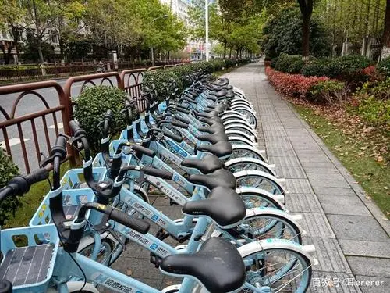
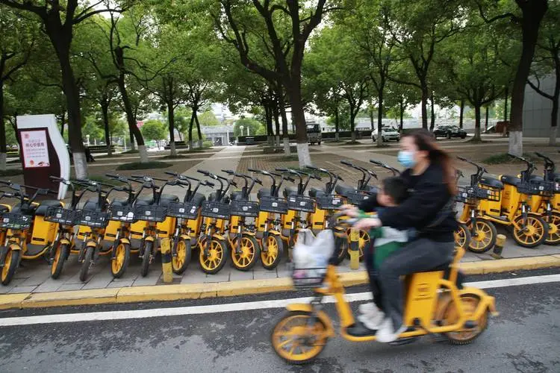
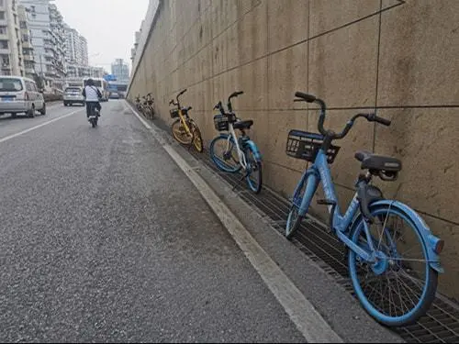

Slide 10
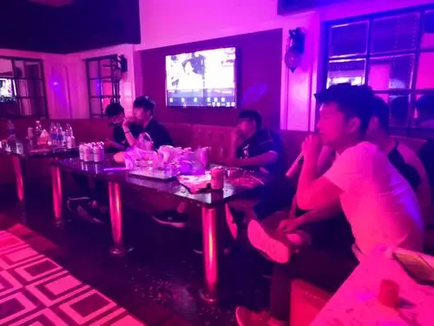
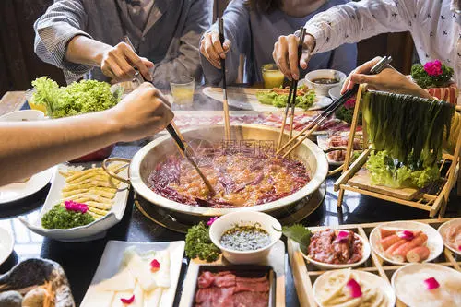
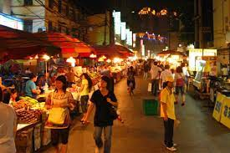


Slide 11
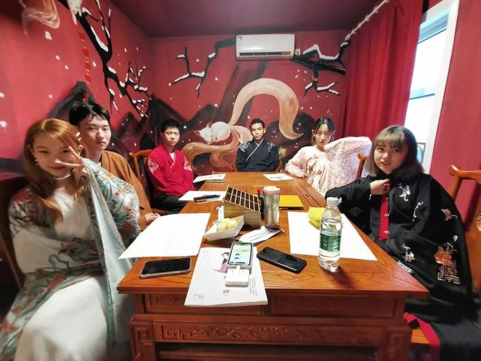
Live Action Role Playing (LARP) games
剧本杀

Slide 12
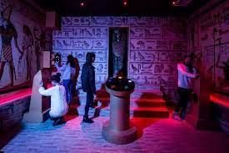
密室逃脱
Escape Room

Slide 13
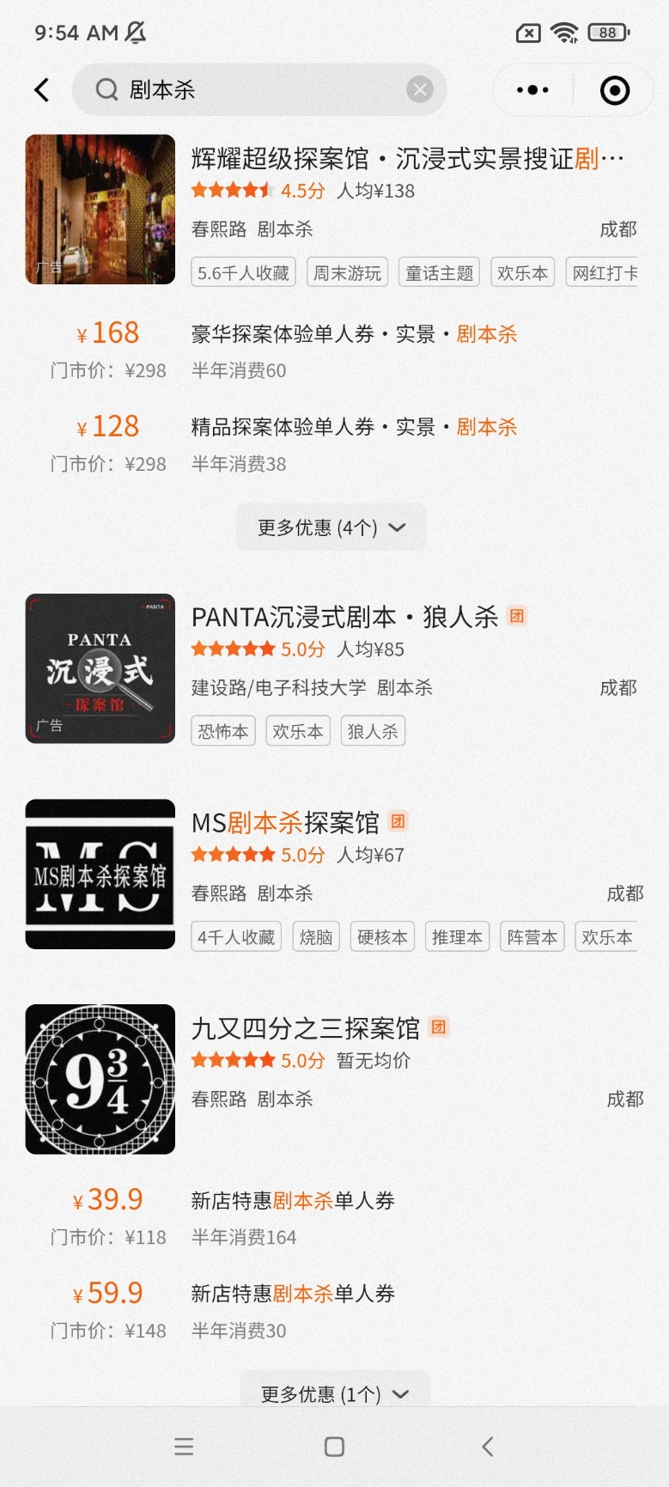
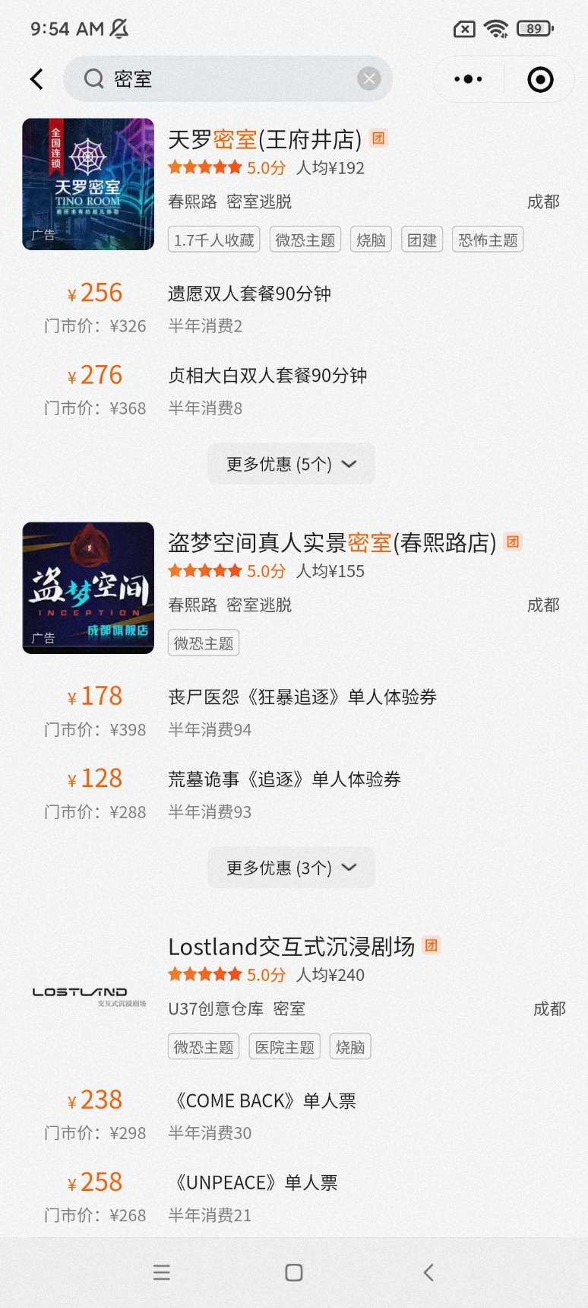
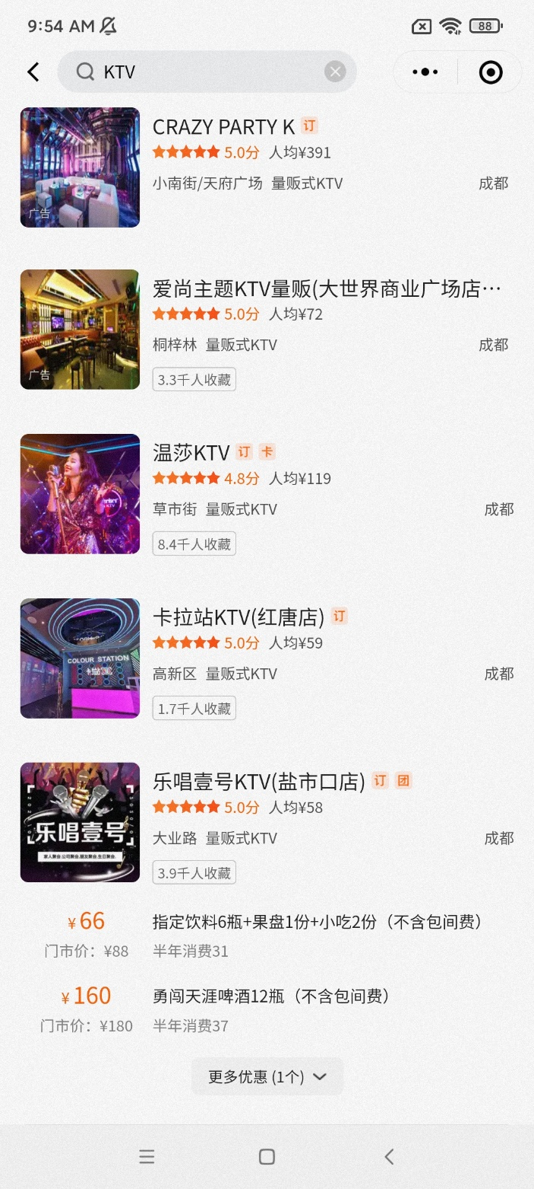
美 团

Slide 14
学习篇
Study

Slide 15
Watch a video
【街访】国内外学习到底有哪些差异？

Slide 16
本科（undergraduate）：四年 （four years）
大一至大三：上课，≥160学分
Freshman to junior year： complete 160 credits
大四：实习，完成毕业论文（8000 字）
Senior：internship，completing graduation thesis
学费（tuition）：5500RMB/Year ≈ 753.6€ （accommodation fee included ）
硕士（postgraduate）：三年 （three years）
研一：上课，修学分：≥29学分 First Year：complete 29 credits
研二：写论文 ，实习 Second Year：internship，dissertation
研三：论文答辩，找工作 Third Year：thesis defense, find a job
学费（tuition）：8000RMB/ Year ≈ 1094.7 €， 75% have scholarship

Slide 17
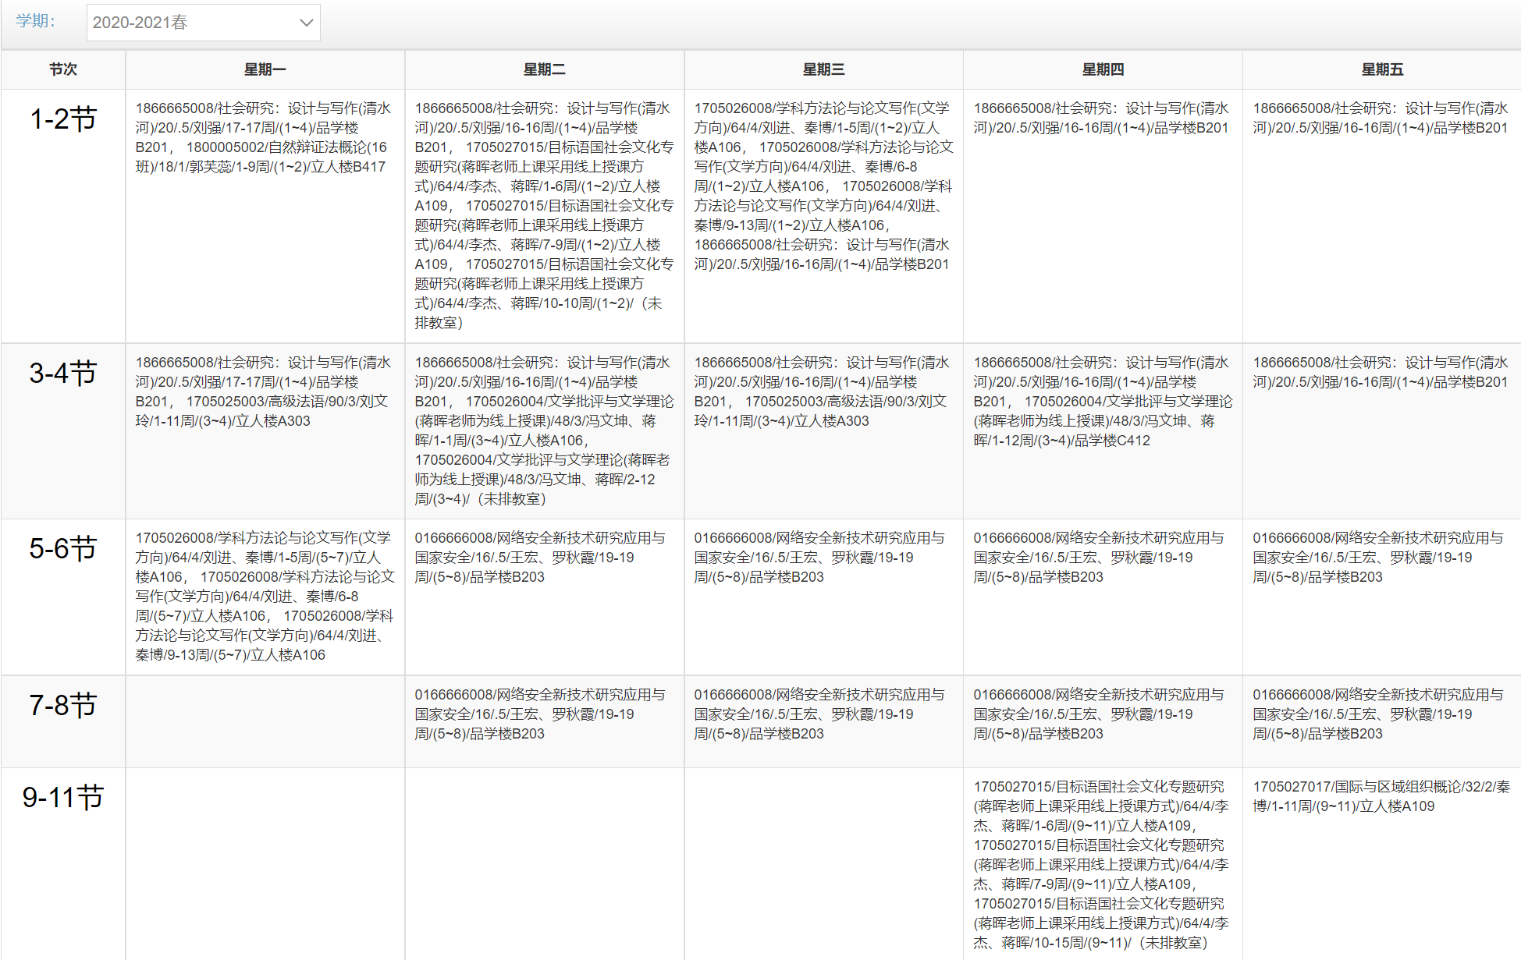
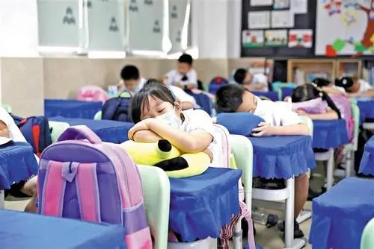
8.30-10.05 am
10.20-11.55 am
2.30-4.05 pm
4.20-5.55 pm
7.30-9.50 pm

Slide 18
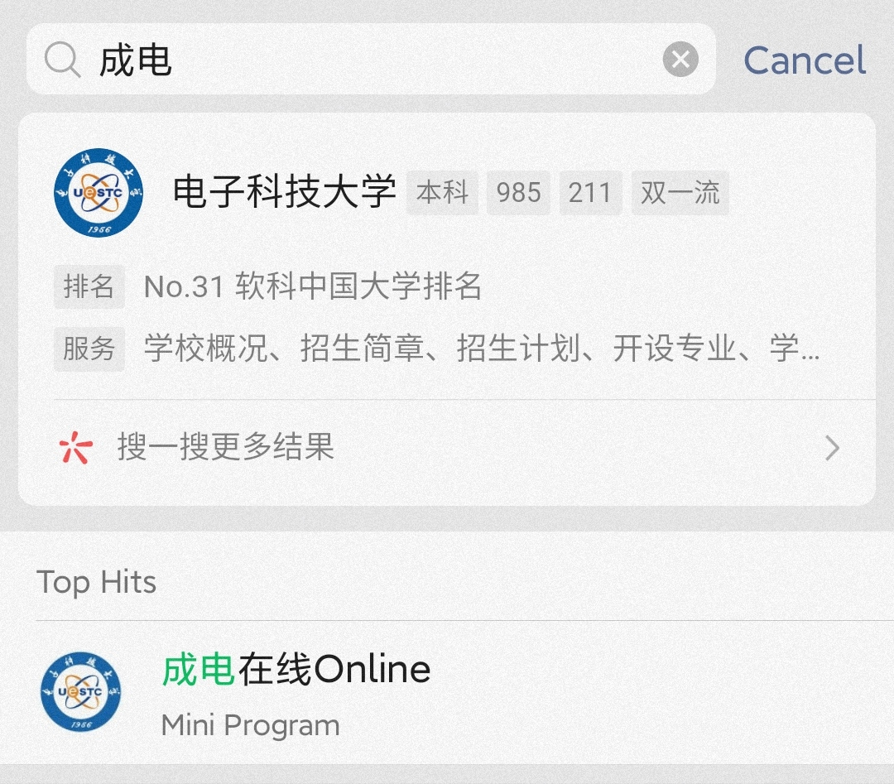
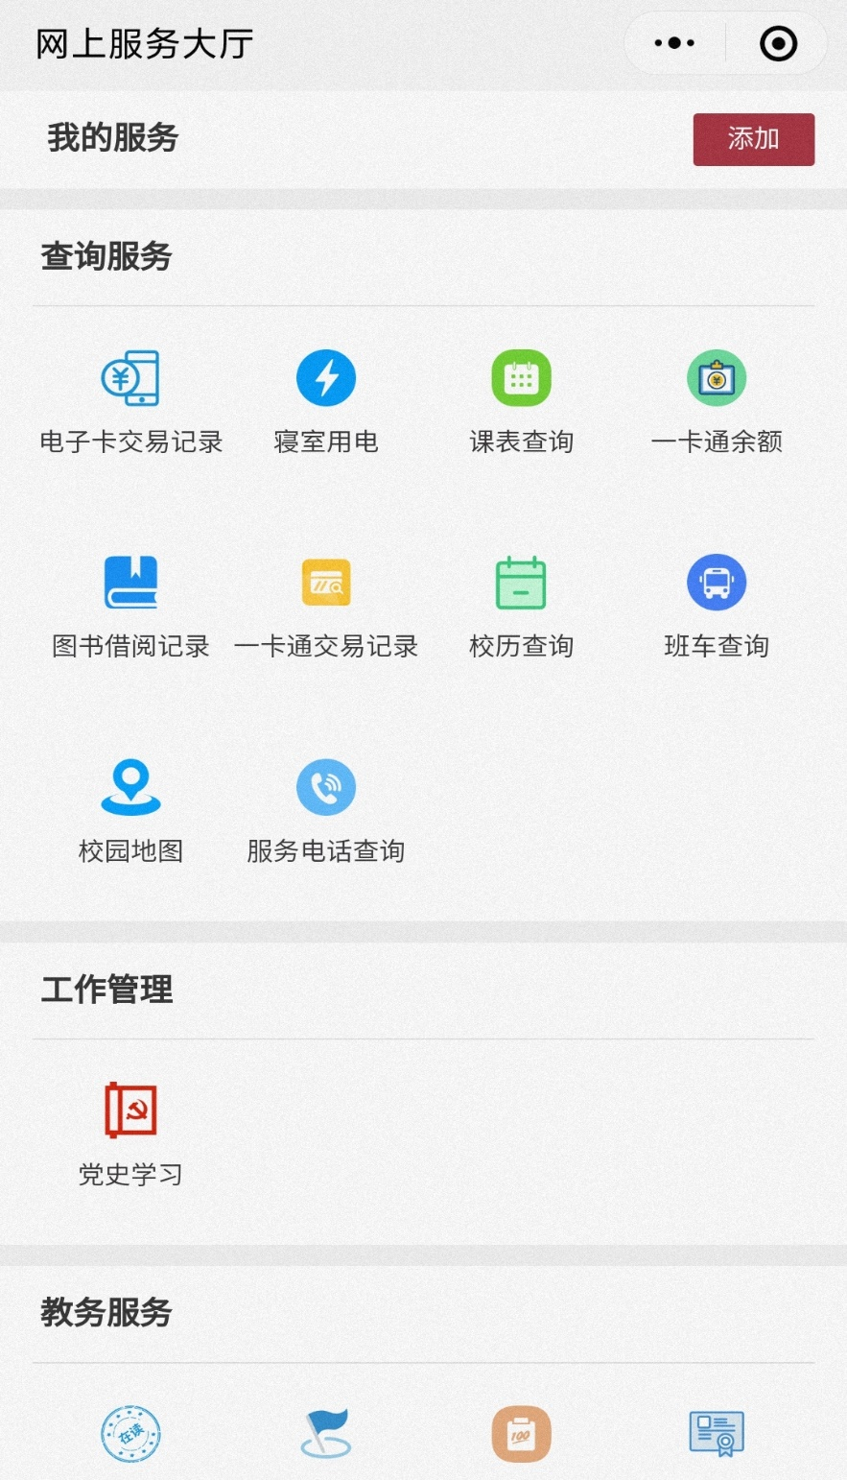
≈Moodle

Slide 19

≈ Teams + email

Slide 20
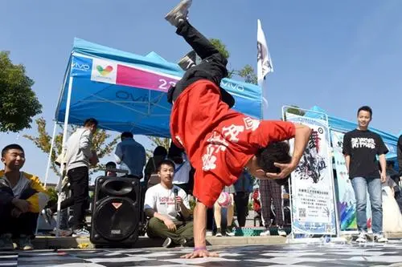
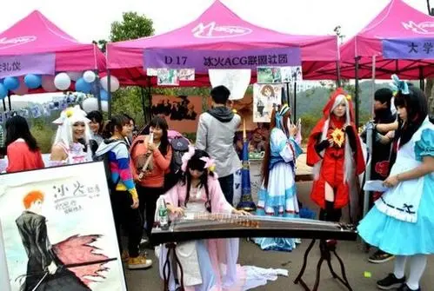
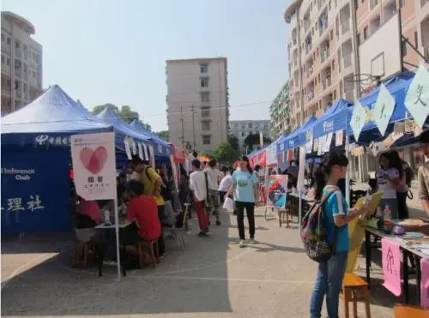
Clubs
社团

Slide 21

Class assessment
60% 期末考试 final exam/essay
20% 出勤率 attendance
30% 口头报告 presentation
60/100 pass
final exam/essay ≥ 50/100

Slide 22
Lecture
Attendance
Students who fail to attend class more than three times will directly fail the course
请假条 Leave of Absence Note
2. Self-learning
Lecturers are only the guides
3. Systemic

Slide 23
Objectives of Teaching
1.Self-identity (which area to train talent for)
2. Internship
Organized by the Faculty or find one by yourself
3. Certificate : a）College English Test Band 4 and Band 6 (大学英语四、六级）
b）Certificates in your major
Eg. Teacher Qualification Certificate
c) Skills Certificates：
Eg.National Computer Rank Examination （计算机二级）
Certified Practising Accountant （注册会计师证）

Slide 24
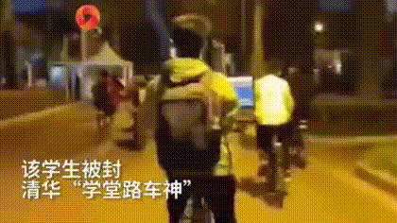

Involution
Tsinghua University

Slide 25
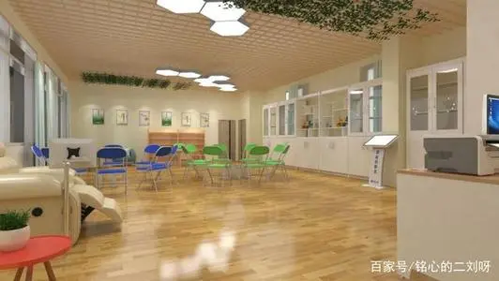
Psychological counseling room
1.心理老师 psychology instructor
2.辅导员 student supervisor
3.班长： class leader
4.心理委员 ： psychological commissioner

Slide 26
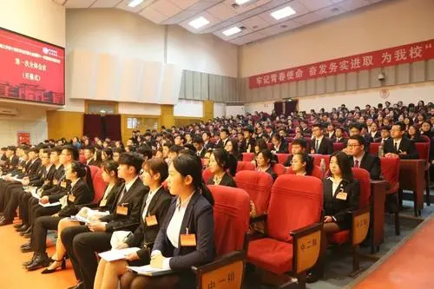

Tutorial class：
Final thesis
辅导员 student supervisor
questions for the lectures chat group
life
study
评 教
evaluate teaching and learning
Lecturers
student supervisor
Student Union Congress
Every two years

Slide 27
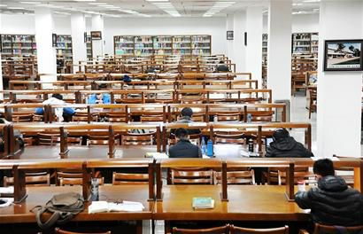
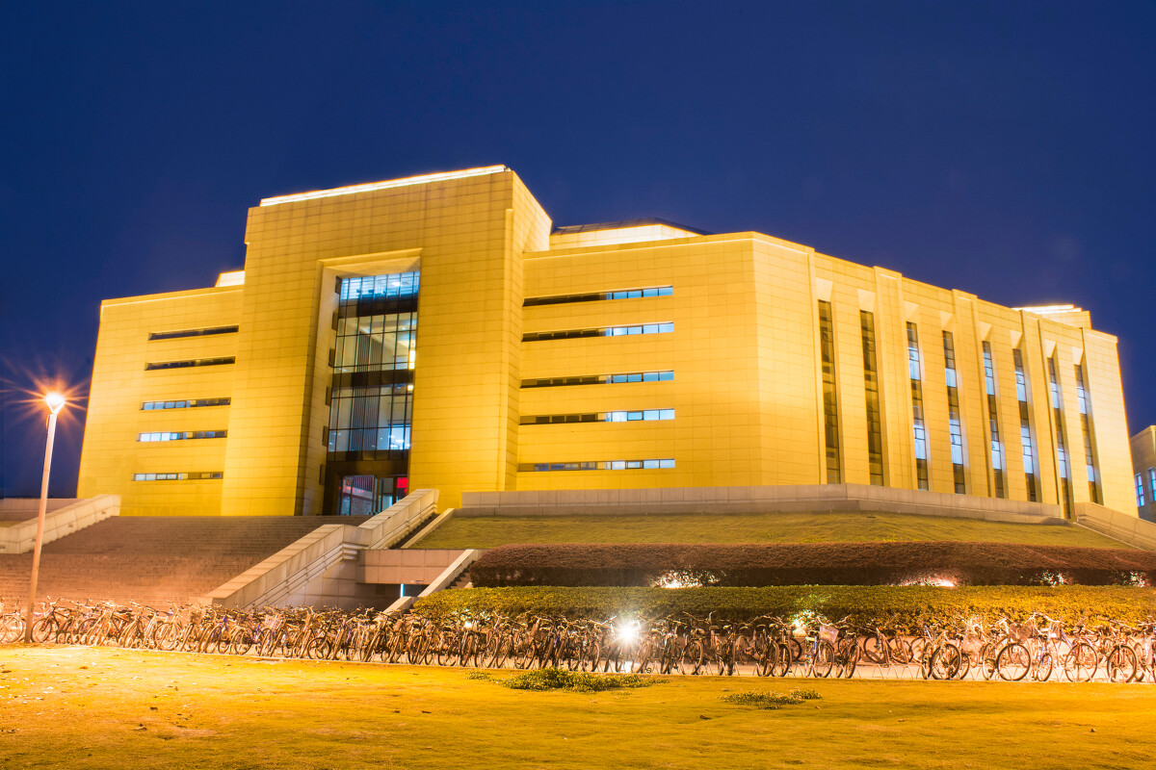
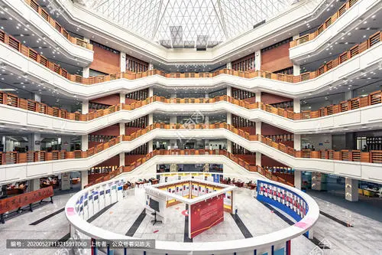

Slide 28
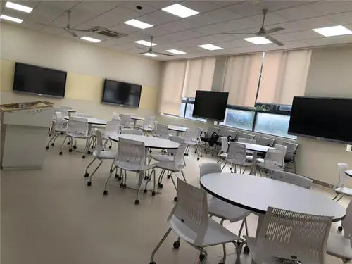
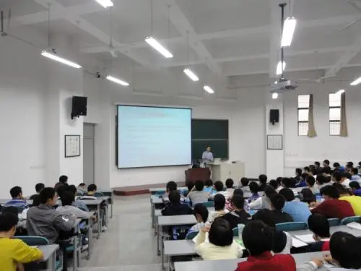

Slide 29
问 答
Q&A

Slide 30
谢 谢！

