Slide 1
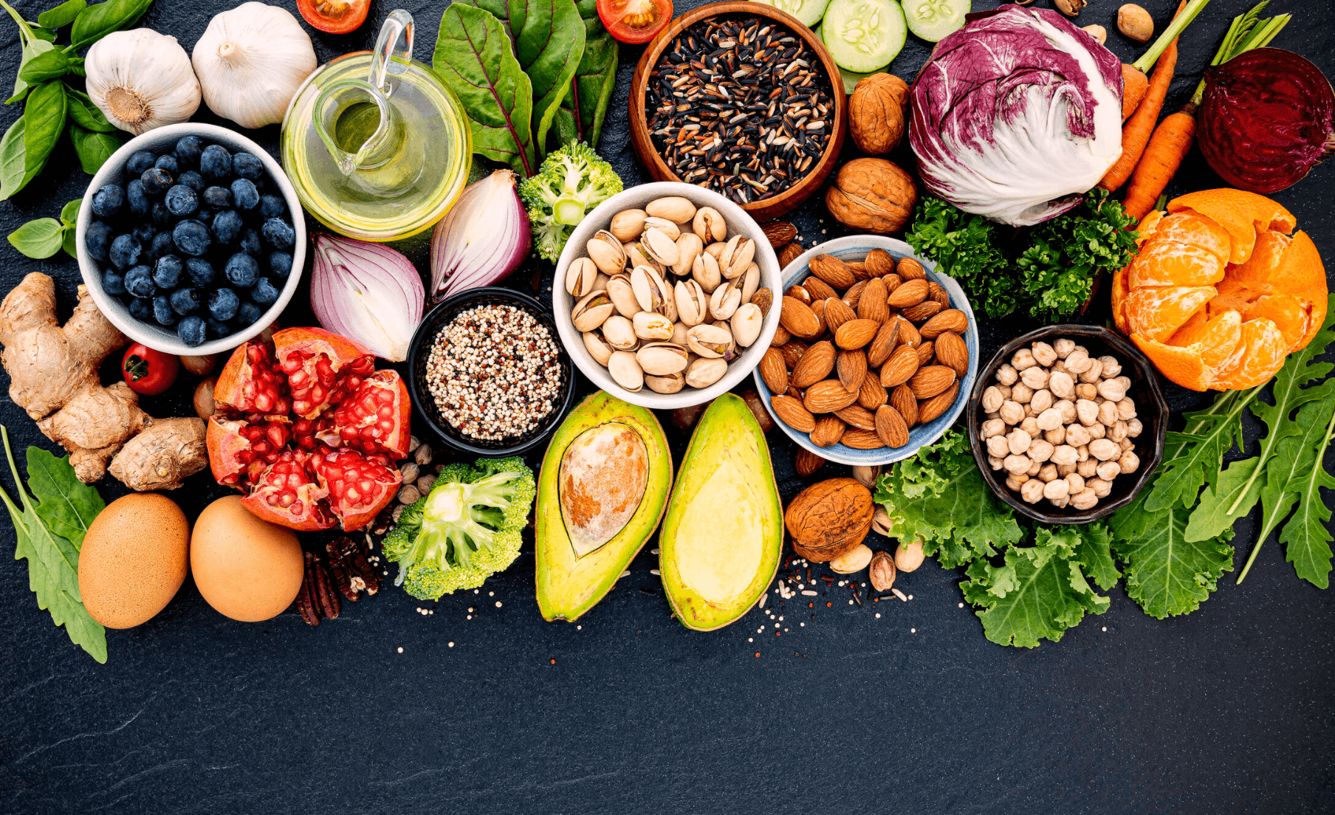
MH222 BSc Food Science & Human Nutrition

Slide 2
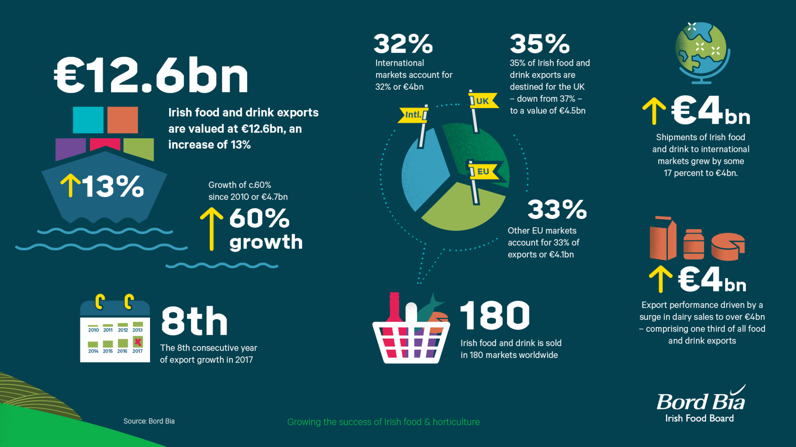
A major sector, employing over 400,000 people

Slide 3
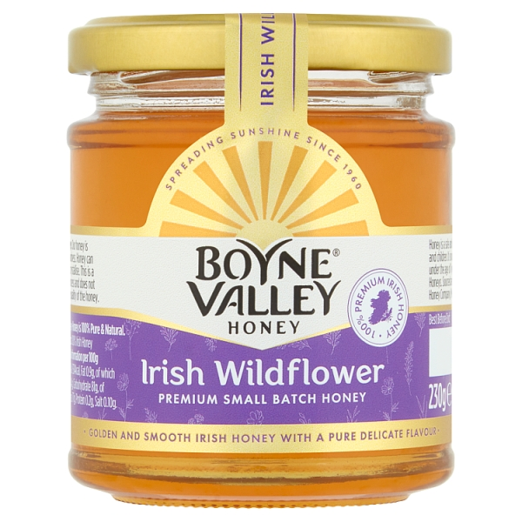
Examples in the Maynooth Hinterland

Slide 4
BSc Food Science & Human Nutrition - 2023
Places for 2023: 25-30
Entry requirements
Programme requirement of O4/H7 Maths
One science subject is required
No 3rd Language Requirement
Entry via CAO system, code MH222

Slide 5
MH222 - BSc Food Science & Human Nutrition
It is a 4-year programme
It is based around the core Maynooth Science programme, providing a broad science background.
The programme will build on core understanding in nutritional science, biology, and chemistry, as applied to food.
It has a 6-month work placement in 3rd year

Slide 6
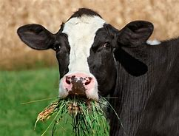
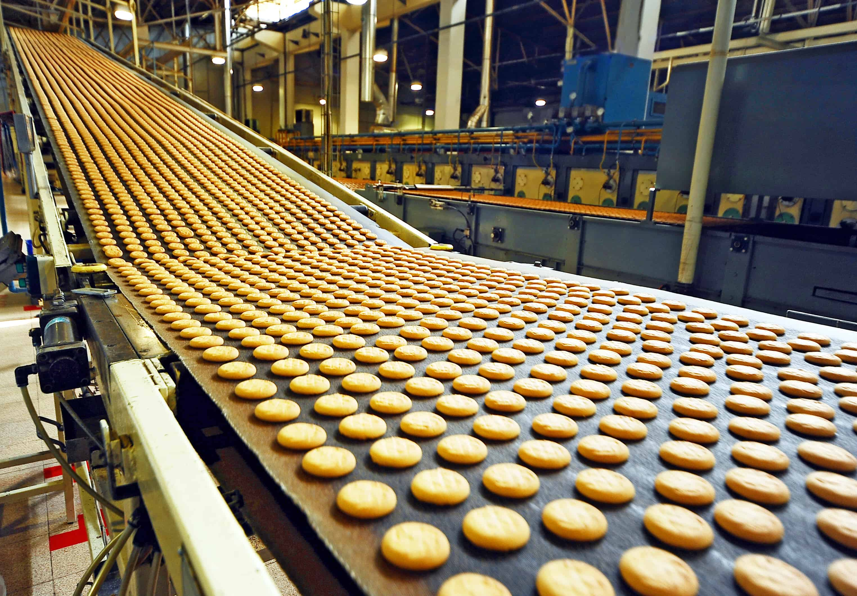
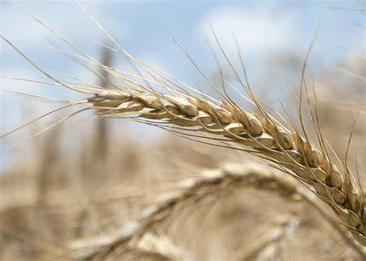
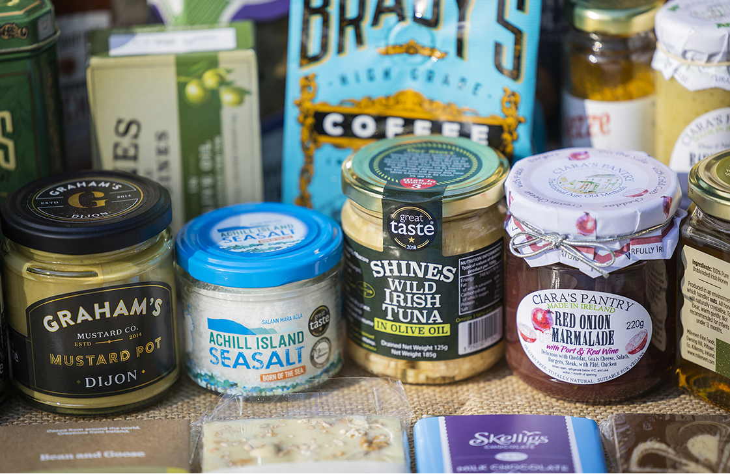
The Focus of this programme
Ingredients
Production
Products
Nutrition
The Focus of this programme
The biological aspects of food and food spoilage
Chemical and rheological aspects around food materials, textures, and mixtures
Future foods, nutrachemicals, functional food products
Food product safety, quality assurance, and regulatory compliance
The role of taste, flavours, and texture
Global food security, sustainable foods, and the circular economy
Human nutrition, energy and metabolism, personalised nutrition, and sports nutrition

Slide 7
Year 1 – the foundation modules
60 core credits
Food, Diet and Health (7.5 credits)
Food, Physiology And Exercise (7.5 credits)
Biology (15 credits)
Introductory Maths (15 credits)
Chemistry (15 credits)

Slide 8
Year 2 – strengthening the scientific foundations
Core modules 50 credits
Human Nutrition 1
Food Chemistry And Analysis
Energy & Metabolism
Food – Trends, Challenges And Opportunities
Biochemistry
Animal Physiology
Molecular Biology Of The Cell
Organic Chemistry
Physical Chemistry
Spectroscopy & Analytical Chemistry
May choose 10 credits from electives, critical skills, or additional modules in chemistry or biology. Total 60 credits.
Food and nutrition
Biology
Chemistry

Slide 9
Year 3 – dedicated content and work placement
Core modules 30 credits
Food Choice - Taste and Flavours
Food Production Systems
Nutrition for Health and Performance
Food Microbiology
Nutrition As We Age
Food Rheology, Texture and Structure of Food
There is a 30 credit work placement or experiential learning module. This takes all of second semester.

Slide 10
Year 4 – the option to specialise
Choose 9 of the following modules
Nutrition & Global Health
Personalised Nutrition
Food Safety and Authenticity
Nutrition within the Clinical Setting
Food Marketing and Product Development
Food Policy & Regulation
Nutrition within the Clinical Setting
Exercise and Nutrition: Health Promotion and Policy
Food Analysis and Quality Assurance
Sports Nutrition & Pharmacology
Future Foods – Functional and Sustainable Foods
Students will also undertake a 15-credit capstone project

Slide 11
Career Pathways
Graduates of this programme will be able to take up roles in
This programme is excellent preparation for students to progress to accredited postgraduate programmes in the area of dietetics, as well as other postgraduate opportunities in the area of public health and social policy.
There are opportunities for students to undertake research degrees, at Master’s and PhD level in a variety of topics in the area of food science and nutrition.
Production management | Food quality and safety
Nutrition | Public sector (e.g. DAFM, Teagasc)
New product development and research | Health promotion
Entrepreneur and new business startups

Slide 12
Questions

