Slide 1
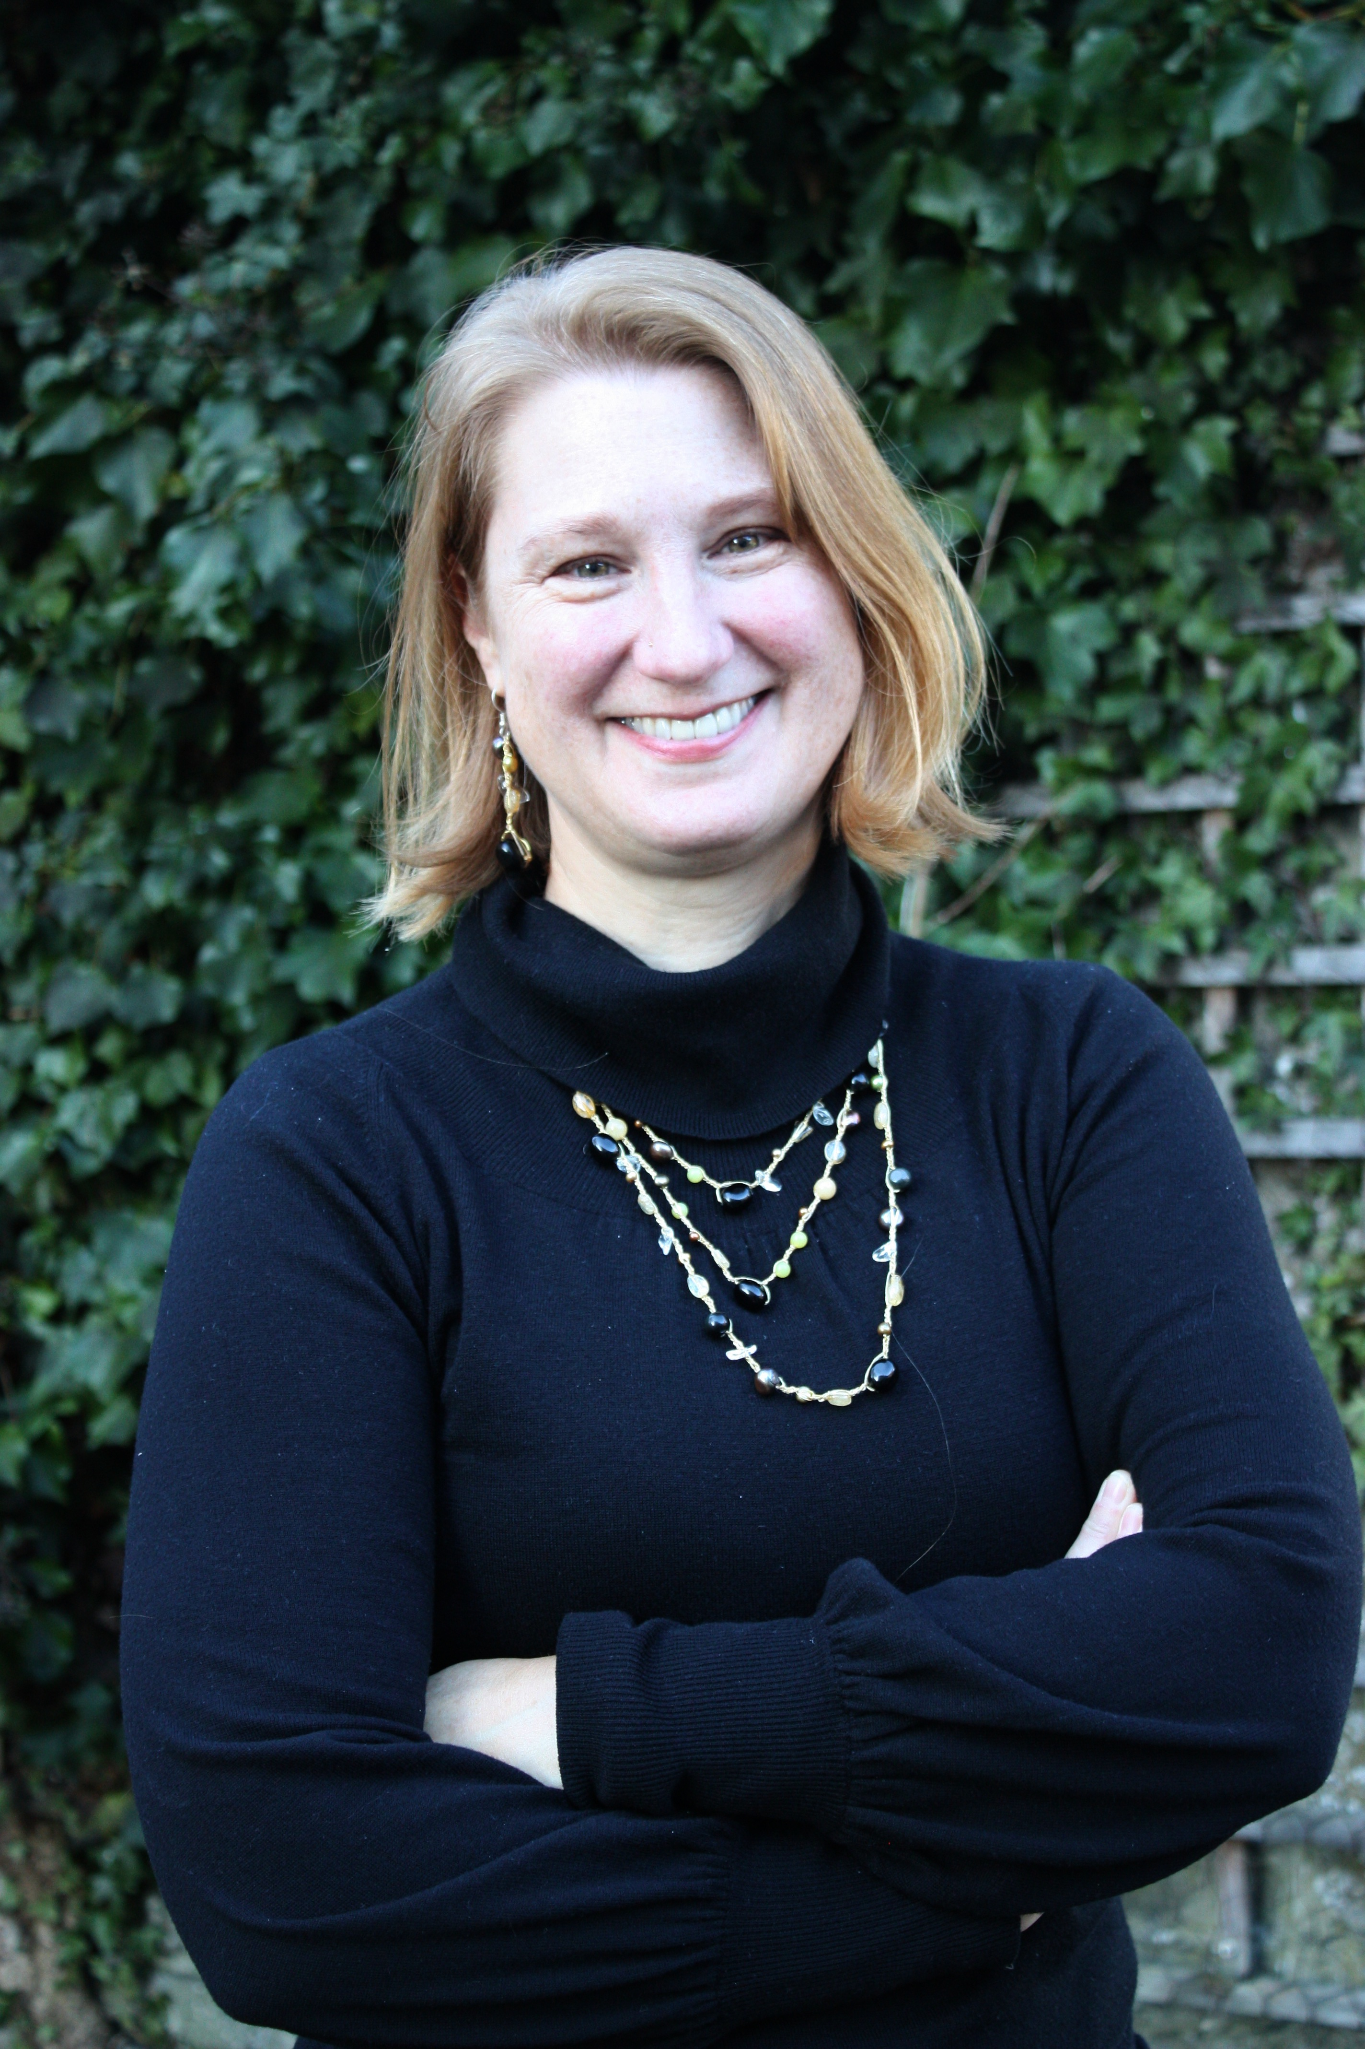
Athena Swan at Maynooth Geography
← Please click on the sound icon to hear more!
Orientation 2020-21
Professor Karen Till
Chair, Athena Swan
Geography Committee
karen.till@mu.ie
Notes:
Hello, my name is Karen Till and I am a Professor in the Department of Geography. I am also our department’s Athena Swan Committee Chair. This video provides an overview of what Athena Swan is, and why it is important to Maynooth Geography.

Slide 2
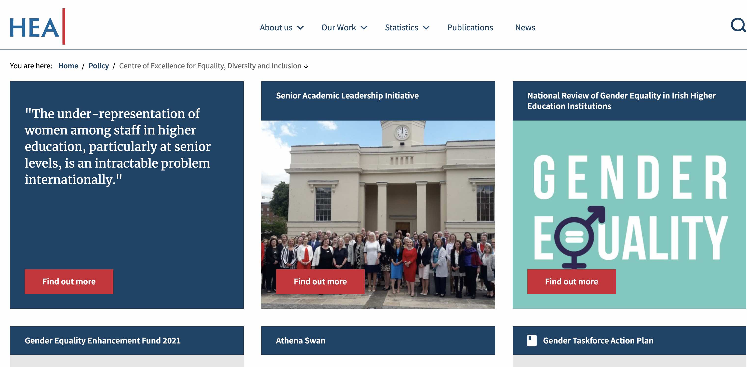
What is Athena Swan?
← click here for more!
https://hea.ie/policy/gender/
https://www.advance-he.ac.uk/equality-charters/international-charters/athena-swan-ireland
Notes:
What is Athena SWAN? Athena SWAN was originally set up in 2005 in the UK to help advance the careers of women in or STEMM areas of higher education, or the sciences, technology, engineering, maths and medicine. It later expanded to include the arts, humanities, social sciences, business and law. Athena Swan now addresses issues of equality across all genders, including the experiences of transgender staff and students.
In 2015, the Higher Education Authority in Ireland launched the Athena Swan Charter as a national strategy to promote gender equality in higher education.

Slide 3
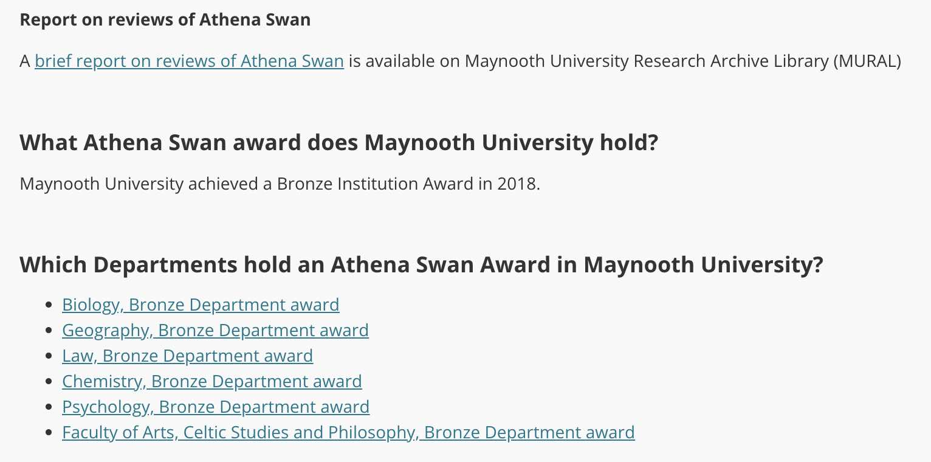
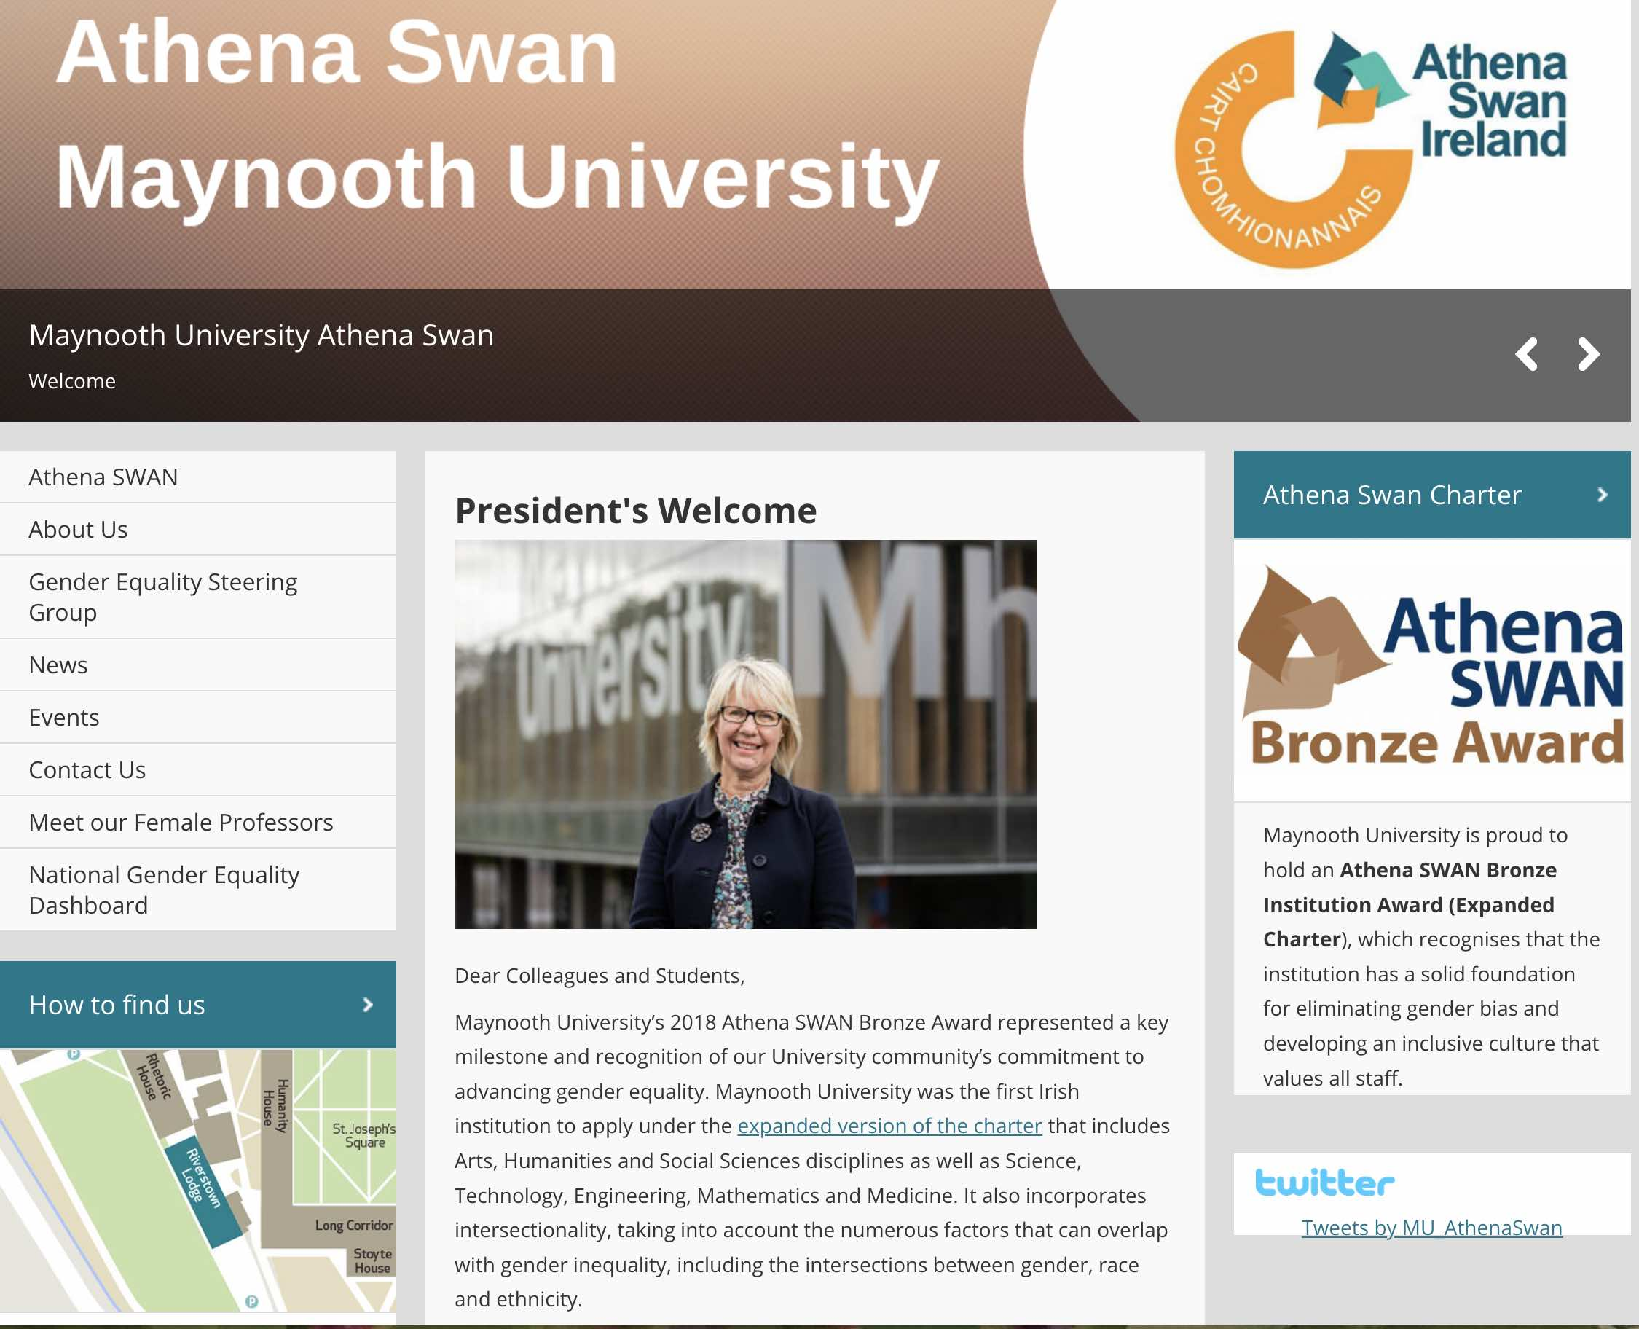
← click here for more info about AS at Maynooth!
Notes:
Universities can become part of the Athena SWAN Charter by completing an application for Bronze, which is reviewed and awarded by an international board. Once a University is awarded Bronze status, departments can apply. Then both departments and Universities can then apply for the Silver and then the Gold Awards.
The Athena SWAN application is designed to make the University and its departments look critically at themselves and identify where issues of gender inequity exist, particularly within representation, career advancement opportunities, and professional and personal support. As part of the application, an in-depth Action Plan must address any issues identified in relation to gender inequality in the self-assessment process. There is also the opportunity in the application to highlight the positive aspects of the University and department in terms of gender equality and this is also a factor in the awarding process. The gaol is for the University and its departments to create more gender-equal, diverse and inclusive working environments
Maynooth was awarded Bronze status in 2018, and highlighted an intersectional approach. It was the first Irish institution to achieve Bronze status under the expanded ECU charter. Geography was one of the first departments to volunteer and begin the Athena Swan process the same year.

Slide 4
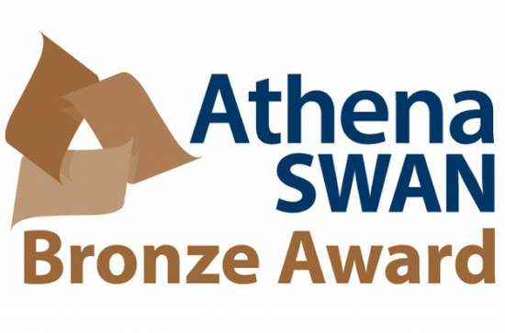
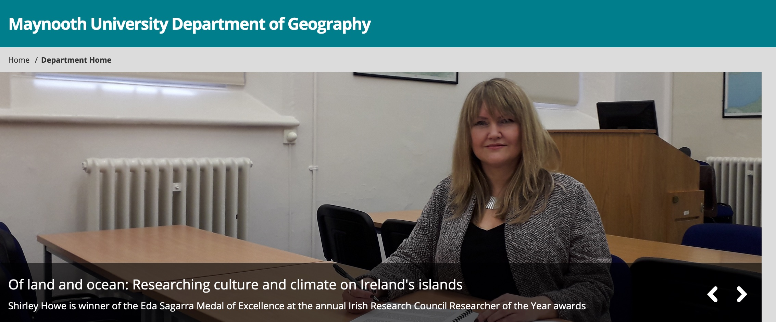
Why is Athena Swan important for Geography?
← click here!
Our Athena Swan committee of staff and students are working to acknowledge and address our own issues, while contributing to advancing the subject and the Department, with respect to diversity, equality and being inclusive to people of all genders. Join us!
In Geography, due to our history of being male dominated, the AS process helps promote equality within the subject.
Issues of inequality are critical to geographical research, so the AS process can contribute to our research in spatial, environmental and climate justice.
Questions? Email: karen.till@mu.ie
Notes:
We were awarded Bronze status in 2019, the second department at Maynooth to earn this award. We are now working with our students and staff to continue this process and hope to achieve Silver status in a couple of years. The Athena SWAN process helps us to ensure that our Department is inclusive to people of all genders. This involves looking critically at ourselves, through surveys and small group discussions, and making necessary improvements in Departmental practices and culture.
Why is it important to Geography?
The AS process promotes equality within the subject, given our discipline’s history of being male dominated.
In human geography, various issues of inequality are examined through theories of spatial, environmental and climate justice, so this process can contribute to this emerging research area.
If we as geographers are passionate and driven by the desire for equality, we are obligated to hold ourselves accountable as a Department. This means we can focus on addressing our own issues, while contributing to advancing the subject and the Department, with respect to diversity and equality.
We hope you will join us in our goal by participating in workshops and seminars about gender equity and diversity, and by providing us feedback in our annual surveys to let us know how we are doing.
If you would like to learn more, please feel free to contact our Athena Swan Chair, Professor Karen Till, karen.till@mu.ie.

